Slide 1
JAVA PROJECT CSE-310
BRICK-BREAKER GAME

Slide 2
CONTENTS
1
INTRODUCTION
2
OBJECTIVES
3
MODULE 1
4
MODULE 2
5
TOOLS USED AND CONCLUSION

Slide 3
INTRODUCTION
Brick Breaker is a classic game involving breaking a brick wall with a ball and a paddle. The game was popularized in the 1970s and has since been adapted for various platforms, including mobile devices and personal computers.
In this game, the player controls a paddle at the bottom of the screen using the left-arrow key and right-arrow key and when the ball collides with the paddle ball bounces towards a wall of bricks at the top of the screen if the ball collides with brick, the brick will be removed from the screen, and the player's score will be increased. The objective of the game is to break all the bricks without letting the ball fall off the bottom of the screen.

Slide 4
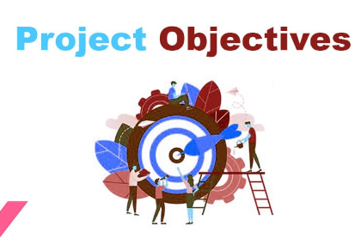
OBJECTIVES FOR CREATING THIS GAME
To develop a fun and challenging game.
To utilize the platform-independent and object-oriented features of Java to create a game that can run on multiple platforms.
To gain experience in,object-oriented programming, and graphical user interface (GUI) design in java.
To explore new programming techniques and technologies.

Slide 5
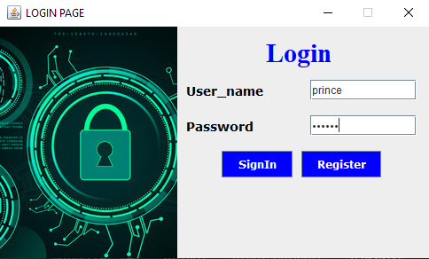
MODULE 1
MODULE 1 contains a login page and a register page to allow users to create an account and sign in to access the game.
LOGIN PAGE
The login page allows users who have already registered an account to authenticate their identity by entering their Username and password. Once the user's credentials are verified against the information stored in the database, they are granted access to their account and game if not matched it will display an invalid username and password.

Slide 6
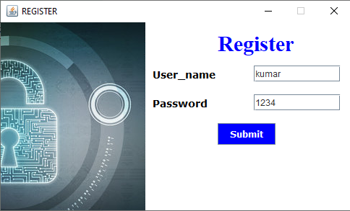
REGISTER PAGE
The register page in this game serves the primary function of allowing new users to create an account and register their information. Specifically, the register page prompts the user to enter their username, and password. Once the user's information is submitted, it is stored in a database and associated with their account after that user can login to the game by entering their username and password.

Slide 7
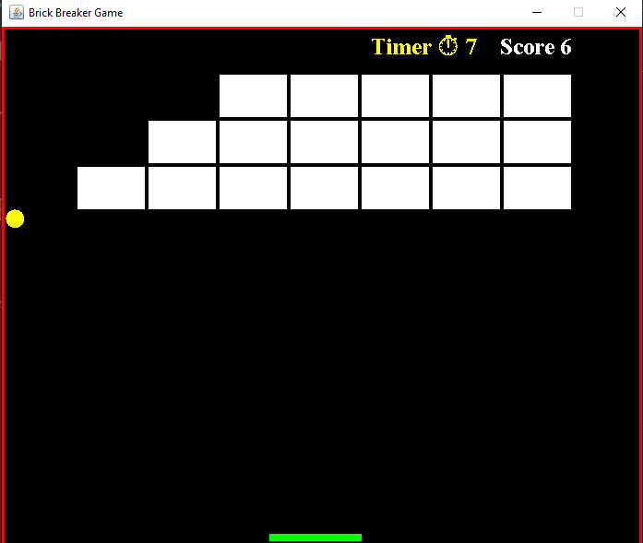
MODULE 2
BRICK-BREAKER GAME ( GUI )
The interface of a brick breaker game typically includes several key elements:
Game board: The game board is where the bricks are located, and it's where the player will bounce the ball around to destroy them.
Paddle: The paddle is controlled by the player and is used to bounce the ball back up towards the bricks.
Ball: The ball is what the player uses to hit the bricks and destroy them. It bounces off the walls and paddle, and must be kept in play to continue the game.

Slide 8
MODULE 2
Bricks: The bricks are arranged on the game board and the player must hit them with the ball to destroy them.
Score: The player's score is typically displayed on the screen, and it updates by +2 as the player destroys bricks.
Timer: The time spent Playing the game it increases every second.
Overall, the interface of this game is designed to be intuitive and easy to use, with simple controls and clear feedback to the player about their progress and performance.

Slide 9
TOOLS USED TO BUILD THIS GAME
Java Swing: Java Swing is a powerful toolkit for building graphical user interfaces (GUIs) in Java. It provides a wide range of components, including buttons, labels, text fields, and more, that I used to create the login page and register page.
In this project I olso used JavaFX to draw the game board, bricks, paddle, ball, and other visual elements of the game.

Slide 10
CONCLUSION
In conclusion, building a Brick Breaker game in Java requires a solid understanding of Java programming concepts, such as object-oriented programming, event-driven programming,JFrames, and graphics programming.

Slide 11
THANKS

