Slide 1
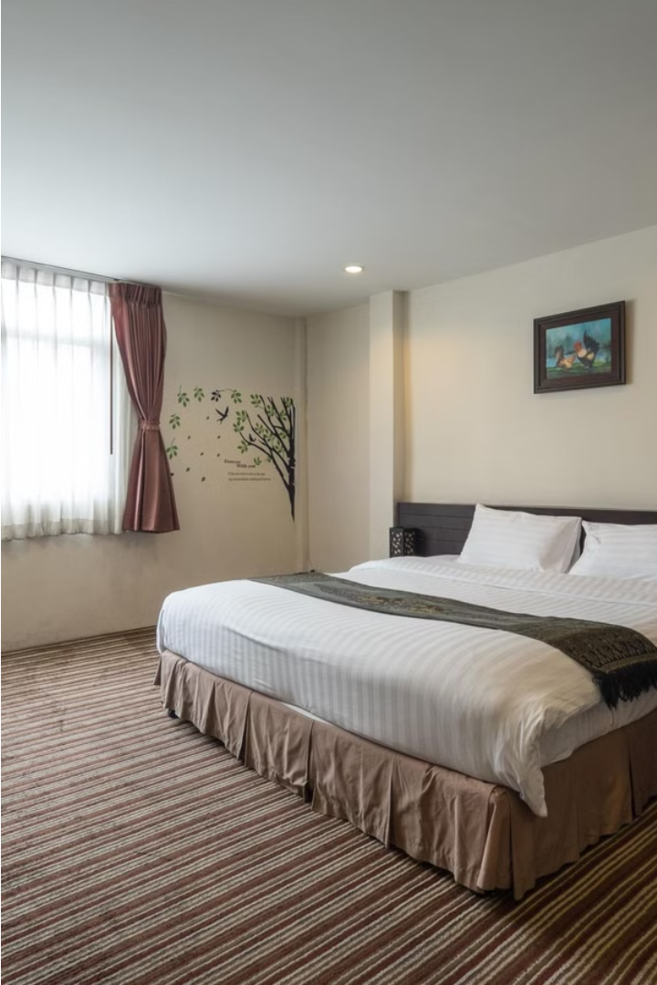
Room Booking System
The Room Booking System is a comprehensive web-based platform that enables users to effortlessly search, reserve, and manage their accommodations, while providing room owners the tools to list, manage, and rent out their properties.

Slide 2
MERN Stack: React, Node.js, Express.js, MongoDB
React
Node.js & Express.js
MongoDB
The user-friendly front-end framework that powers the system's responsive and intuitive interfaces.
The robust back-end technologies that handle server-side logic, API integration, and data management.
The scalable, document-oriented database that efficiently stores and retrieves user, room, and booking data.

Slide 3
User Management
1
User Registration
2
User Login
Secure sign-up process with email verification and password protection.
Streamlined login experience with options for social media and traditional email/password authentication.
3
User Profiles
4
Roles and Permissions
Customizable user profiles that allow guests to manage their booking history and personal information.
Differentiated access levels for guests, room owners, and administrators to ensure data security and privacy.

Slide 4
Room Listing and Booking
Room Listing
Room Search
Booking Process
Room owners can showcase their properties with detailed descriptions, pricing, availability, and high-quality images.
Guests can search for rooms based on location, dates, amenities, and other criteria to find the perfect match.
Seamless booking flow with real-time availability checks, secure payment options, and customizable reservation details.

Slide 5
Rent vs. Lodging Options
Rent
Lodging
Long-term accommodation options for guests seeking a more permanent living arrangement.
Short-term stays for guests in need of temporary accommodations, such as for travel or events.
Flexible Pricing
Booking Preferences
Room owners can set different rates and policies for rent vs. lodging to cater to diverse guest needs.
Guests can easily filter and select their preferred accommodation type based on their requirements.

Slide 6
Database Schema
User Table
Booking Table
Stores user registration details, login credentials, and booking history.
Records all confirmed reservations, including guest details, dates, and payment information.
1
2
3
Room Table
Maintains comprehensive information about each listed property, including availability and pricing.

Slide 7



Frontend and Backend Integration
User Interaction
API Calls
Data Management
Guests interact with the React-powered user interface to search, book, and manage their accommodations.
The front-end communicates with the Node.js/Express.js back-end through a secure API layer.
The back-end processes user requests, interacts with the MongoDB database, and returns the necessary data.

Slide 8
Thank You
by Prince Raj
and Manyank

