Slide 1
Solution of Mid Term

Slide 2
Divide and Conquer

Slide 3
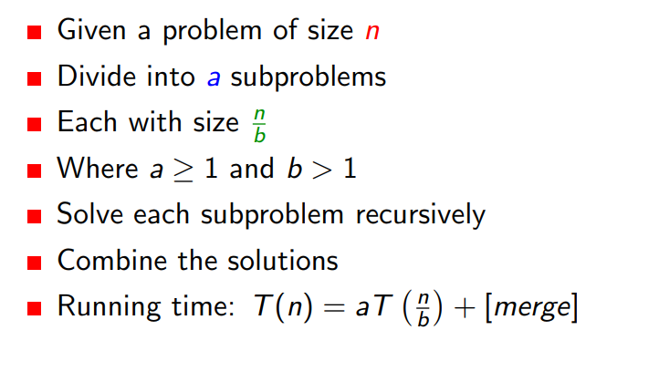

Slide 4
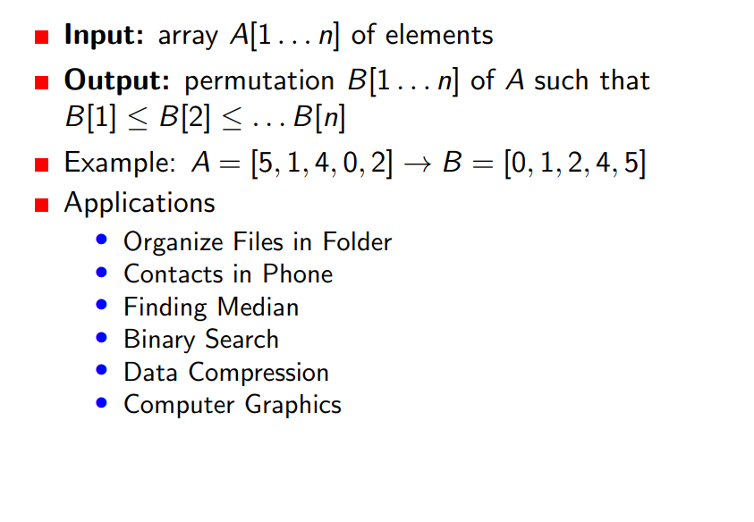
Merge sort

Slide 5
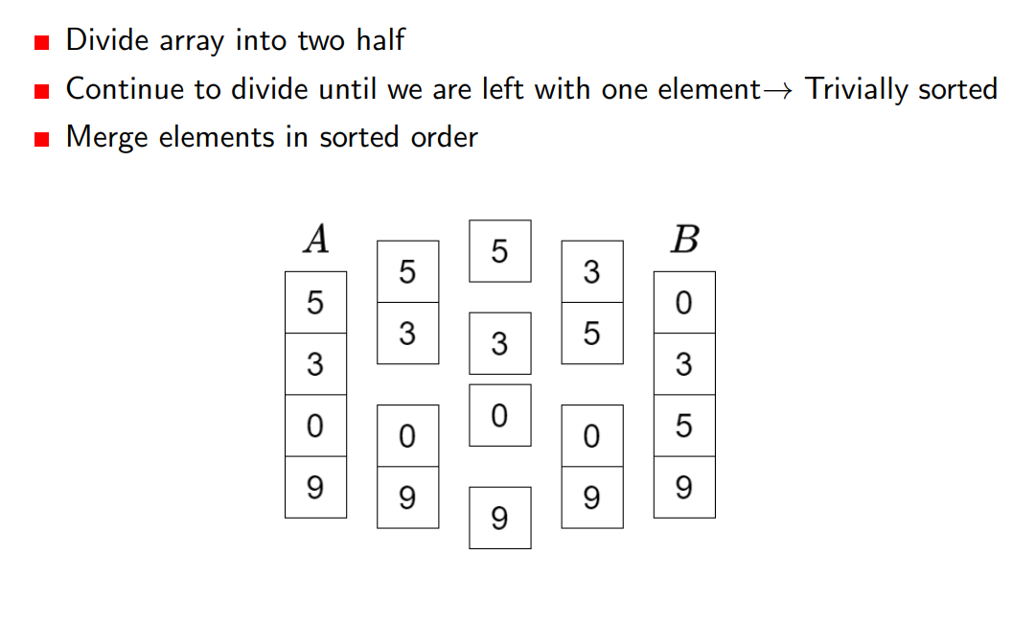
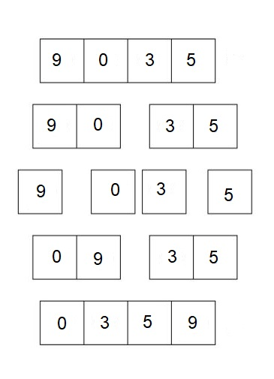
Merge sort

Slide 6
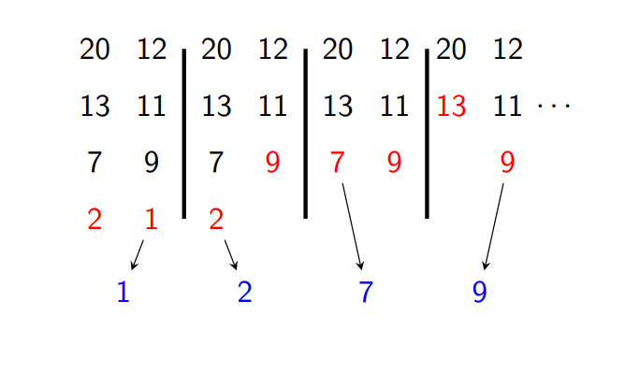
Merge Operation
2 Subarrays to merge: [20,13,7,2] and [12, 11, 9, 1]

Slide 7
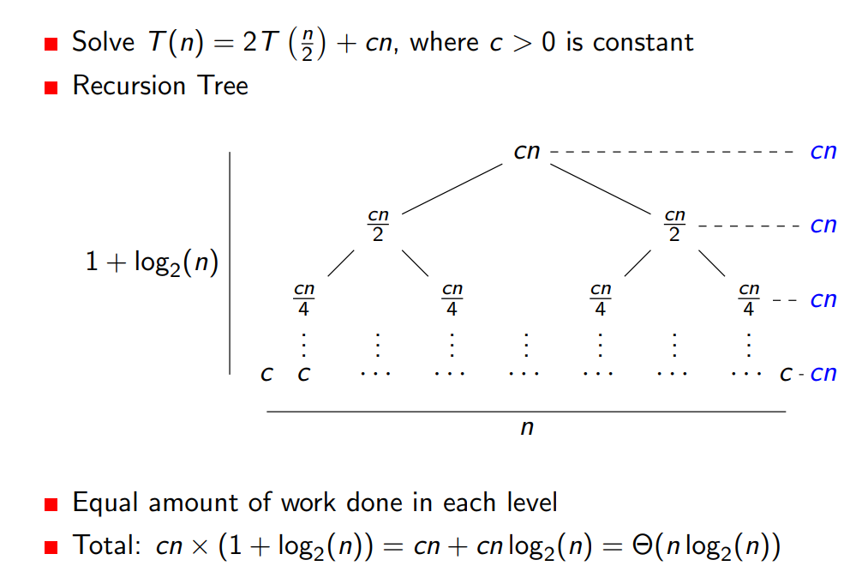
Solving Recurrences

Slide 8
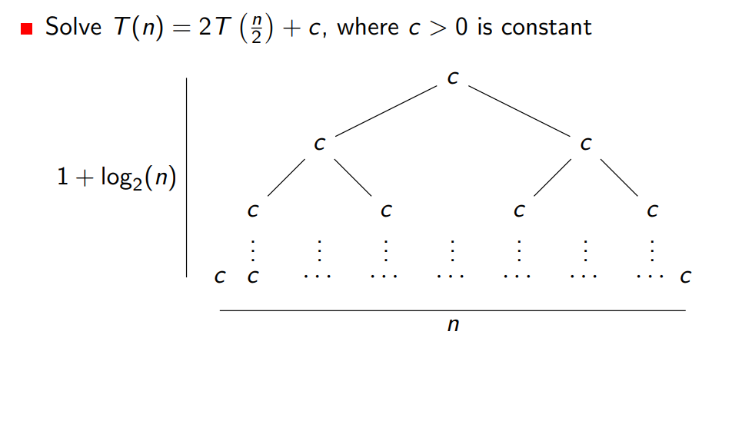
Solving Recurrences

Slide 9
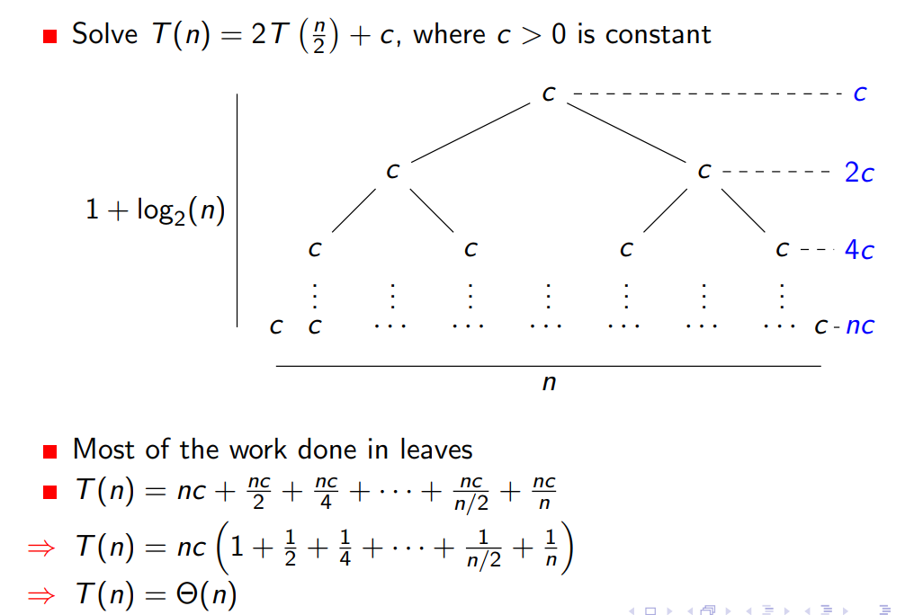
Solving Recurrences

Slide 10
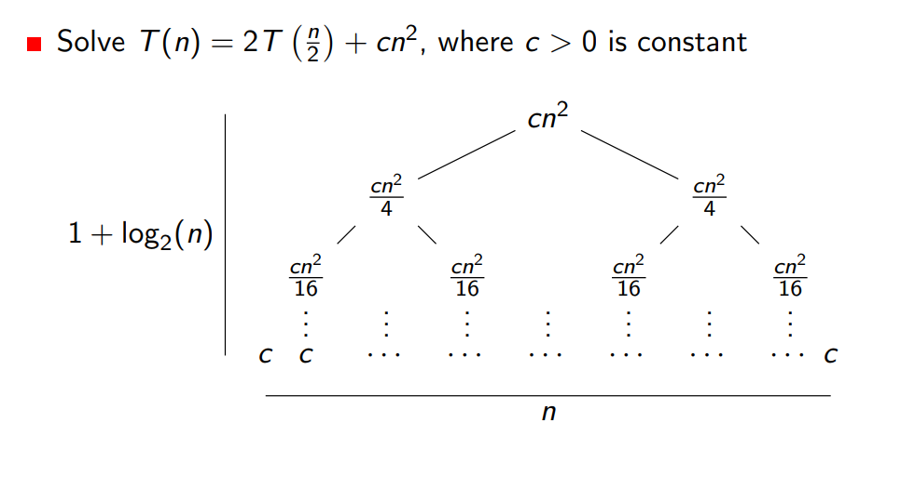
Solving Recurrences

Slide 11
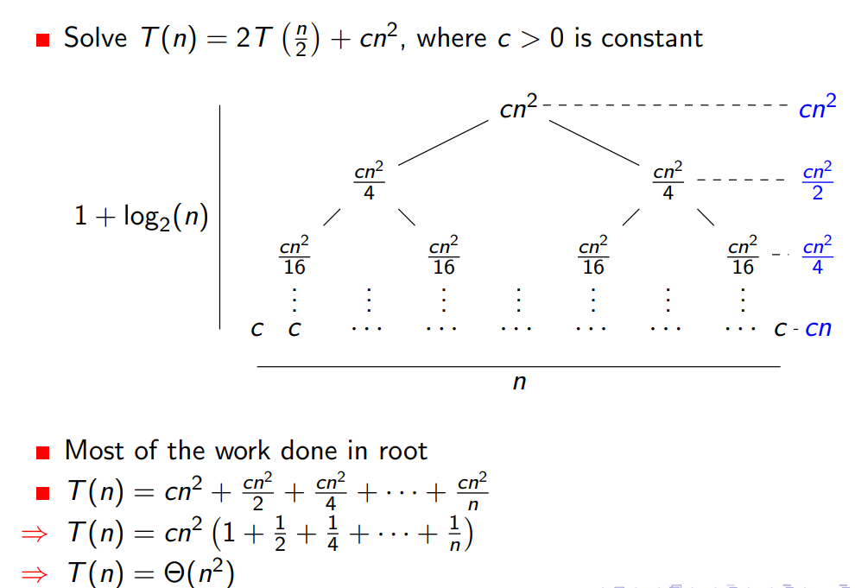
Solving Recurrences

Slide 12
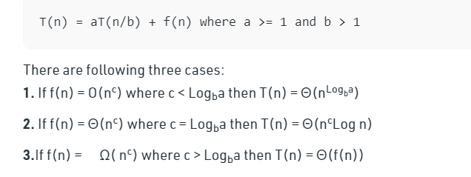
Solving Recurrences (Master Theorem)

Slide 13
Divide and Conquer (Cont…)

Slide 14
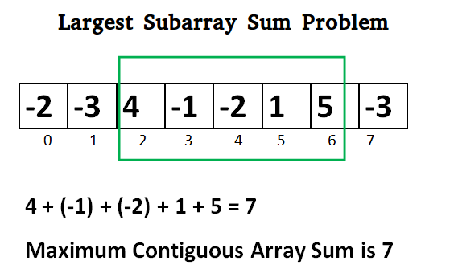
Maximum Subarray Sum

Slide 15
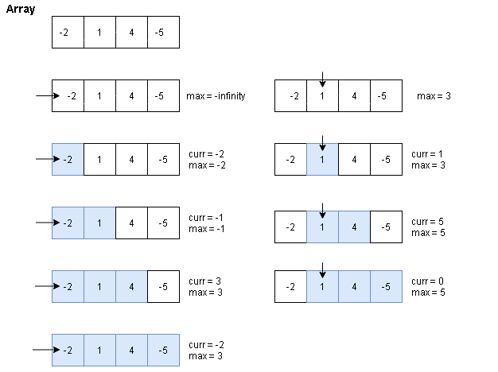
Maximum Subarray Sum

Slide 16
Maximum Subarray Sum
Complexity : O(N²)

Slide 17
Maximum Subarray Sum
Divide the given array in two halves
Return the maximum of following three
Maximum subarray sum in left half (Make a recursive call)
Maximum subarray sum in right half (Make a recursive call)
Maximum subarray sum such that the subarray crosses the midpoint
Time Complexity: T(n) = 2T(n/2) + Θ(n)

Slide 18
Maximum Subarray Sum
Maximum subarray sum such that the subarray crosses the midpoint
return lefpartsum + rightpartsum
for (int i = mid; i >= low; i--) { sum = sum + arr[i]; if (sum > leftpartsum) leftpartsum = sum; } | for (int i = mid+1; i <= high; i++) { sum = sum + arr[i]; if (sum > rightpartsum) rightpartsum = sum; }

Slide 19
Maximum Subarray Sum
Time Complexity: T(n) = 2T(n/2) + Θ(n)

Slide 20
Maximum Subarray Sum (Kadane’s Algorithm)
Local Max: Max possible value including the i^{th} element.
Max(A[i], A[i] + localmax[i-1])
Do we need an array to store localmax?

Slide 21
Maximum Subarray Sum (Kadane’s Algorithm)
Local Max: Max possible value including the i^{th} element.
Max(A[i], A[i] + localmax[i-1])
Do we need an array to store localmax?
Yes, if we don’t keep the track of global max
No, for the previous approach

Slide 22
Maximum Subarray Sum (Kadane’s Algorithm)
Local Max: Max possible value including the i^{th} element.
Max(A[i], A[i] + localmax[i-1])
Global Max: Update every time localmax is calculated
for (i=0; i < n; i++){
localmax = max(A[i], A[i] + localmax);
if(localmax > globalmax)
globalmax = localmax;
}

Slide 23
Maximum Subarray Sum (Kadane’s Algorithm)
for (i=0; i < n; i++){ localmax = max(A[i], A[i] + localmax); if(localmax > globalmax) globalmax = localmax; } | for (i=0; i < n; i++){ localmax = A[i] + localmax; if(localmax > globalmax) globalmax = localmax; if(localmax < 0) localmax = 0; }

Slide 24
Divide and Conquer

Slide 25
Longest Nice Substring
A string s is nice if, for every letter of the alphabet that s contains, it appears both in uppercase and lowercase
aAbBAAA – Nice string
Abc – Not nice
abBxCDScsedEad - ??

Slide 26
Longest Nice Substring
A string s is nice if, for every letter of the alphabet that s contains, it appears both in uppercase and lowercase
aAbB – Nice string
Abc – Not nice
abBxCDScsedEad – Not nice (But there are substrings, which are nice)

Slide 27
Longest Nice Substring
aAAbB – Nice string
Abc – Not nice
abBxCDScsedEad – (Goal is to find the longest nice substring)

Slide 28
Trivial Solution
Find all possible substring
Check which one of them are nice
Print the one with highest length
Number of all possible nonempty substring: n(n+1)/2
O(n²)

Slide 29
Solution
If the string length is less than 2, return empty string.
Keep the track of occurrence of every alphabets.
(To check whether a letter have its counter-letter in the string or not)

Slide 30
Solution
If the string length is less than 2, return empty string.
Keep the track of occurrence of every alphabets.
if(s.length()<2) return "";
set <char> ch_set;
int len = s.length();
for(int i = 0; i<len; i++){
ch_set.insert(s[i]); // In case of set
//ar[ s[i] ] = 1; //In case of array
}

Slide 31
Keep the track of occurrence of every alphabets
Using array:
ch = s[i]
if ( ar[toupper(ch)] && ar[ tolower(ch)])
Using set:
ch = s[i]
if( ch_set.contains(toupper(ch)) && ch_set.contains(tolower(ch)) )
0 | 0 | 0 | 0 | 0 | 0 | 0 | 0 | 0 | 0 | 0 | 0 | 0 | 0 | 0 | 0 | 0 | 0
0 | 1 | ….. | 65 | 66 | 67 | … | 88 | 89 | 90 | … | 97 | 98 | 99 | … | 120 | 121 | 122

Slide 32
Solution
If the string length is less than 2, return empty string.
Keep the track of occurrence of every alphabets.
Run a loop from the beginning of the string (s)
until you found a letter which does not have its counter-letter in the string
Or reached to the end of the string
If it is the end of the string, return s
Otherwise
Split the string into two substring from the left and right of the non-matching character and return the longest nice substring from both parts

Slide 33
Solution
Run a loop up to the end of the string
Check if (ch_set.count(toupper(ch)) && ch_set.count(tolower(ch)) )
if true, check the next letter.
else
Recursively call the left and right substring to find the longest nice substring in them.
Return the bigger one among them

Slide 34
Solution
Recursively call the left and right substring:
Left: s1 = f1(s.substr(0,i))
Right: s2 = f1(s.substr(i+1,len-i+1))

Slide 35
string longestNiceSubstring(string s) {
if(s.length()<2) return "";
set <char> ch_set;
int len = s.length();
for(int i = 0; i<len; i++){
ch_set.insert(s[i]);
}
for(int i = 0; i<len; i++){
char ch = s[i];
if(ch_set.count(toupper(ch)) && ch_set.count(tolower(ch)))
continue;
string s1 = longestNiceSubstring(s.substr(0,i));
string s2 = longestNiceSubstring(s.substr(i+1));
return s1.length() >= s2.length() ? s1:s2;
}
return s;
}

Slide 36
Problem Link
https://leetcode.com/problems/longest-nice-substring/description/

Slide 37
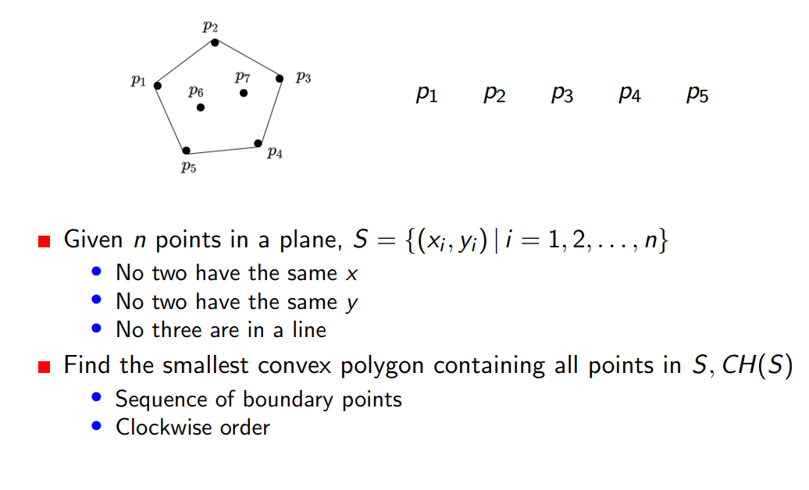
Convex Hull Problem

Slide 38
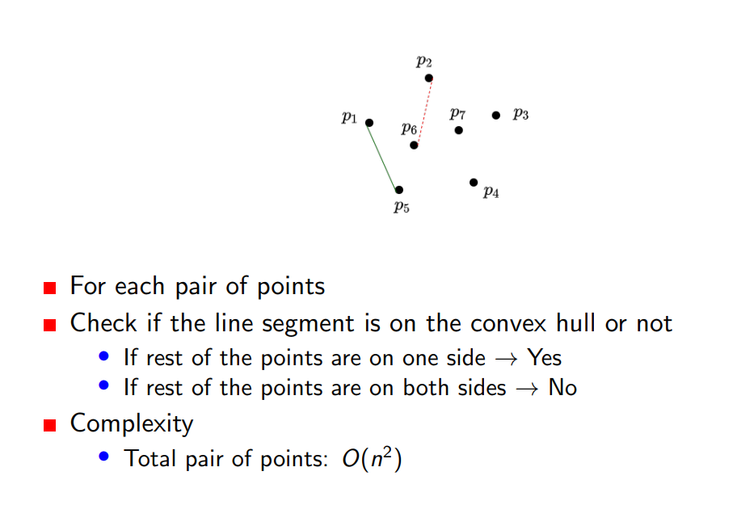
Convex Hull Problem
Notes:
D = (x-x1)(y2-y1) – (y-y1)(x2-x1)

Slide 39
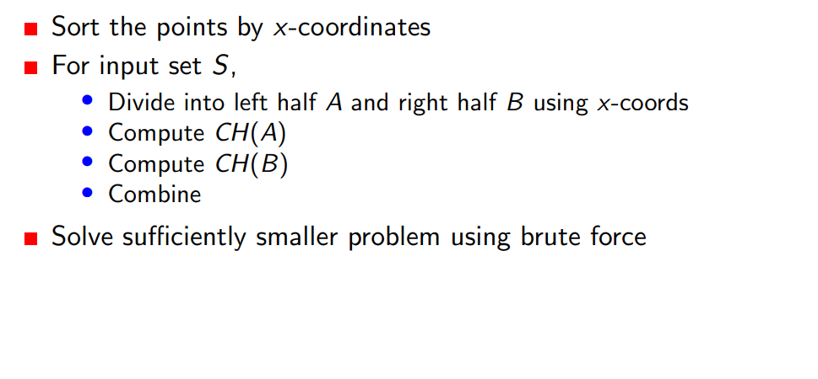
Convex Hull Problem

Slide 40
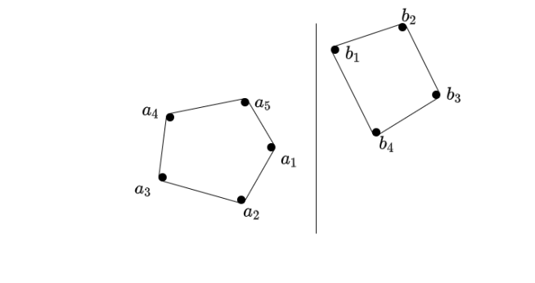
Convex Hull Problem

Slide 41
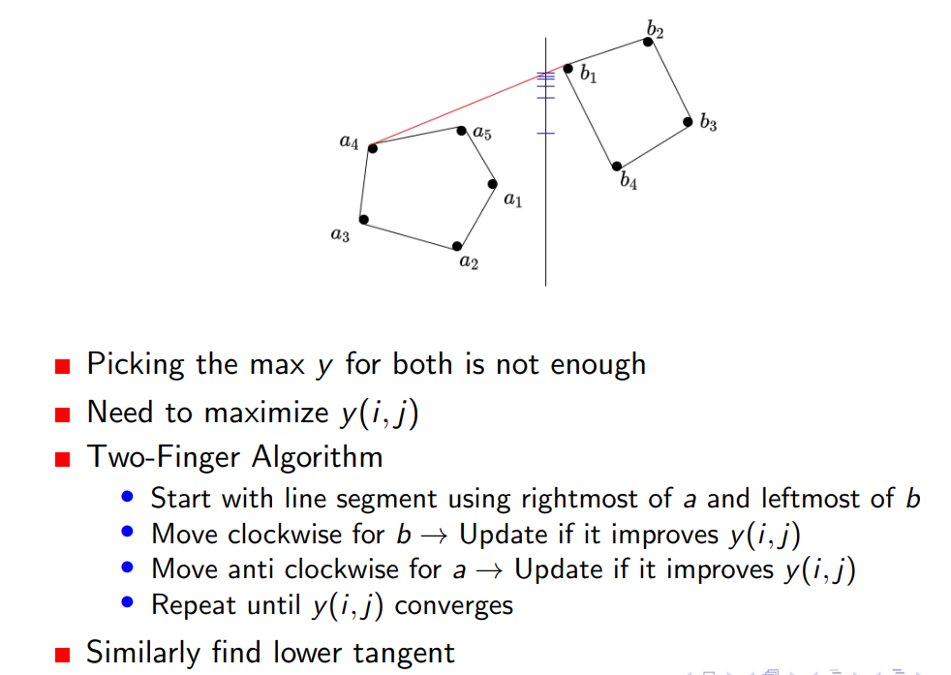
Convex Hull Problem

Slide 42
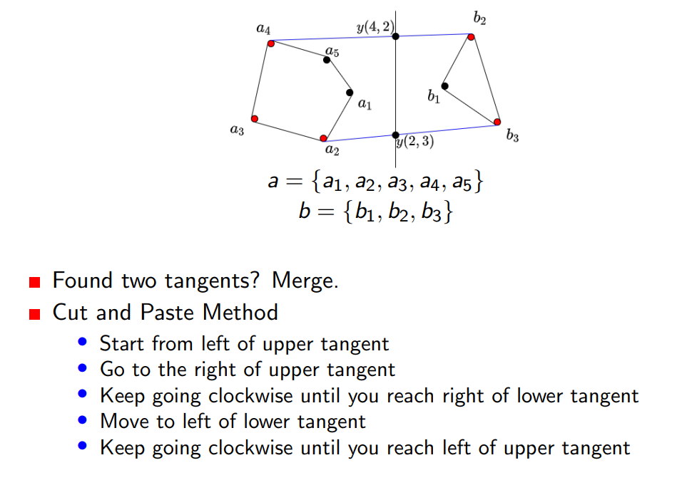
Convex Hull Problem

Slide 43
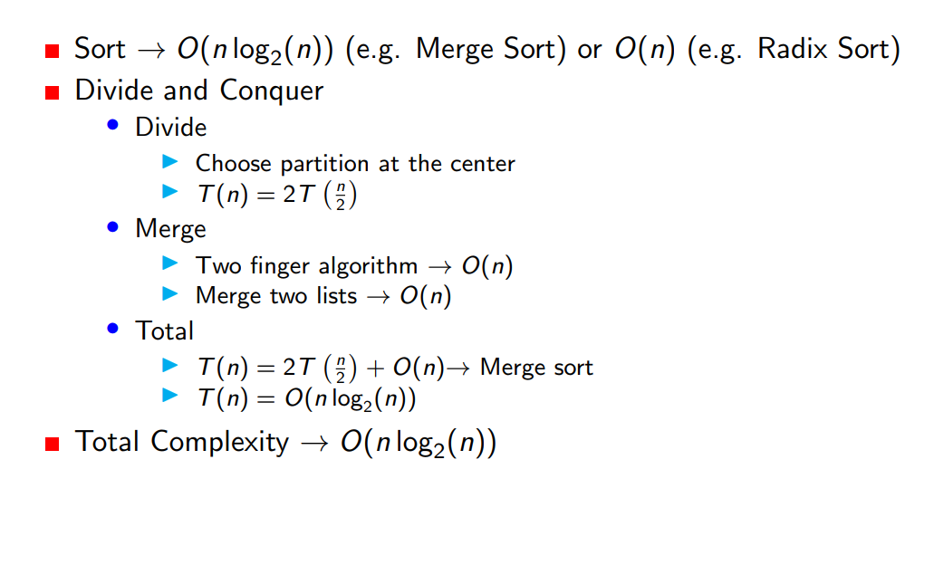
Convex Hull Problem (Complexity)

Slide 44
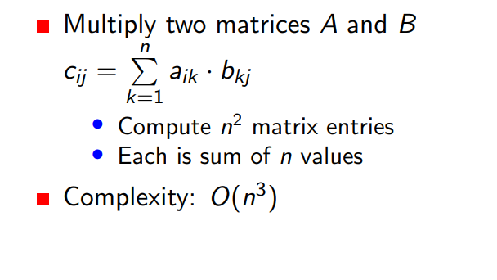
Matrix Multiplication

Slide 45
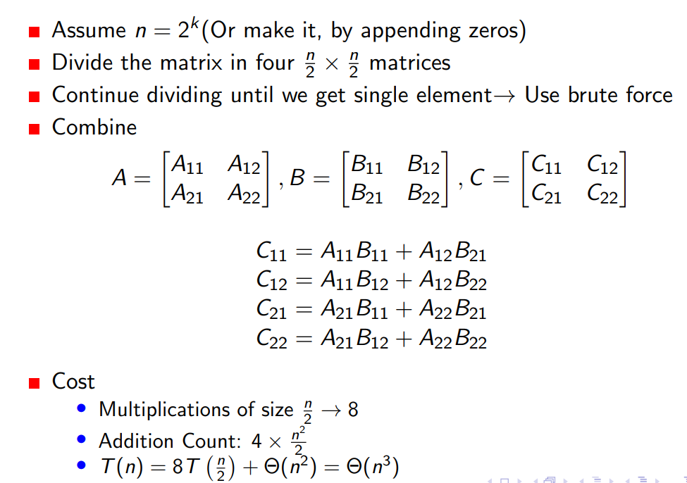
Matrix Multiplication

Slide 46
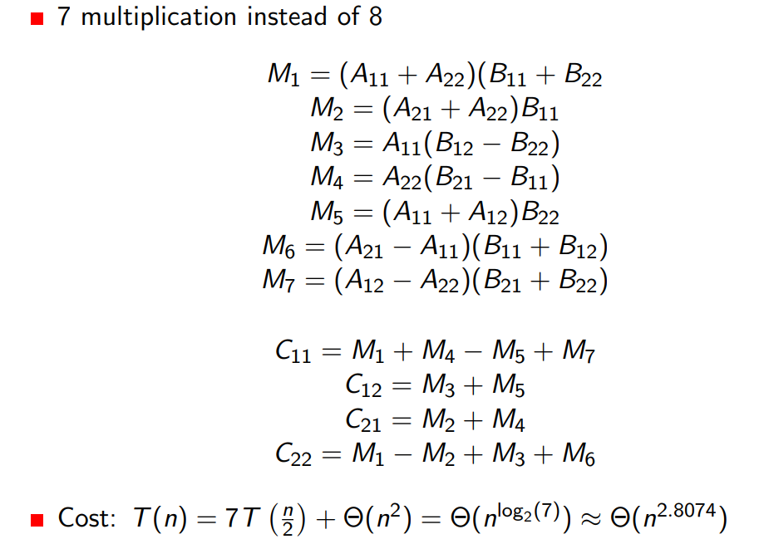
Matrix Multiplication (Strassen’s Method)

