Slide 1
Inventory management system
This is a RESTful Inventory Management System built using FastAPI and SQLite
It manages products, stock levels, and inventory transactions
Every stock change is atomic, validated, and transaction-logged
Exposes CRUD and inventory operations via REST APIs
Uses FastAPI for API layer
Uses SQLite for persistence
Maintains transaction audit logs

Slide 2
WHAT THE SYSTEM DOES
At a high level, the system manages two core resources:
Products — which represent inventory items
Inventory transactions — which record every change made to product quantity
The system supports:
Creating products
Updating or adjusting quantity
Placing orders (reducing stock)
Viewing current inventory
Viewing transaction history
Backing up the database
All changes are stored safely using database transactions so that partial updates never occur.”

Slide 3
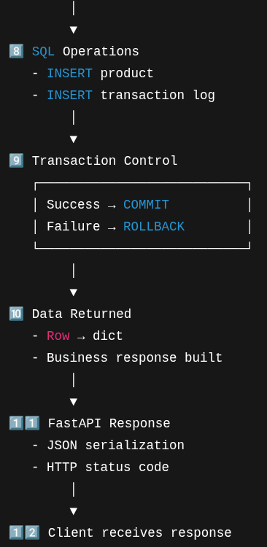
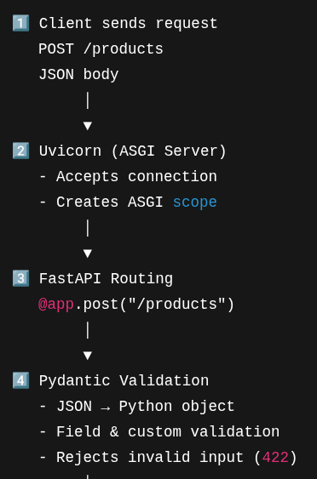
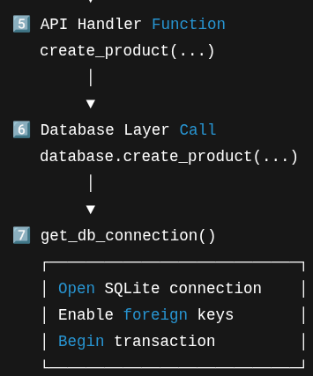
Complete lifecycle diagram

Slide 4
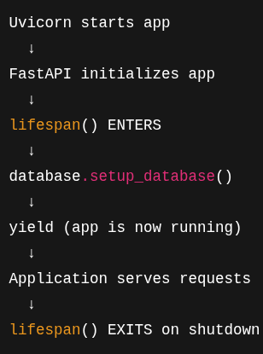
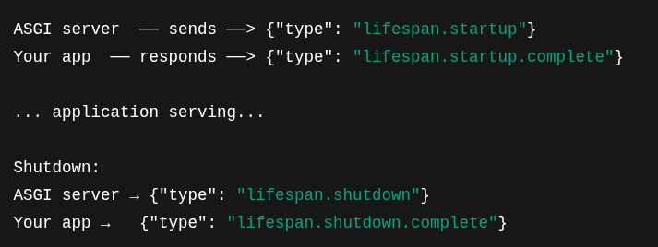
Lifespan (app)
ASGI(Asynchronous server gateway interface) lifespan protocol

Slide 5
Database level Constraints used
Products Table
id INTEGER PRIMARY KEY AUTOINCREMENT
Ensures unique identity for each product
product_name TEXT UNIQUE NOT NULL
Prevents duplicate product names
Disallows NULL values
quantity INTEGER NOT NULL DEFAULT 0
Quantity must always exist
Defaults to 0 if not provided
CHECK (quantity >= 0)
Prevents negative inventory at database level
Inventory Transactions Table
product_id INTEGER NOT NULL
REFERENCES products(id)
ON DELETE CASCADE
Enforces referential integrity
Deletes transactions automatically if product is deleted
Database functions in database.py
if not product_name.isalnum():
raise ValueError("Product name must contain only letters and numbers")
Ensures alphanumeric product names
if quantity < 0:
raise ValueError("Quantity cannot be negative")
Prevents invalid quantity input
if order_quantity > old_quantity:
raise ValueError("Insufficient stock")
Prevents ordering more than available stock

Slide 6
Constrains used
Pydantic Models
ProductCreate
product_name: str = Field(..., min_length=1, max_length=100)
Enforces valid length
@field_validator("product_name")
def validate_product_name(cls, v):
if not v.isalnum():
raise ValueError("Product name must be alphanumeric")
quantity: int = Field(..., ge=0)
Quantity must be ≥ 0
QuantityAdjust
quantity: int = Field(..., gt=0)
Adjustment must be positive (no zero or negative)
OrderItem
quantity: int = Field(..., ge=1)
Order quantity must be at least 1

Slide 7
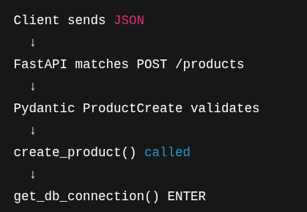
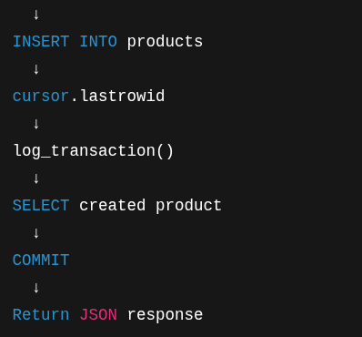
Create_product (in main.py) lifecycle

Slide 8
Database layer responsibilites
Schema definition
Constraints & indexes
Transaction management
Audit logging
Backup & recovery

Slide 9
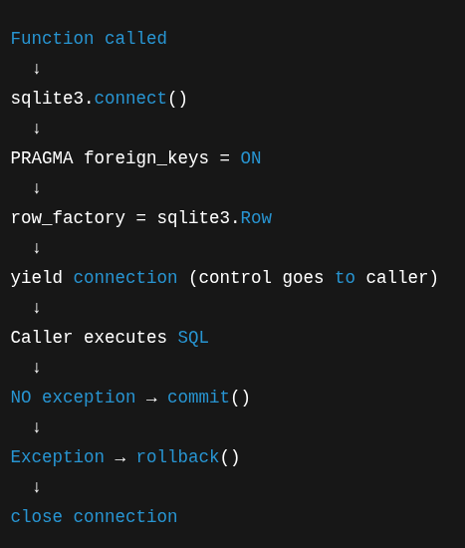
Database connection lifecycle (get_db_connection)

Slide 10
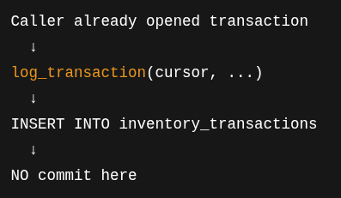
log_transaction

Slide 11
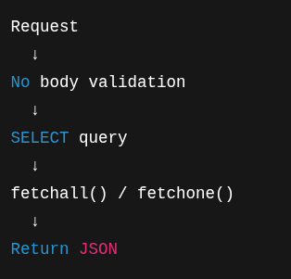
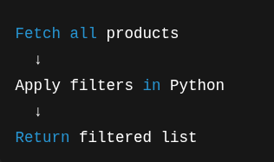
Read operations (get) Search (get) operation

Slide 12
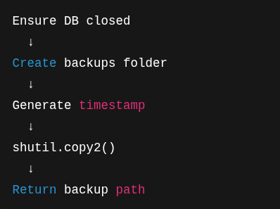
Backup database (post /backup)

Slide 13
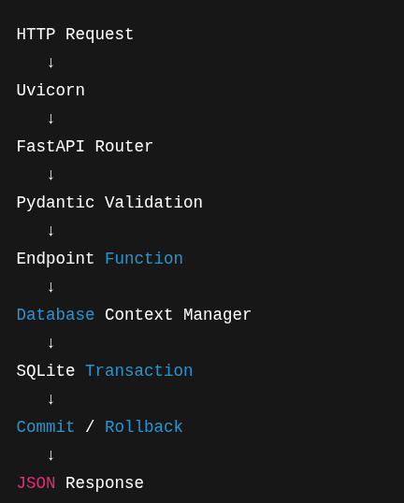
Complete lifecycle summary

