Slide 1
WIAAS ASIA · FIELD BRIEFING
PLATE 00 · ALIBABA HACKATHON
◇ WEATHER INTELLIGENCE PLATFORM
WIaaS
Weather Intelligence as a Service
A pan-Asian decision layer that turns weather signals into clear action for farms, grids, logistics teams, and crisis operators.
ALIBABA HACKATHON · TWO AGENTS · ASIA-ONLY OPERATING SCOPE
WIAAS ASIA · ALIBABA HACKATHON BRIEF
01 / 12

Slide 2
WIAAS ASIA · SECTION 01
PLATE 02
◇ DIAGNOSTICS
The operational disconnect
1
2
FORECASTS STOP AT OBSERVATION
ASIA COMPOUNDS THE COST
A temperature, humidity, or rain probability is useful only after an operator translates it into a decision. That translation still happens manually across agriculture, energy, transport, and emergency desks.
Monsoon rain, coastal humidity, heat domes, typhoon corridors, and mountain runoff can affect the same city in different ways. A single regional view needs local context, not one global average.
The gap is operational, not informational
WIaaS Asia closes that gap by keeping calculations deterministic and using language models only when interpretation or action planning is needed.
WIAAS ASIA · ALIBABA HACKATHON BRIEF
WIAAS ASIA · ALIBABA HACKATHON BRIEF
02 / 12
02 / 12

Slide 3
WIAAS ASIA · SECTION 02
PLATE 03
◇ RESPONSE ARCHITECTURE
A decision layer for Asian weather
01
02
The bridge
Action over observation
FastAPI computes the physical state. Two n8n decision graphs interpret that state and return a structured answer that people can act on.
The operator can ask for a metric, a sector plan, a research summary, or a threat assessment. The response keeps the selected city and its evidence in view.
DATA INGEST
PHYSICS ENGINE
DECISION WORKFLOW
FIELD ACTION
VPD, wet-bulb, heat index, grid headroom, water loss, fuel reserve, radar and wind evidence
WIAAS ASIA · ALIBABA HACKATHON BRIEF
WIAAS ASIA · ALIBABA HACKATHON BRIEF
03 / 12
03 / 12

Slide 4
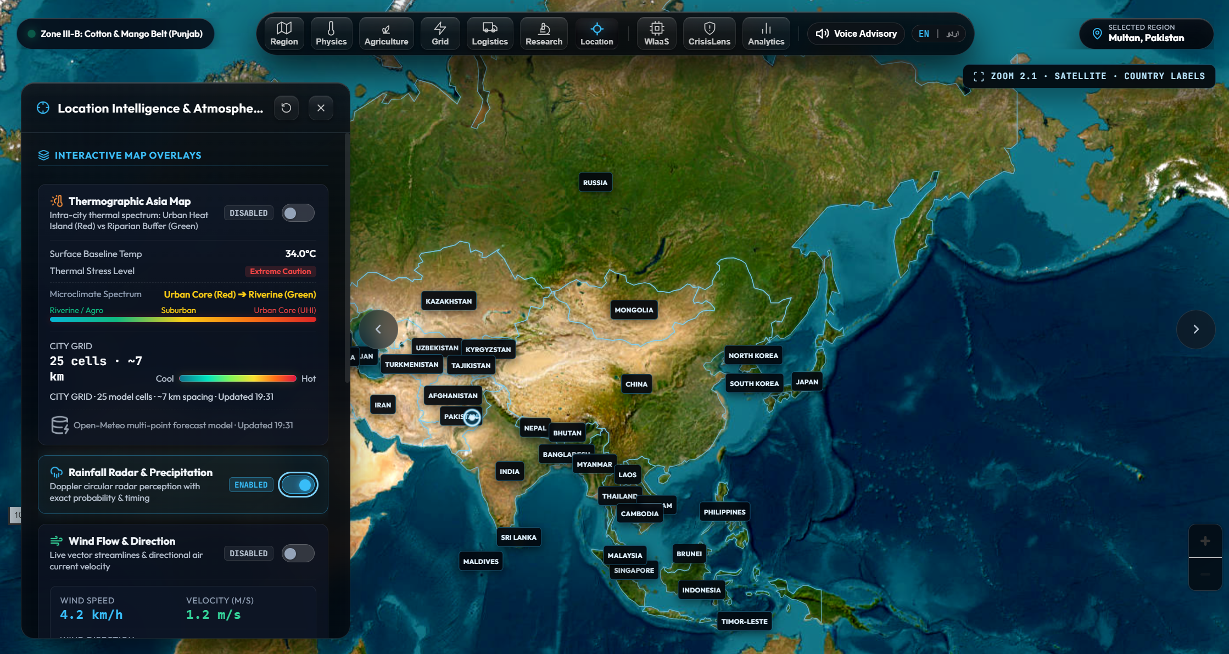
WIAAS ASIA · SECTION 02
PLATE 04
◇ OPERATOR EXPERIENCE
One screen, four kinds of evidence
Select a country or city, then inspect the same location through map layers and conversational guidance.
1
2
THERMAL
RAIN RADAR
City-level heat bands expose urban stress and cooler buffers.
Localized circles show where precipitation is most likely.
3
4
Product UI shown from the current WIaaS Asia build
WIND
VOICE
Direction and speed stay tied to the selected place.
English and Urdu input and playback keep the interface accessible.
WIAAS ASIA · ALIBABA HACKATHON BRIEF
WIAAS ASIA · ALIBABA HACKATHON BRIEF
04 / 12
04 / 12

Slide 5
WIAAS ASIA · SECTION 03A
PLATE 05
◇ TOKEN ECONOMY
Token-efficient architecture
1
Operating principle
Rules, APIs, and memory handle predictable work first. The model is called for interpretation, correlation, or action generation.
2
3
4
DETERMINISTIC CORE
CONTEXT COMPRESSION
OUTPUT CONTROL
Intent routing separates greetings, FAQs, direct metrics, and full analysis. The fast path answers predictable requests without spending a model call.
Backend payloads become a compact state vector. Each specialist sees only task-relevant fields, and telemetry is reused from short-lived caches.
Strict response fields keep parsing stable. When evidence is missing, the workflow returns a safe limitation instead of inventing certainty.
REQUEST
ROUTE
COMPACT EVIDENCE
ONLY REQUIRED AGENT
STRUCTURED RESPONSE
WIAAS ASIA · ALIBABA HACKATHON BRIEF
WIAAS ASIA · ALIBABA HACKATHON BRIEF
05 / 12
05 / 12

Slide 6
WIAAS ASIA · SECTION 03B
PLATE 06
◇ WORKFLOW MAP
WIaaS operational workflow
One workflow coordinates the operational domains that must agree on the same weather state.
58 NODES IN CURRENT EXPORT
Input
Route
Evidence
Specialists
Output
Webhook, message, session, region metadata
Region resolver, intent router, fast or deep path
Telemetry, climate matrix, ledger, cached state
Research, Agriculture, Grid, Logistics
Chat or full report
WHAT IT RETURNS
A single answer can carry the selected region, exact metrics, sector interpretation, one prioritized action, a research summary, and a clear evidence boundary.
WIAAS ASIA · ALIBABA HACKATHON BRIEF
WIAAS ASIA · ALIBABA HACKATHON BRIEF
06 / 12
06 / 12

Slide 7
WIAAS ASIA · SECTION 03C
PLATE 07
◇ WORKFLOW MAP
CrisisLens threat workflow
CrisisLens focuses the same regional context on multi-hazard evidence, severity, and safe action.
47 NODES IN CURRENT EXPORT
Input + memory
Geo + route
Evidence
Reasoning
Safety output
Message, user state, previous assessment
Resolve city, coordinates, intent and cache
Open-Meteo, GDACS, FIRMS, GDELT
Correlate severity, confidence and stakeholders
Actions, limits, source list
1
2
3
HAZARD COVERAGE
CAUTION BY DESIGN
FOLLOW-UP REUSE
Heat, flood, wildfire, cyclone, earthquake and other alerts when evidence supports them.
Separates observed signals from inference and keeps uncertainty visible.
Cached severity and evidence paths reduce repeated work in the same session.
WIAAS ASIA · ALIBABA HACKATHON BRIEF
WIAAS ASIA · ALIBABA HACKATHON BRIEF
07 / 12
07 / 12

Slide 8
WIAAS ASIA · SECTION 04
PLATE 08
◇ REGIONAL SCOPE
Asia-wide coverage with local context
The registry stores 29 Asian countries and 67 regional or microclimate profiles. The same engine can move from a continental view to a city-level decision.
South Asia
Pakistan, India, Bangladesh, Nepal, Sri Lanka
heat domes, monsoon runoff, coastal humidity
East Asia
China, Japan, Korea, Mongolia
typhoon wind, urban heat, continental extremes
Southeast Asia
Indonesia, Philippines, Thailand, Malaysia, Vietnam
convective rain, storm surge, maritime logistics
Central Asia
Kazakhstan, Uzbekistan, Kyrgyzstan, Tajikistan
arid steppe, glacier-fed water, cold resilience
West Asia
UAE, Saudi Arabia, Qatar, Oman and neighbors
hyper-arid heat, desalination, peak cooling load
Coverage means the same schema travels with the location: city, province, country, coordinates, timezone, and biome.
WIAAS ASIA · ALIBABA HACKATHON BRIEF
WIAAS ASIA · ALIBABA HACKATHON BRIEF
08 / 12
08 / 12

Slide 9
WIAAS ASIA · SECTION 05
PLATE 09
◇ DETERMINISTIC CORE
Physics keeps the answer grounded
1
2
3
THERMAL STATE
RESOURCE STATE
EVIDENCE STATE
Tetens saturation pressure feeds VPD. Stull wet-bulb and heat-index thresholds surface heat stress before a language model writes the explanation.
Water evaporation, grid demand surge, fuel reserve, and transformer headroom remain explicit values in the ledger.
Open-Meteo telemetry, NASA POWER climate context, RainViewer radar, and CrisisLens sources are labeled by their role and limitation.
CORE EQUATIONS
eₛ(T) = 0.61078 × exp(17.27T / (T + 237.3))
VPD = eₛ(T) × (1 − RH / 100)
The workflow can explain a number because the backend calculated it first.
WIAAS ASIA · ALIBABA HACKATHON BRIEF
WIAAS ASIA · ALIBABA HACKATHON BRIEF
09 / 12
09 / 12

Slide 10
WIAAS ASIA · SECTION 06
PLATE 10
◇ ENGINEERING DISCIPLINE
Efficiency without hiding the limits
1
CURRENT SIGNALS
WHAT IS VERIFIED IN THE CURRENT BUILD
WIaaS workflow
58 nodes
Two local endpoint probes returned HTTP 200. WIaaS returned in 3.3 seconds with a concise answer. CrisisLens returned in 2.6 seconds with a detailed evidence response.
CrisisLens workflow
47 nodes
Conversation context
8 turns
2
Spatial-grid cache
240 seconds
WHAT DRIVES LOWER SPEND BY DESIGN
Smoke test reliability
2 / 2 HTTP 200
The app keeps the last eight turns, routes predictable requests before model calls, caches the spatial grid for four minutes, and limits specialist output lengths.
These are implementation and smoke-test signals, not a production SLA. Alibaba deployment should add token counters, p95 latency, and provider-level accuracy evaluation.
WIAAS ASIA · ALIBABA HACKATHON BRIEF
WIAAS ASIA · ALIBABA HACKATHON BRIEF
10 / 12
10 / 12

Slide 11
WIAAS ASIA · SECTION 07
PLATE 11
◇ INCLUSIVE INTERFACE
The operator can speak the question
1
2
3
ENGLISH AND URDU
VOICE INPUT
NEURAL PLAYBACK
The chat layer detects Urdu input, keeps the regional context, and returns a parallel Urdu response instead of a generic translation.
A microphone button captures a spoken question. The composer shows listening state and stops cleanly when the user ends the turn.
Speaker controls use Edge neural voices: en-US-JennyNeural and ur-PK-UzmaNeural. A stop control cancels active playback.
ACCESSIBLE BY DEFAULT
A field operator can ask in natural language, receive a structured answer, and hear the same answer in English or Urdu while keeping the map and selected region visible.
WIAAS ASIA · ALIBABA HACKATHON BRIEF
WIAAS ASIA · ALIBABA HACKATHON BRIEF
11 / 12
11 / 12

Slide 12
WIAAS ASIA · SECTION 08
PLATE 12
◇ ALIBABA HACKATHON FIT
A practical path to regional climate resilience
WIaaS Asia is ready to demonstrate the core loop: resolve a place, calculate the physical state, route to the right agent, and return an action that a person can use.
1
2
3
TODAY
NEXT ON ALIBABA
THE OUTCOME
FastAPI telemetry, MapLibre Asia map, two active n8n exports, bilingual chat, voice input, and localized overlays.
Instrument tokens and p95 latency, connect managed secrets, add provider accuracy checks, and package the webhooks for repeatable deployment.
One regional interface for decisions that usually live in separate weather, grid, agriculture, logistics, and emergency systems.
From a weather signal to a defensible next step
WIaaS ASIA · ALIBABA HACKATHON
WIAAS ASIA · ALIBABA HACKATHON BRIEF
WIAAS ASIA · ALIBABA HACKATHON BRIEF
12 / 12
12 / 12

