Slide 1
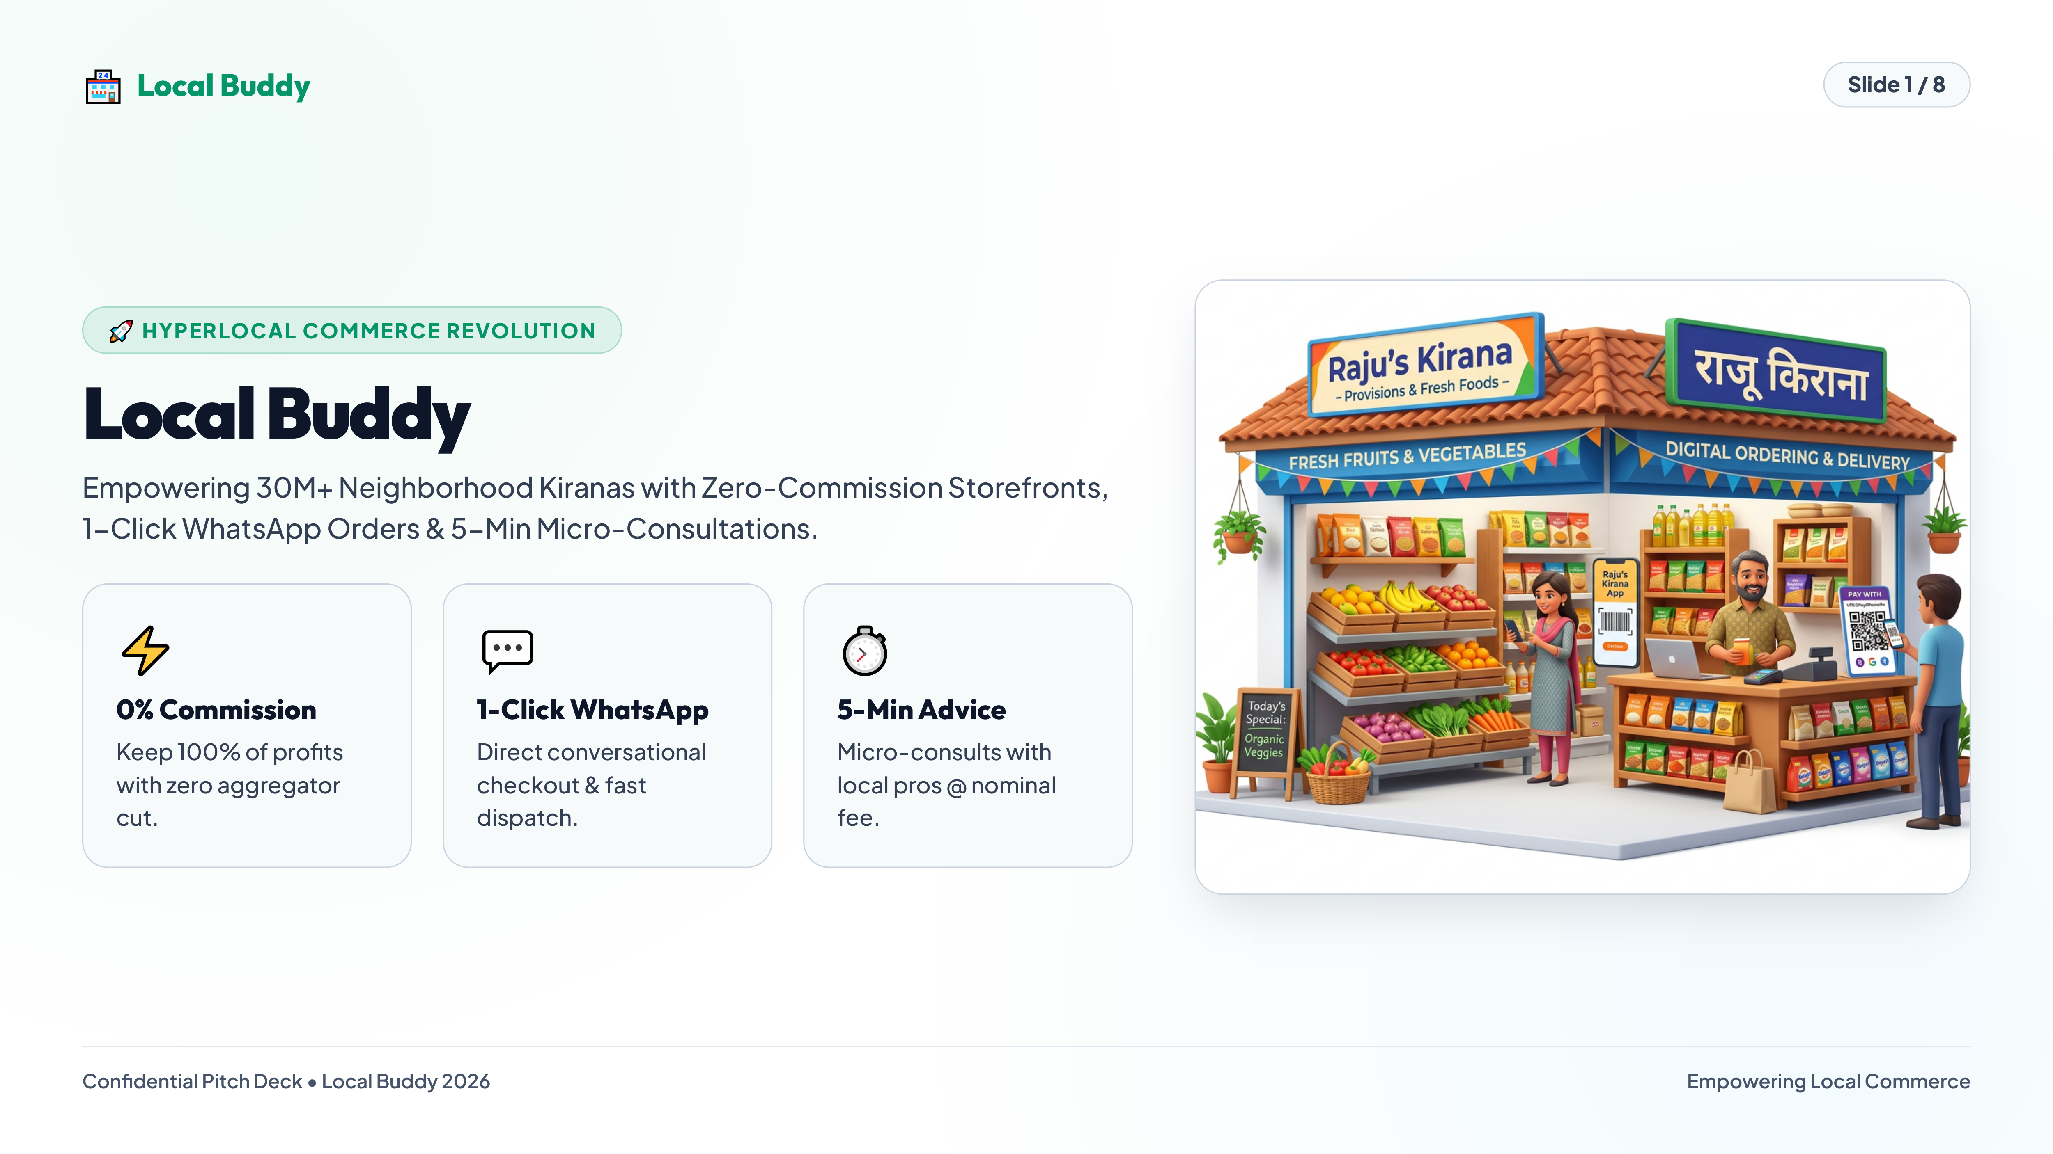
Notes:
🏪Local Buddy
Slide 1 / 8
🚀 HYPERLOCAL COMMERCE REVOLUTION
Local Buddy
Empowering 30M+ Neighborhood Kiranas with Zero-Commission Storefronts,
1-Click WhatsApp Orders & 5-Min Micro-Consultations.
⚡
0% Commission
Keep 100% of profits
with zero aggregator
cut.
💬
1-Click WhatsApp
Direct conversational
checkout & fast
dispatch.
⏱️
5-Min Advice
Micro-consults with
local pros @ nominal
fee.
Confidential Pitch Deck • Local Buddy 2026
Empowering Local Commerce

Slide 2
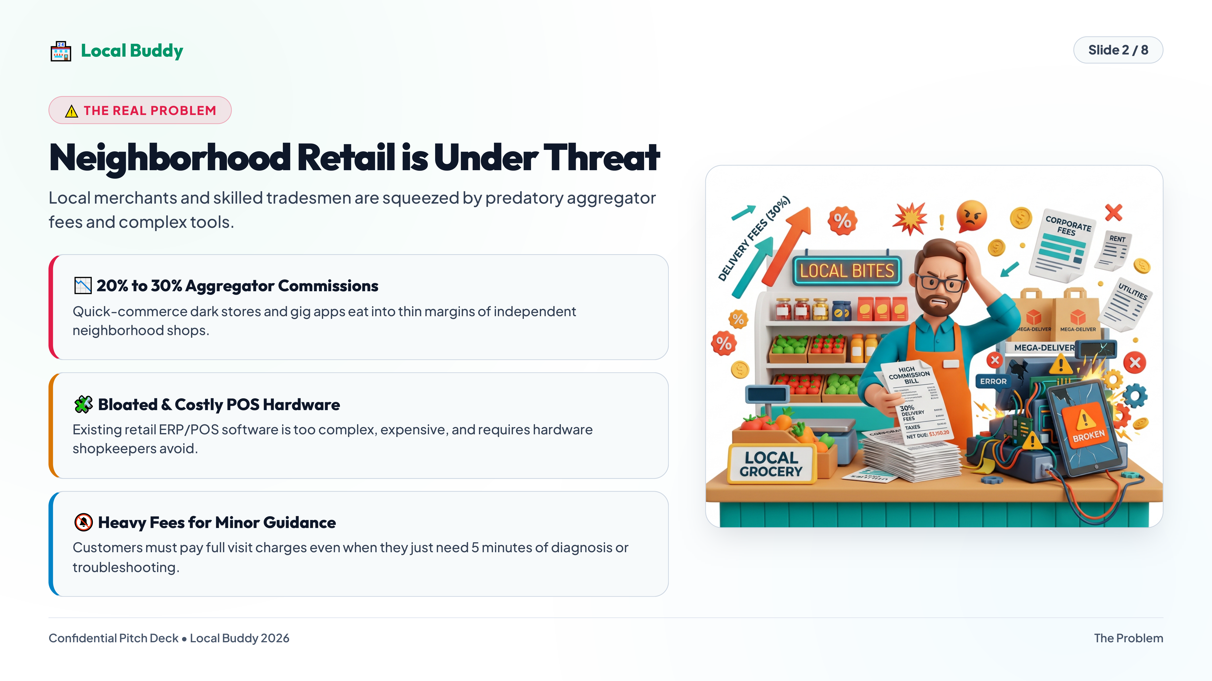
Notes:
🏪Local Buddy
Slide 2 / 8
⚠️ THE REAL PROBLEM
Neighborhood Retail is Under Threat
Local merchants and skilled tradesmen are squeezed by predatory aggregator
fees and complex tools.
📉 20% to 30% Aggregator Commissions
Quick-commerce dark stores and gig apps eat into thin margins of independent
neighborhood shops.
🧩 Bloated & Costly POS Hardware
Existing retail ERP/POS software is too complex, expensive, and requires hardware
shopkeepers avoid.
🔕 Heavy Fees for Minor Guidance
Customers must pay full visit charges even when they just need 5 minutes of diagnosis or
troubleshooting.
Confidential Pitch Deck • Local Buddy 2026
The Problem

Slide 3
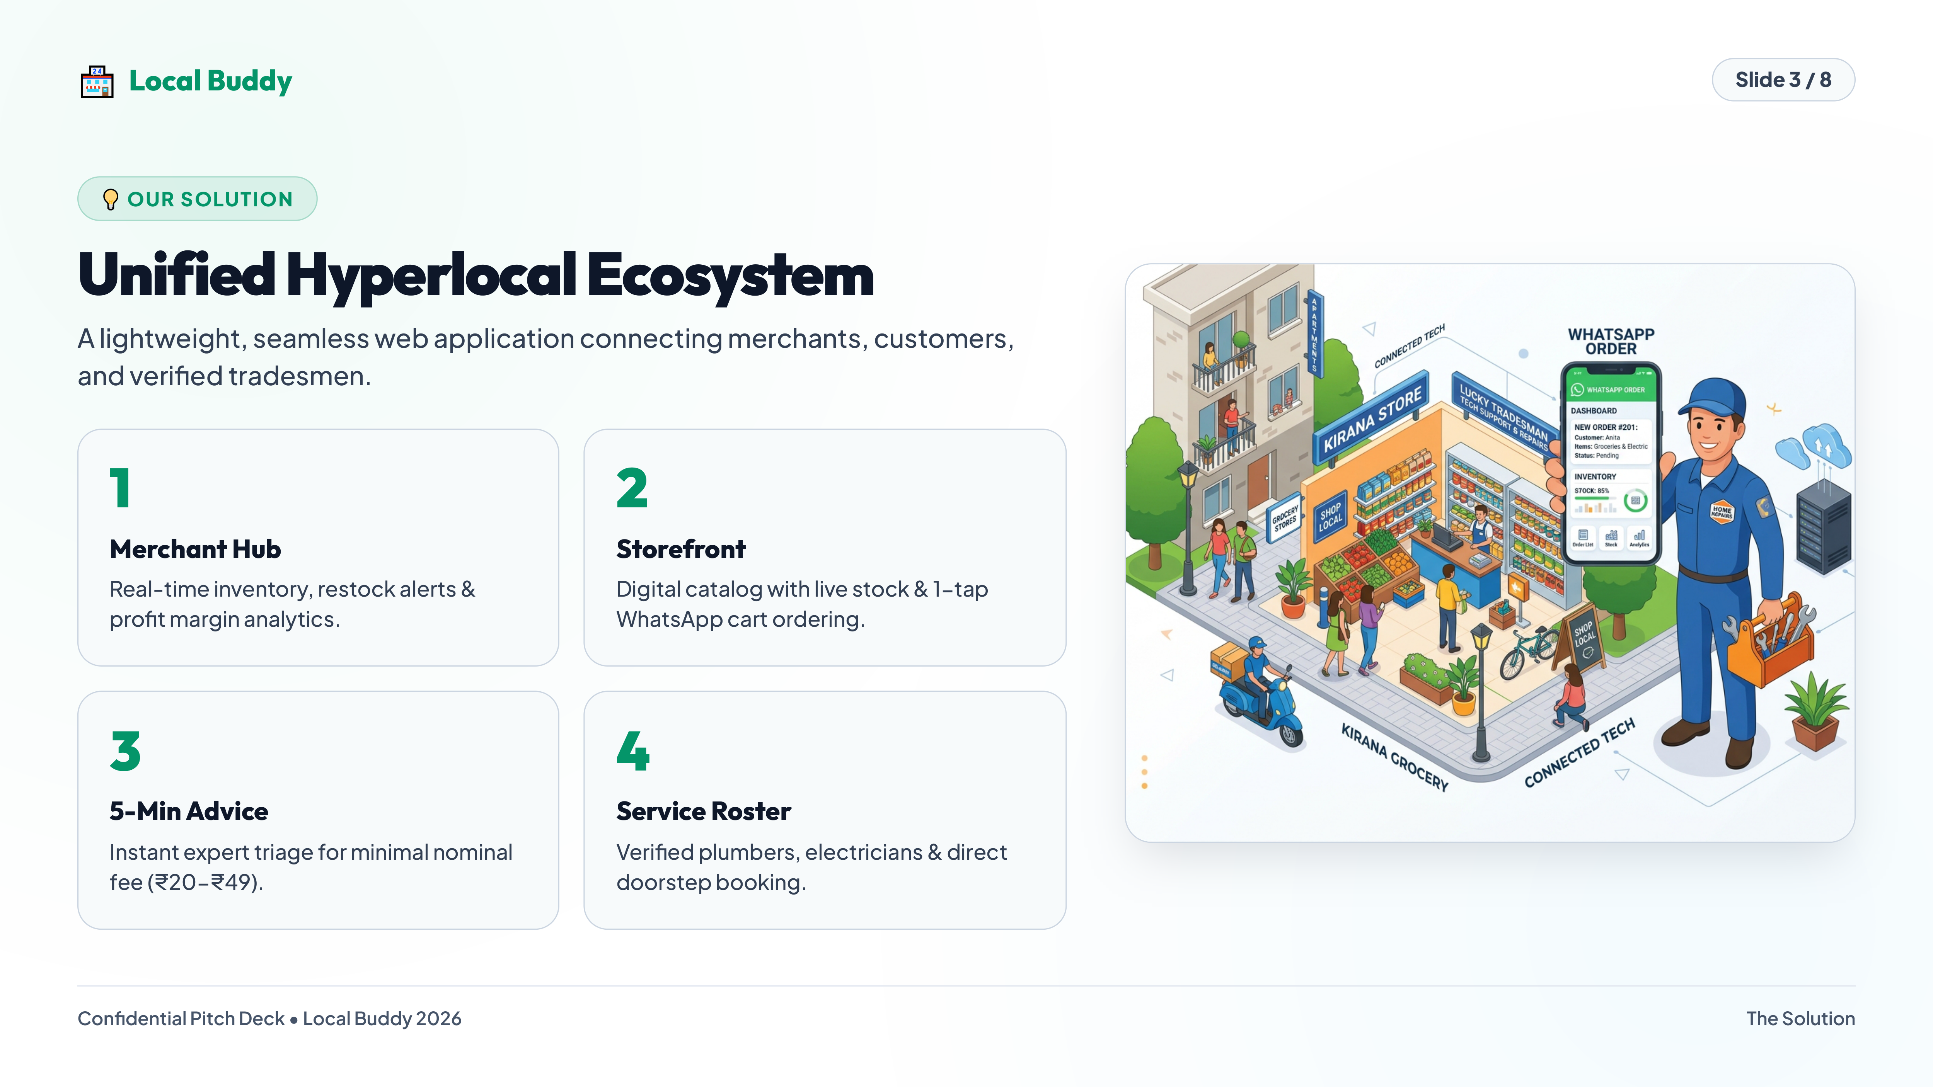
Notes:
🏪Local Buddy
Slide 3 / 8
💡 OUR SOLUTION
Unified Hyperlocal Ecosystem
A lightweight, seamless web application connecting merchants, customers,
and verified tradesmen.
1
Merchant Hub
Real-time inventory, restock alerts &
profit margin analytics.
2
Storefront
Digital catalog with live stock & 1-tap
WhatsApp cart ordering.
3
5-Min Advice
Instant expert triage for minimal nominal
fee (₹20-₹49).
4
Service Roster
Verified plumbers, electricians & direct
doorstep booking.
Confidential Pitch Deck • Local Buddy 2026
The Solution

Slide 4
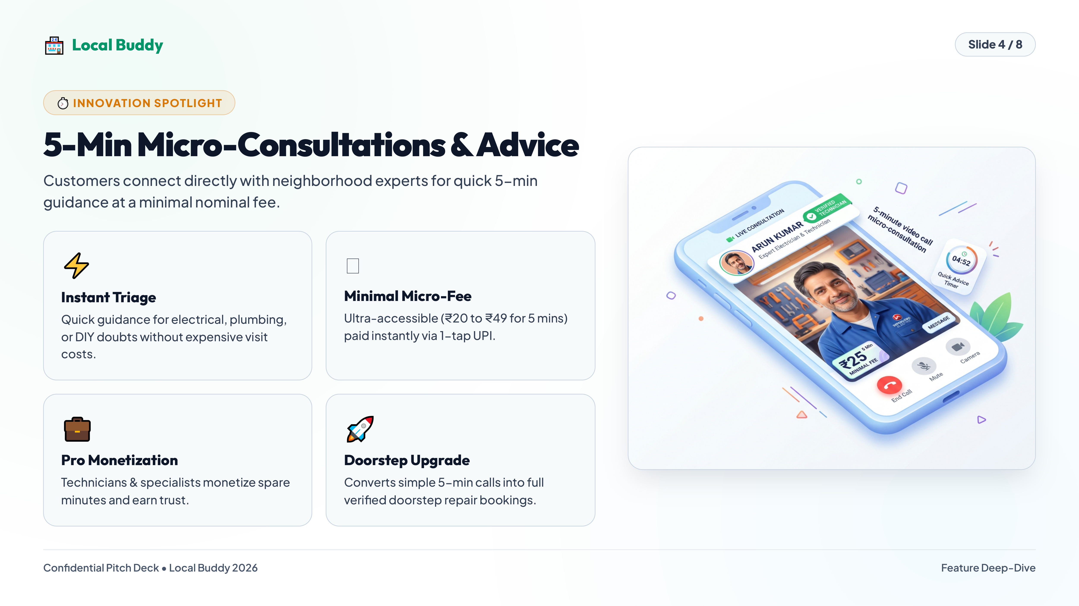
Notes:
🏪Local Buddy
Slide 4 / 8
⏱️ INNOVATION SPOTLIGHT
5-Min Micro-Consultations & Advice
Customers connect directly with neighborhood experts for quick 5-min
guidance at a minimal nominal fee.
⚡
Instant Triage
Quick guidance for electrical, plumbing,
or DIY doubts without expensive visit
costs.
_x0000_Minimal Micro-Fee
Ultra-accessible (₹20 to ₹49 for 5 mins)
paid instantly via 1-tap UPI.
💼
Pro Monetization
Technicians & specialists monetize spare
minutes and earn trust.
🚀
Doorstep Upgrade
Converts simple 5-min calls into full
verified doorstep repair bookings.
Confidential Pitch Deck • Local Buddy 2026
Feature Deep-Dive

Slide 5
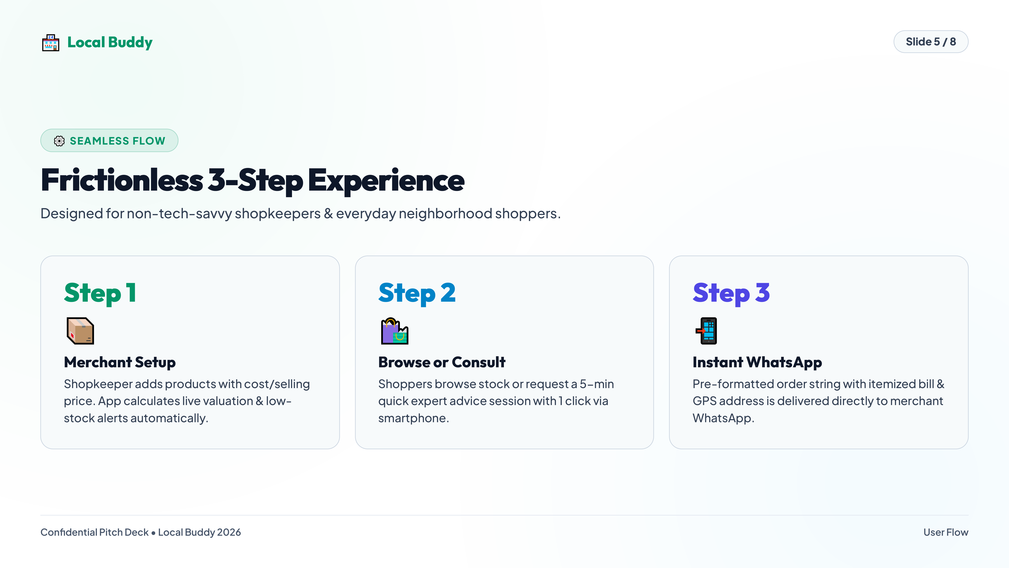
Notes:
🏪Local Buddy
Slide 5 / 8
⚙️ SEAMLESS FLOW
Frictionless 3-Step Experience
Designed for non-tech-savvy shopkeepers & everyday neighborhood shoppers.
Step 1
📦
Merchant Setup
Shopkeeper adds products with cost/selling
price. App calculates live valuation & low-
stock alerts automatically.
Step 2
🛍️
Browse or Consult
Shoppers browse stock or request a 5-min
quick expert advice session with 1 click via
smartphone.
Step 3
📲
Instant WhatsApp
Pre-formatted order string with itemized bill &
GPS address is delivered directly to merchant
WhatsApp.
Confidential Pitch Deck • Local Buddy 2026
User Flow

Slide 6
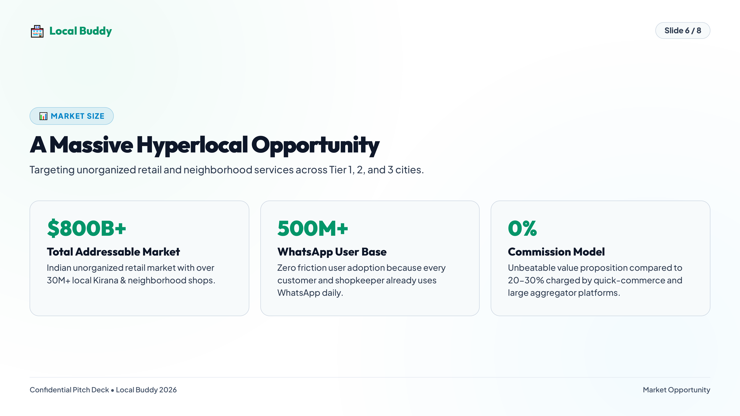
Notes:
🏪Local Buddy
Slide 6 / 8
📊 MARKET SIZE
A Massive Hyperlocal Opportunity
Targeting unorganized retail and neighborhood services across Tier 1, 2, and 3 cities.
$800B+
Total Addressable Market
Indian unorganized retail market with over
30M+ local Kirana & neighborhood shops.
500M+
WhatsApp User Base
Zero friction user adoption because every
customer and shopkeeper already uses
WhatsApp daily.
0%
Commission Model
Unbeatable value proposition compared to
20-30% charged by quick-commerce and
large aggregator platforms.
Confidential Pitch Deck • Local Buddy 2026
Market Opportunity

Slide 7
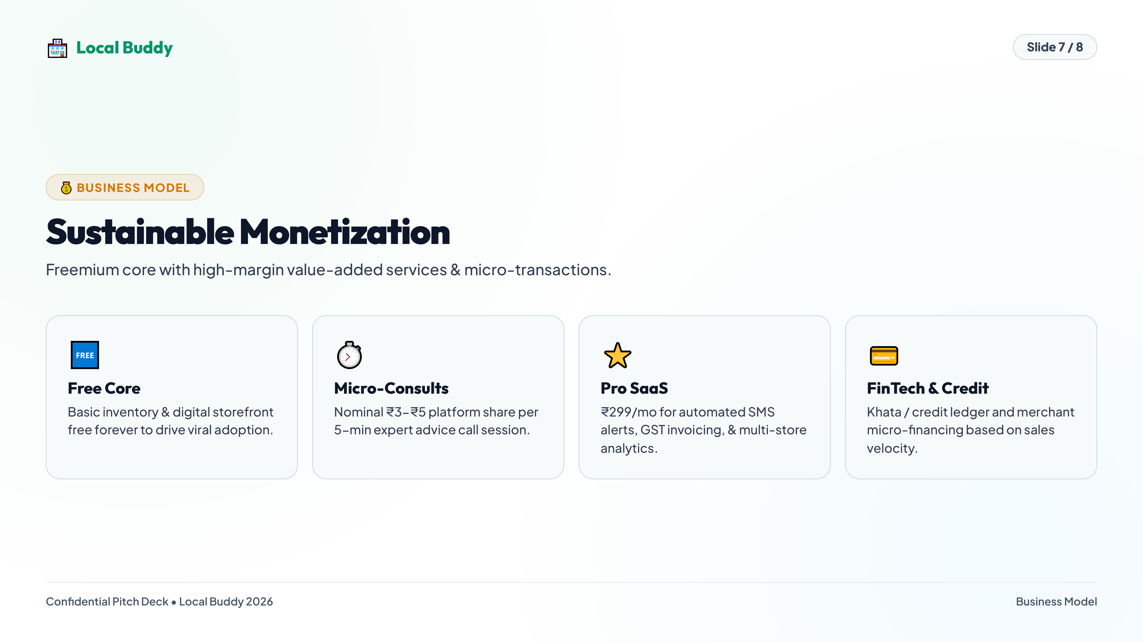
Notes:
🏪Local Buddy
Slide 7 / 8
💰 BUSINESS MODEL
Sustainable Monetization
Freemium core with high-margin value-added services & micro-transactions.
🆓
Free Core
Basic inventory & digital storefront
free forever to drive viral adoption.
⏱️
Micro-Consults
Nominal ₹3-₹5 platform share per
5-min expert advice call session.
⭐
Pro SaaS
₹299/mo for automated SMS
alerts, GST invoicing, & multi-store
analytics.
💳
FinTech & Credit
Khata / credit ledger and merchant
micro-financing based on sales
velocity.
Confidential Pitch Deck • Local Buddy 2026
Business Model

Slide 8
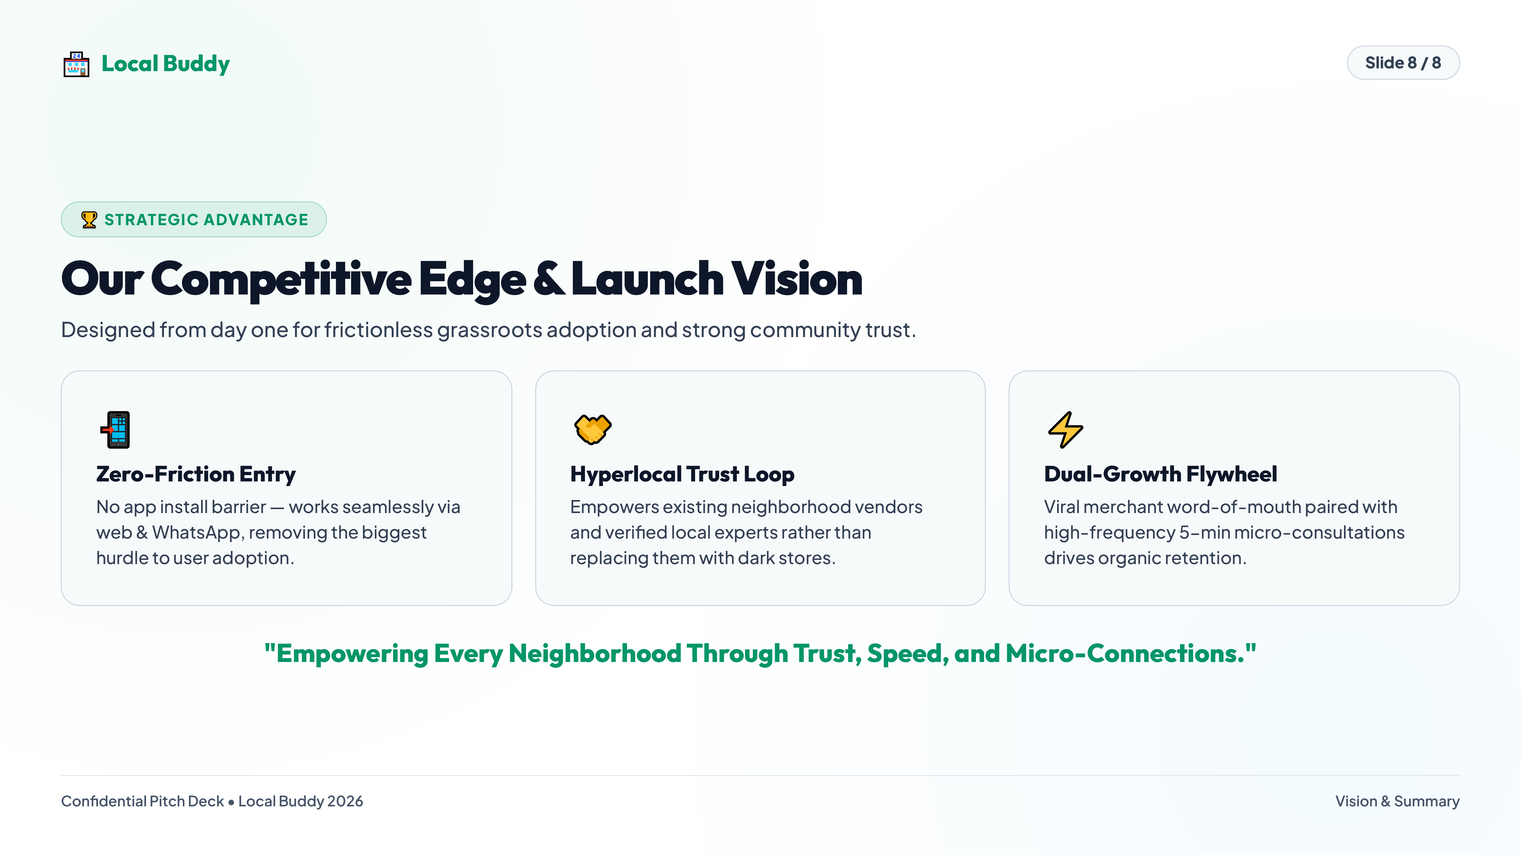
Notes:
🏪Local Buddy
Slide 8 / 8
🏆 STRATEGIC ADVANTAGE
Our Competitive Edge & Launch Vision
Designed from day one for frictionless grassroots adoption and strong community trust.
📲
Zero-Friction Entry
No app install barrier — works seamlessly via
web & WhatsApp, removing the biggest
hurdle to user adoption.
🤝
Hyperlocal Trust Loop
Empowers existing neighborhood vendors
and verified local experts rather than
replacing them with dark stores.
⚡
Dual-Growth Flywheel
Viral merchant word-of-mouth paired with
high-frequency 5-min micro-consultations
drives organic retention.
"Empowering Every Neighborhood Through Trust, Speed, and Micro-Connections."
Confidential Pitch Deck • Local Buddy 2026
Vision & Summary

