Slide 1

B.Tech Project Evaluation - 2
NYAYSETU: AN AI-ASSISTED LEGAL SUGGESTION SYSTEM
Presented by :
Anupam Kumar Singh (2023305089)
Akshay Pratap Singh (2023409091)
Prince Kumar (2023284684)
Under the Supervision of:-
Prof. (Dr.) Velayudham Sathiyasuntharam
Professor, CSE
DEPARTMENT OF COMPUTER SCIENCE & ENGINEERING
SHARDA SCHOOL OF ENGINEERING AND TECHNOLOGY
October 2026
1

Slide 2
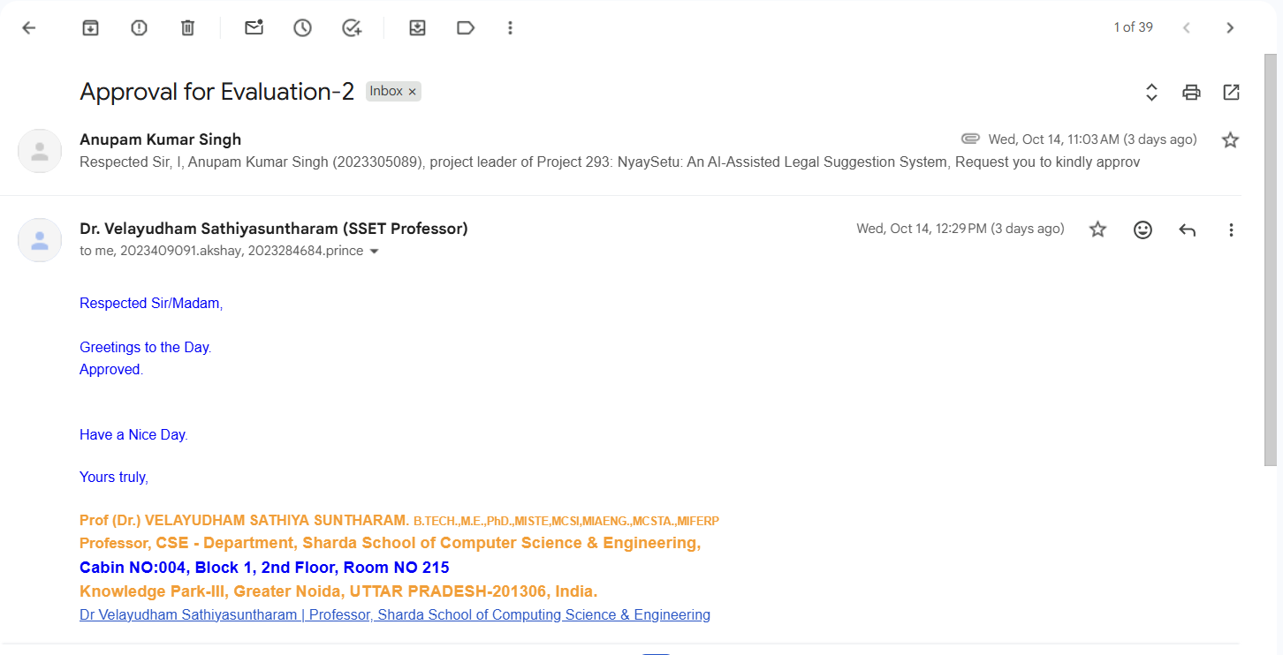
Approval from guide for the evaluation

Slide 3
Contents of the Presentation
Introduction
Project Objectives
Literature Survey
Research Gap
Functional & Non - Functional Requirements
SDLC Model
Proposed System Architecture
UML – Use Case Diagram
Database Design
Design Tool & Technology Stack
Conclusion

Slide 4
Introduction of the project
Access to legal information can be difficult because of limited legal awareness, economic constraints, geographical barriers, and complex legal procedures.
Users often describe their legal problems in ordinary language rather than formal legal terminology.
NyaySetu aims to interpret natural-language legal concerns, identify relevant legal categories, and provide preliminary informational guidance.
The system also aims to facilitate connection with appropriate legal professionals while maintaining clear ethical boundaries and avoiding the presentation of AI output as legal advice.

Slide 5
Project Objectives
To develop an AI-assisted system that can understand users' legal concerns expressed in natural language and identify relevant legal categories.
To provide preliminary and understandable legal-information guidance based on the identified category while maintaining appropriate disclaimers and ethical boundaries.
To facilitate access to legal professionals by connecting users with lawyers according to relevant profiles and specializations.

Slide 6
Literature Survey (1/2)
Paper | Author | Year | Problem Addressed | Method Used | Key Contribution | Limitation
Text Classification: A Survey | Fabrizio Sebastiani | 2002 | Automatic text categorization | Machine learning classification | Established foundations for text classification | Traditional ML limitations
BERT: Pre-training of Deep Bidirectional Transformers | Devlin et al. | 2019 | Language understanding | Transformer-based pretraining | Improved contextual language representation | Computational requirements
Legal-BERT: The Muppets straight out of Law School | Chalkidis et al. | 2020 | Legal-domain language understanding | Domain-specific BERT | Improved legal NLP representation | Domain and data dependency
Speech and Language Processing | Jurafsky & Martin | 2024 | NLP and language processing | Statistical and neural NLP | Comprehensive NLP foundations | Broad scope
Natural Language Toolkit | Bird, Klein & Loper | 2009 | NLP processing | Python NLP tools | Practical NLP processing framework | General-purpose NLP

Slide 7
Literature Survey (2/2)
Paper | Author | Year | Problem Addressed | Method Used | Key Contribution | Limitation
A Survey of Legal Text Classification | Legal NLP researchers | — | Classification of legal documents | ML and NLP techniques | Demonstrates applicability of classification | Domain-specific datasets
Attention Is All You Need | Vaswani et al. | 2017 | Sequence modelling | Transformer architecture | Introduced Transformer architecture | High computational requirements
Word2Vec: Efficient Estimation of Word Representations | Mikolov et al. | 2013 | Word representation | Word embeddings | Distributed semantic representations | Limited contextual understanding
Legal Text Processing and Classification | Various researchers | — | Legal document analysis | NLP and ML | Supports automated legal text analysis | Data quality challenges
Conversational AI Systems | Various researchers | — | Natural-language interaction | Retrieval and generative approaches | Enables conversational assistance | Accuracy and trust concerns

Slide 8
Research Gap
Lack of Integrated Legal Assistance – Existing approaches often focus separately on legal text classification, conversational systems, or lawyer consultation rather than integrating these components into one accessible workflow.
Limited Personalization – General legal-information systems may not sufficiently consider the user's specific concern or relevant legal category.
Accessibility Challenges – Legal information can remain difficult to understand for users without formal legal knowledge.
Ethical and Trust Concerns – AI-assisted legal systems require clear boundaries, privacy considerations, disclaimers, and appropriate human professional involvement.

Slide 9
Functional Requirements
Requirement | Description
User authentication | Register, log in and maintain authenticated sessions
Role-based access | Separate access for CLIENT, LAWYER and ADMIN
Lawyer profile | Maintain lawyer-related profile information
Legal-query submission | Allow users to describe legal concerns
Legal classification | Identify relevant legal categories (Planned)
Informational guidance | Present preliminary information (Planned)
Lawyer referral | Help users find suitable legal professionals (Planned)

Slide 10
Non - Functional Requirements
Requirement | Description
Security | Password hashing, authentication and role-based authorization.
Privacy | Protect sensitive user information.
Usability | Simple, accessible interface.
Maintainability | Modular frontend and backend.
Reliability | Consistent request handling and error management.
Scalability | Support future integration of AI and legal-information components.
Lawyer referral | Help users find suitable legal professionals (Planned)

Slide 11
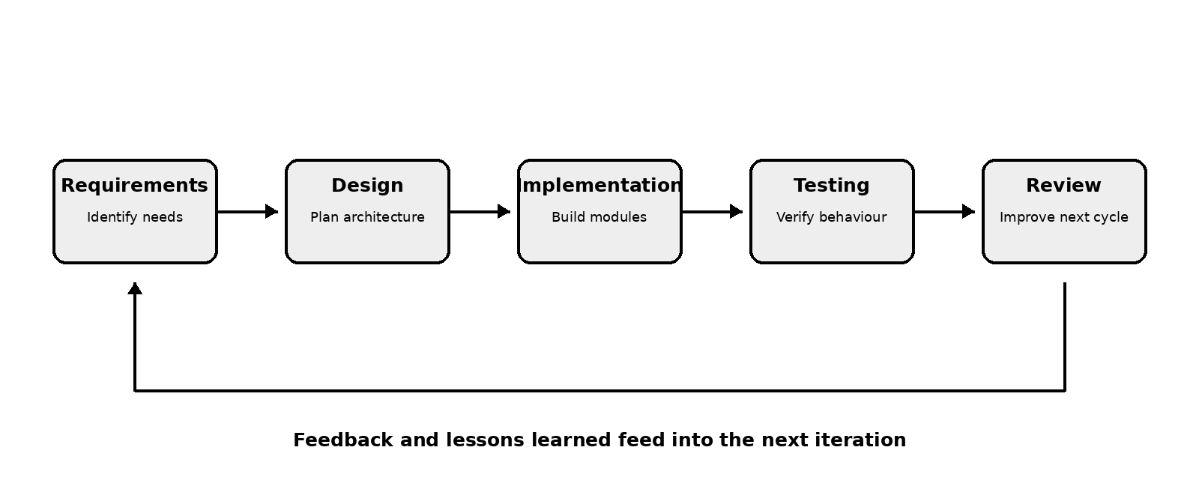
SDLC Model
Iterative and Incremental Development Model:

Slide 12
Proposed System Architecture
Architecture Components
1. Presentation Layer
  Next.js
  TypeScript
  Tailwind CSS
2. Backend Layer
  FastAPI
  REST API endpoints
  Authentication and authorization
  Application logic
3. Database Layer
  PostgreSQL
  SQLAlchemy ORM
  Alembic migrations
  Persistent application data
4. Planned AI Layer
  Natural-language preprocessing
  Legal-query classification
  Knowledge retrieval and grounded responses
  Informational guidance

Slide 13
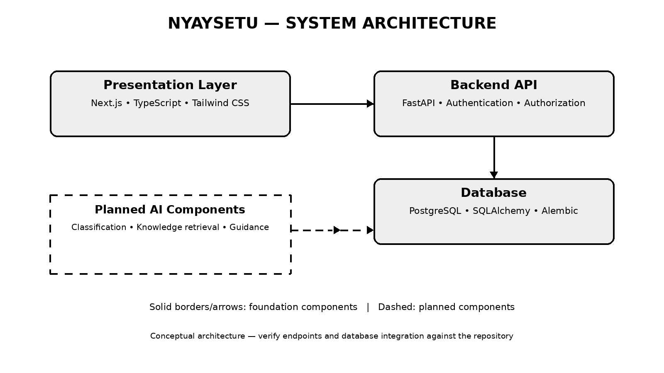
Proposed System Architecture

Slide 14
UML – Use Case Diagram
Actors and Use Cases
CLIENT
  Register and log in
  Access client dashboard
  Submit legal concerns (Planned)
  View informational guidance (Planned)
  Find relevant lawyers (Planned)
LAWYER
  Log in
  Access lawyer dashboard
  Manage profile information
  Manage availability (Planned)
  Respond to consultation requests (Planned)
ADMIN
  Access administrative functions
  Manage users and verification (Planned unless implemented)

Slide 15
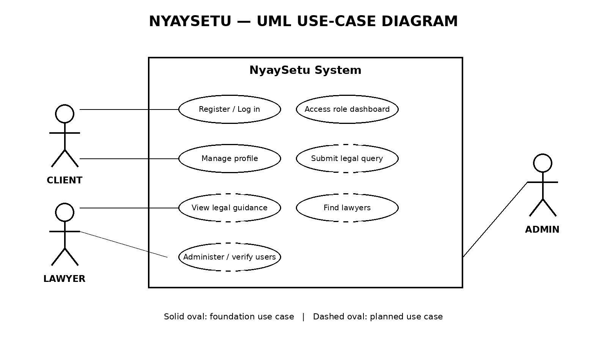
UML – Use Case Diagram

Slide 16
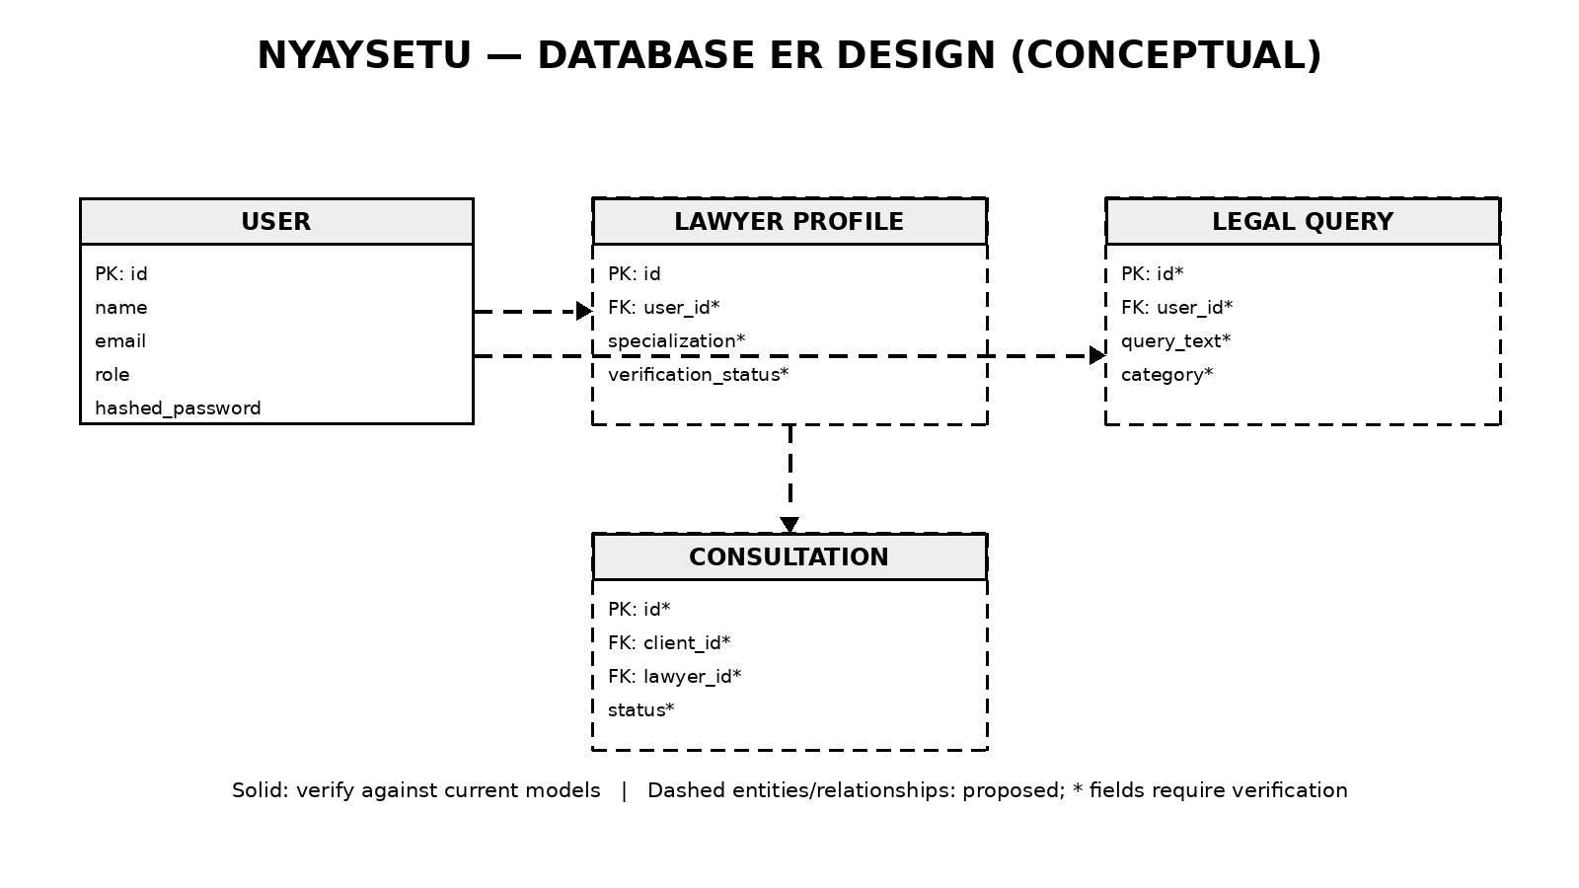
Database Design (ER Diagram)

Slide 17
Design Tools and Technology Stack
Layer | Technology | Purpose
Frontend | Next.js, TypeScript | User interface and application routing
Styling | Tailwind CSS | Consistent interface styling
Backend | FastAPI, Python | API and business logic
Database | PostgreSQL | Persistent data storage
ORM | SQLAlchemy | Database interaction
Migrations | Alembic | Database schema changes
Authentication | JWT and refresh tokens | Session and access management
Version control | Git and GitHub | Source control and collaboration
Diagramming | draw.io or equivalent | Architecture and UML diagrams

Slide 18
Team Members & Responsibilities
Member | Responsibility
Anupam Kumar Singh | AI/NLP research, system architecture, backend and AI-assisted legal-information workflow
Akshay Pratap Singh | Frontend development, authentication, user interface and lawyer-side functionality
Prince Kumar | Database design, testing, documentation and system integration

Slide 19
Conclusion
NyaySetu aims to improve access to preliminary legal information.
Its technical foundation combines a web frontend, backend API, database and authentication.
The design separates verified existing functionality from planned AI-assisted capabilities.
Privacy, usability and clear legal-information boundaries remain key design priorities.
NyaySetu is intended to support access to legal information, not replace qualified legal advice.
THANK YOU

