Slide 1
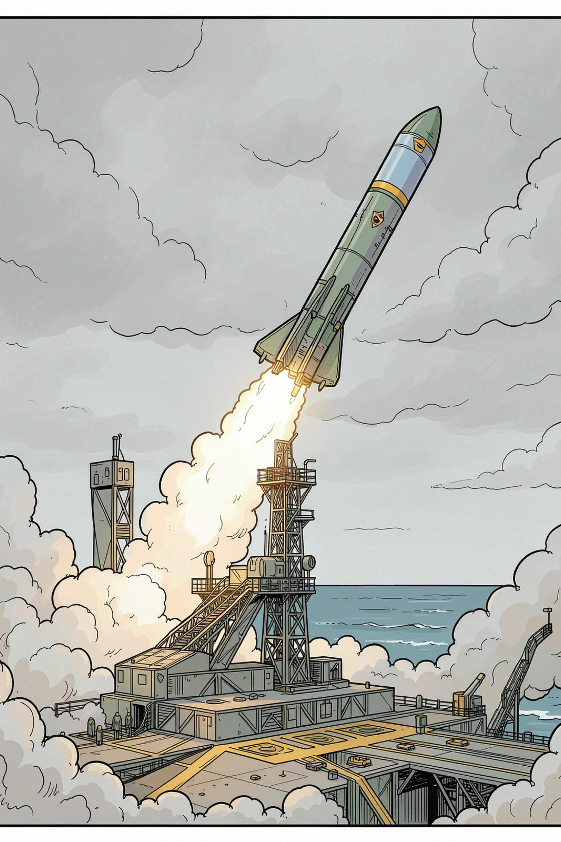
Aerodynamic and Aero‑Thermal Characterisation of the Agni Missile Series
A CFD‑Based Case Study of Hypersonic Flight and Re‑Entry
Student: Rahul Kumar · Roll No: BTE/2023/045
Department of Aerospace Engineering · Indian Institute of Technology (Example)
Guided by: Prof. S. R. Iyer
Academic Year: 2025–26

Slide 2





Aim & Objectives
Primary Aim
Investigate aerodynamic and aero‑thermal characteristics of the Agni family using CFD.
Aerodynamic Analysis
Analyse factors influencing flight performance, drag, and stability at hypersonic speeds.
CFD Application
Demonstrate CFD workflows for pressure, Mach and force prediction used in the programme.
Re‑entry Challenges
Study aerodynamic heating, heat‑flux prediction and thermal‑protection strategies.
Materials & Protection
Examine documented thermal‑protection technologies and carbon‑composite usage.

Slide 3
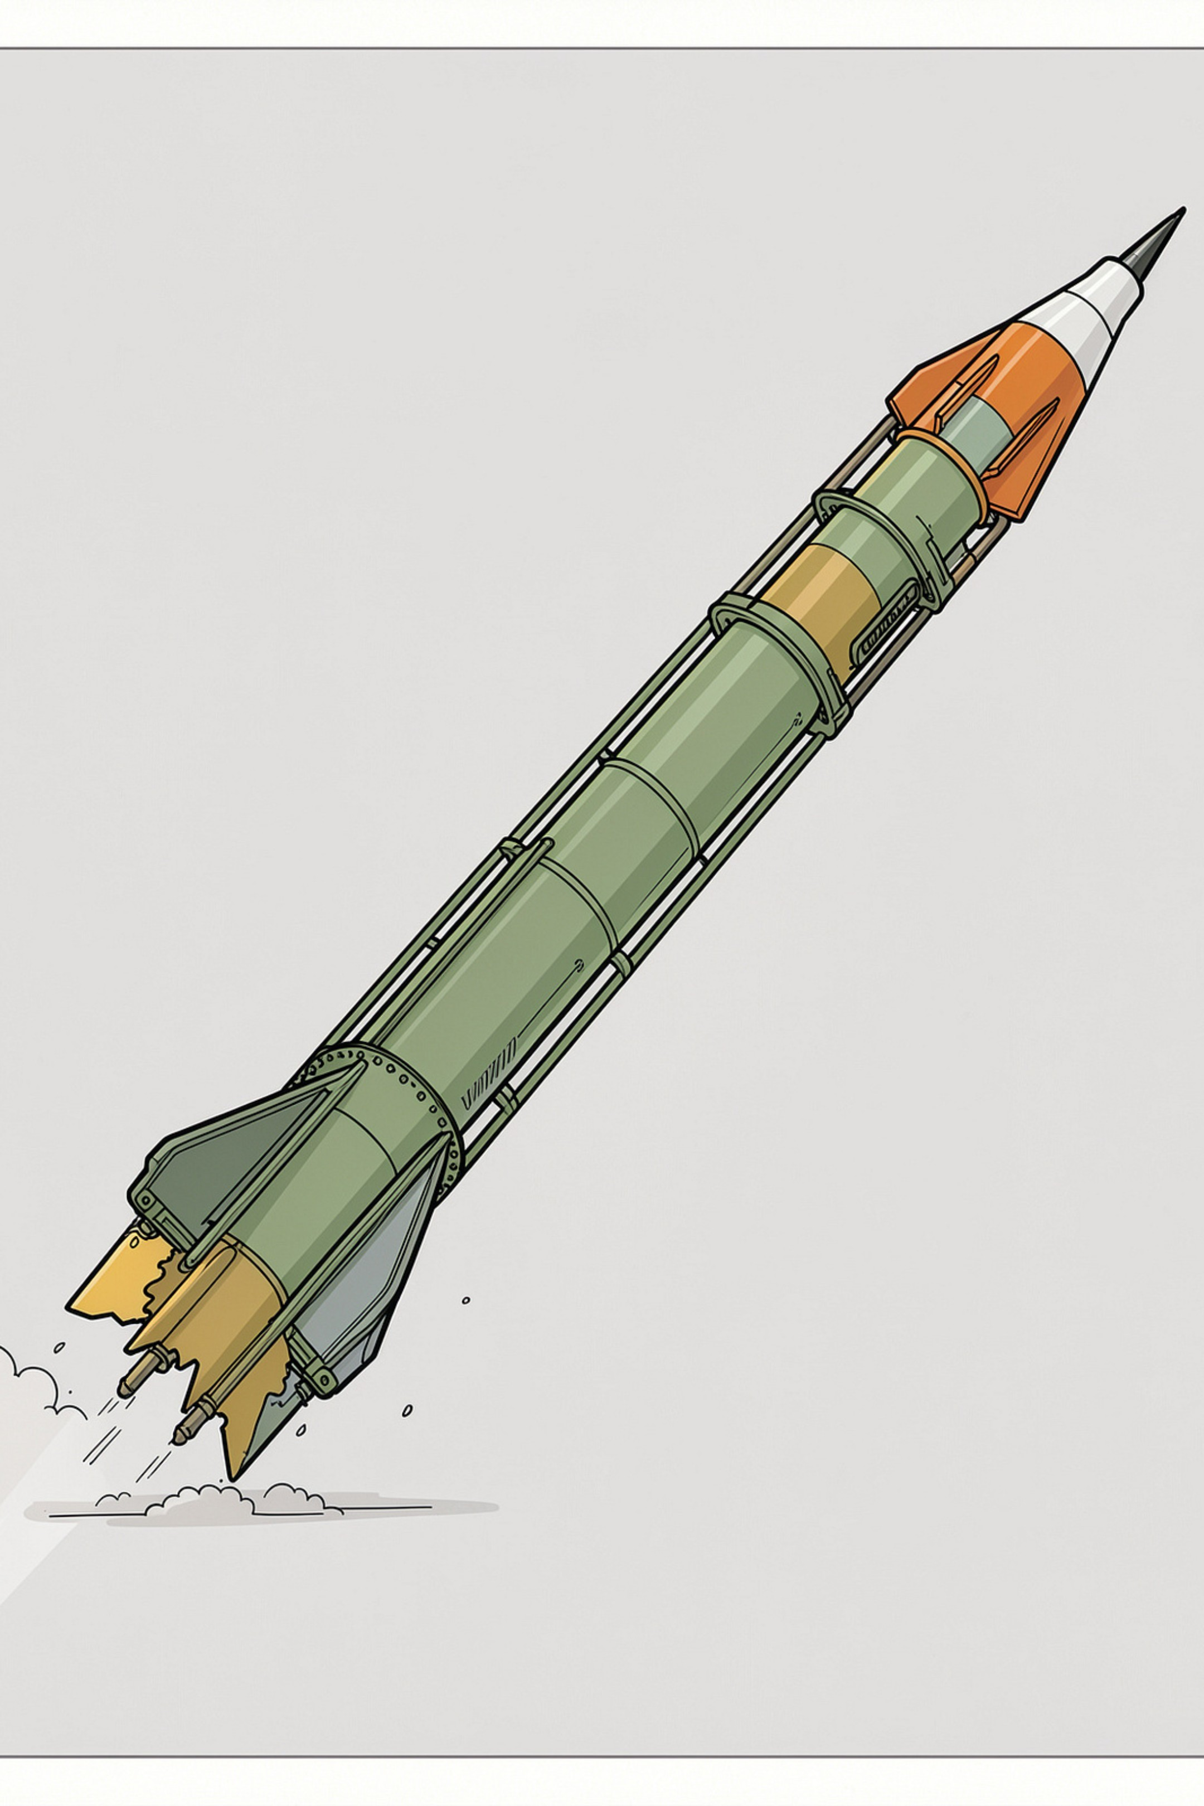
Introduction to the Agni Missile Series
- Indigenous strategic missile programme developed by DRDO.
- Aerodynamic design is central to high‑speed flight, trajectory accuracy and re‑entry survivability.
- Key design considerations: drag reduction, static & dynamic stability, trajectory control, aerodynamic heating, and structural/payload protection.
- Agni‑Prime: advanced generation emphasising light weight, canisterisation and mobility.

Slide 4
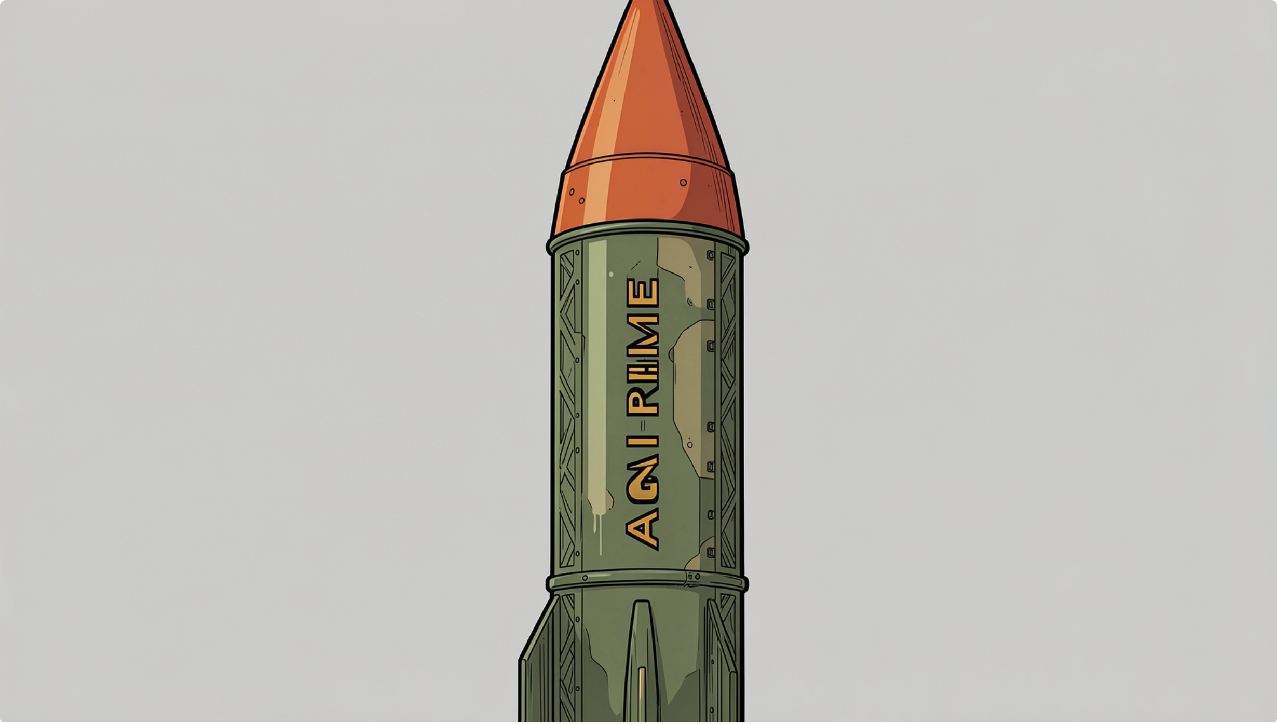
Agni‑Prime — Next Generation Ballistic Missile
- Publicly documented: intermediate‑range ballistic missile (IRBM).
- Range: up to approximately 2,000 km.
- Canisterised configuration; lightweight composite structure.
- Road‑mobile and rail‑mobile launch capability for rapid deployment.
- Designed for operational mobility and reduced launch preparation time.
Note: “The Road Mobile Agni‑P has already been inducted into service after successful flight trials.”

Slide 5
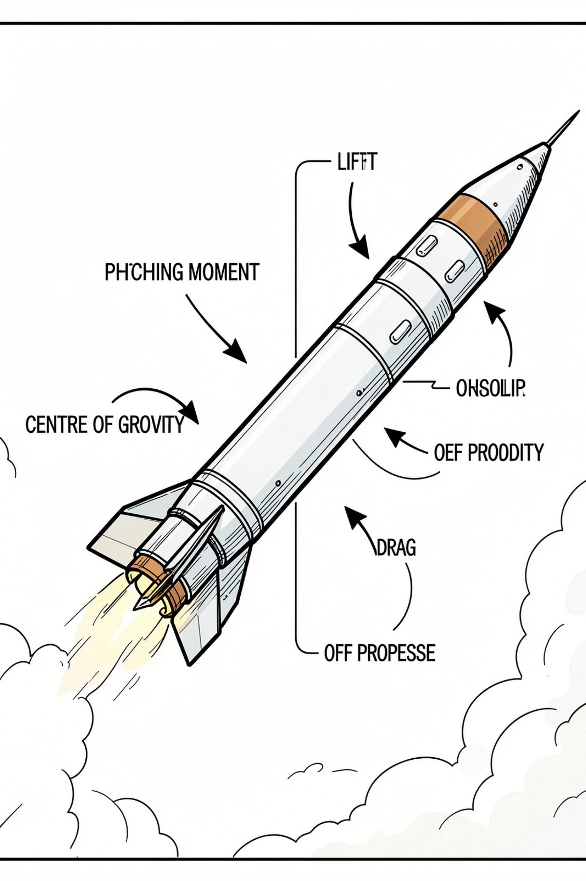
Fundamentals of Missile Aerodynamics
- Lift: force perpendicular to flight direction; small but may arise from body/lifting surfaces.
- Drag: retarding force opposing motion; increases strongly with dynamic pressure and wetted area.
- Pitching moment: causes rotation about lateral axis; depends on CP relative to CG.
- Aerodynamic forces depend on air density, velocity, reference area and aerodynamic coefficients (CD, CL, Cm).
- Stability relationship: CG → CP separation governs static stability and trim characteristics.

Slide 6
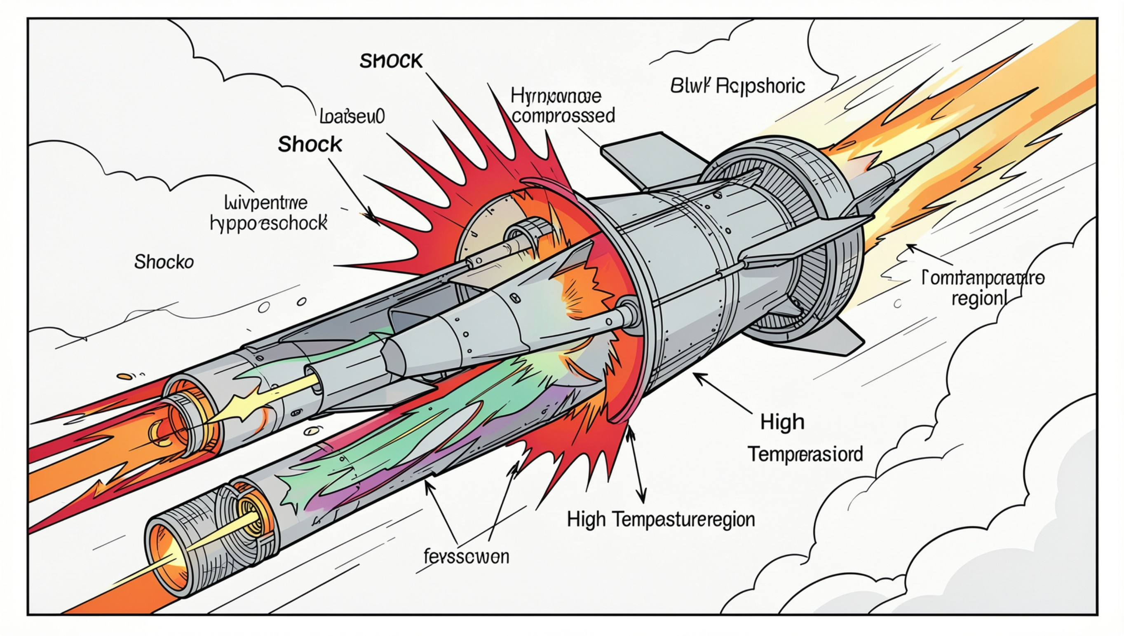
Hypersonic Flow and Shock‑Wave Effects
- At high Mach numbers (hypersonic regime) air becomes highly compressible.
- Strong bow shock forms upstream, causing abrupt rises in pressure, temperature and density.
- Shock interactions modify surface loading and can induce flow separation.
- Nose and forward regions experience concentrated compression and aerodynamic heating.
- Design implication: shock‑induced loads and heating must be captured in CFD and structural design loops.

Slide 7
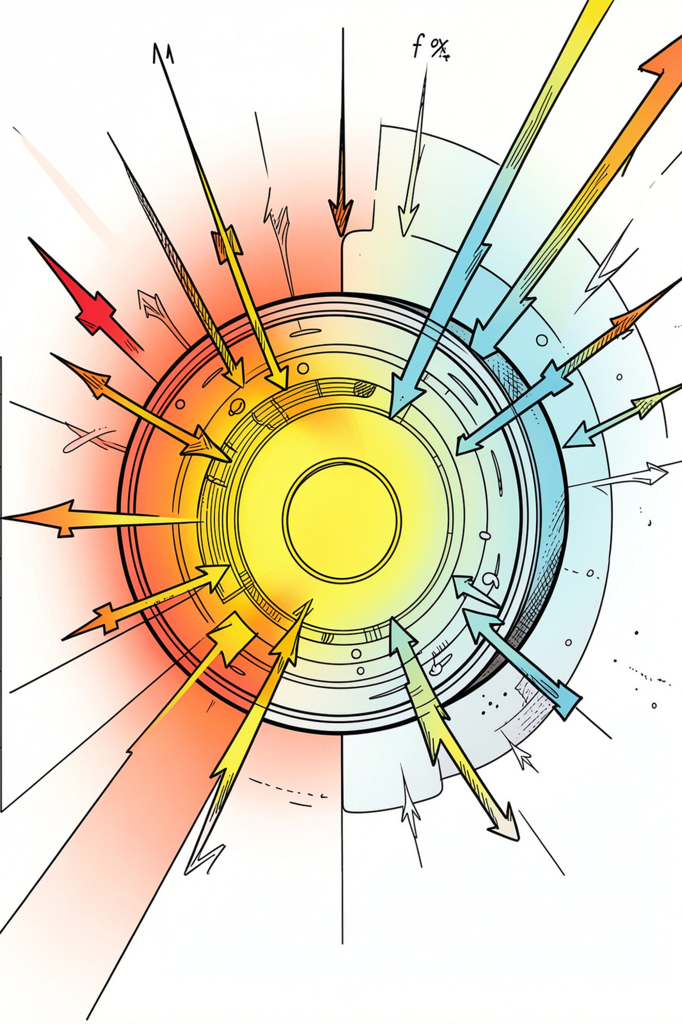
The Re‑Entry Challenge
Hypersonic Velocity → Shock Compression → Temperature Rise → Heat Flux → Thermal Stress → Structural Protection
- Re‑entry couples aerodynamic stability, drag management, and extreme thermal loads.
- Documented case‑study notes report severe re‑entry environments with temperatures of approximately 3000°C in peak regions (reported figure from supplied material).
- Engineering focus: accurate heat‑flux prediction, transition modelling (laminar → turbulent), and thermal‑protection qualification.

Slide 8
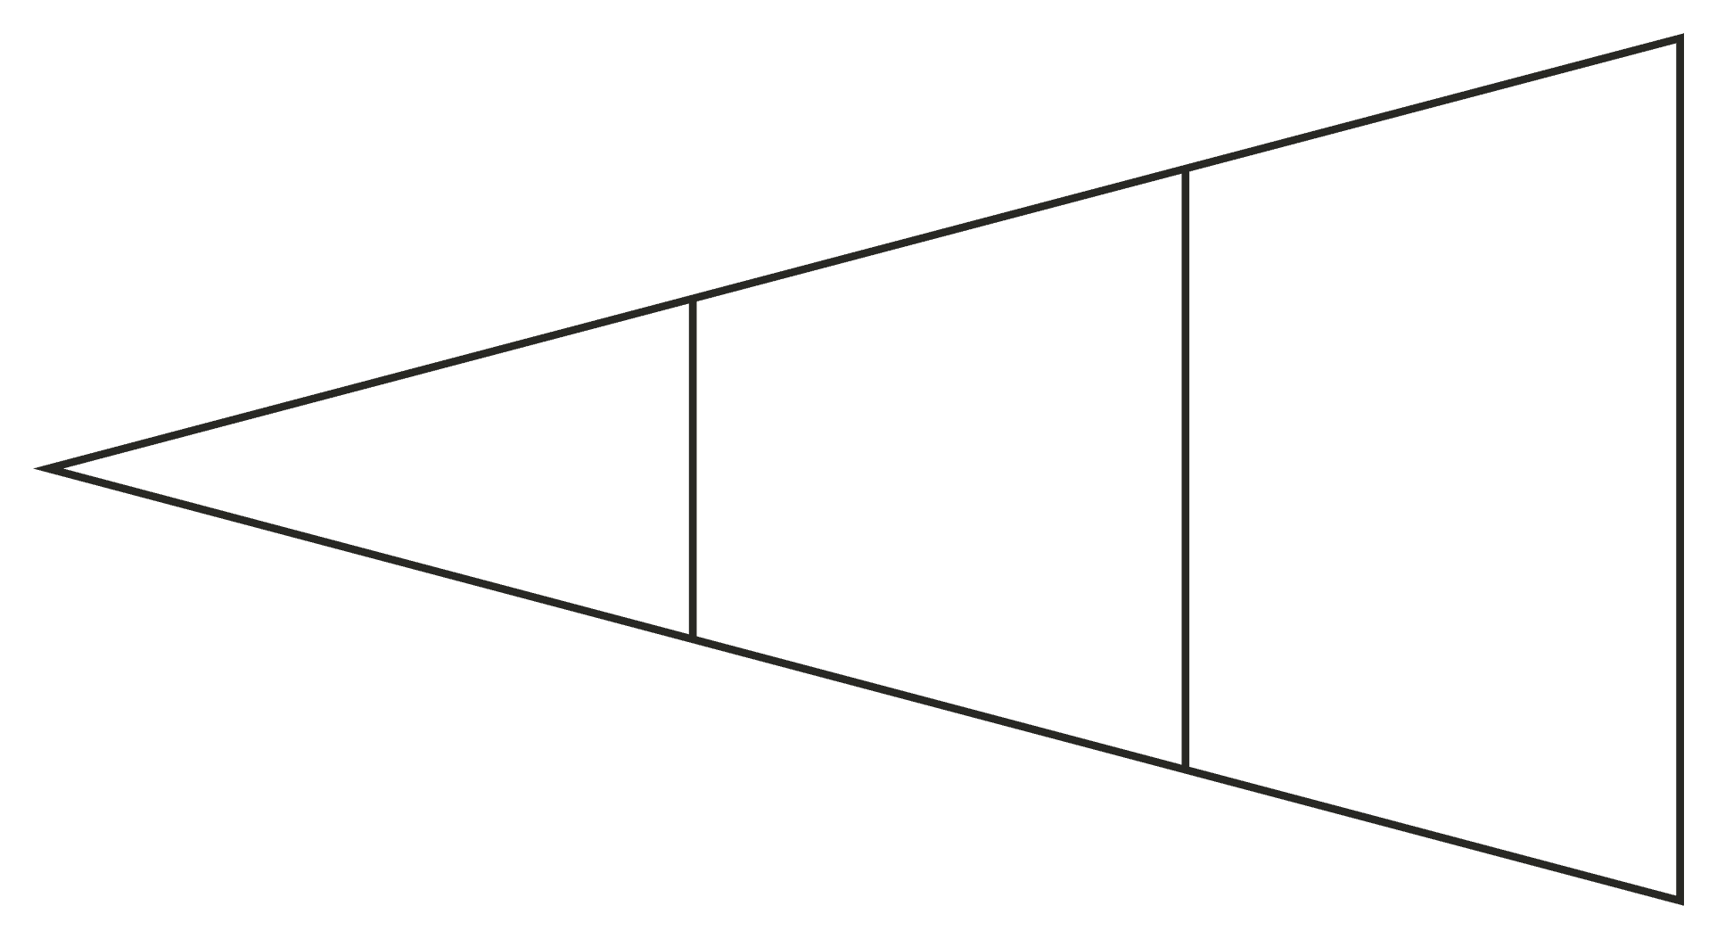
Computational Fluid Dynamics (CFD)
- Documented statement: “Computational Fluid Dynamics was used to obtain aerodynamic design data for India’s Agni Missile programme.”
- CFD applications: flow‑field visualisation, pressure and Mach distributions, aerodynamic forces & moments, high‑angle‑of‑attack studies, control‑surface aerodynamics, and aeroelastic assessment.
- Notable contributors: DRDL and IISc CFD research groups participated in computational efforts documented in supplied material.
Missile Geometry
Flow Simulation
CFD Model

Slide 9
CFD Methods Used for Aerodynamic Analysis
Table summarising the documented computational approaches and purposes.
CFD Method
Purpose
3‑D Euler
High‑speed inviscid flow analysis; shock capture and initial pressure loading.
Navier–Stokes / RANS
Viscous flow, boundary‑layer prediction, aerodynamic characterisation and force estimation.
Mach Distribution
Assess local supersonic/hypersonic regions and shock locations over body surfaces.
Pressure Distribution
Surface loading maps for structural design and moment calculations.
Forces & Moments
Performance and stability analysis across flight envelopes.
- Documented computational systems: KFSG (upwind finite‑volume Euler solver) and CERANS (3‑D RANS solver).

Slide 10
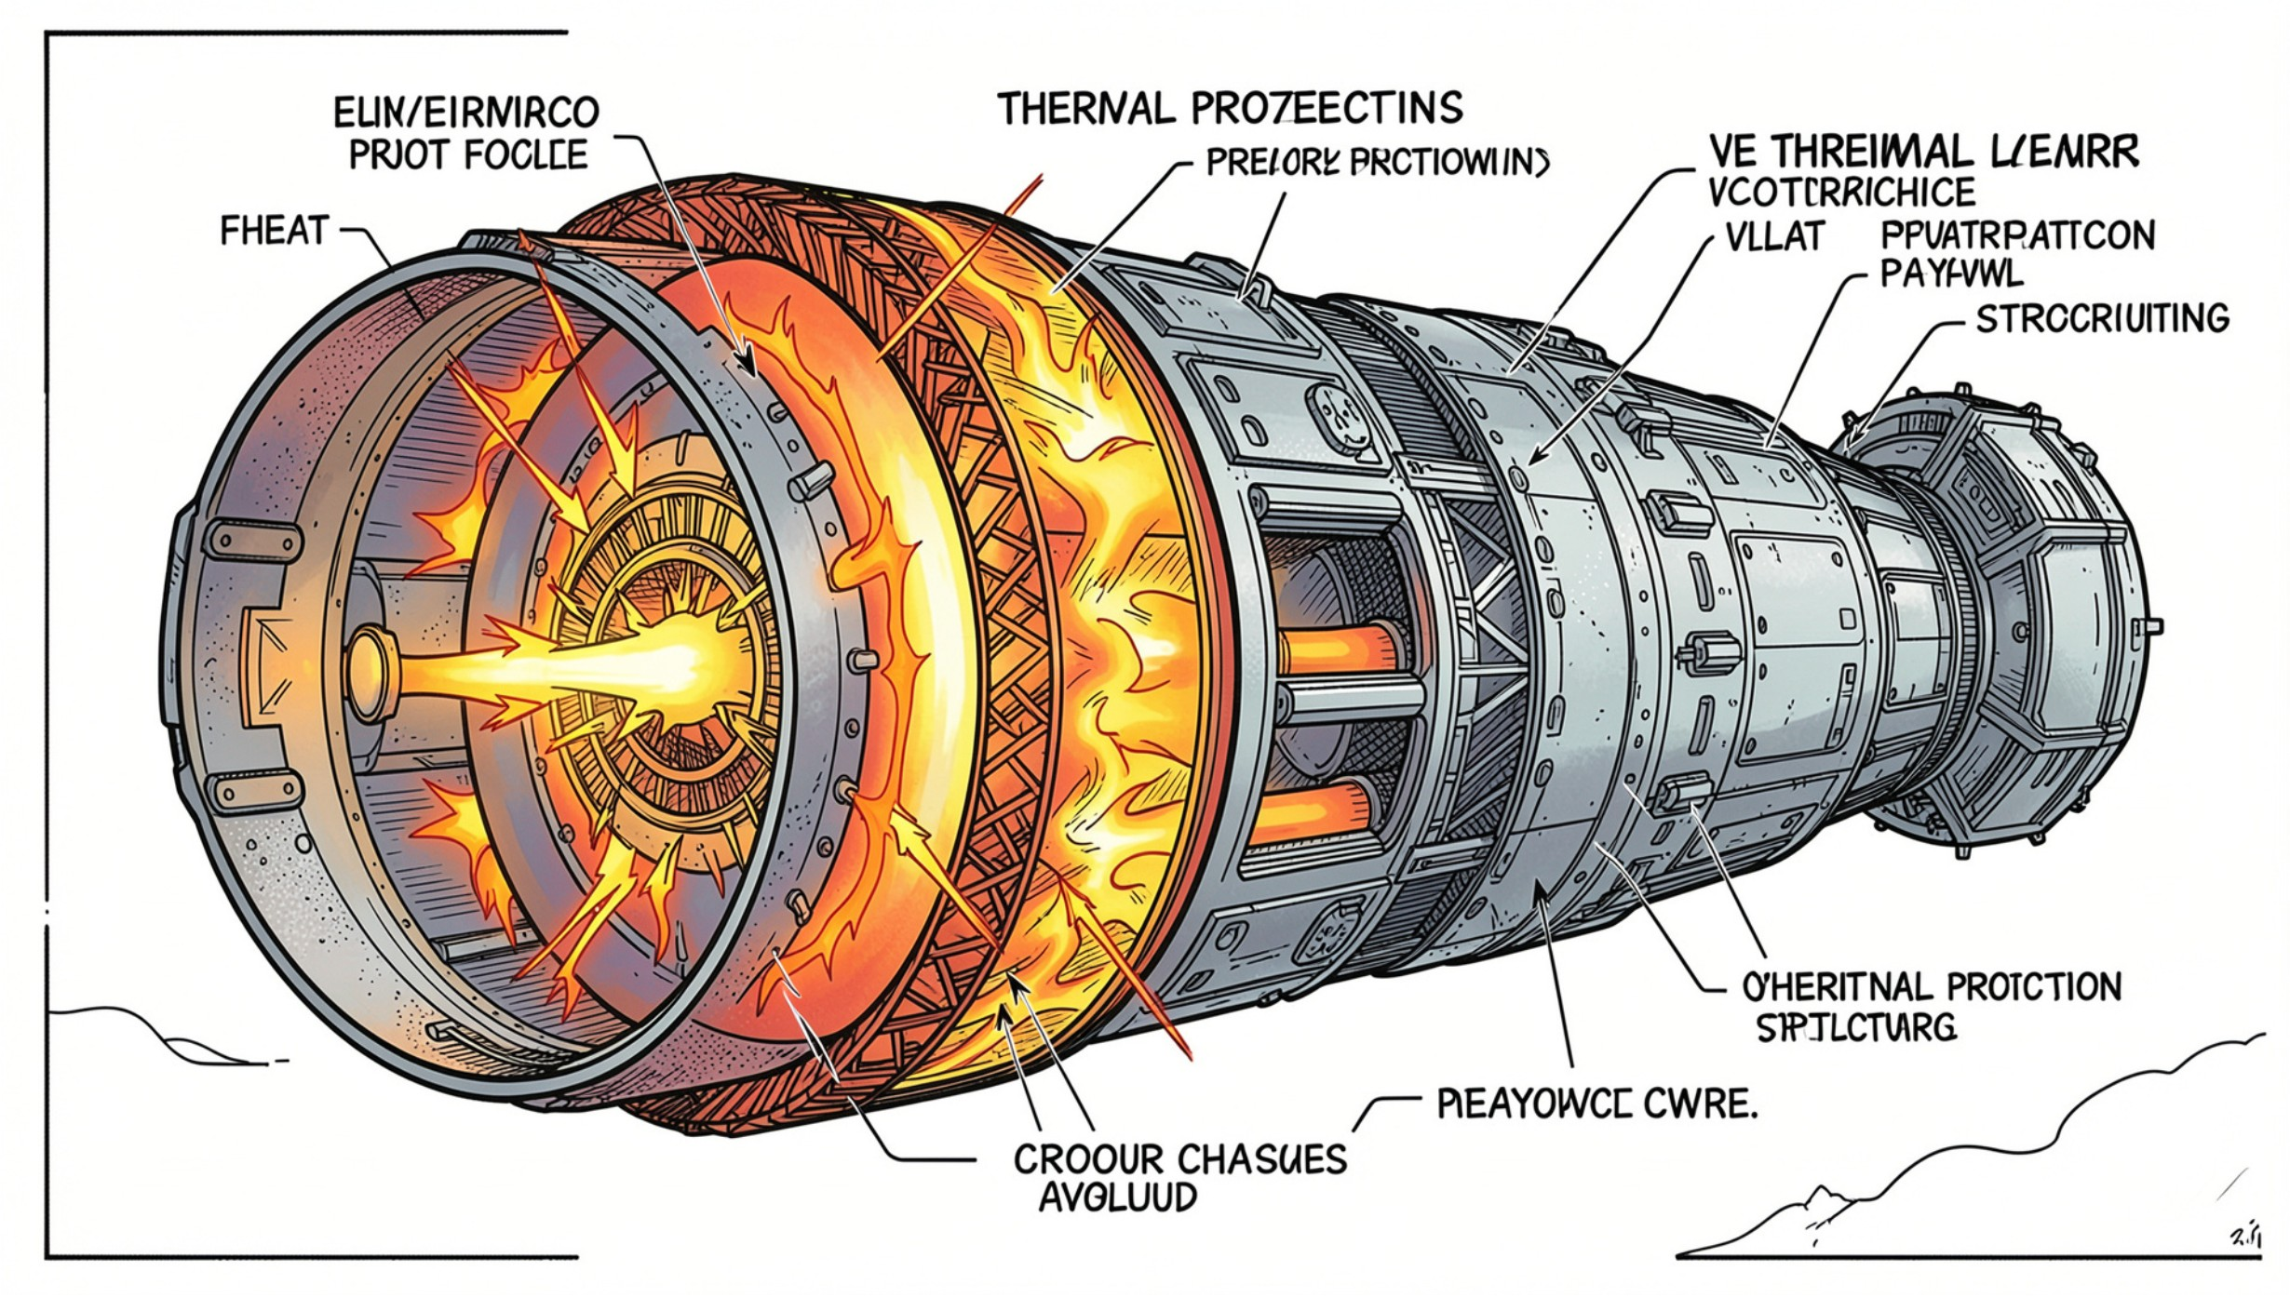
Aero‑Thermal Protection
- Engineering chain: Aerodynamic compression → Heating → Heat‑flux → Material response → Structural integrity.
- Key points:
Severe aerodynamic heating during peak re‑entry phases.
Laminar→turbulent transition strongly affects heat‑flux estimates.
Development and qualification of thermal‑protection systems are essential.
Documented materials: carbon‑composite re‑entry structures (Agni‑III) and external thermal protection for Agni‑IV composite motor casing.

