Slide 1
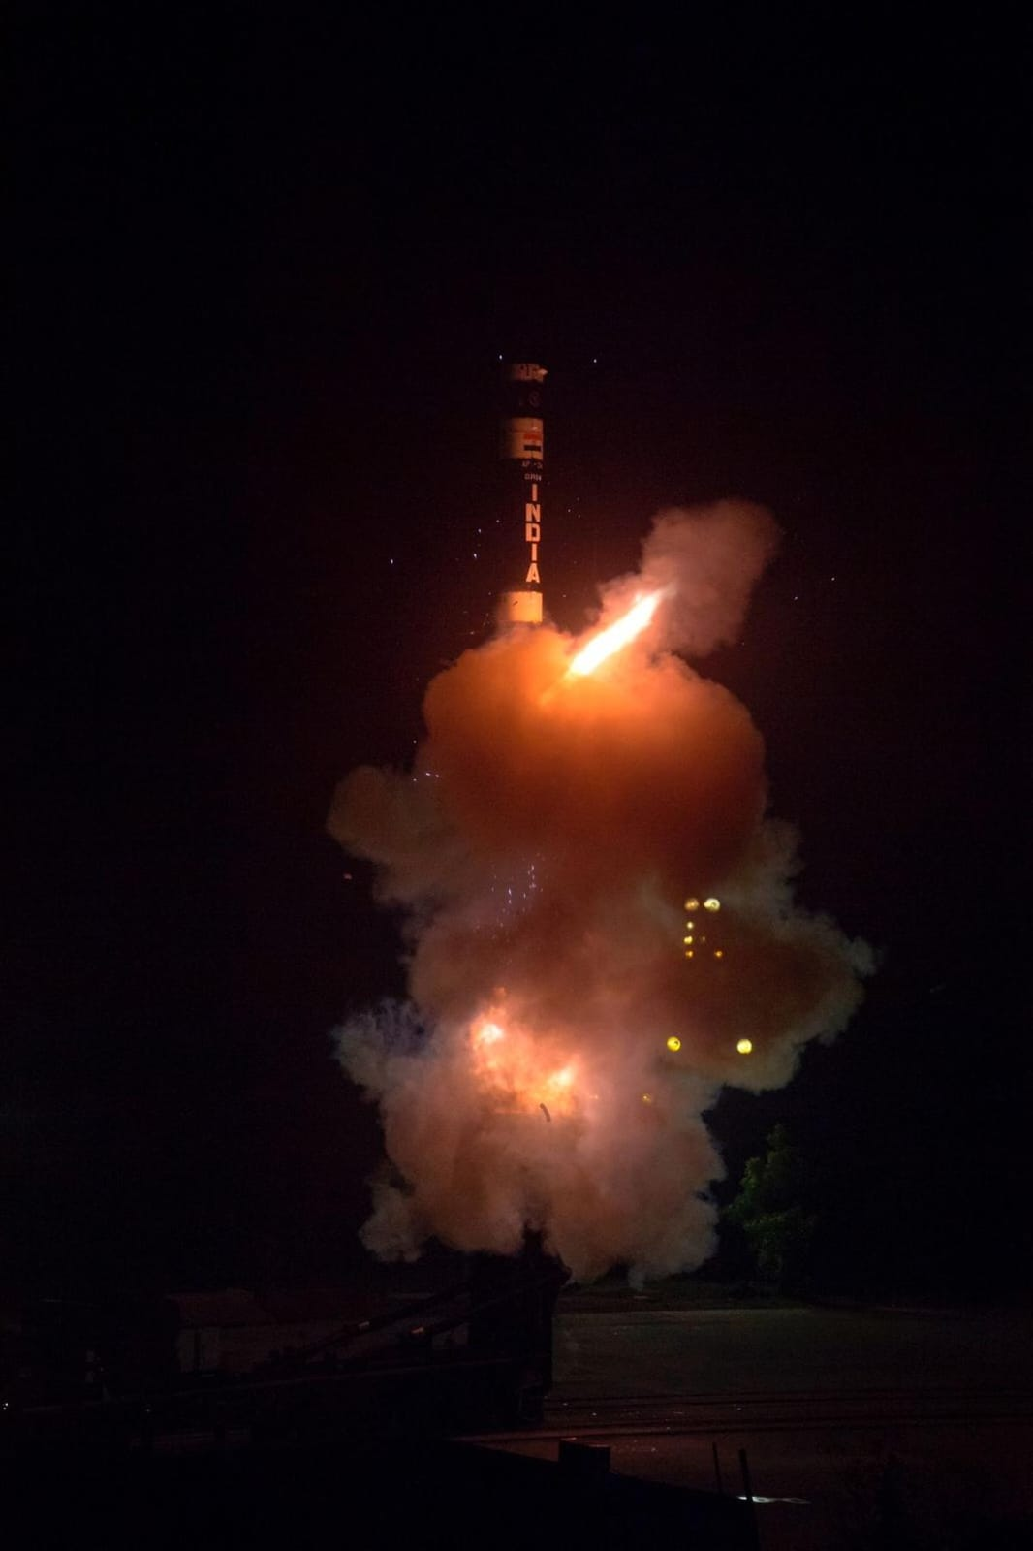
B.TECH ENGINEERING PROJECT PRESENTATION
Aerodynamic and Aero-Thermal
Characterisation of the Agni
Missile Series
A CFD-Based Case Study of Hypersonic Flight and Re-Entry
Presented by
Saloni Kumari & Khushi Singh
Roll Numbers
[Roll Number] & [Roll Number]
Department
[Department Name]
College / University
[College / University Name]
Guided By
[Guide's Name & Designation]
Academic Year
[Academic Year]
Agni-Prime flight test, Dr. A.P.J. Abdul Kalam Island, Odisha · Photo: PIB

Slide 2
SECTION 01
Aim & Objectives
This study investigates the aerodynamic and aero-thermal behaviour of the Agni missile series using documented CFD-based design practice.
1
2
3
4
5
Aerodynamic Design
Flight Stability
CFD Applications
Re-Entry Challenges
Aero-Thermal Effects
Investigate design principles of the Agni missile series
Analyse factors influencing performance and stability
Understand CFD in high-speed flow analysis
Study aerodynamic challenges during re-entry
Examine thermal effects and protection strategies
Aerodynamic & Aero-Thermal Characterisation of the Agni Missile Series
02

Slide 3
SECTION 02
Introduction to the Agni Missile Series
Agni is an indigenous strategic missile programme developed by DRDO
Aerodynamic design is central to high-speed flight and re-entry performance
Key design considerations govern every stage of the flight envelope:
Exo-atmosphere
Drag Reduction
Static & Dynamic Stability
Upper Atmosphere
Accurate Trajectory
Aerodynamic Heating
Structural & Payload Protection
Lower Atmosphere
Agni-Prime is introduced as an advanced, next-generation member of the Agni family.
Launch → Trajectory → Re-Entry
Aerodynamic & Aero-Thermal Characterisation of the Agni Missile Series
03

Slide 4
SECTION 02
Agni-Prime — Next-Generation Ballistic Missile
CATEGORY
RANGE
Intermediate-range ballistic missile
Up to approximately 2,000 km
LAUNCH SYSTEM
STRUCTURE
Canisterised design
Lightweight composite structure
MOBILITY
DEPLOYMENT
Road-mobile and rail-mobile launch capability
Designed for rapid deployment and mobility
“The Road Mobile Agni-P has already been inducted into service after successful flight trials.”
Aerodynamic & Aero-Thermal Characterisation of the Agni Missile Series
04

Slide 5
SECTION 03
Aerodynamic Forces During Flight
LIFT
DRAG
FLIGHT DIRECTION
CG
CP
CG → CP relative position governs static stability
Drag acts opposite to the direction of motion
Lift acts perpendicular to the flight direction
Aerodynamic forces depend on air density, velocity, reference area and aerodynamic coefficients
Aerodynamic & Aero-Thermal Characterisation of the Agni Missile Series
05

Slide 6
SECTION 03
Hypersonic Flow and Shock-Wave Effects
Bow Shock
At high Mach numbers, airflow becomes highly compressible
A strong bow shock develops around the vehicle
Shock waves cause rapid changes in pressure, temperature and density
The nose region experiences strong compression and aerodynamic heating
Hypersonic Flow
Low Temperature
High Temperature
Aerodynamic & Aero-Thermal Characterisation of the Agni Missile Series
06

Slide 7
SECTION 04
The Re-Entry Challenge
Hypersonic
Velocity
Shock
Compression
Temperature
Rise
Heat
Flux
Thermal
Stress
Structural
Protection
Re-entry demands simultaneous management of aerodynamic and thermal-structural requirements:
Hypersonic aerodynamic stability
Drag and controlled trajectory
High-temperature structural survival
Payload protection
Thermal protection systems
Reported re-entry temperatures of approximately 3000°C are documented in publicly available case-study material for high-speed re-entry vehicles.
This is presented as a documented / publicly reported figure, not an exact universal surface temperature.
Aerodynamic & Aero-Thermal Characterisation of the Agni Missile Series
07

Slide 8
SECTION 05
Computational Fluid Dynamics (CFD)
“Computational Fluid Dynamics was used to obtain aerodynamic design data for India’s Agni Missile programme.”
CFD is applied to study:
• Flow fields
• Pressure distributions
• Mach-number distributions
• Aerodynamic forces & moments
• High-angle-of-attack flow
• Control-surface aerodynamics
• High-speed flow
• Aeroelastic effects
Documented CFD research involvement: DRDL and IISc.
CFD Design Data Pipeline
Missile
Geometry
CFD
Model
Flow
Simulation
Pressure / Mach /
Force Data
Aerodynamic
Design
Aerodynamic & Aero-Thermal Characterisation of the Agni Missile Series
08

Slide 9
SECTION 05
CFD Methods Used for Aerodynamic Analysis
CFD Method | Purpose
3-D Euler | High-speed inviscid flow analysis
Navier–Stokes / RANS | Viscous flow and aerodynamic characterisation
Mach Distribution | Flow behaviour analysis
Pressure Distribution | Surface loading analysis
Forces & Moments | Performance and stability analysis
Documented DRDL Computational Systems
KFSG — upwind finite-volume Euler solver
CERANS — 3-D RANS solver
Aerodynamic & Aero-Thermal Characterisation of the Agni Missile Series
09

Slide 10
SECTION 04
Aero-Thermal Protection
Aerodynamic
Compression
Heating
Heat
Flux
Material
Response
Structural
Integrity
Heat Path
Severe aerodynamic heating occurs during high-speed flight
Accurate prediction of heat flux is essential
Laminar-to-turbulent transition affects heat-flux estimation
Thermal-protection technologies are developed and qualified for service
Carbon-composite re-entry structures documented for Agni-III
External thermal protection developed for the Agni-IV composite motor casing
Hot Flow
Thermal Protection
Structure
Payload
Aerodynamic & Aero-Thermal Characterisation of the Agni Missile Series
10

Slide 11
SECTION 06
Recent Publicly Reported Flight Tests
03 April 2024
24 September 2025
Successful Agni-Prime flight test from Dr. A.P.J. Abdul Kalam Island, Odisha
Successful Agni-Prime launch from a rail-based mobile launcher system
24 September 2025 — Rail-Based Launch Highlights
Conducted by DRDO with Strategic Forces Command
Full operational scenario
Rail-based mobile launcher
Cross-country mobility
Short reaction capability
Launch capability with reduced visibility
Mission objectives successfully achieved
Aerodynamic & Aero-Thermal Characterisation of the Agni Missile Series
11

Slide 12
SECTION 07
How the Technologies Work Together
Aerodynamic
Design
Compressible /
Hypersonic Flow
Shock-Wave
Analysis
1
2
3
Aero-Thermal
Analysis
Aerodynamic Forces
& Stability
CFD
Simulation
6
5
4
Thermal
Protection
Structural
Integrity
Successful High-Speed
Re-Entry
7
8
9
Aerodynamic & Aero-Thermal Characterisation of the Agni Missile Series
12

Slide 13
SECTION 08
Key Learning from the Case Study
1
Hypersonic aerodynamic design is critical for high-speed vehicles
2
CFD has a documented role in obtaining aerodynamic design data for the Agni programme
3
Shock waves strongly influence pressure and temperature
4
Aerodynamic and thermal design are closely interconnected
5
Euler and Navier–Stokes / RANS methods support flow and aerodynamic analysis
6
Laminar–turbulent transition is important for heat-flux prediction
7
Thermal protection and structural design cannot be separated from aerodynamic design
Engineering Takeaway For hypersonic re-entry vehicles, aerodynamic performance and thermal survivability must be designed together.
Aerodynamic & Aero-Thermal Characterisation of the Agni Missile Series
13

Slide 14
SECTION 09
Conclusion
The Agni programme represents an important Indian case of integrating:
Aerodynamics
CFD
Shock-Wave Analysis
Aero-Thermal Engineering
Structural Design
Thermal Protection
The documented use of indigenous CFD and re-entry technology demonstrates the importance of computational and multidisciplinary engineering in high-speed aerospace systems.
Aerodynamic & Aero-Thermal Characterisation of the Agni Missile Series
14

Slide 15
REFERENCES
References
Press Information Bureau (PIB), Government of India — Agni-Prime flight-test releases
DRDO — Public information on the Agni missile programme
IISc — Published material on CFD research related to the Agni programme
Supplied project and documentation material
Thank You
Questions & Discussion
Aerodynamic & Aero-Thermal Characterisation of the Agni Missile Series
15

