Slide 1
COREMA T1 13.x.x Automation result
log checking
Timisoara, 12.04.2021
Ovidiu Tripon

Slide 2
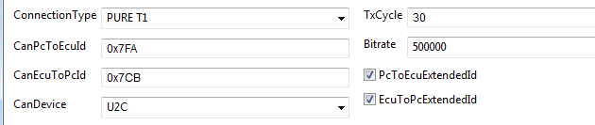
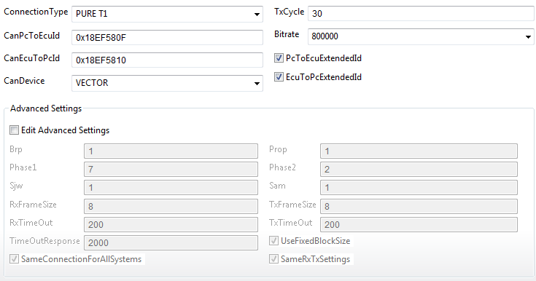
COREMA T1 – EXPERT – Step 11
Step 11 : Can Configuration
Default CAN IDs
Target Rx ID=GUI TxID
Target TxID = GUI RxID
CAN settings are already prefilled :
CanPcToEcuId = T1 Host Tx ID (should be the same as T1 Target Rx ID)
CanEcuToPcId = T1 Target Tx ID (should be the same as T1 Host Rx ID)
CSV report is also generated with prefilled settings.
Customer related CAN IDs

Slide 3
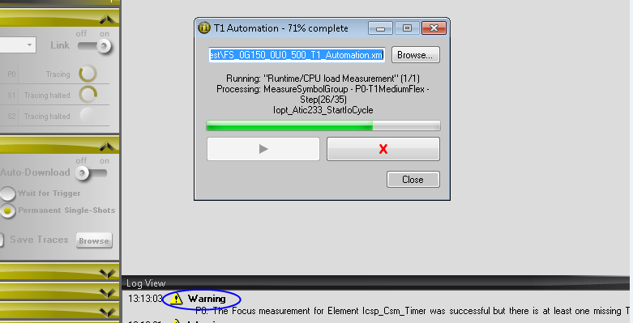

COREMA T1 – Runtime Measurements Plausibility Check
Failed commands
These are marked with “Warning”
These functions were not measured, so you should analyze:
The warning message
The functions for which a certain warning had been displayed

Slide 4
COREMA T1 – Runtime Measurements Plausibility Check
Failed commands, functions not measured, and the common reasons are
Functions is not called by the Application
The symbol is not a function but a Macro so it doesn’t have a Start/End address ( needed by the Flex measurement)
In these cases, the Flex warnings are like this :
Warning: "FlexSWF – Symbol name " failed: focus measurement did not get valid results: element was not executed
Warning: "FlexSWF - Symbol name " failed: target state: DATA_READY focus measurement did not get valid results: element was not executed
Warning: Focus measurement for element Symbol name was successful but there is at least one missing T1.cont
the important statement is “Element was not executed”
Its quite common to have warnings like these as not all of the automatically determined functions by CoremaT1 ( based on the project’s tree) are also called by the application.

Slide 5

COREMA T1 – Runtime Measurements Plausibility Check
Failed commands, functions not measured, other errors :
CAN communication between the Target code ( ECU) and the Host Software (T1 GUI) is not working
This is mainly caused by WRONG connection of the T1 Dongle CAN wires to the right ECU CAN bus (e.g. if CCP node is used for T1 messages, the dongle should be connected to this CAN bus not to another one)
In this case
make sure the SW is running without resets
ask for project test bench support to get the right CAN bus
just plug the T1 Dongle CAN cables on other CAN bus and try again until you have communication (with respect to CAN-H / CAN-L wires)

Slide 6
COREMA T1 – Runtime Measurements Plausibility Check
Failed commands, functions not measured, other errors :
In some situations, if the selected CAN bus for T1 messages is quite busy then it could be that the T1 GUI enters in a timeout mode and the measurements results for certain functions are lost
In these cases, the Flex warnings from the log file are like this :
Warning: "FlexSWF - Symbol name " failed: focus measurement did not get valid results: focus state invalid”
the important statement is “Focus state invalid” in this case
If there are a high number of warning messages like this then we have 2 options:
Change the T1 HOST timeouts for CAN frames
Select another active CAN node on which the Bus load is not that high
Use the same CAN node but change the T1 CAN IDs to increase the priority

Slide 7
COREMA T1 – Runtime Measurements Plausibility Check
Summary :
Flex warnings like Element was not executed are quite common for a reduced number of functions. The project can analyze the functions which are not called to see if the measurement conditions are the right ones.
Flex warnings like Focus state invalid are more severe and mainly indicates that the measurement was not performed for that functions. These should be analyzed because missing measurements for called function will influence the CPU load calculation
Flex error Enable Link means the CAN communication cannot be established because the SW is not running, T1 dongle is not plugged to the correct CAN Bus.
For other details please refer to the T1.Help file present on the WIKI page

Slide 8
Let’s discuss!

