Slide 1
COREMA T1 13.x.x T1 Target code v3
Overall Runtime Measurements
Timisoara, 12.04.2021
Ovidiu Tripon

Slide 2
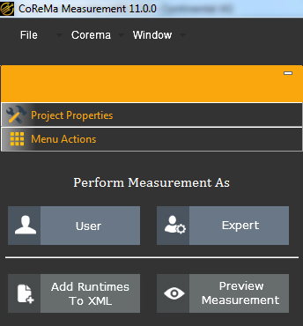

COREMA T1 GUI - Overview
Copy Corema folder to your local LegacyApp folder and run it from there
CoremaT1 Meas part executed on a PC to prepare the measurement files / import the measurement results
The tool looks different, but the fields are the same !
In this release only EXPERT mode is implemented
For target code V3,
the communication settings
T1P settings
are no longer part of the COREMA configuration.
These settings will be made in PROJECT ANALYZER (PA) and they will be part of the project.

Slide 3
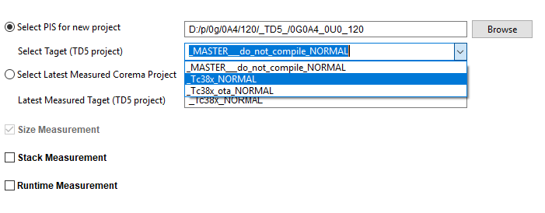
COREMA T1 GUI – EXPERT – Step 1
Step 1 : Project Selection
User can select the Active Project from TD4/TD5 or
Latest measured project or
At this point, user shall activate the Stack And / Or Runtime measurement
NOTE : Stack measurement uses T1.API and a dedicated license, details on how to use it will be placed in Corema Community.

Slide 4
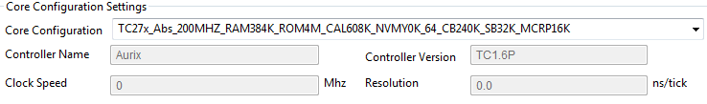
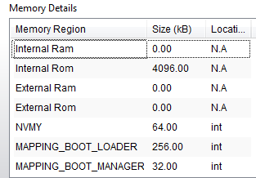
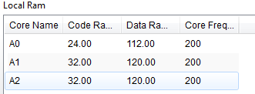
COREMA T1 GUI – EXPERT – Step 2
Step 2 : Configuration Check
In this step the Project and Core configuration details are revealed
Project Architect should check these configurations before proceeding further
Core configuration is described on Corema Wiki page

Slide 5
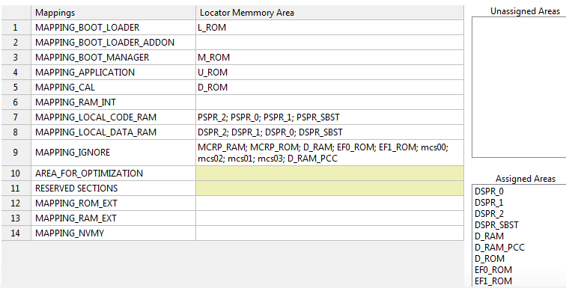
COREMA T1 GUI – EXPERT – Step 3
Step 3 : Size Mappings
By default, there are a set of rules to assign Locator Memory mappings to Corema Mappings.
Expert should check if all the locator areas are assigned
There shall not be any un-assigned areas before moving on
Size measurement training covers these topics in detail so please refer to that document from the Corema WIKI page.

Slide 6
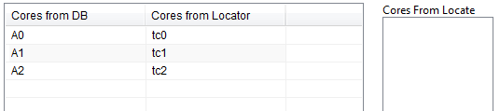
COREMA T1 GUI – EXPERT – Step 4
Step 4 : Core Mappings
This is related to Size measurements as well.
Corema reads available HW cores from locator definition file and then assign them to Abstraction core names for size measurement.
Expert should check this automatic assignment, with special care on the TC299 cores where different Abstraction core names are used depending on the project.

Slide 7
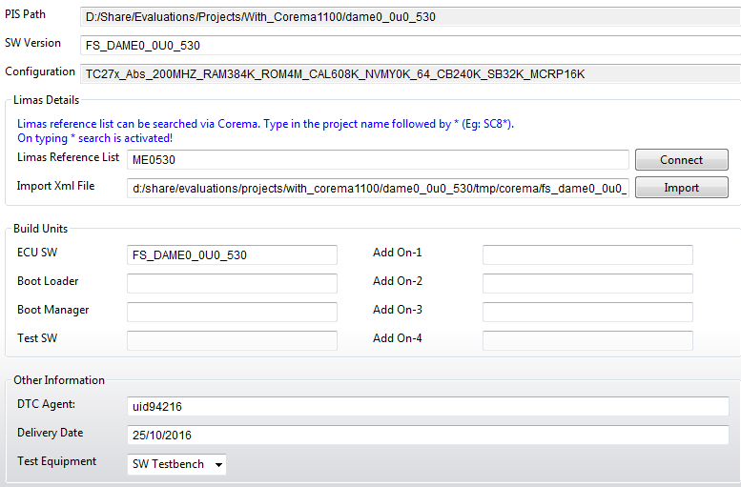
COREMA T1 GUI – EXPERT – Step 5
Step 5 : Project Information
The Expert should make sure that the LIMAS Reference List is filled in.
If the “import XML File” line is empty the connection to LIMAS has not been established, press the CONNECT button.
The project path and SW version are displayed

Slide 8
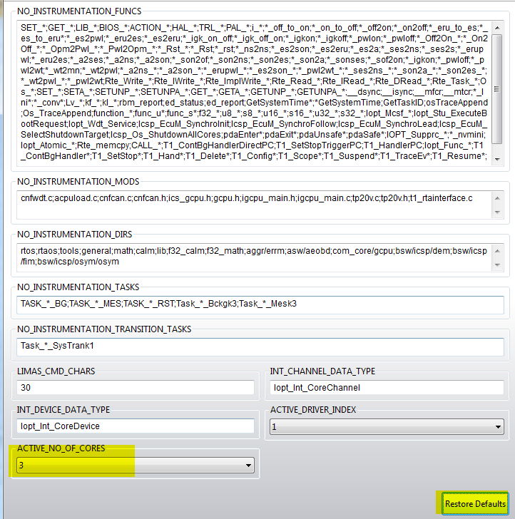
COREMA T1 GUI – EXPERT – Step 6
Step 6 : Runtime Mapping
Use Restore Defaults when you run Corema the first time !
For Runtime Measurement, different nb of cores compared to the core config is now supported by the tool !
From the Runtime Mappings the user can decide what will be instrumented and what not!
Multiple INT configuration supported directly by the tool.
Only in case of multiple INT configurations (CoremaT1 will detect this case), the user shall specify the name or index of the active (used) configuration
This configuration looks different for single core projects !
Background TASKS should be excluded from measurements!

Slide 9
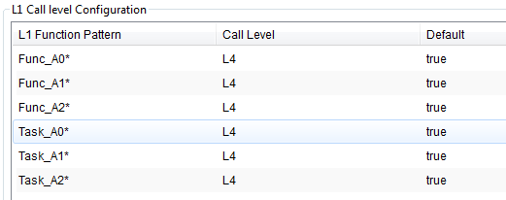
COREMA T1 GUI – EXPERT – Step 7
Step 7 : L1 Call level configuration
In Multi core case we have a different approach because we want to instrument only what we are interested in. So, we now have this L1 Function Pattern for which we can select the Level to instrument. By default, everything is instrumented L1 and for the patterns available here , the instrumentation goes up to the selected level for this pattern. Make sure that pattern selection matches the core names from project.

Slide 10
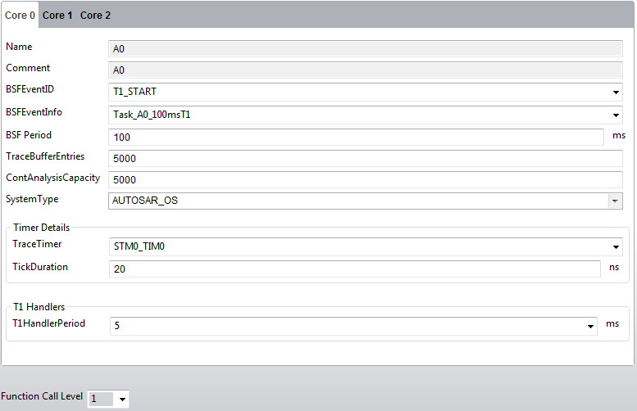
COREMA T1 GUI – EXPERT – Step 8
Step 8 : T1P file – system settings
These settings are core dependent so please make sure you check the settings for all the cores if you have a multi core project.
As before, CoremaT1 will pre-fill these fields by default based on some internal algorithms.
Make sure that selected TraceTimer really works at prefilled TickDuration (for multicores) or insert the calculated TickDuration for single Cores.
There is a document on the CoremaWiki with more details for these fields.
For Multicore the Function Call Level should stay at 1 ( because we are using the pattern selection to instrument what we are interested)
TO BE CONFIGURED IN PROJECT ANALYZER !

Slide 11
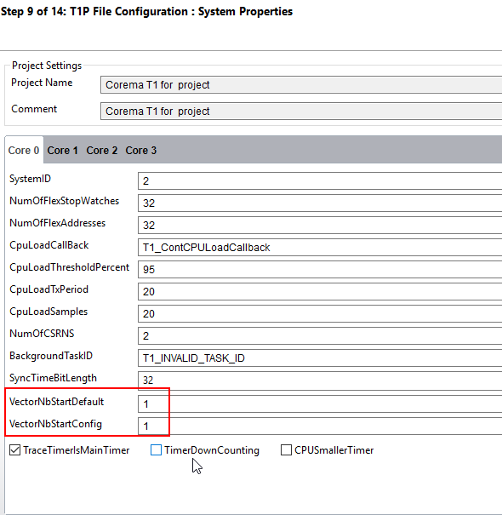
COREMA T1 GUI – EXPERT – Step 9
Step 9 : T1P file – other system settings
These settings are core dependent so please make sure you check the settings for all the cores if you have a multi core project.
As before, CoremaT1 will pre-fill these fields by default based on some internal algorithms.
A more detailed description can be found on the CoremaT1 community.
Take care about the red marked info, these defines should be equal if TSC30 is used
Ask CRO if you are not sure.
TO BE CONFIGURED IN PROJECT ANALYZER !

Slide 12
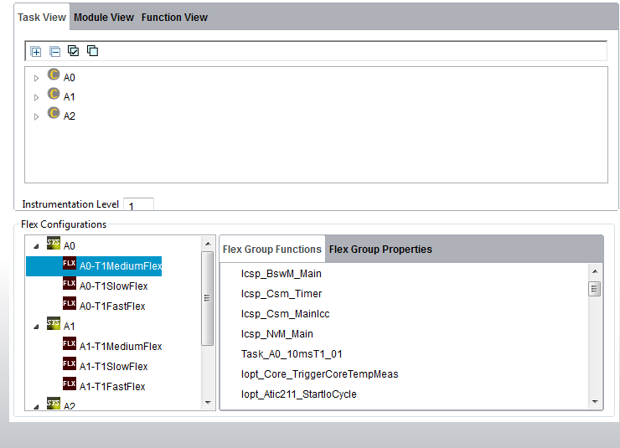
COREMA T1 – EXPERT – Step 10
Step 10 : Standard Corema Flex Functions
Here we can see :
Available TASKs in the project , core related which can be expanded
3 default FLEX groups created by default (no user intervention is needed) for each of the available cores holding:
Fast recurrence functions
Medium recurrence function
Function with slow recurrence
User doesn’t have to select anything; this is an automatic function assignment based on the project tree !
*note for single core projects there will be only P0 ( only one core) available !

Slide 13
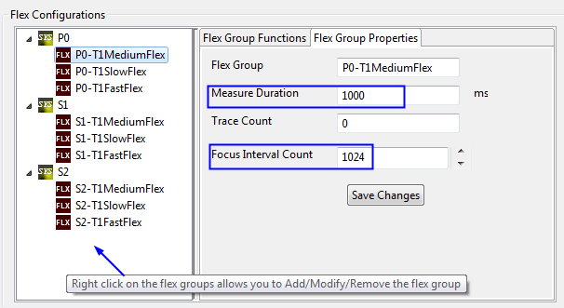
COREMA T1 – EXPERT – Step 10 (cont)
Each FLEX group has its own properties to maximize the results accuracy and minimize the overall measurement duration
Measurement Duration (ms) - Set the timeout in ms to be used for functions from this group
Focus Interval Count (occurrences) - Set the number of occurrences to be measured per function on this group
The 2 settings are ORed so which one comes first will end the ongoing function’s measurement
User intervention is not really required at this Standard Measurement step

Slide 14
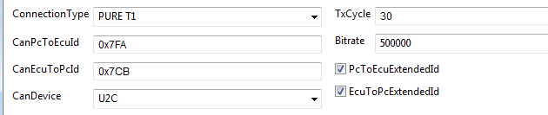
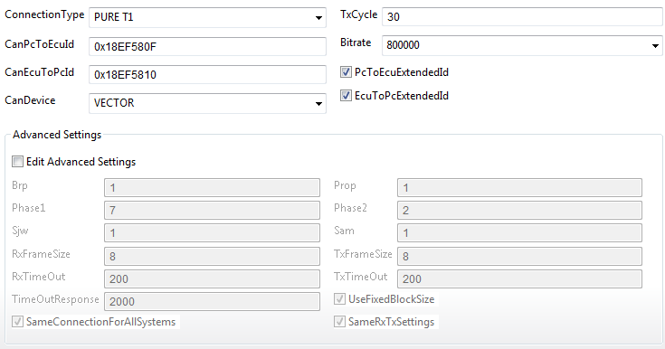
COREMA T1 – EXPERT – Step 11
Step 11 : Can Configuration
Default CAN IDs
Target Rx ID=GUI TxID
Target TxID = GUI RxID
CAN settings are already prefilled :
CanPcToEcuId = T1 Host Tx ID (should be the same as T1 Target Rx ID)
CanEcuToPcId = T1 Target Tx ID (should be the same as T1 Host Rx ID)
CSV report is also generated with prefilled settings.
Customer related CAN IDs
TO BE CONFIGURED IN PROJECT ANALYZER !

Slide 15
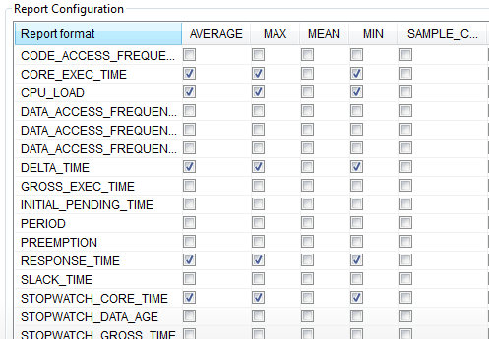
COREMA T1 – EXPERT – Step 12
Step 12 : Report Configuration
CSV report is also generated with prefilled settings.
We are by default interested in
CoreExecutionTime (Min, Max, Avg)
CPU load ( Min, Max, Avg)
The user must be aware that different measurement values will require different measurement methods or a combination of measurement methods.

Slide 16
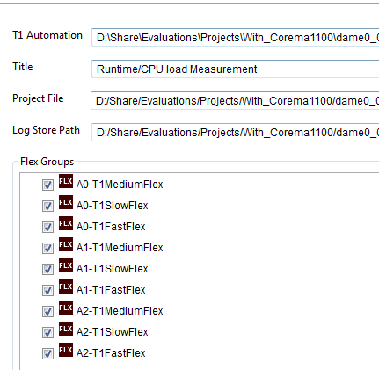
COREMA T1 – EXPERT – Step 13
Step 13 : Automation Configuration
T1 automation files will be generated
The functions from the selected groups will be part of the FLEXIBLE measurement

Slide 17
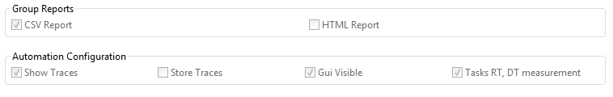
COREMA T1 – EXPERT – Step 14
Step 14 : Miscellaneous Settings
Other settings can be done regarding the report generation and automation options using Miscellaneous Settings

Slide 18
COREMA T1 – EXPERT – Step 15
Step 15 : T1.Stack Measurements
For this one the T1.API is used – a Stack license is needed and needs to be configured under the Gliwa License Manager
Descriptions for this will be made available on Corema Connext Community.

Slide 19
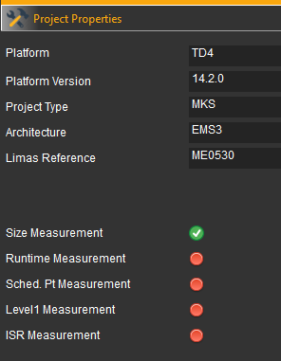
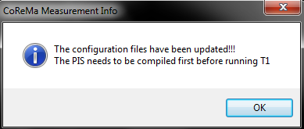
COREMA T1 GUI – Finish
At this point all the needed configuration files and automation files have been exported by CoremaT1. Because of the newly generated header files a new SW compilation is necessary.
Afterwards the user can check if the automation files have been generated as described on next slide.

Slide 20
COREMA T1 GUI – Notes on configuration items
Please note
After first integration the configuration files T1_gen_config.h and T1_os_config.h doesn’t contain project related information, they are just templates
the settings on the previous page together with all OS related information will be written in the files after running CoremaT1 for the first time
after this first run of CoremaT1 the project must be compiled to take into consideration these settings !
Within COREMAT1 GUI the fields are already prefilled with the right values for a Standard COREMA measurement !
this SW version has an auto-calibration feature built in for Overhead's determination, so a manual calibration is no longer necessary.

Slide 21
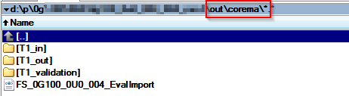
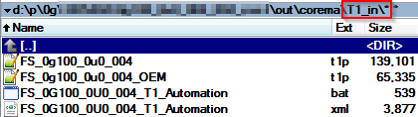
COREMA T1 GUI – Automation test files
T1P files
T1P project file – holds all the CoremaT1 information of the project to be measured.
The T1P file with ***_OEM is created to be exchanged with OEM ( it doesn’t have any FLEX group inside)
XML file
is the automation testing descriptor file – what exactly is measured, where the results are stored
Automation BAT file
Bat file for automated testing process ( launched automatically by bellow bat file)
At this point the user is ready to go to test bench
Auto-calibration will be performed automatically when the automation measurement is launched.
There is a separate document with more explanation automation tests
CoremaT1_AutomationTest_overview_AAA.pptx (AAA is released version)

Slide 22
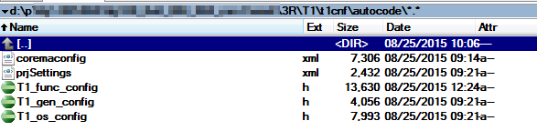
COREMA T1 – Autocoded and Configuration files
After Corema is run
3 auto coded header files are updated, and they hold the all the project details needed for measurement
2 configuration files so to read out all the measurement details (reuse for the next measurement )
These 5 files will be archived In MKS/ PVCS so they can be fetched with a new project version.

Slide 23
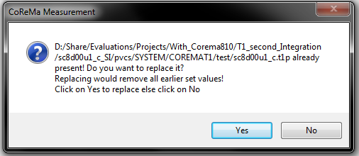
COREMA T1 GUI – Additional information (1)
If the project has been already instrumented the user is asked of the existing T1P will be overwritten with a new one or the user wants to keep it and only change the automation configuration. If you click YES, new header files and T1P file will be generated. If you click NO you are directed to the last window from where you can change the Automation configuration.

Slide 24
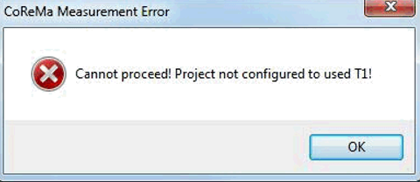
COREMA T1 GUI – Additional information (2)
Corema 13.x.x GUI for runtime measurement can only be used with the 13.x.x related libraries and adaption code.
If you didn’t update the CoremaT1 files for the 13.x.x releases please stop now, update the files first and then try again !
Otherwise, the error on the left will be displayed !

Slide 25
COREMA T1 – Add runtime to XML
After the Automation Measurement is finished there is another step to be done - add the measurement values to the existing XML file.
In order to do this please follow the Wiki indications and the CoremaT1_AddRuntimesToXML_overview presentation.

Slide 26
Let’s discuss!

