Slide 1

Technical hour.
Debugger from Developer and Tester point of view (basics).
Christian Zitzmann
P HEV

Slide 2
Content:
How To – Start Trace32
How To – Trace32 Overview
How To – Flash SW
How To – Debug SW (Start/Break/Step/Over/GoUp)
How To – Debug SW (Debug mode)
How To – Debug SW (Watch/Change variables)
How To – Debug SW (Breakpoint)
How To – Debug SW (Peripherals)
How To – Debug SW (Trace methods - Overview)
How To – Debug SW (Trace methods - SNOOPer)
How To – Debug SW (Dump flash)
How To – Debug SW (Script language)
END
Additional info

Slide 3
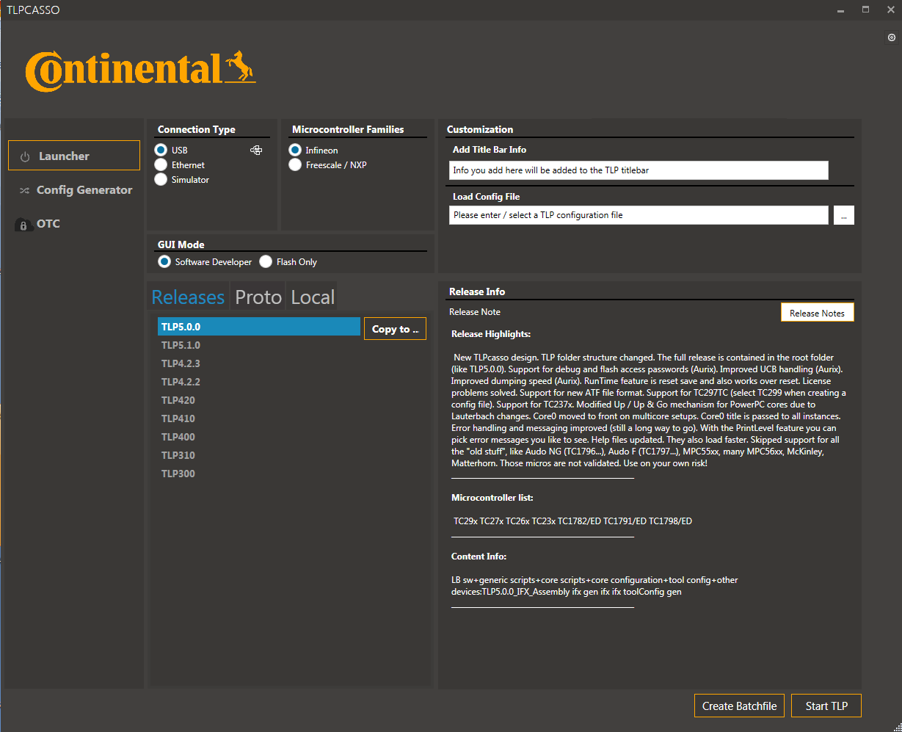
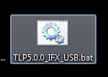
How To – Start Trace32
Trace32 will be started via Batch-Script, created by TLP.
Last version of TLP can be found here: “a:\Trace32\TLP\TLPcasso\”
Bellow is an example how to create Batch-Script:
Execution of “TLPcasso.exe”
Select version (in this example „TLP5.0.0“ and then press „Create Batch-File“
Batch-Script will be created on your Desktop.
Plug in the debugger and start Trace32 with the Batchfile

Slide 4
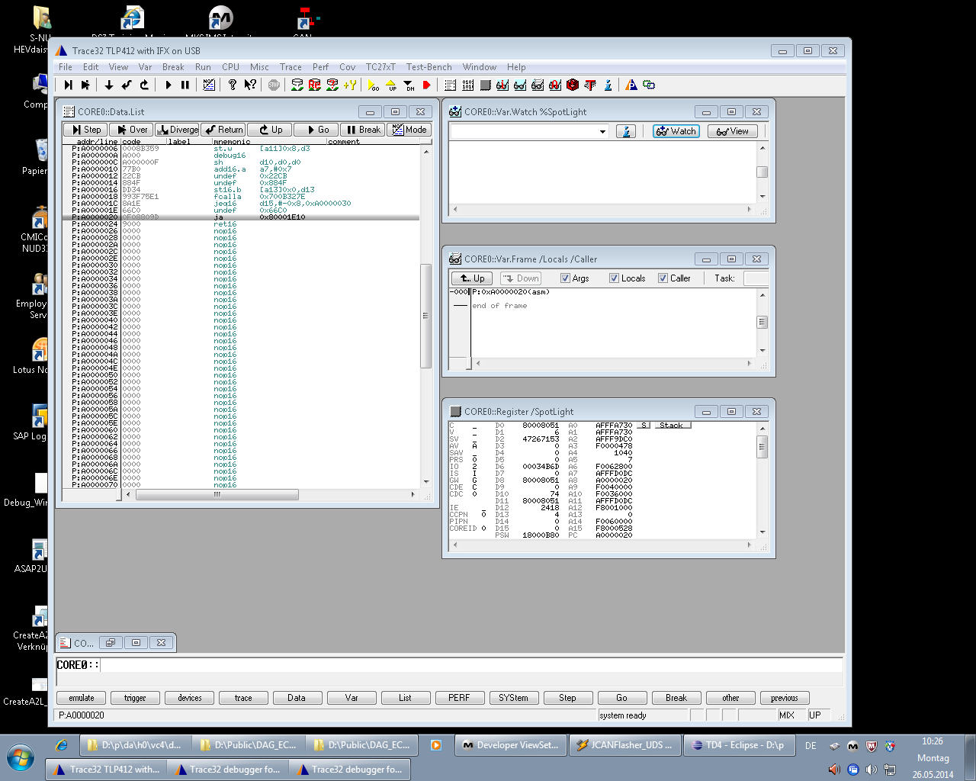
How To – Trace32 Overview
After start batch file was executed, three windows will be shown (one window per core).
If HSM is activated a fourth window will be opened.

Slide 5
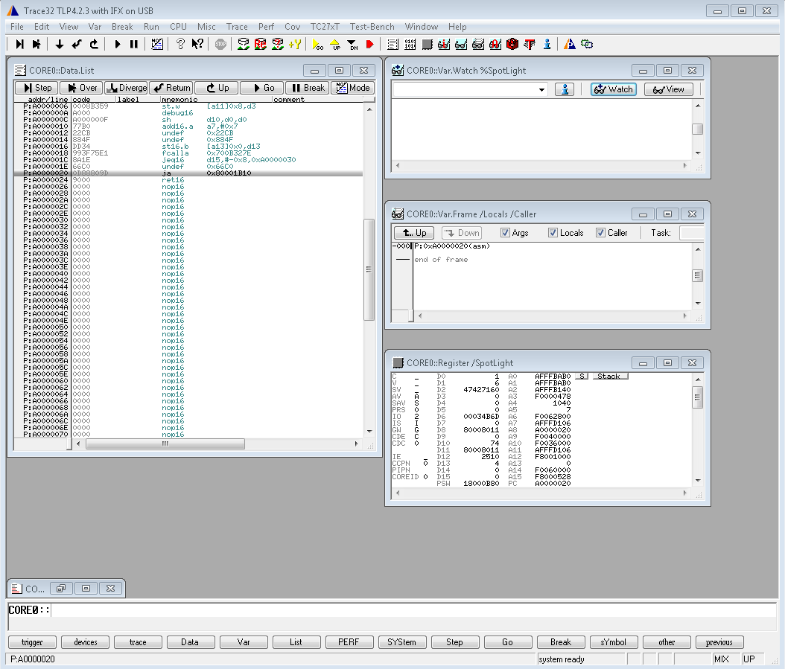
How To – Trace32 Overview
Four windows by default:
Data list window
Watch window
Stack frame window
Register window

Slide 6
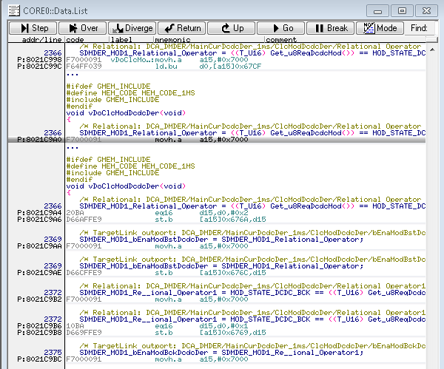
How To – Trace32 Overview
Data list window - This window shows the programm listing around programm counter (PC). If you stop sw execution this window will focus on the current place of the programm counter.

Slide 7
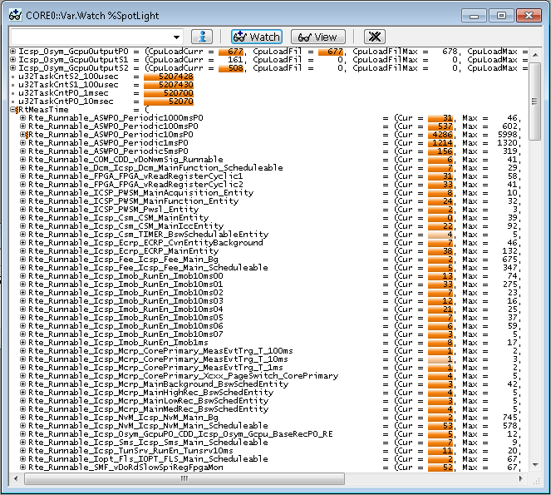
How To – Trace32 Overview
Watch window

Slide 8
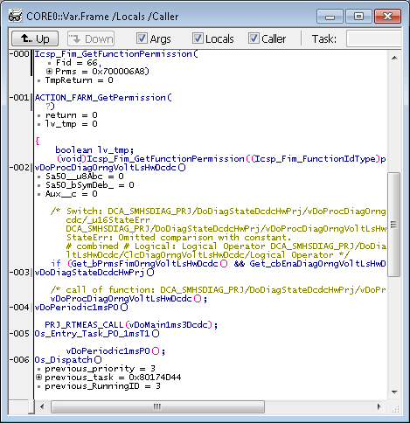
How To – Trace32 Overview
Stack frame window - This window displays the function nesting for the application program.
The local variables of each function are displayed also.
You can also see a few lines from the C-code and so indicate where the function
was called.

Slide 9
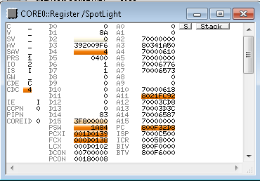
How To – Trace32 Overview
Register window - Register window contains state of the cpu‘s reigsters. In this window you can also modify the values. For example you can set programmcounter on a specific address and so start execution from that place.

Slide 10
How To – Flash SW
Only in the first window command buttons can be found.
Load Symbols for SW (ELF-File)
Flash new files
Re-Flash last files
Compare PDS with Flash

Slide 11
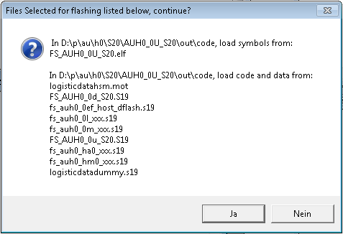
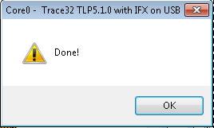
How To – Flash SW
After pressing of „Flash new files“-Button, user will be asked to select folder to be flashed.
(e.g.: “D:\p\au\h0\s30\auh0_0u_s30\out\code)
Then trace32 will ask for confirmation
At the end user will be informed about flash process result:

Slide 12
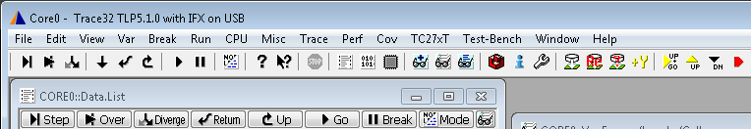

How To – Flash SW
Now SW can be started via „Go“-Button
Status can be seen in status-bar:

Slide 13
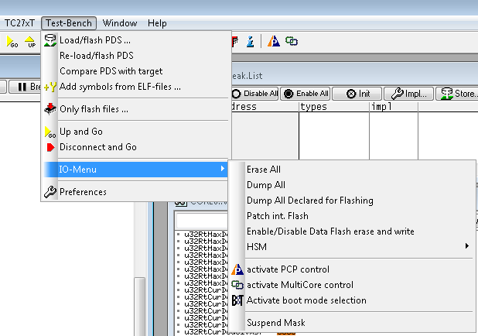
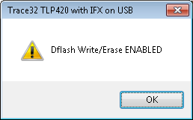
How To – Flash SW
It’s possible also to flash “protected” ranges (DFLASH, HSM, HSM-DFLASH)
Enable flashing of the DFLASH:

Slide 14
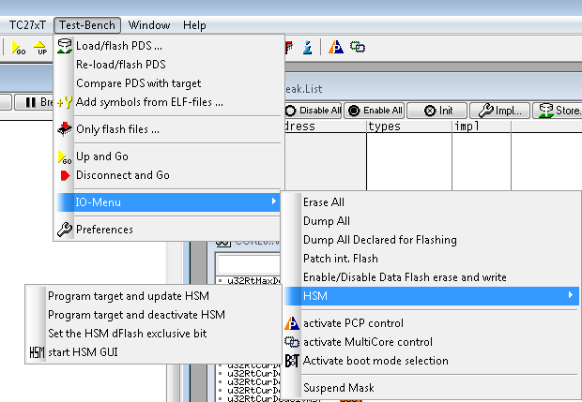
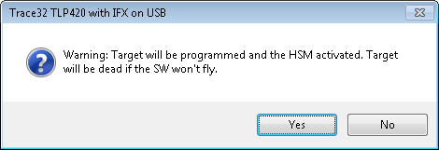
How To – Flash SW
To update HSM:

Slide 15
How To – Flash SW (How it works)
Before files will be flashed on usual way, flash ranges, which are not covered by these files, will be erased.
If you remove one file from to be flashed folder (for example logistic data) this range will be erased.
Exceptions are write protected ranges (DFLASH, HSM, HSM_DFLASH, UCB).

Slide 16
How To – Flash SW
Short overview of the flash possibilities:
 | Lauterbach normal | Lauterbach „Prog. … update HSM“ | Lauterbach „Enable DFLASH“ Normal flash | Lauterbach „Enable DFLASH“ + „Prog … update HSM“
HOST Flash1 | X | X | X | X
HSM Flash1 |  | X |  | X
HOST Flash2 | X | X | X | X
HSM Flash2 |  | X |  | X
Host Flash3 | X | X | X | X
Host DFLASH |  |  | X | X
HSM DFLASH |  |  |  | X
UCB

Slide 17
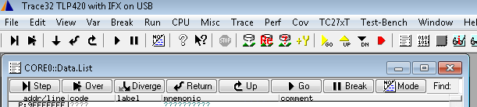
How To – Debug SW (Start/Break/Step/Over/GoUp)
Step – single step through the program.
Step Over – step over function call or subroutines
Go Next – go to the next code line written in the program listing
Go Return – go to the last instruction of a function
Go Up – return to the caller function.
Start – start the realtime emulation.
Break – stop the realtime emulation.

Slide 18
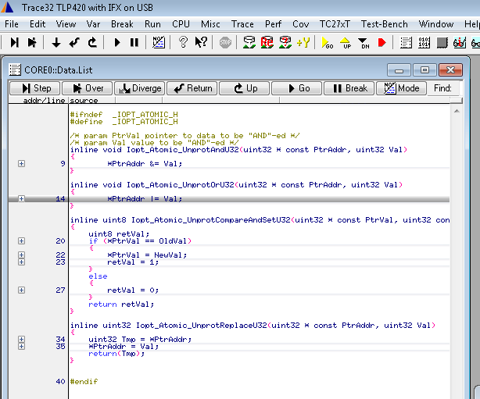
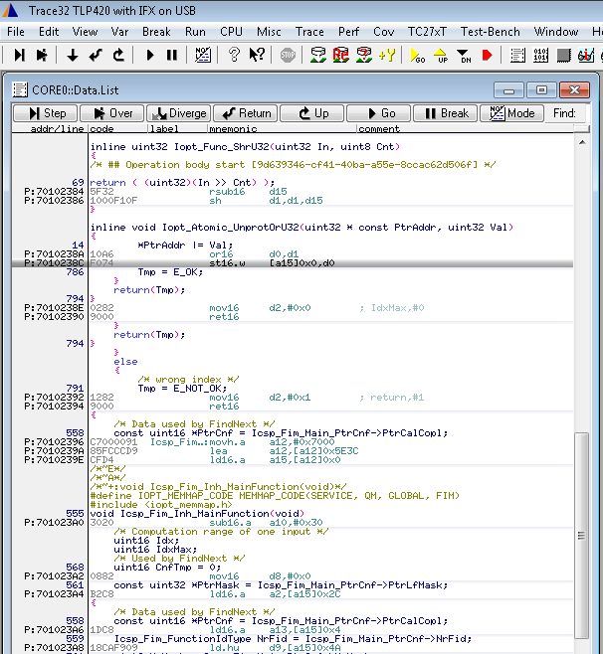
How To – Debug SW (Debug mode)
You can toggle between HLL and MIX views

Slide 19
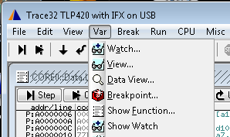
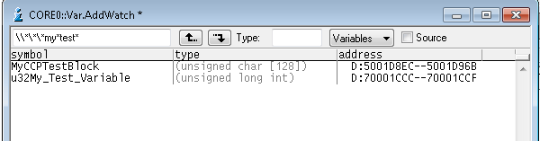
How To – Debug SW (Watch/Change variables)
For monitoring of the variables, they can be added into Watch-Window:
Now you can search for variable to be watched (regular expression is allowed):

Slide 20
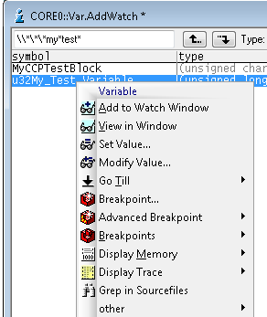
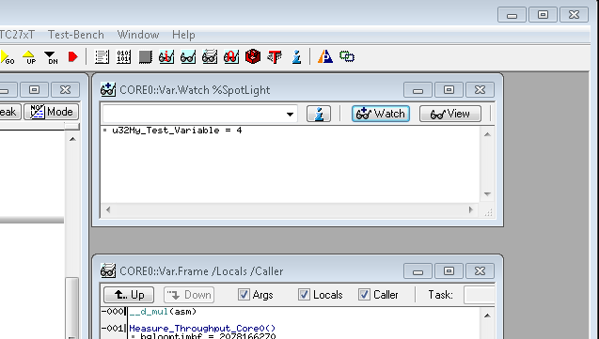
How To – Debug SW (Watch/Change variables)
Via right-click and “Add to Watch Window” variable can be added to watch window:

Slide 21
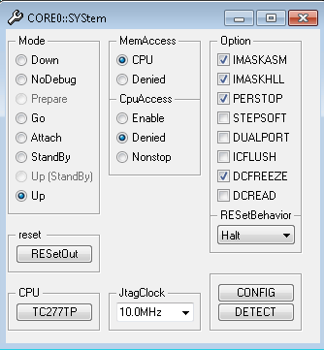
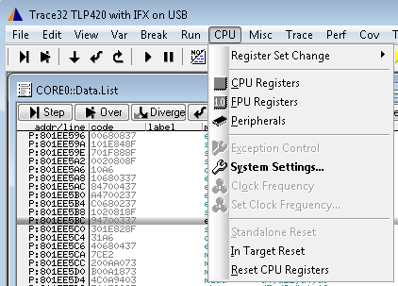
How To – Debug SW (Watch/Change variables)
For “real-time” monitoring, DUALPORT option should be enabled:

Slide 22


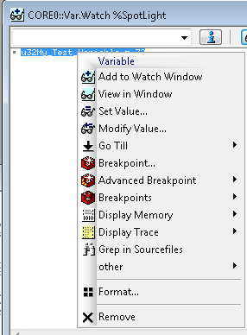
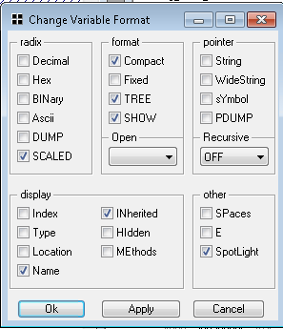



How To – Debug SW (Watch/Change variables)
Now value of the variable can be watched during runtime (value will be updated without holding on the sw).
View of the value can be formatted (dec/hex/bin view).

Slide 23


How To – Debug SW (Watch/Change variables)
Value of the variables can be modified by double click in the watch window on the variable
in command line type in new value
press enter.

Slide 24
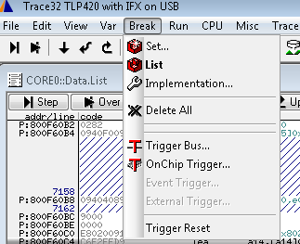
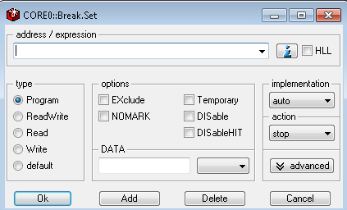
How To – Debug SW (Breakpoint)
Breakpoint is a point, at which the CPU will hold on, as soon as it was reached. Breakpoints can be set on functions (instructions) or variables (read/write access).
Setting of the breakpoint can be done through menu (example for function, but it’s similar to variable):

Slide 25
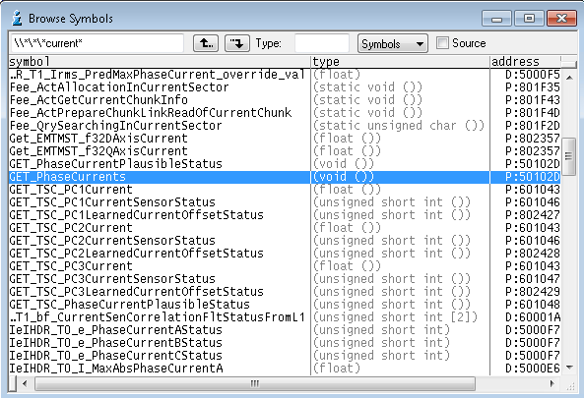
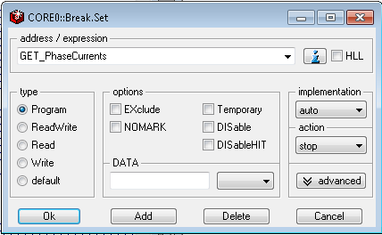
How To – Debug SW (Breakpoint)
Double click on the needed function
Click “Ok” and SW will stop as soon as function is called (before function execution).

Slide 26
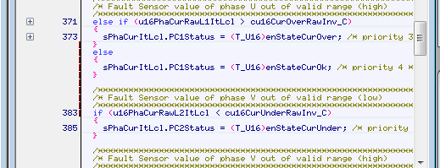
How To – Debug SW (Breakpoint)
It’s possible to set breakpoint also somewhere inside of the function. Just find the needed place and double click on the left side:

Slide 27
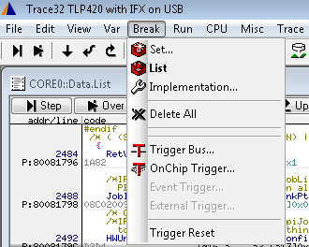
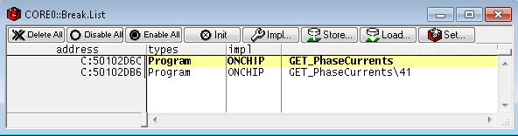
How To – Debug SW (Breakpoint)
A list of all breakpoints can be shown by “List”-Command from “Break”-Menu:

Slide 28
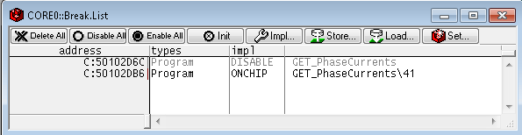
How To – Debug SW (Breakpoint)
Breakpoints can be deactivated by double click in the “impl”-column:
Active
Inactive

Slide 29
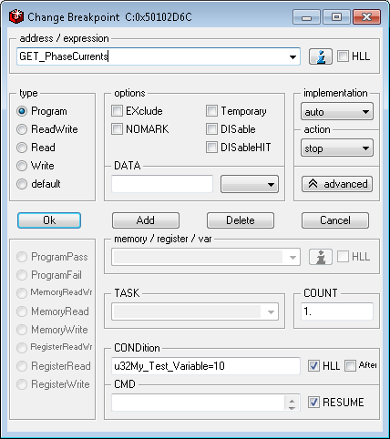
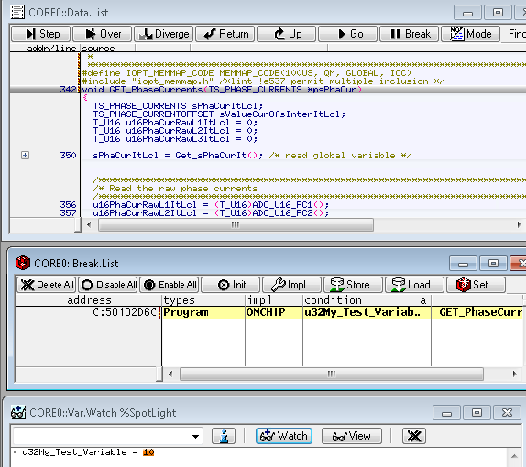
How To – Debug SW (Breakpoint)
Breakpoint with condition:
Stop before “GET_PhaseCurrents” will be executed, if u32My_Test_Variable is 10.

Slide 30
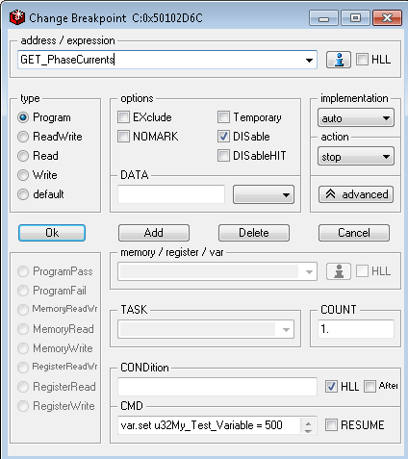
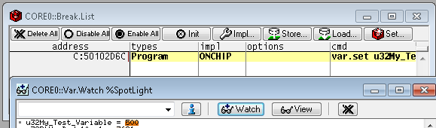
How To – Debug SW (Breakpoint)
Breakpoint with condition:
Set u32My_Test_Variable = 500 , when “GET_PhaseCurrents” will be executed.

Slide 31
How To – Debug SW (Breakpoint)
Please note: it’s important to set breakpoint on the correct core. It means, on which core is function executed, on the same core breakepoint should be set.
In our case function “Get_PhaseCurrents” will be executed on Core1, so also breakpoint should be set on Core1.

Slide 32
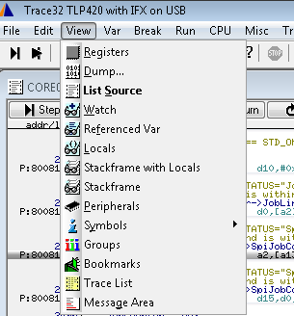
How To – Debug SW (Peripherals)
With help of Trace32 it‘s possible to get information about different internal states of the CPU’s special registers.
You can find it in “View->Peripherals”:

Slide 33
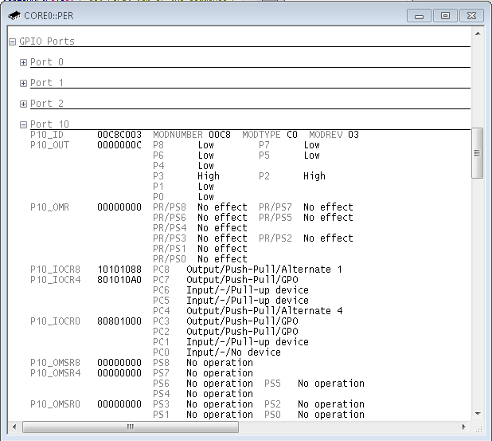
How To – Debug SW (Peripherals)
So you can see/change for example state and configuration of the ports/pins:

Slide 34
How To – Debug SW (Trace methods - Overview)
There are different trace methods available, e.g.:
ART (Advanced Register Trace): Provides a history for single stepping. For each step the contents of the general purpose registers is recorded.
Logger: A part of the target RAM is used as trace memory. (SW adaptations is needed).
SNOOPer: TRACE32 can read up to 16 data addresses in a fixed sampling rate and record their contents to the trace during program execution.
FDX (Fast Data eXchange): target fill ring buffer with information relevant for debugging. TRACE32 collects the contents of the ring buffer permanently while the program is running and builds the trace contents based on this information. (SW adaptation is needed).

Slide 35
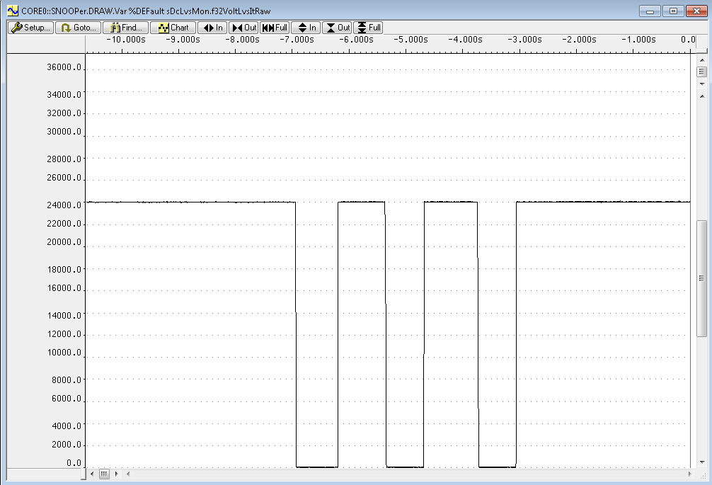
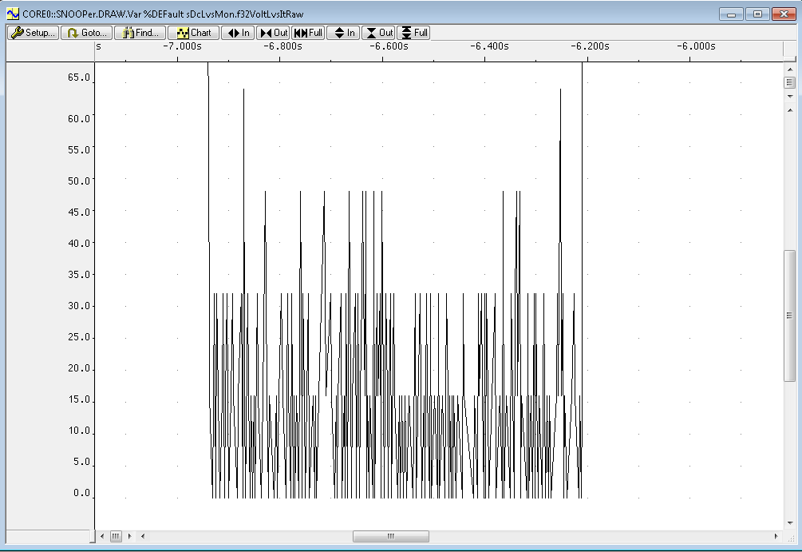
How To – Debug SW (Trace methods - SNOOPer)
SNOOPer trace method reads (snoops) target’s physical memory while program execution is running.

Slide 36
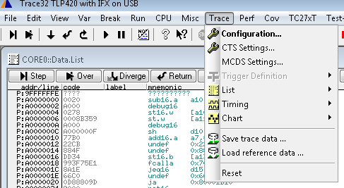
How To – Debug SW (Trace methods - SNOOPer)
Overview over available trace methods and configuration for them can be found under “Trace -> Configuration”:

Slide 37
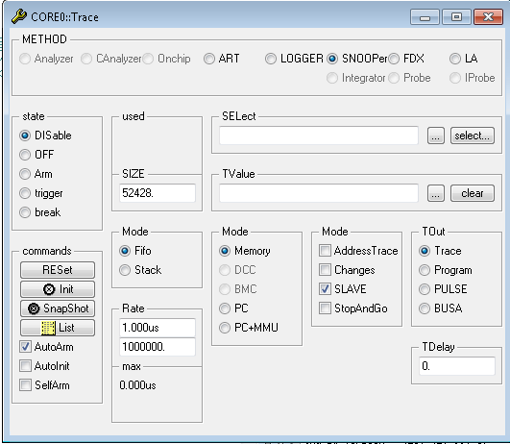
How To – Debug SW (Trace methods - SNOOPer)
Select trace method.
Use “select...” button to open SNOOPer.SELect dialog.

Slide 38
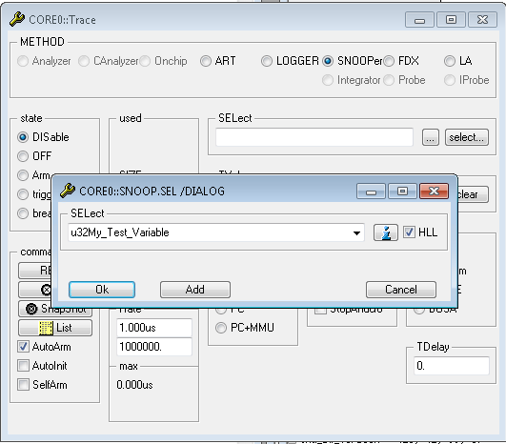
How To – Debug SW (Trace methods - SNOOPer)
Use the List Symbols button to get a list of all variables.
Select the variable you are interested in and click ok.

Slide 39
How To – Debug SW (Trace methods - SNOOPer)
Size: number of trace records.
Snooping rate (by default 1µs)

Slide 40
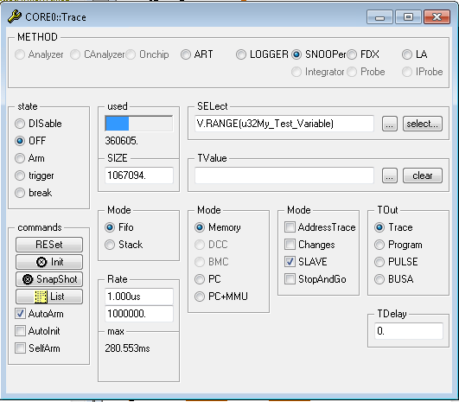
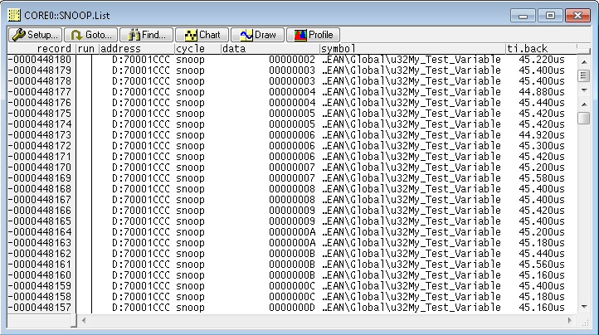
How To – Debug SW (Trace methods - SNOOPer)
Start the program execution
Stop the program execution
Display the result by pushing the “List” button

Slide 41
How To – Debug SW (Trace methods - SNOOPer)
Short overview over the result table.

Slide 42
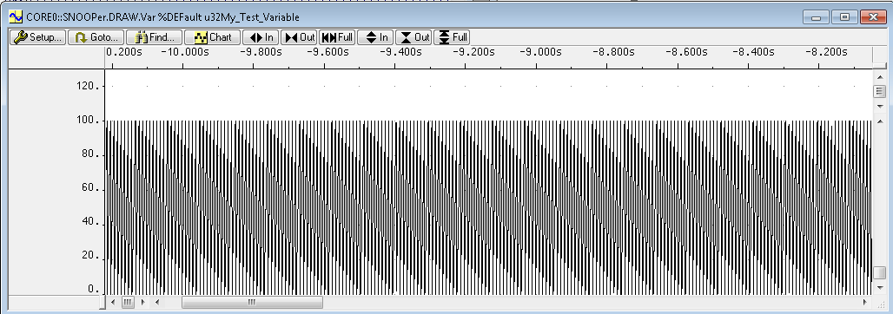
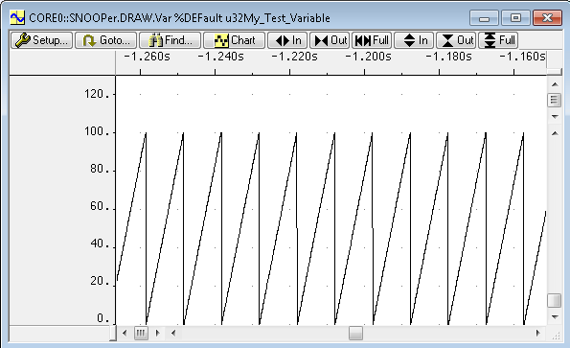
How To – Debug SW (Trace methods - SNOOPer)
Now we can draw results by execution of the following command:
SNOOPer.DRAW.Var %DEFault u32My_Test_Variable

Slide 43
How To – Debug SW (Trace methods - SNOOPer)
Check Mode Changes, if the read variable content should only be stored to the SNOOPer trace when it has changed.

Slide 44
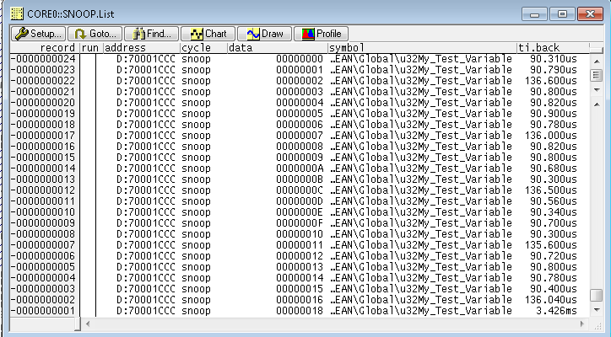
How To – Debug SW (Trace methods - SNOOPer)
Changes OFF
Changes ON

Slide 45

How To – Debug SW (Trace methods - SNOOPer)
Results can be exported and stored on the host:
PRinTer.FILE Trace_Results.lst - specify documentation file name
PRinTer.FileType CSV - specify Comma Separated Value as output format
WinPrint.SNOOPer.List - save result of the command SNOOPer.List to file

Slide 46
How To – Debug SW (Dump flash)
It’s possible to read flash from target and store it on the host.
Following example will read and store application range into file ApplicationSW.hex
data.save.S3RECORD asw.s19 0x80080000--0x8033FFFF /RECORDLEN 20. /SKIPERRORS
The same in Intel Hex-Record format:
data.save.INTELHEX asw.hex 0x80080000--0x8033FFFF /TYPE4 /RECORDLEN 32. /SKIPERRORS
Command
Format
File name
Address range
Options

Slide 47
How To – Debug SW (Script language)
The main tasks of PRACTICE scripts are:
• to provide the proper start-up sequence for the development tool
• to automate FLASH programming
• to customize the user interface
• to store and reactivate specific settings
• to run automatic tests
The standard extension for PRACTICE scripts is.cmm.

Slide 48
END
Thank you for your attention.

Slide 49


Additional info – Debug SW (Core assignment)
You can also assign all three cores to one (single) trace32 window, to be able to control all cores from single window.
to do this please go to “system down”-state:
and type in following in the command line:
core.assign 1 2 3
press ok/enter.
After this click „Up and Go“.

Slide 50

Additional info – Debug SW (Trace methods - SNOOPer)
TRACE32 allows the logging of up to 16 variables.
By using “Add” button you can add further variables for logging.

Slide 51

Additional info – Debug SW (Trace methods - SNOOPer)
Result of the trace for variables u32My_Test_Variable and u32RtCurDcdc10ms1

Slide 52

Additional info – Debug SW (Trace methods - SNOOPer)
For the graphical display of variables changes over the time, you can superimpose up to three variables
SNOOPer.DRAW.Var %DEFault u32My_Test_Variable u32RtCurDcdc10ms1

Slide 53
Additional info – Debug SW (Trace methods - SNOOPer)
or you can establish a time- and zoom-synchronization between the different displays
Execution of the following commands will show two windows.
SNOOPer.DRAW.Var %DEFault u32My_Test_Variable /ZoomTrack
SNOOPer.DRAW.Var %DEFault u32RtCurDcdc10ms1 /ZoomTrack

Slide 54

Additional info – Debug SW (Trace methods - SNOOPer)
Windows with the option /ZoomTrack are time- and zoom-synchronized to the cursor in the active window.

