Slide 1

Analog to Digital Converter (ADC ) Driver Training Slides
Harald Paschke
Driver Responsible
P E&DS SE EEA BSW RBG1
Harald.Paschke@continental-corporation.com
+49 941 790 928747
ECU 17
Jithin Jose
Driver Developer
P E&DS SE EEA BSW BLR
Jithin.Jose@continental-corporation.com
+91-80-66791100-3152
www.continental-corporation.com

Slide 2
Agenda
1
Functional Description & Features
2
APIs
3
Integration Highlights
4
Configuration
4.1
Configuration Structure
4.2
Configuration Example
5
Dependencies
6
HW Resources
7
Constraints & Limitations

Slide 3
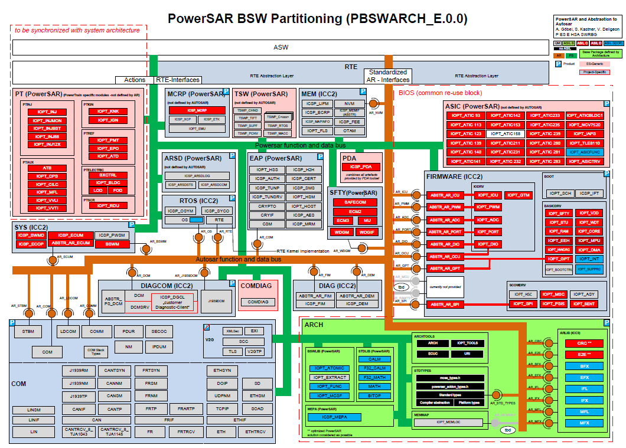
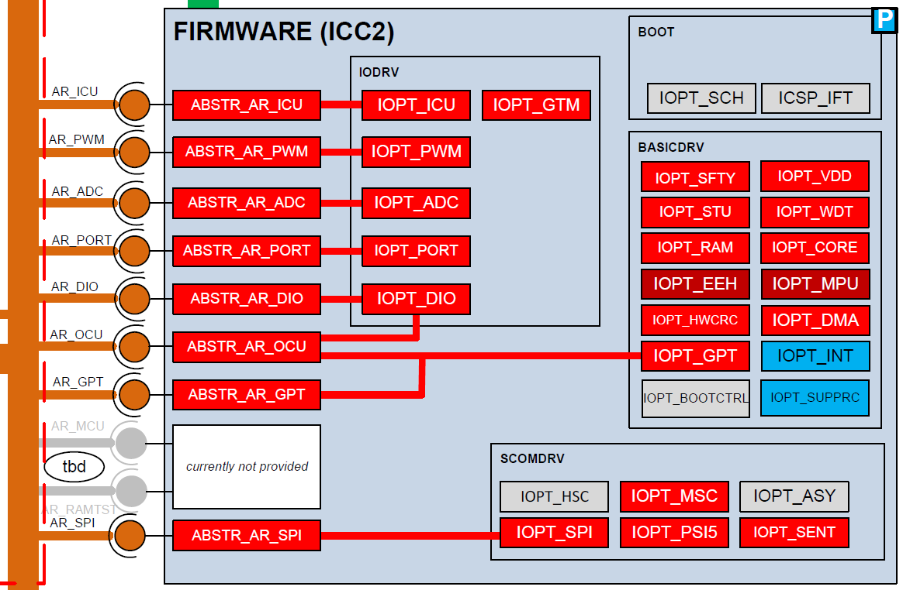
ADC Driver Functional Description & Features

Slide 4
ADC Driver Functional Description & Features
FCOMP
DSADC
Fast Comapre
Successive Approximation
High Speed (5 Msampes/s)
Dedicated compare features
VADC
Delta Sigma ADC
High resolution
High stability
Filters and noise reduction
Versatile ADC
Successive Approximation
Low Latency-time
High Accuracy
Easy to use
ADC
Driver

Slide 5
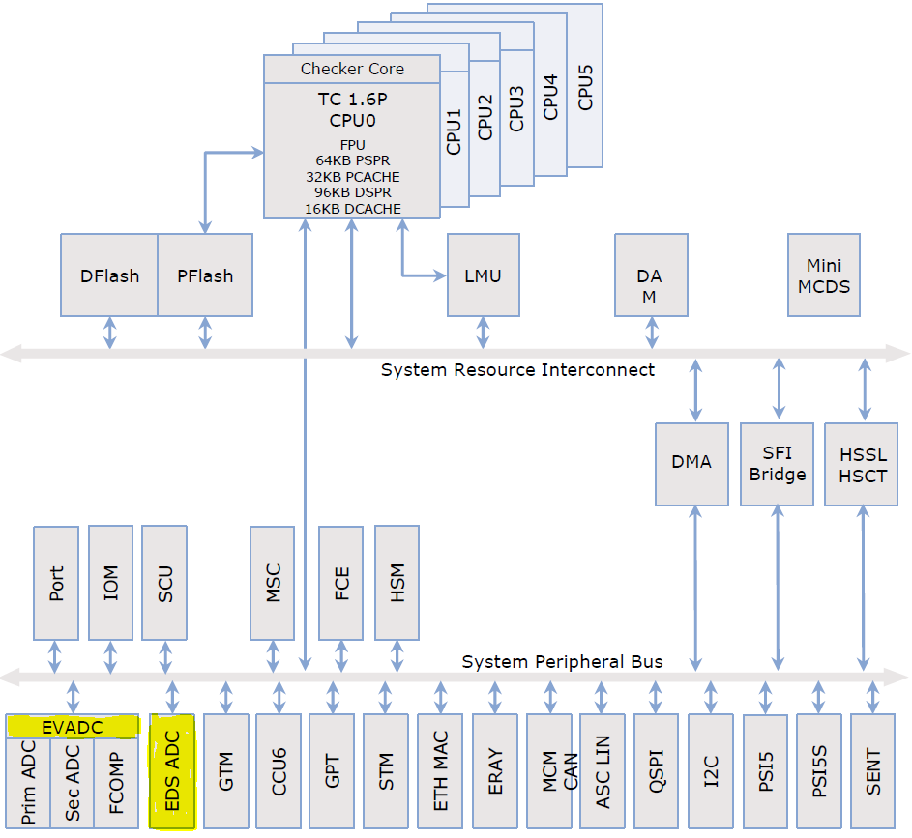

ADC Driver Functional Description & Features
VADC: Versatile ADC
- Primary
- Secundary
FCOMP: Fast Compare
DSADC: Delta Sigma ADC
ADC Driver

Slide 6
ADC Driver Functional Description & Features
The ADC driver provides:
AUTOSAR APIs (adc.h)
PowerSAR APIs (iopt_adc.h)
Two (CESSAR) user configuration for VADC + FCOMP and DSADC
4 Trigger trigger modes for VADC / 1 trigger mode for DSADC
Support of external Buffers (linear and circular)
Result Handling (VADC)
Internal: Internal setup of DMA, copy results from result register to the buffer (internal or external)
External: The user takes care to fetching the results from the ADC peripheral on his own
Notification:
The user can set up a notification which is called after the configured set of conversions

Slide 7
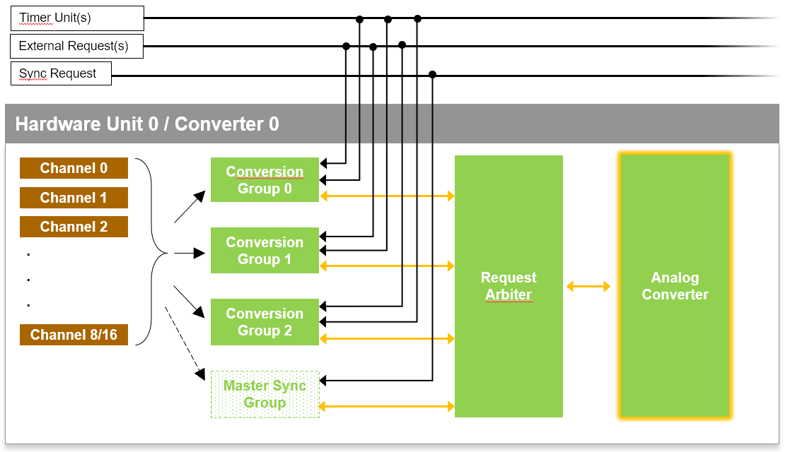
ADC Driver - VADC Functional Description & Features
Up to 11 HwUnits ## 3 Conversion Groups + 1 Master Sync Group ## 8/16 Channels
Each HwUnit has one Analog to Digital Converter ( Successive Approcimation [SAR] )
Conversion groups (Queues) get activated/started via trigger signals
An arbiter resolves concurrent conversion requests
VADC (internal structure)
HwUnit 1
HwUnit y
. . . .

Slide 8
ADC Driver Functional Description & Features
Timer Unit(s)
External Request(s)
Sync Request
Hardware Unit 0 / Converter 0
Channel 0
Conversion Group 0
Request Arbiter
Analog Converter
Channel 1
Channel 2
Conversion Group 1
.
.
.
Conversion Group 2
Channel 8/16
Master Sync Group

Slide 9

ADC Driver - VADC Functional Description & Features
4 trigger types per conversion group (Queue)
AutoScan
SwTrigger
1
2
Periodic software trigger (e.g.10ms )
10ms: convert
20ms: fetch result (10ms), convert
30ms: fetch result (20ms), convert
n ms: fetch result (n-10ms), convert
External Multiplexer (EMUX) support
1:8 multiplexer
Internal result handling (in software)
Triggert via function call
Internal result Handling:
via interrupt after group convertion
Adc_StartGroupConverion(ConversionGroup)

Slide 10
ADC Driver - VADC Functional Description & Features
HwTrigger
SyncTrigger
3
4
Triggered via hardware signal
e.g. Falling edge on input-pin or TOM
Resulte handling:
Internal (internal DMA configuration)
External (no DMA configuration)
Linear or circular buffer (streaming)
Convertion modes
Single: Only convert once
Continous: Always convert on trig. sig.
Same features as HwTrigger
Triggered via hardware signal
Internal/External result handling
Single or continuous mode
Synchronized conversion of multiple groups
One master triggers up to three slaves
Special connection between certain HwUnits

Slide 11
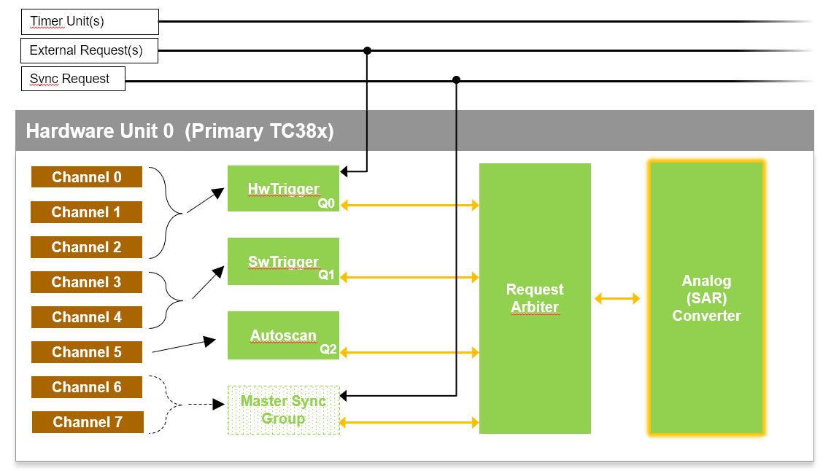
ADC Driver - VADC Functional Description & Features
3 Request Sources (Trigger Type) can be assigned to 3 Conversion Groups (Queues)
Only HwTrigger and the Master Sync Group (Queue) are connected to a hardware line
SwTrigger and Autoscan are handled completely in software ( iopt_adc function calls )
Priorities (CESSAR):
High (Q0) : HwTrigger
Medium (Q1): SwTrigger
Low (Q2): AutoScan
Highest (byHw): MasterSync

Slide 12
ADC Driver Functional Description & Features
Timer Unit(s)
External Request(s)
Sync Request
Hardware Unit 0 (Primary TC38x)
Channel 0
HwTrigger
Request Arbiter
Analog (SAR) Converter
Channel 1
Q0
Channel 2
SwTrigger
Channel 3
Q1
Channel 4
Autoscan
Channel 5
Q2
Channel 6
Master Sync Group
Channel 7

Slide 13
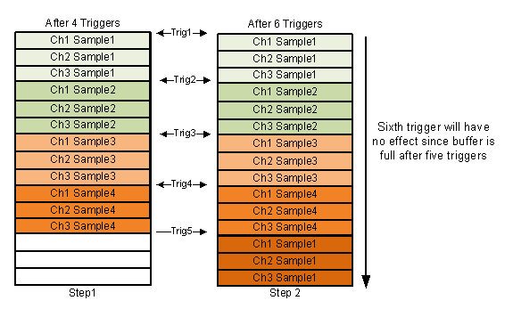
ADC Driver - VADC Functional Description & Features
Linear streaming buffer (external)
Example
Length: 15
Channels: 3
Buffer will be reset again via
VadcEnableHwTrigger(Group)

Slide 14
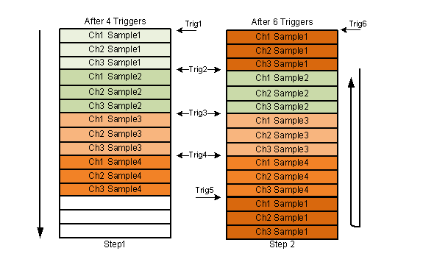
ADC Driver - VADC Functional Description & Features
Circular streaming buffer (external)
Example
Buffer length: 15
Channels: 3

Slide 15
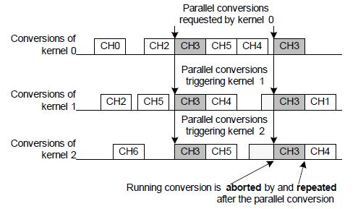
ADC Driver - VADC Functional Description & Features
Synchronized conversion
CH0,1,2,4,5: regular conversion (e.g. HwTrigger, AutoScan)
CH3: Used for parallel conversion
Internal trigger / synchronisation signal
Master:
Master:
Slave 1:
Slave 1:
Slave 2:
Slave 2:
Slave 2:

Slide 16

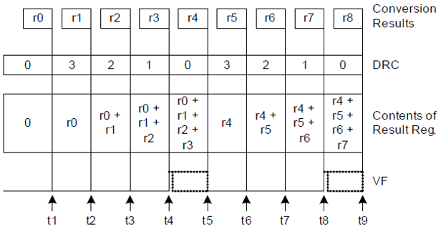
ADC Driver - VADC Functional Description & Features
Data Reduction
Used for digital anti-aliasing filtering
automatically adds up to 16 conversions before issuing a valid result
+
+
+
+
+
+

Slide 17
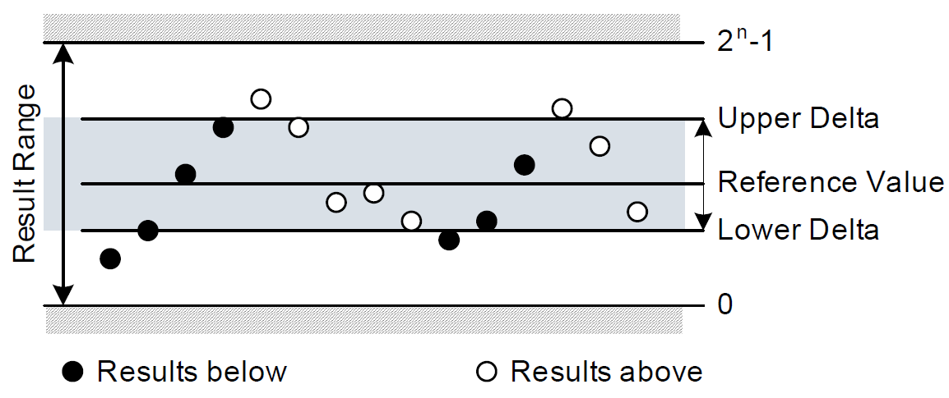
ADC Driver - VADC Functional Description & Features
Fast Compare
Up to 8 independent channels (no arbitration)
Conversion result gets compared to a configurable reverence band
The output can be routed e.g. to a output pin or a user provided function

Slide 18
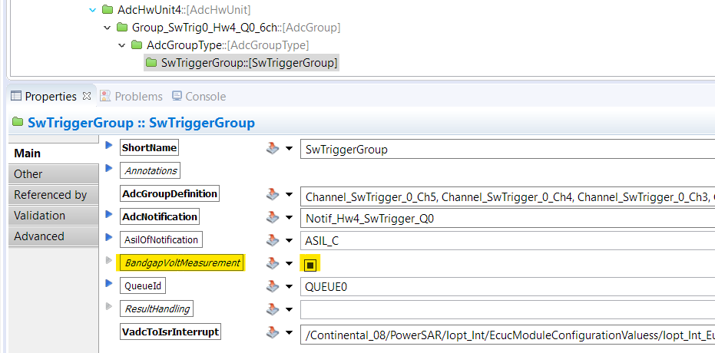
ADC Driver - VADC Functional Description & Features
Bandgap Voltage Measurement
Measuring of the bandgap voltage provided by the Power Management Subsystem (PMS).
Used for Module integrity test (ECM3)
Implemented via SwTrigger only
Internal Routing to channel 0 and channel 1 (via alias feature)

Slide 19
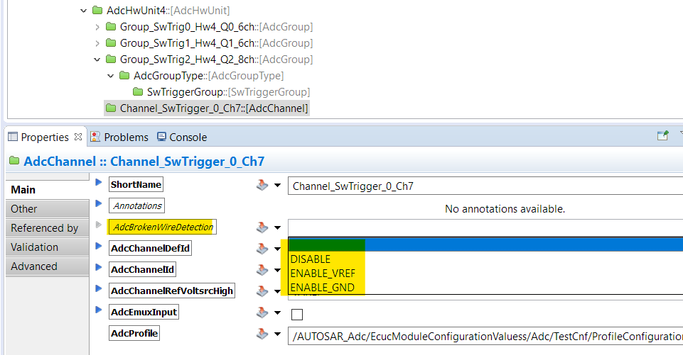
ADC Driver - VADC Functional Description & Features
Broken Wire Detection (BWD)
Test for proper connectivity
Discharge / Charege the converter network before sampling the new input channel
Reflection of a reduced result value if the input signal is no more conneted
Based on the measured voltage the user can decide necessary actions for broken wire detection.

Slide 20
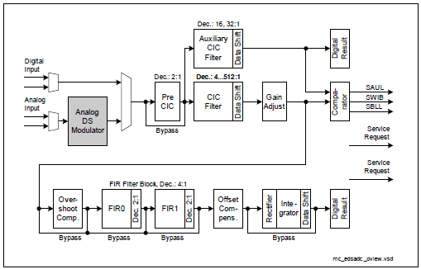
ADC Driver - DSADC What is a delta sigma ADC
The first step in a delta - sigma measurement is a delta modulation. In delta modulation the change in the signals (it´s delta) is encoded, rather than the absolute value.
The converters provide a lot of filters. Usually the settings are provided by HW team.

Slide 21
ADC Driver - DSADC Functional Description & Features
DSADC supports following conversion:
Streaming trigger
Possibility to configure different filters for removing results that are beyond range.
Main filter using finite impulse response - FIR filter.
Main filter using cascaded integrator - comb filter - CIC filter.
Auxiliary filter.
DSADC needs to be calibrated during initialization phase and during runtime.
(e.g. due to higher change of the temperature)
The DSADC is much faster than the VADC.
Once a converter is activated / started the conversion is always running.
Each converter channel operates independent to the others.
On chip modulators accept signals for single ended, differential ended or pseudo differential ended modes.

Slide 22
Agenda
1
Functional Description & Features
2
APIs
3
Integration Highlights
4
Configuration
4.1
Configuration Structure
4.2
Configuration Example
5
Dependencies
6
HW Resources
7
Constraints & Limitations

Slide 23

ADC Driver - VADC APIs
ADC_GETVERSION_IF
Adc_GetVersionInfo | Returns the version information of this module.
AR_ADC_IF
Adc_Init | This interface is used for ADC Initialization.
Adc_DeInit | This interface is used for ADC shutdown.
Adc_SetupResultBuffer | This interface is used to setup the result buffer.
Adc_GetStreamLastPointer | Returns the location in the ADC result buffer to the oldest conversion result not yet read.
Adc_EnableGroupNotification | Enables the notification mechanism for the requested ADC group.
Adc_DisableGroupNotification | Disables the notification mechanism for the requested ADC group.
Adc_StartGroupConversion | Starts the conversion of all channels of the requested ADC group.
Adc_EnableHardwareTrigger | Enables the hardware trigger for the requested ADC Channel group.
Adc_DisableHardwareTrigger | Disables the hardware trigger for the requested ADC Channel group.
Adc_ReadGroup | Returns the result values of requested group channels after conversion.

Slide 24

ADC Driver - VADC APIs
IOPT_ADC_AUTOSCAN_IF
Iopt_Adc_ActivateAutoscanTrigger | Starts the conversion for all configured Autoscan groups.
IOPT_ADC_BANDGAP_IF
Iopt_Adc_GetBandGapValues | Provides theoretical bandgap voltage along with UpperBoundaryVoltage and LowerBoundaryVoltage
IOPT_ADC_CONTROL_IF
Iopt_Adc_Init | Initializes the ADC peripheral.
Iopt_Adc_Shutdown | Stops all ADC driver activity on all configured HwUnits, resets all ADC HwUnits.
Iopt_Adc_GetGroupStatus | Returns the status of conversion for the requested group.
Iopt_Adc_GetResult | Reads the result of the latest ADC conversion for the requested channel.
Iopt_Adc_ReadGroup | Reads the latest available conversion results of the requested group.
IOPT_ADC_HWTRIGGER_IF
Iopt_Adc_EnableHardwareTrigger | Enables the Hardware Trigger signal for the given ADC group.
Iopt_Adc_DisableHardwareTrigger | Disables the Hardware Trigger signal for the given ADC group.
Iopt_Adc_GetStreamLastPointer | Returns two values, number of valid samples stored in the result buffer, the pointer to latest result.
Iopt_Adc_SetupResultBuffer | Prepares the external result buffer of a streaming type Hardware Trigger.

Slide 25
ADC Driver - VADC APIs
IOPT_ADC_SYNC_IF
Iopt_Adc_SetSyncBuffer | Prepares the user defined result buffer for synchronized conversion.
Iopt_Adc_StopSyncBuffer | Stops the running synchronized conversion and resets the used resources.
Iopt_Adc_SyncGetStreamLastPointer | Returns two values, number of valid samples stored in the result buffer and the pointer to latest results.
IOPT_ADC_SIGNAL_IF
Iopt_Adc_EnableGroupNotification | Enables the notification mechanism for the requested ADC channel group.
Iopt_Adc_DisableGroupNotification | Disables the notification mechanism for the requested ADC channel group.
IOPT_ADC_SIGNAL_IF
Iopt_Adc_StartGroupConversion | Starts conversion of all channels of the requested ADC group.

Slide 26
ADC Driver - DSADC APIs
IOPT_ADC_DS_FILTER_IF
Iopt_Adc_DsEnableFilter | Enables or disables different configuration parameters of main or comb filter.
IOPT_ADC_DS_GAIN_IF
Iopt_Adc_DsSetGain | This operation sets the gain factor of a DSADC channel.
IOPT_ADC_DS_MAIN_IF
Iopt_Adc_DsInit | Initializes all the configured features of DSADC and also the Filter configuration.
Iopt_Adc_DsShutdown | Stops all converters and resets all registers and data variables.
Iopt_Adc_DsGetStreamLastPointer | Returns two values, number of valid samples stored in the result buffer and the pointer to latest results.
Iopt_Adc_DsSetUpResultBuffer | Prepares the external result buffer where the conversion results will be stored.
Iopt_Adc_DsDisableHardwareTrigger | Disables the DSADC module to store result data inside the external user buffer.
Iopt_Adc_DsEnableHardwareTrigger | Enables the DSADC module to store result data inside the external user buffer.
Iopt_Adc_DsEnableGroupNotification | Enables or disables the activation of the notification at a completed group conversions.
Iopt_Adc_DsCalibrateDevice | Calibrates the DSADC converter due to change in the temperature or other conditions.
Iopt_Adc_DsGetCalibStatus | Returns the calibration status of the converter.
Iopt_Adc_DsActivateDevice | Activates or deactivates a particular converter.

Slide 27
ADC Driver APIs (PowerSAR)
Iopt_Adc_ActivateAutoscanTrigger
This interface starts the conversion for all configured autoscan groups.
Iopt_Adc_GetBandGapValues
This interface provides theoretical bandgap voltage along with UpperBoundaryVoltage and LowerBoundaryVoltage.
Iopt_Adc_GetGroupStatus
This operation returns the status of conversion for the requested group.
1 - Conversion of the group is completed
0 - Conversion of the group is either not requested or not completed
Iopt_Adc_GetResult
This operation is used to read the result of the latest ADC conversion for the requested channel. This interface can be used for autoscan group, software trigger group or hardware trigger group with the internal result buffer. The result value is left shifted by 3 bits to get a 15 bit alignment.
Iopt_Adc_ReadGroup
The function Adc_ReadGroup read the latest available conversion results of the requested group. Reads the group conversion result of the last completed conversion round of the requested group and stores the channel values starting at the DataBufferPtr address.

Slide 28
ADC Driver APIs (PowerSAR)
Iopt_Adc_EnableHardwareTrigger
This interface enables the hardware trigger signal for the given ADC group. This operation prepares the ADC converter and related variables to start hardware trigger based conversion.
Iopt_Adc_DisableHardwareTrigger
This interface disables the hardware trigger signal for a given ADC group. It also stops the ongoing conversion of the given ADC group.
Iopt_Adc_GetStreamLastPointer
This interface returns two values, number of valid samples stored in the result buffer, the pointer to latest result.
Iopt_Adc_SetupResultBuffer
This operation prepares the external result buffer of a streaming type hardware trigger.
Iopt_Adc_EnableGroupNotification
This interface enables the notification mechanism for the requested ADC channel group. This interface has to be called before starting the ADC group conversions.

Slide 29
ADC Driver APIs (PowerSAR)
Iopt_Adc_DisableGroupNotification
This interface disables the notification mechanism for the requested ADC channel group.
Iopt_Adc_StartGroupConversion
This interface starts conversion of all channels of the requested ADC group. Software trigger based conversion results are stored in the internal result buffer which can be accessed by calling the interface GetResult.
Iopt_Adc_SetSyncBuffer
This operation is used to setup the user defined result buffer, ADC converter for Synchronize conversion and other variables which are used for synchronized conversions.
Iopt_Adc_StopSyncBuffer
This interface stops the running synchronize conversion and resets the used resources.
Iopt_Adc_SyncGetStreamLastPointer
This interface returns two values, number of valid samples stored in the result buffer and the pointer to latest results. In circular buffer when the number of samples exceeds the buffer size, the maximum buffer size is returned.

Slide 30
ADC Driver APIs (AUTOSAR R4.3)
Function | Explanation | Deviation to AUTOSAR
Adc_Init (Iopt_Adc_Init) | This function initializes the ADC driver with the configuration structure which specifies the required configuration of the ADC driver. It initializes autoscan, software trigger, hardware trigger, sync trigger and streaming trigger conversion modes if they are configured. | -
Adc_DeInit (Iopt_Adc_Shutdown) | This function stops all ADC driver activity on all configured devices and resets the used hardware. | Adc_DeInit can be called irrespective of any group state as ADC group status is not implemented.

Slide 31
ADC Driver APIs (AUTOSAR R4.3)
Function | Explanation | Deviation to AUTOSAR
Adc_SetupResultBuffer (Iopt_Adc_SetupResultBuffer) | This interface is used to initialize the result buffer pointer of the selected conversion group with the address value passed as parameter. | Adc_SetupResultBuffer initializes the result buffer pointer of the selected conversion group with the address value passed as parameter only for streaming conversion group.
Adc_GetStream LastPointer (Iopt_Adc_GetStreamLastPointer) | This interface is used to set the pointer, passed as parameter (PtrToSamplePtr) to point to the ADC result buffer to the oldest conversion, where the result was not yet read. | Returns the number of valid samples per channel only for streaming group conversion. Pointer to the address of the oldest conversion element not yet read. ADC_RESULT_ALIGNMENT is the natural alignment coming from the HW. Group status is not implemented with - call during ADC_BUSY returns NULL. - No state transition trigger for group status. - No guarantee for consistency.

Slide 32
ADC Driver APIs (AUTOSAR R4.3)
Function | Explanation | Deviation to AUTOSAR
Adc_EnableGroupNotification (Iopt_Adc_EnableGroupNotification(Group,1)) | The interface is used to enable the notification mechanism for the requested ADC channel conversion group. | -
Adc_DisableGroupNotification (Iopt_Adc_DisableGroupNotification (Group,0)) | The interface is used to disable the notification mechanism for the requested ADC channel conversion group. | -

Slide 33
ADC Driver APIs (AUTOSAR R4.3)
Function | Explanation | Deviation to AUTOSAR
Adc_EnableHardwareTrigger (Iopt_Adc_EnableHwTrigger(Group,1)) | This interface is used to enable the hardware trigger for the requested ADC channel conversion group. | The following requirement is not implemented: “The function Adc_EnableHardwareTrigger shall reset the internal group result buffer pointer, that conversion result storage always starts, after calling Adc_EnableHardwareTrigger, at the result buffer base address which was configured with Adc_SetupResultBuffer”.
Adc_DisableHardware Trigger (Iopt_Adc_EnableHwTrigger(Group,0)) | This interface is used to disable the hardware trigger for the requested ADC channel conversion group. | Adc_DisableHardwareTrigger does not set the group status to state ADC_IDLE as ADC group status is not implemented.

Slide 34
ADC Driver APIs (AUTOSAR R4.3)
Function | Explanation | Deviation to AUTOSAR
Adc_StartGroupConversion | This interface is used to start the conversion of all channels of the requested ADC Channel conversion group. Only for groups configured with software trigger source. | Conversion result storage starts from the first address of the internal buffer. (The result buffer base address set by Adc_SetupResultBuffer() can be used only for streaming conversion channels.)
Adc_ReadGroup | Reads group conversion result of the last completed conversion round. | DSADC: ADC_RESULT_ALIGNMENT is the natural alignment coming from the HW. VADC: ADC_RESULT_ALIGNMENT is right aligned and not configurable. Calling Adc_ReadGroup does not trigger the required state transition as ADC Group Status is not implemented.
Can not be used for streaming conversion groups
!

Slide 35
ADC Driver APIs (AUTOSAR R4.3)
Deviations of functional requirements
No service is provided to stop running conversion of a SwTrigger Group
No service is provided to get the ConverterGroup Status
Adc_GetStreamLastPointer() service can only be used for streaming conversion (burst)
Limit checking feature for HwTrigger is not implemented (yet). Channel specific limit checking is only implemented for fast compare channels
ADC channels can be assigned to more than one group with some limitations. Please refer the DIM for Iopt_Adc for limitations and constraints

Slide 36
IOPT_ADC Driver APIs - DSADC
Iopt_Adc_DsEnableFilter
This operation enables or disables different configuration parameters of main or comb filter. This interface can also reset main or comb filter. If the user does not pass correct command (or no command) for the given filter parameter, then this interface makes that filter parameter to the reset value.
Iopt_Adc_DsSetGain
This operation sets the gain factor of a DSADC channel. Gain factor of analog input path can be set to 1, 2 or 4.
Iopt_Adc_DsGetStreamLastPointer
This interface returns two values, number of valid samples available to copy from the time when last read happened and the pointer to the latest result. After each call of this interface, the pointer and result count are reset to the new values. In case of circular buffer, when the number of samples has exceeded the buffer size, the maximum buffer size is returned.

Slide 37
IOPT_ADC Driver APIs - DSADC
Iopt_Adc_DsSetUpResultBuffer
This interface prepares the external result buffer where the conversion results will be stored. This interface must be called each time before calling the Iopt_Adc_DsEnableHardwareTrigger interface.
Iopt_Adc_DsEnableHardwareTrigger
This interface enables the DSADC module to store result data inside the external user buffer and it also enables the used DMA or INT resources.
Iopt_Adc_DsDisableHardwareTrigger
This interface disables the DSADC module to store result data inside the external user buffer and it also disables the used DMA or INT resources.
Iopt_Adc_DsEnableGroupNotification
This operation enables or disables the activation of the notification at a completed group conversions. This interface must be called before starting the conversion. This operation can be used with hardware trigger with streaming linear buffer. When the buffer is full, notification is generated for the user function. External linear buffer mode supports only the notification mechanism, whereas the external circular buffer mode does not support it.

Slide 38
IOPT_ADC Driver APIs - DSADC
Iopt_Adc_DsCalibrateDevice
This interface is used to calibrate the DSADC converter due to change in the temperature or other conditions which affects DSADC normal operation. The user must make sure that the conversions are not requested when the calibration is running.
Iopt_Adc_DsGetCalibStatus
The user can poll current status of calibration of needed converter with this interface. This interface returns the calibration status as uncalibrated, running, calibrated or terminated for the given converter.
Iopt_Adc_DsActivateDevice
This interface activates or deactivates a particular converter. This operation can also be used to activate or deactivate more than one converter at the same time when synchronized operation is required.

Slide 39
Agenda
1
Functional Description & Features
2
APIs
3
Integration Highlights
4
Configuration
4.1
Configuration Structure
4.2
Configuration Example
5
Dependencies
6
HW Resources
7
Constraints & Limitations

Slide 40
ADC Driver - VADC Integration Highlights
Software trigger mode
One interrupt channel is needed for each conversion group
Hardware trigger mode and streaming mode
One DMA channel per conversion group
Three interrupt channels per conversion group
Service request handling of VADC conversion group (to trigger DMA after conversion)
DMA transaction finished (resetting DMA, call user notification)
Sync trigger mode
1 + x interrupt channels per Sync “Family”
Service request handling of VADC master and each slave (to trigger DMA after conversion)
General
One PWM channel per trigger has to be configured if the GTM is used as trigger
PORT channel configuration is needed for using GPIO pins as trigger

Slide 41
ADC Driver - DSADC Integration Highlights
Hardware trigger streaming mode
One DMA channel per channel.
Two interrupt channels per DSADC channel, one for service request handling of the DSADC and another for the DMA after copying the results from the registers to the result buffer.

Slide 42
Agenda
1
Functional Description & Features
2
APIs
3
Integration Highlights
4
Configuration
4.1
Configuration Structure
4.2
Configuration Example
5
Dependencies
6
HW Resources
7
Constraints & Limitations

Slide 43
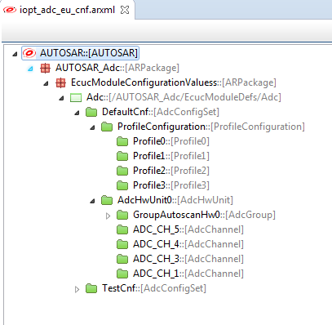
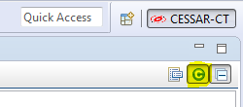
ADC Driver - VADC Configuration
General configuration structure
Display the class type along with the Object

Slide 44

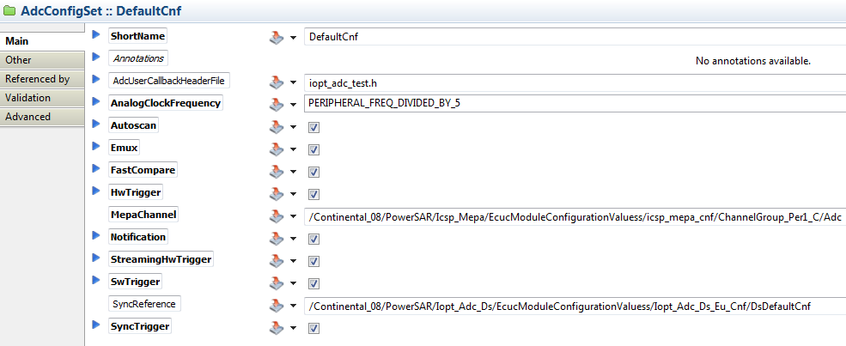
ADC Driver - VADC Configuration - AdcConfigSet

Slide 45
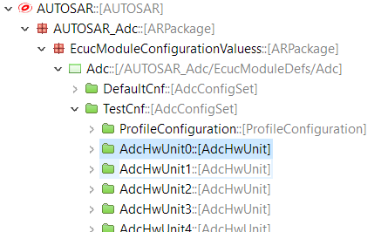
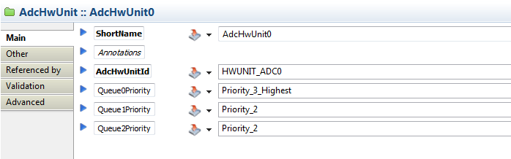
ADC Driver - VADC Configuration - AdcHwUnit

Slide 46
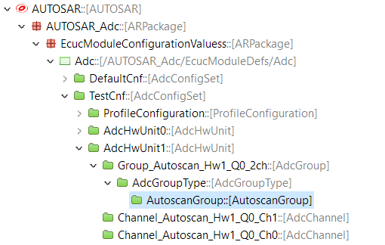
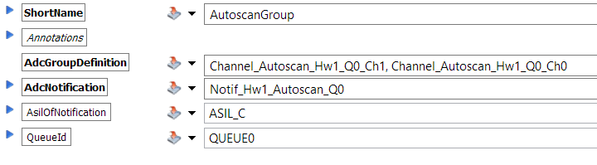
ADC Driver - VADC Configuration - AutoscanGroup

Slide 47
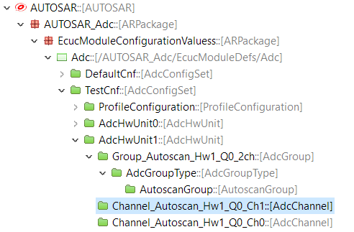
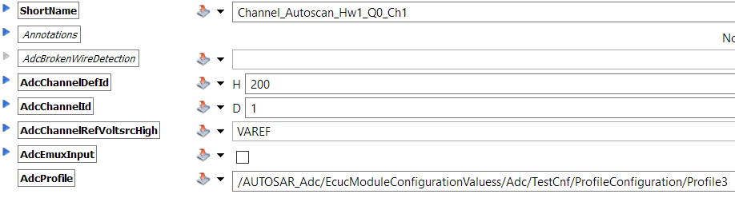
ADC Driver - VADC Configuration - AdcChannel

Slide 48
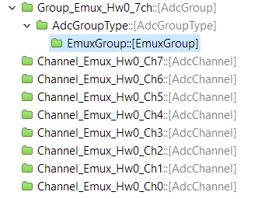
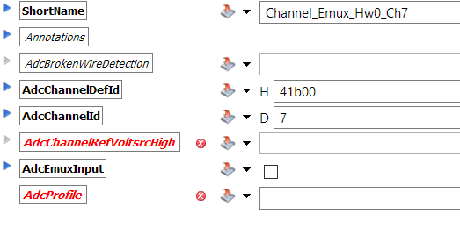
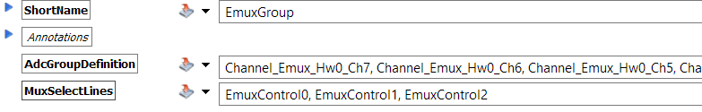
ADC Driver - VADC Configuration - EmuxGroup

Slide 49
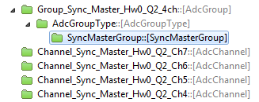
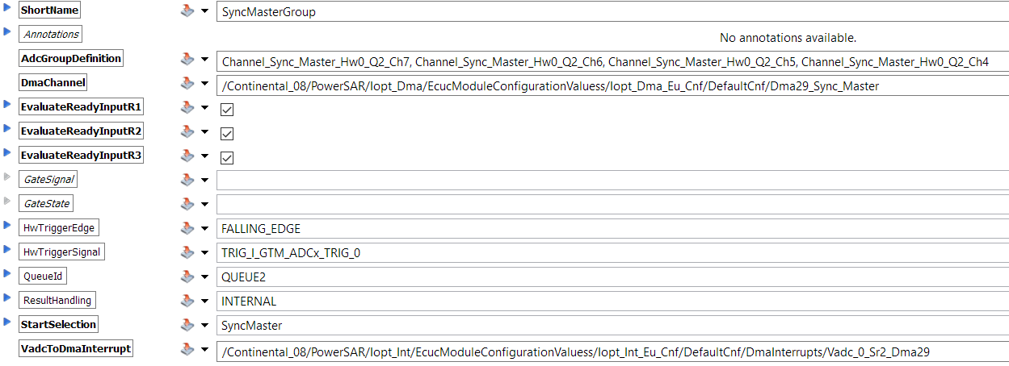
ADC Driver - VADC Configuration - SyncMasterGroup

Slide 50
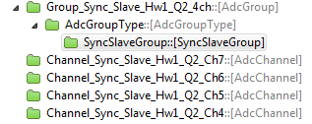
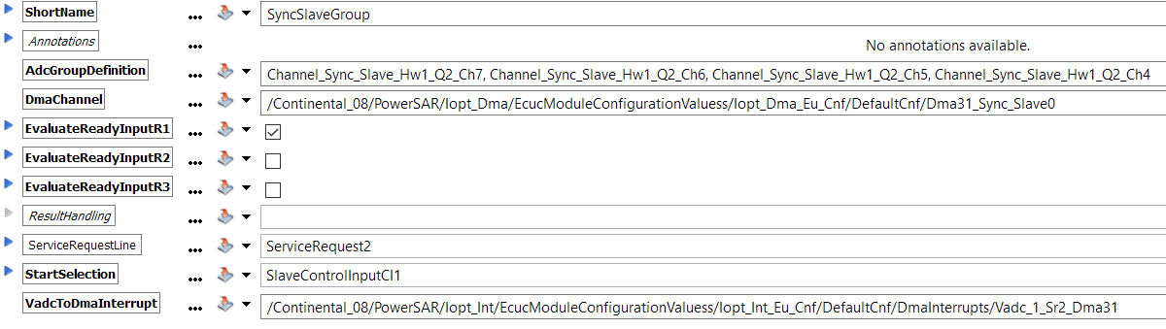
ADC Driver - VADC Configuration - SyncSlaveGroup

Slide 51
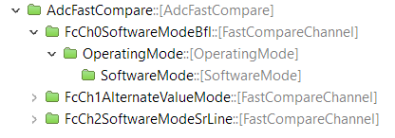
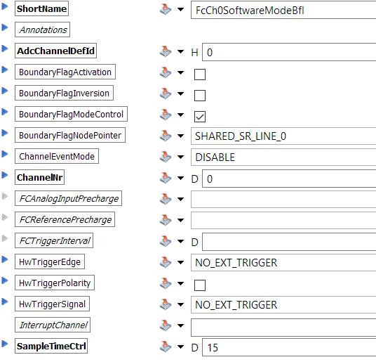
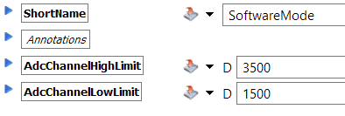
ADC Driver - VADC Configuration - FastCompare

Slide 52
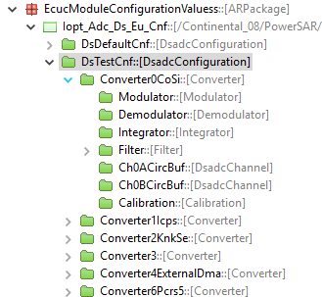
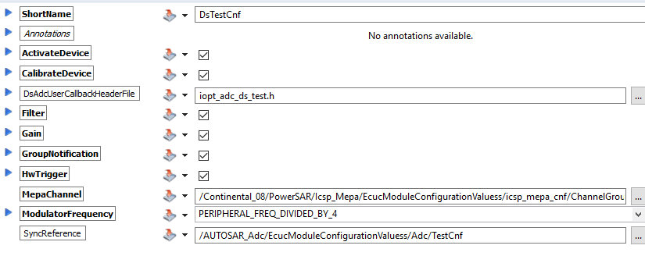
ADC Driver Configuration Example - DSADC module
Configuration
General configuration structure

Slide 53
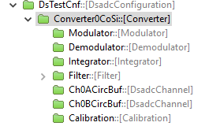
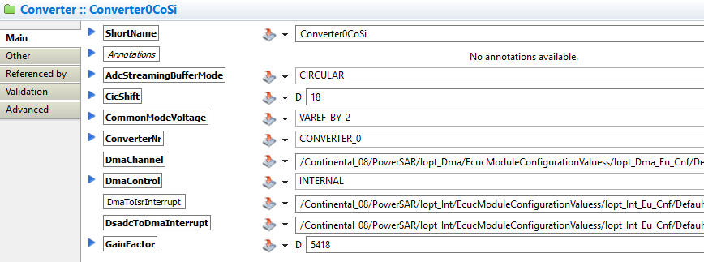
ADC Driver Configuration Example - DSADC module
Converter

Slide 54
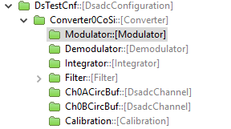
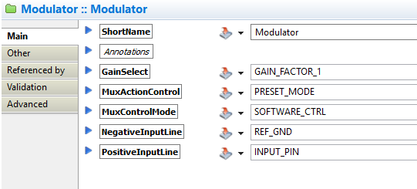
ADC Driver Configuration Example - DSADC module
Modulator

Slide 55
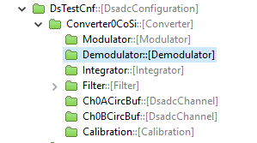
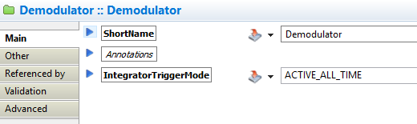
ADC Driver Configuration Example - DSADC module
Demodulator

Slide 56
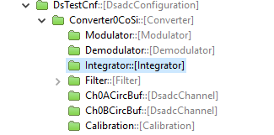
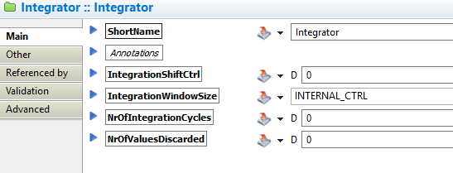
ADC Driver Configuration Example - DSADC module
Integrator

Slide 57
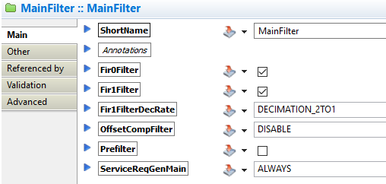
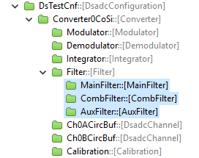
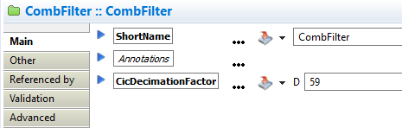
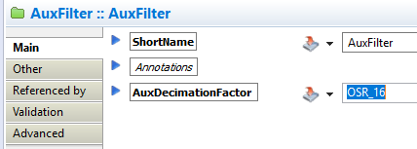
ADC Driver Configuration Example - DSADC module
Filter

Slide 58
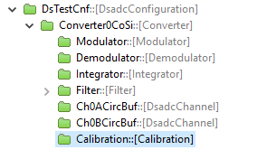
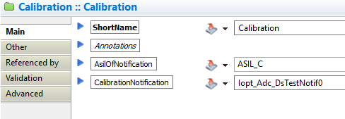
ADC Driver Configuration Example - DSADC module
Calibration

Slide 59
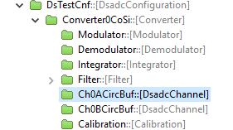
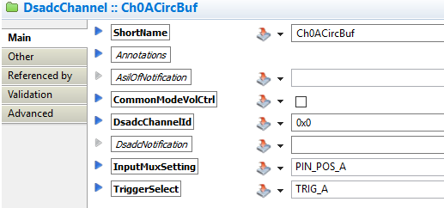
ADC Driver Configuration Example - DSADC module
DsadcChannel

Slide 60
Agenda
1
Functional Description & Features
2
APIs
3
Integration Highlights
4
Configuration
4.1
Configuration Structure
4.2
Configuration Example
5
Dependencies
6
HW Resources
7
Constraints & Limitations

Slide 61
ADC Driver Dependencies
IOPT_CORE
use

Slide 62
Agenda
1
Functional Description & Features
2
APIs
3
Integration Highlights
4
Configuration
4.1
Configuration Structure
4.2
Configuration Example
5
Dependencies
6
HW Resources
7
Constraints & Limitations

Slide 63

ADC Driver Hardware Resources

Slide 64
Agenda
1
Functional Description & Features
2
2
APIs
6
3
Integration Highlights
8
4
Configuration
10
4.1
Configuration Structure
4.2
Configuration Example
5
Dependencies
13
6
HW Resources
15
7
Constraints & Limitations
17

Slide 65
ADC Driver - VADC Constraints & Limitations
Max three of four trigger groups per Hardware Unit (HwUnit)
AutoScan
Software Trigger (SwTrigger)
Hardware Trigger (HwTrigger)
Synchronized Trigger (Master / Slave)
Either master or slave sync. group can be configured on a single hardware unit.
The external result buffer (streaming buffer) must be
associated with ASIL_C safety level
accessible by DMA (RessourcePatition)

Slide 66
ADC Driver - DSADC Constraints & Limitations
Either hardware or software
The external result buffer must have ASIL_C safety class level for the buffer allocation and the buffer memory must accessible by DMA. The DMA driver integration manual provides more details about the DMA buffer allocation.

Slide 67


Thank You
Please Feel Free To Ask Questions
?

