Slide 1

DIO Driver Training Slides
ECU17
www.continental-corporation.com
Rev. 1.0 / 09-Aug-2018 / P ES SE EEA BSWP

Slide 2
Agenda
1
Functional Description & Features
2
2
APIs
6
3
Integration Highlights
8
4
Configuration
10
4.1
Configuration Structure
4.2
Configuration Example
5
Dependencies
13
6
HW Resources
15
7
Constraints & Limitations
17

Slide 3
Functional Description & Features
The generic DIO functionality handles the microcontroller's pins (e.g. PORT or MSC) and ASIC pins. The driver is able to read the logical level or physical state of a pin and to control the logical level or physical state of an output pin.
All processor resources are covered which are able to perform the DIO functionality for setting or getting the state or level.

Slide 4
Agenda
1
Functional Description & Features
2
2
APIs
6
3
Integration Highlights
8
4
Configuration
10
4.1
Configuration Structure
4.2
Configuration Example
5
Dependencies
13
6
HW Resources
15
7
Constraints & Limitations
17

Slide 5
APIs
Iopt_Dio_Init - It initializes the given configuration instance.
Iopt_Dio_SetOutput - It sets the logical level or physical state of the given DIO channel
Iopt_Dio_GetOutput - It gets the logical level or physical state of the given DIO channel
Iopt_Dio_ReadChannelGroup- It reads a subset of the adjoining bits of a port, as an LSB aligned value.
Iopt_Dio_WriteChannelGroup- It sets a subset of the adjoining bits of a port to a specified level, without changing the remaining channels of the port and the channels configured as input.
Iopt_Dio_ReadPort- It reads the level of all channels of a port.
Iopt_Dio_WritePort- It sets the level of all channels of a port.
Iopt_Dio_FlipChannel- It flips the level of a channel (change from 1 to 0 or from 0 to 1).

Slide 6
Agenda
1
Functional Description & Features
2
2
APIs
6
3
Integration Highlights
8
4
Configuration
10
4.1
Configuration Structure
4.2
Configuration Example
5
Dependencies
13
6
HW Resources
15
7
Constraints & Limitations
17

Slide 7
Integration Highlights
DIO driver is dependent on MSC and ASIC configurations if these pins are controlled via DIO operations.

Slide 8
Agenda
1
Functional Description & Features
2
2
APIs
6
3
Integration Highlights
8
4
Configuration
10
4.1
Configuration Structure
4.2
Configuration Example
5
Dependencies
13
6
HW Resources
15
7
Constraints & Limitations
17

Slide 9
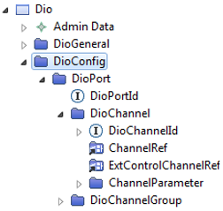
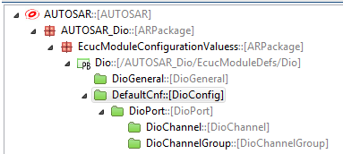
Configuration Structure

Slide 10
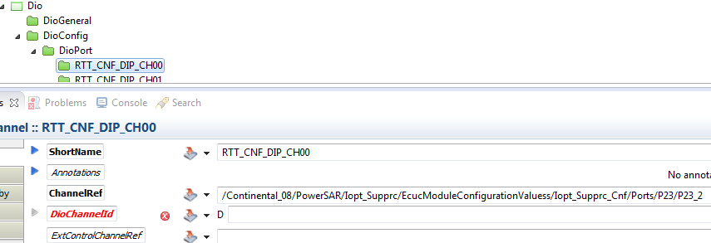
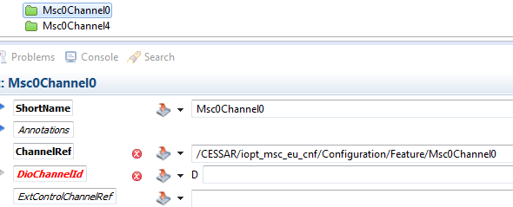
Configuration Example
Port pin
MSC Channel

Slide 11
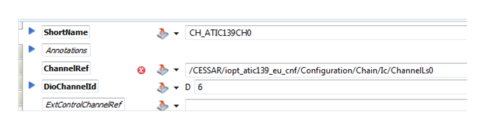
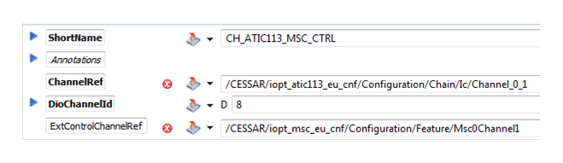
Configuration Example
ASIC Channel
ASIC channel parallel control over MSC channel.

Slide 12
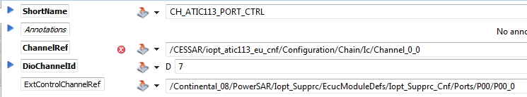
Configuration Example
ASIC channel parallel control over PORT channel.

Slide 13
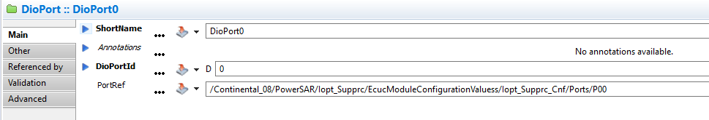
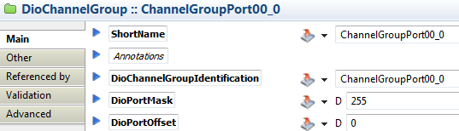
Configuration Example
Access to all pins of same Port peripheral
DioChannelGroup

Slide 14
Agenda
1
Functional Description & Features
2
2
APIs
6
3
Integration Highlights
8
4
Configuration
10
4.1
Configuration Structure
4.2
Configuration Example
5
Dependencies
13
6
HW Resources
15
7
Constraints & Limitations
17

Slide 15
Dependencies

Slide 16
Agenda
1
Functional Description & Features
2
2
APIs
6
3
Integration Highlights
8
4
Configuration
10
4.1
Configuration Structure
4.2
Configuration Example
5
Dependencies
13
6
HW Resources
15
7
Constraints & Limitations
17

Slide 17
HW Resources
General Purpose I/O Ports and Peripheral I/O Lines (Ports)
MSC and ASIC input/output channel

Slide 18
Agenda
1
Functional Description & Features
2
2
APIs
6
3
Integration Highlights
8
4
Configuration
10
4.1
Configuration Structure
4.2
Configuration Example
5
Dependencies
13
6
HW Resources
15
7
Constraints & Limitations
17

Slide 19
Constraints & Limitations
Check microcontroller manual for available port channels which can be used for DIO application.
PORT/MSC/ASIC channels need to be configured in the respective drivers before they are used by DIO operations. All dependent drivers must be initialized before DIO driver.
MSC and ASIC pre-process should be called before DIO pre-process if they are controlled by DIO.

Slide 20
Document History
Revision | Changes | Valid for
1.0 | First version for ECU17 | DIO_1.3.0

