Slide 1

ICU Driver Training Slides
ECU17
www.continental-corporation.com
14-Mar-2019 / P E&DS SE EEA BSW

Slide 2
Agenda
1
Functional Description & Features
2
2
APIs
17
3
Integration Highlights
25
4
Configuration
26
4.1
Configuration Structure
4.2
Configuration Example
5
Dependencies
44
6
HW Resources
46
7
Constraints & Limitations
48

Slide 3
Functional Description & Features
The ICU driver manages digital signal inputs
The ICU driver provides the following features
Count the number of Active Edges* on the Input pulse
Call an Interface when the Active Edge* is detected
Measure the Period and ActiveTime** of an Input PWM signal
Capture the Timestamps to a buffer when the ActiveEdge* is detected
Get the EdgeCount and EdgeTime from the latest ActiveEdge on Input pulse
(*Active Edge can be Rising Edge or Falling Edge or Both Edges depending on user configuration)
(**Active Edge for PWM Signal measurement should be only be Rising edge or Falling edge)

Slide 4
Functional Description & Features
Notes:
The ICU driver provides several features.
Each channel is configured with only one feature except the Read input state which can be used combined with any other feature.
Init and Shutdown are the only default features of the driver. All other features are optional.
The API is available on every cores of the processor. It is possible to read measurements of a same channel from different cores.

Slide 5
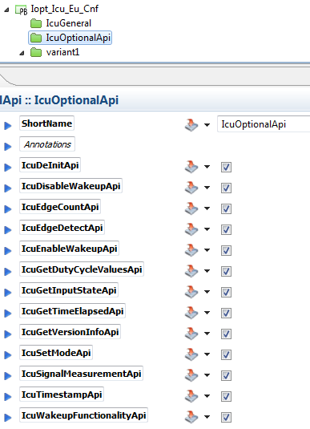
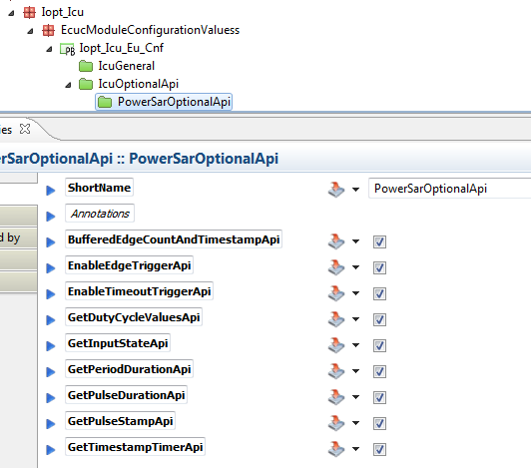
AUTOSAR and PowerSAR API‘s
The ICU driver provides two sets of interfaces.
The PowerSAR APIs and the AUTOSAR APIs.
PowerSAR APIs can be selected in the container PowerSarOptionalApi.
AUTOSAR APIs can be selected in the container IcuOptionalApi

Slide 6
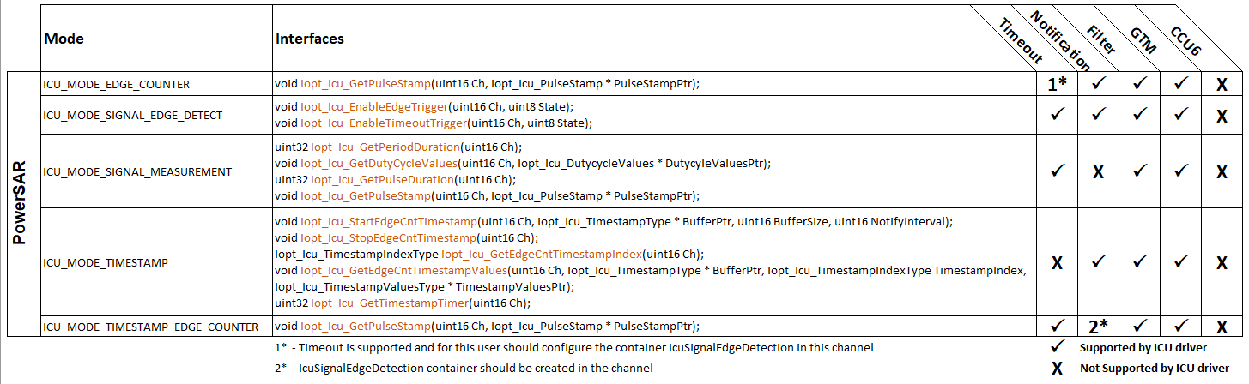
Features - PowerSAR

Slide 7
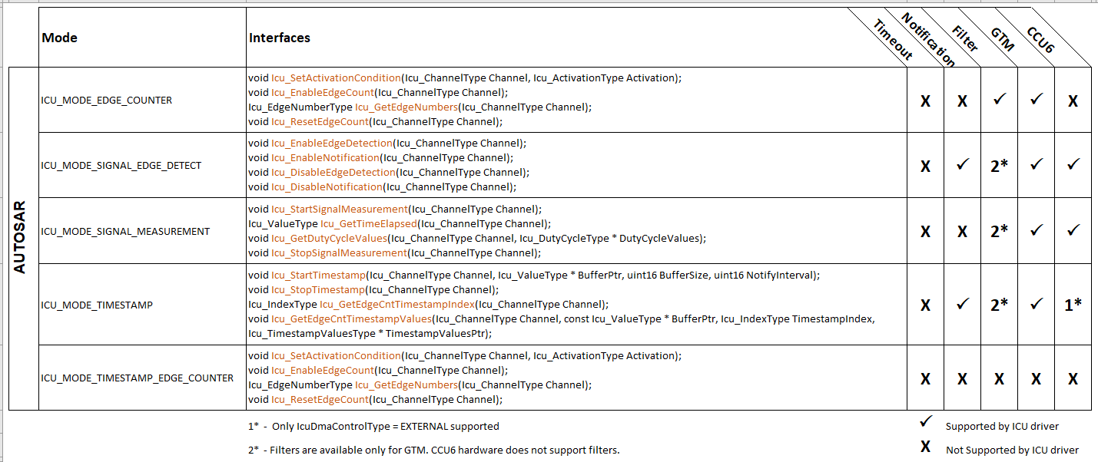
Features - AUTOSAR

Slide 8
Feature - “Period” and “Period with active time” measurement
The GTM allows to perform signal measurement without interrupt (except for timeout management). Therefore the CPU load increasement produced by this ICU channel does not depend on the input signal’s frequency but it only depends on the call frequency of its API by its users.
No counter overflow management is done for period and active time measurement. Therefore the returned period and active time values are limited to the 24-bit range of this counter. If the counter overflow, the measurement values are not be valid and it is not be possible to detect it.
Optional triggers can be raised for end of period and timeout.
Timeout management: timeout runs from the last IcuDefaultStartEdge.

Slide 9
Features- “Period” and “Period with active time” measurement
How does it work? A reset counter is used to measure the number of clock ticks elapsed in-between two active edges. An additional timeout counter can be used to invalidate a measurement after a configured time.

Slide 10
Feature – “Active time” measurement
The GTM was not designed to support this feature. Therefore this feature is provided with some limitations: each time the result interface is called, the measurement is not set to 0 as long as a new measurement is done.
This feature is performed without interrupt. Therefore the CPU load increase produced by this ICU channel does not dependent on the input signal’s frequency but it only depends on the call frequency of its API by its users.
No counter overflow management is done. Therefore the returned values are limited to the 24-bit range of this counter.

Slide 11
Feature – “Active time” measurement
How does it work? A reset counter is used to measure the number of clock ticks elapsed in-between active and inactive edges.

Slide 12
Feature – Edge count with timestamp coherent
Similarly this feature is performed without interrupt. Therefore the CPU load increase produced by this ICU channel does not dependent on the input signal’s frequency but it only depends on the call frequency of its API by its users.
No counter overflow management is done neither for the edge counter nor the timestamp counter. Therefore the returned values are limited to the 24-bit range of this counter.
Optional trigger can be raised for active edge detection and timeout.
Timeout management: timeout runs from the last IcuDefaultStartEdge.

Slide 13
Feature – Edge count with timestamp coherent
How does it work? An active edge captures a free running timer and increments an edge counter.

Slide 14
Feature – Buffered edge count with timestamp coherent
This feature allows capturing a timestamp and increment a counter into a buffer when the configured default start edge (active edge) is detected on the input signal.
The buffer can be linear or circular.
This feature is performed with DMA. Therefore the CPU load increase produced by this ICU channel does not dependent on the input signal’s frequency but it only depends on the call frequency of its API by its users.
No counter overflow management is done neither for the edge counter nor the timestamp counter. Therefore the returned values are limited to the 24-bit range of the timestamp counter.
Optional trigger can be raised after a number of active edge detected.
Similary as before, an active edge captures a free running timer and increments an edge counter then the data is transferred into the buffer.

Slide 15
Feature – Edge detection notification
This feature allows to call a callback function when an active edge is detected on the input signal.

Slide 16
Feature – Read input state
This feature allows to get the input state of a given channel.
When a digital filter is enabled, it is the filtered input state which is returned.

Slide 17
Agenda
1
Functional Description & Features
2
2
APIs
17
3
Integration Highlights
25
4
Configuration
26
4.1
Configuration Structure
4.2
Configuration Example
5
Dependencies
44
6
HW Resources
46
7
Constraints & Limitations
48

Slide 18
APIs - Init & Shutdown
PowerSAR APIs
ICU driver has to be initialized with Iopt_Icu_Init() and stopped with Iopt_Icu_Shutdown()
AUTOSAR APIs
ICU driver has to be initialized with Icu_Init() and stopped with Icu_DeInit()

Slide 19
APIs - “Period” and “Period with active time” measurement
PowerSAR API
Iopt_Icu_GetPeriodDuration() returns the period of the input signal on 24 bits.
Iopt_Icu_GetDutyCycleValues() returns the period and active time of the input signal on 24 bits with the structure Iopt_Icu_DutyCycleValues.
AUTOSAR API
Icu_GetDutyCycleValues() returns the period and active time of the input signal on 24 bits with the structure Iopt_Icu_DutyCycleValues.
Struct Iopt_Icu_DutycycleValues_tag
{
uint32 Period; /**< Period duration */
uint32 ActiveTime; /**< Active signal duration */
};

Slide 20
APIs – “Active time” measurement
Iopt_Icu_GetPulseDuration() returns the active time of the input signal on 24 bits.

Slide 21
APIs – Edge count with timestamp coherent
Iopt_Icu_GetPulseStamp() returns the timestamp and edge count since driver initialization or since the counters overflowed in the Iopt_Icu_PulseStamp structure.
struct Iopt_Icu_PulseStamp_tag
{
uint32 EdgeCount; /**< Number of active edges counted since the reset of this counter. */
uint32 EdgeTime; /**< Time stamp of the last active edge */
};
Iopt_Icu_GetTimestampTimer() returns the current value of the free running time counter used to create the 24-bit timestamps.
This mode cannot be used with the AUTOSAR APIs.

Slide 22
APIs – Buffered edge count with timestamp coherent
Iopt_Icu_GetEdgeCntTimestampValues() returns the timestamp and edge count of any element from the buffer in the Iopt_Icu_TimestampValuesType structure.
struct Iopt_Icu_TimestampValuesType_tag
{
uint32 EdgeCount; /** Number of active edges counted since the reset of this counter. */
uint32 EdgeTime; /** Time stamp of the last active edge */
};
Iopt_Icu_GetEdgeCntTimestampIndex() returns the current index of the next free element of the buffer.
Acquisition is stopped after driver initialization. It can be started with Icu_StartTimestamp() and then stopped with Icu_StopTimestamp()

Slide 23
APIs – Edge detection notification
After driver initialization notifications are disabled (See Init & Shutdown).
PowerSAR API:
The interface Iopt_Icu_EnableEdgeTrigger() must be called in order to enable/disable the timeout notification.
AUTOSAR API:
The interfaces Icu_EnableEdgeDetection() and Icu_EnableNotification() should be called to activate edge detection
The interfaces Icu_DisableNotification() and Icu_DisableEdgeDetection() should be called to deactivate edge detection

Slide 24
APIs – Read input state
Iopt_Icu_GetInputState() returns the current signal state on 1-bit.

Slide 25
Agenda
1
Functional Description & Features
2
2
APIs
17
3
Integration Highlights
25
4
Configuration
26
4.1
Configuration Structure
4.2
Configuration Example
5
Dependencies
44
6
HW Resources
46
7
Constraints & Limitations
48

Slide 26
Agenda
1
Functional Description & Features
2
2
APIs
17
3
Integration Highlights
25
4
Configuration
26
4.1
Configuration Structure
4.2
Configuration Example
5
Dependencies
44
6
HW Resources
46
7
Constraints & Limitations
48

Slide 27
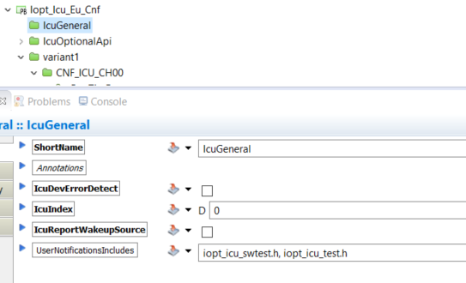
Configuration structure – IcuGeneral
Notes:
IcuDevErrorDetect: Switches the Development Error Detection and Notification on or off.
WARNING: This feature is not supported. Disable it.
IcuIndex: Specifies the InstanceId of this module instance. If only one instance is present it shall have the Id 0.
The current driver implementation does not support multiple instances. Set it to 0
IcuReportWakeupSource: Switch for enabling Wakeup source reporting.
WARNING: This feature is not supported. Disable it.

Slide 28
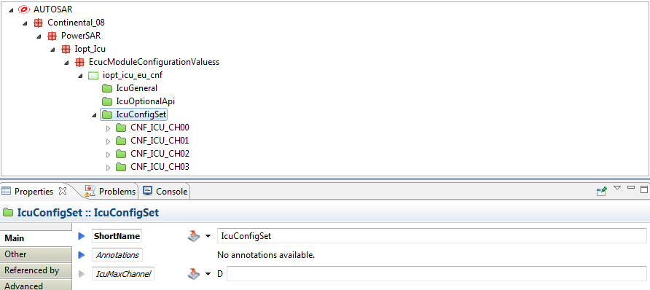
Configuration structure – IcuConfigSet
Notes:
This container is the base for a multiple configuration set.
ShortName: Name of the configuration set. Every configuration set should have an unique name in order to have a proper structure exportation
IcuMaxChannel: Not used. Leave it empty. It will be automatically filled during the preprocess.

Slide 29
Configuration structure – IcuChannel
Measurement modes overview
The measurement modes define how the input signal will be process:
ICU_MODE_EDGE_COUNTER: Active edges are counted continuously (Autosar only).
ICU_MODE_TIMESTAMP: A free running timer is captured on each active edge detected and stored into a buffer.
ICU_MODE_TIMESTAMP_EDGE_COUNTER: A free running timer is captured on each active edge detected.
ICU_MODE_SIGNAL_EDGE_DETECT: Call a notification function when the configured active edge is detected.
ICU_MODE_SIGNAL_MEASUREMENT: Period and active time of the input signal is measured continuously.

Slide 30
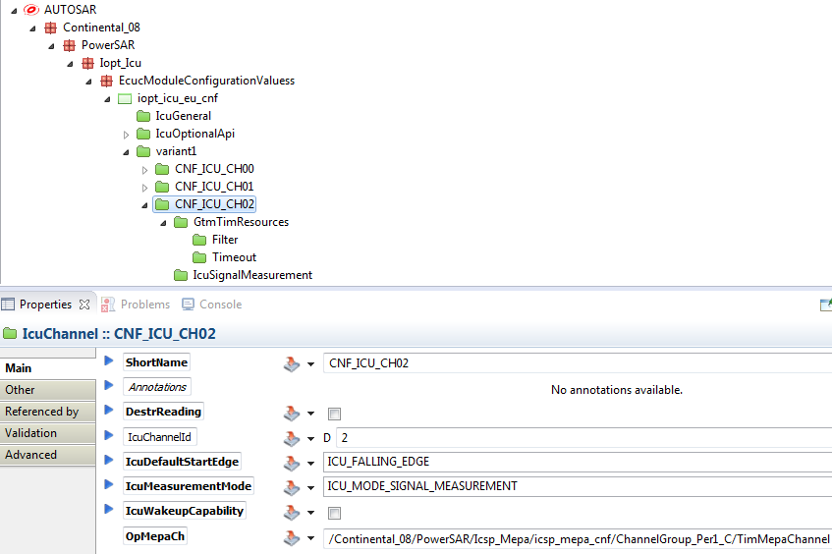
Configuration structure – IcuChannel - ICU_MODE_SIGNAL_MEASUREMENT mode
Notes:
This mode allows signal durations measurement (period, active time). Measured values can be read with the API: GetPulseDuration(), GetDutyCycleValues(), GetPeriodDuration()
ShortName: Channel name. A #define IOPT_ICU_CNF_<channel name> will be generated in the iopt_icu_cnf.h.
For example, #define IOPT_ICU_CNF_CNF_ICU_CH00 0x0. All interfaces should be called with this define as a parameter for Ch.
ChannelIn: see Channel Input source selection.
IcuDefaultStartEdge: In ICU_MODE_SIGNAL_MEASUREMENT mode only Rising edge and Falling edge are available. This is the first edge of a new period or a new pulse.
Note: A Rising edge is a former A-type PWM as input. A Falling edge is a former B-type PWM as input. The C and D-type PWM are no longer relevant as the driver triggers the ASW only on an end of period triggers and the dutycycle is returned not by % but with Active time and Period.
DestrReading: Each time the result interface is called, the measurement is set to 0 as long as a new measurement is done. This strategy is only available for period or period and active time measurement. Warning! this strategy is not compatible with PowerSAR ECM2. It is available for Autosar compliance.
IcuMeasurementMode: ICU_MODE_SIGNAL_MEASUREMENT.
OpMepaCh: MEPA message channel for operation and parameters for inter-cores communication inside the ICU driver (see MEPA channel configuration).
The priority of the interrupt used by the MEPA channel should always be lower than the priority of the TIM channel. The MEPA channel interrupt needs to be placed in a group with lower priority than the group of the TIM channel.

Slide 31
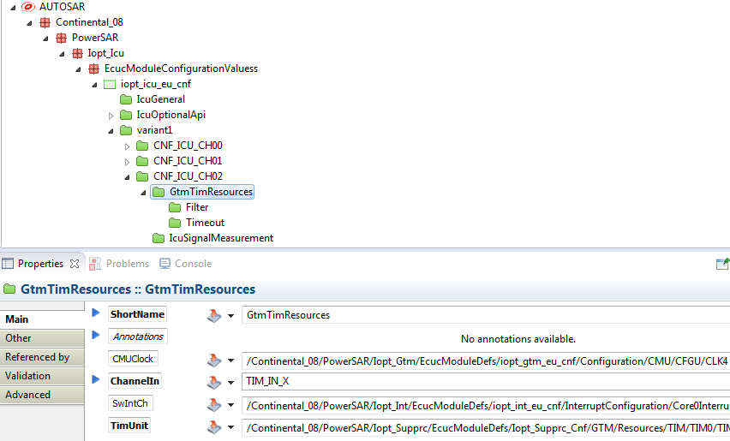
Configuration structure – IcuChannel - ICU_MODE_SIGNAL_MEASUREMENT mode
Notes:
This container contains the configuration (parameters) to set up the GTM TIM resources used by the ICU channel.
TimUnit: Channel address of the TIM channel from the Supprc driver. It defines which TIM cell is used by the driver to measure any signal.
CMUClock: GTM CMU clock source selected for this channel. This clock is configured in the GTM driver. This clock should be selected depending on the resolution and the min/max frequency of the signal. The hardware counter is 24 bits and should not overflow in normal behavior of the driver.
A #define IOPT_ICU_CLK_CNF_<channel name> will be generated in the iopt_icu_cnf.h for legacy compatibility. Do not use this define. It will not be generated in the next releases.
IcuSwIntCh: Software interruption channel used to trigger a Signal edge detection notification function or a Timeout notification function.
If a notification is used on the channel, the corresponding SwIntCh has to be selected.

Slide 32
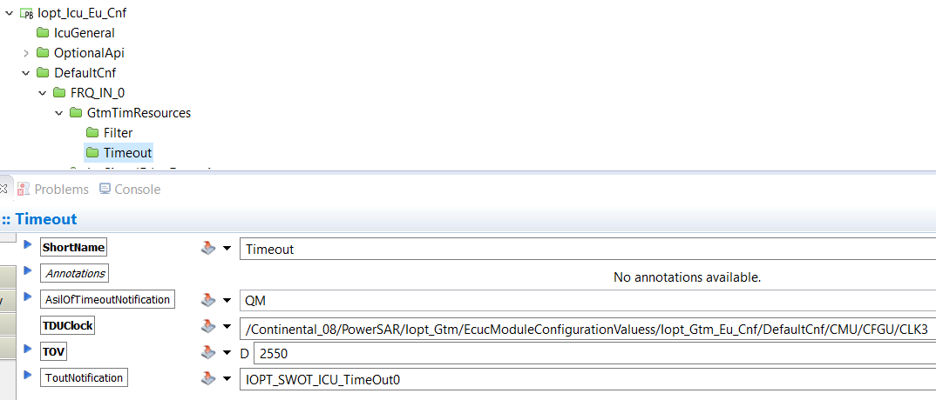
Configuration structure – IcuChannel - ICU_MODE_SIGNAL_MEASUREMENT mode
Notes:
This container contains the configuration (parameters) to define:
a timeout detection (signal lost). When a timeout is configured, the measurement interfaces DutycycleValues() and GetPeriodDuration() will return 0xFFFFFFFF if a timeout occurs.
a timeout detection notification (optional). When a timeout occurs a specified function is called.
Note: A timeout will occurs when the input signal level has not changed if the configured timeout value has been elapsed since the last active edge.
If the timeout without notification, the timout with notification or the edge detection notification is used for an ICU channel, its interrupt channel have to be enabled. After the ICU driver initialization, this interrupt must be enabled with Iopt_Int_ChangeTriggerState() (see Init & Shutdown).
When a timeout notification is configured, by default it is disabled. It has to be enabled at runtime with Iopt_Icu_EnableTimeoutTrigger().
TOV: Timeout value in microseconds.
ToutNotification: Timeout Notification function. It is possible to define a "Notification Function" which is called when the specified "Timeout Value" is reached. It allows to trigger an action when the input signal is lost.
This function must have the following prototype patern
void <function name>(void) (For example: void timeoutNotification(void))
This parameter is optional (leave it empty if not used).
TDUClock: Time base for the timeout.

Slide 33
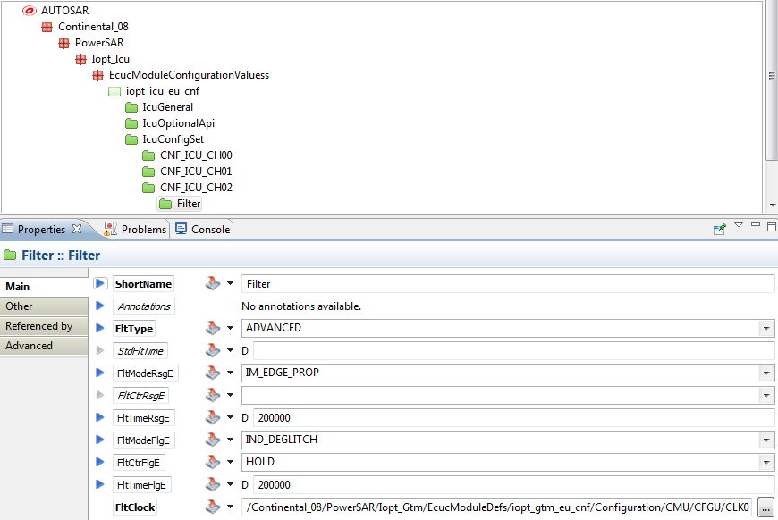
Configuration structure – IcuChannel - ICU_MODE_SIGNAL_MEASUREMENT mode
Notes:
The Filter container contains the configuration (parameters) for digital filtering.
FltType: Select the filter type
STANDARD: this filter mode is Individual De-Glitch Time Mode (up/down counter) on both edges. Fill only the StdFltTime parameter (standard filter time).
ADVANCED: filter is fully configurable. Fill all the parameters except StdFltTime parameter.
StdFltTime: deglitch time for both edges in nanoseconds.
FltModeRsgE / FltModeFlgE: see Immediate edge propagation, Individual De-Glitch Time Mode (up/down counter) and Individual de-glitch time (hold counter) for more details.
FltCtrRsgE / FltCtrFlgE: only applicable for Individual de-glitch time filter mode.
FltTimeRsgE / FltTimeFlgE: time in nanoseconds. It has different meanings regarding the filter mode
FltClock: Filter clock base.
Only CMU_CLK0, CMU_CLK1, CMU_CLK6 or CMU_CLK7 can be selected.
For more details regarding filter parameters, see the GTM reference manual.

Slide 34
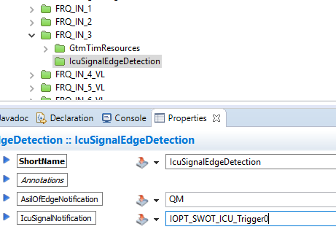
Configuration structure – IcuChannel - ICU_MODE_SIGNAL_EDGE_DETECT mode
Notes:
The IcuSignalEdgeDetection container contains the configuration (parameters) for signal edge detection notification.
If the timeout without notification, the timout with notification or the edge detection notification is used for an ICU channel, its interrupt channel have to be enabled. After the ICU driver initialization, this interrupt must be enabled with Iopt_Int_ChangeTriggerState() (see Init & Shutdown).
When a signal edge detection notification is configured, by default it is disabled. It has to be enabled at runtime with Iopt_Icu_EnableEdgeTrigger().
IcuSignalNotification: Edge detection notification function. It is possible to define a "Notification Function" which is called each time the DefaultStartEdge is detected.
This function must have the following prototype patern
void <function name>(void)

Slide 35
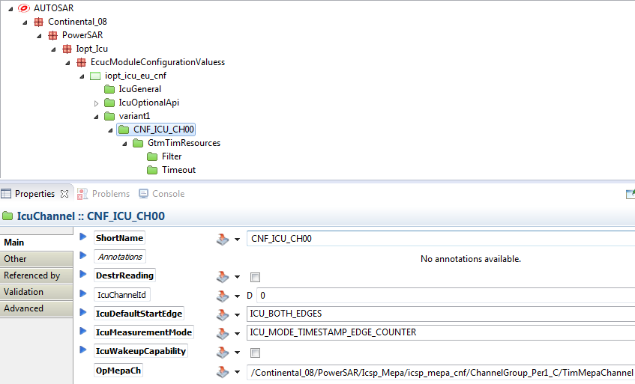
Configuration structure – IcuChannel - ICU_MODE_TIMESTAMP_EDGE_COUNTER mode
Notes:
This modes allow edge detection, edge counting, and timestamping. Edge count and timestamp can be read with the API: GetPulseStamp()
ShortName: Channel name. A #define IOPT_ICU_CNF_<channel name> will be generated in the iopt_icu_cnf.h.
For example, #define IOPT_ICU_CNF_CNF_ICU_CH00 0x0. All interfaces should be called with this define as a parameter for Ch.
ChannelIn: see Channel Input source selection.
IcuDefaultStartEdge: Rising, Falling or Both edge are available. This is the edge which will be count and trigger the timestamp capture.
DestrReading: Not use in this mode.
IcuMeasurementMode: ICU_MODE_TIMESTAMP_EDGE_COUNTER.
OpMepaCh: MEPA message channel for operation and parameters for inter-cores communication inside the ICU driver (see MEPA channel configuration).
The priority of the interrupt used by the MEPA channel should always be lower than the priority of the TIM channel. The MEPA channel interrupt needs to be placed in a group with lower priority than the group of the TIM channel.

Slide 36
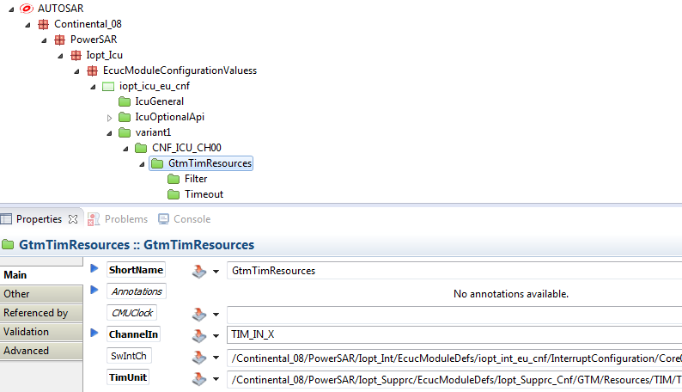
Configuration structure – IcuChannel - ICU_MODE_TIMESTAMP_EDGE_COUNTER mode
Notes:
This container contains the configuration (parameters) to set up the GTM TIM resources used by the ICU channel.
TimUnit: Channel address of the TIM channel from the Supprc driver. It defines which TIM cell is used by the driver to measure any signal.
CMUClock: Not used. The timestamping uses the TBU_TS0 clock. A #define IOPT_ICU_CLK_CNF_<channel name> will be generated in the iopt_icu_cnf.h for legacy compatibility. Do not use this define. It will not be generated in the next releases.
IcuSwIntCh: Software interruption channel used to trigger a Signal edge detection notification function or a Timeout notification function.
If a notification is used on the channel, the corresponding SwIntCh has to be selected.

Slide 37
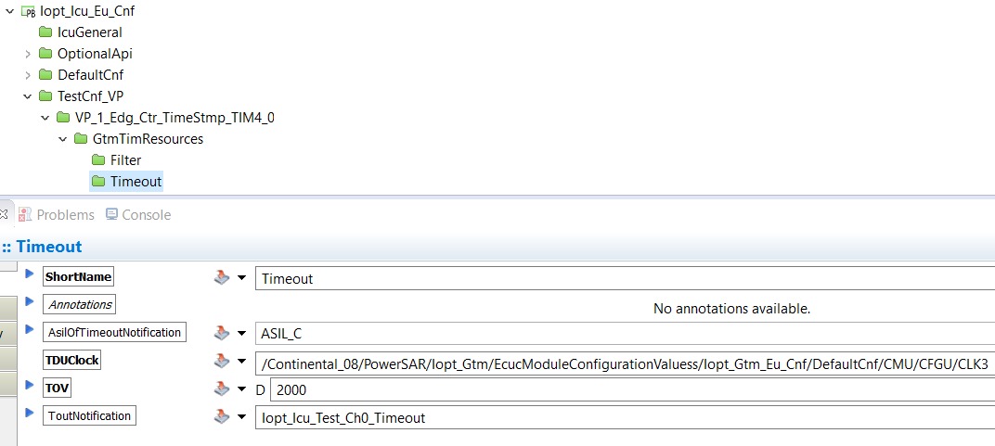
Configuration structure – IcuChannel - ICU_MODE_TIMESTAMP_EDGE_COUNTER mode
Notes:
This container contains the configuration (parameters) to define:
a timeout detection (signal lost). When a timeout is configured, the measurement interfaces DutycycleValues() and GetPeriodDuration() will return 0xFFFFFFFF if a timeout occurs.
a timeout detection notification (optional). When a timeout occurs a specified function is called.
Note: A timeout will occurs when the input signal level has not changed if the configured timeout value has been elapsed since the last active edge.
If the timeout without notification, the timout with notification or the edge detection notification is used for an ICU channel, its interrupt channel have to be enabled. After the ICU driver initialization, this interrupt must be enabled with Iopt_Int_ChangeTriggerState() (see Init & Shutdown).
When a timeout notification is configured, by default it is disabled. It has to be enabled at runtime with Iopt_Icu_EnableTimeoutTrigger().
TOV: Timeout value in microseconds.
ToutNotification: Timeout Notification function. It is possible to define a "Notification Function" which is called when the specified "Timeout Value" is reached. It allows to trigger an action when the input signal is lost.
This function must have the following prototype patern
void <function name>(uint32 channelIndex) (For example: void timeoutNotification(uint32 ch))
This parameter is optional (leave it empty if not used).
TDUClock: Time base for the timeout.

Slide 38
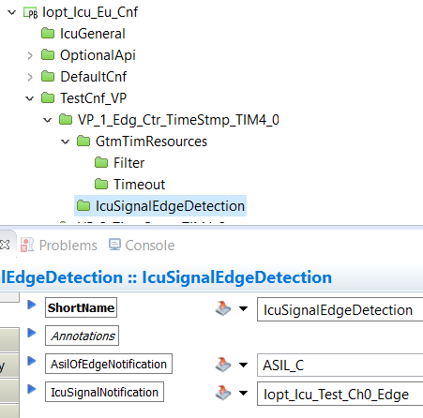
Configuration structure – IcuChannel - ICU_MODE_TIMESTAMP_EDGE_COUNTER mode
Notes:
The IcuSignalEdgeDetection container contains the configuration (parameters) for signal edge detection notification.
If the timeout without notification, the timout with notification or the edge detection notification is used for an ICU channel, its interrupt channel have to be enabled. After the ICU driver initialization, this interrupt must be enabled with Iopt_Int_ChangeTriggerState() (see Init & Shutdown).
When a signal edge detection notification is configured, by default it is disabled. It has to be enabled at runtime with Iopt_Icu_EnableEdgeTrigger().
IcuSignalNotification: Edge detection notification function. It is possible to define a "Notification Function" which is called each time the DefaultStartEdge is detected.
This function must have the following prototype patern
void <function name>(void)

Slide 39
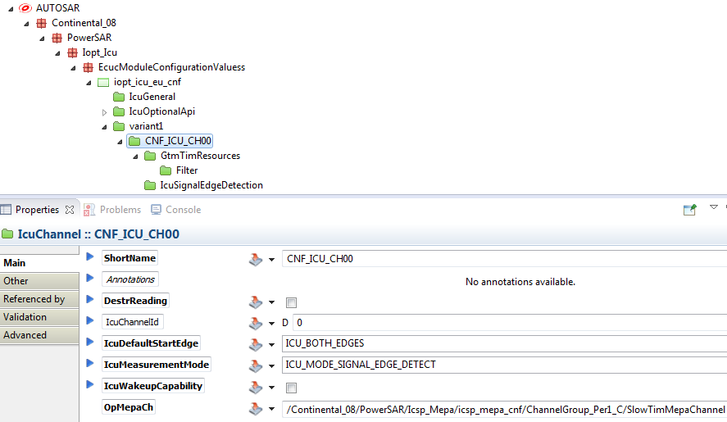
Configuration structure – IcuChannel - ICU_MODE_EDGE_DETECT mode
Notes:
This mode allow edge detection.
ShortName: Channel name. A #define IOPT_ICU_CNF_<channel name> will be generated in the iopt_icu_cnf.h.
For example, #define IOPT_ICU_CNF_CNF_ICU_CH00 0x0. All interfaces should be called with this define as a parameter for Ch.
ChannelIn: see Channel Input source selection.
IcuDefaultStartEdge: Rising, Falling or Both edge are available. This is the edge which will be detected.
DestrReading: Not use in this mode.
IcuMeasurementMode: ICU_MODE_EDGE_DETECT.
OpMepaCh: MEPA message channel for operation and parameters for inter-cores communication inside the ICU driver (see MEPA channel configuration).
The priority of the interrupt used by the MEPA channel should always be lower than the priority of the TIM channel. The MEPA channel interrupt needs to be placed in a group with lower priority than the group of the TIM channel.

Slide 40
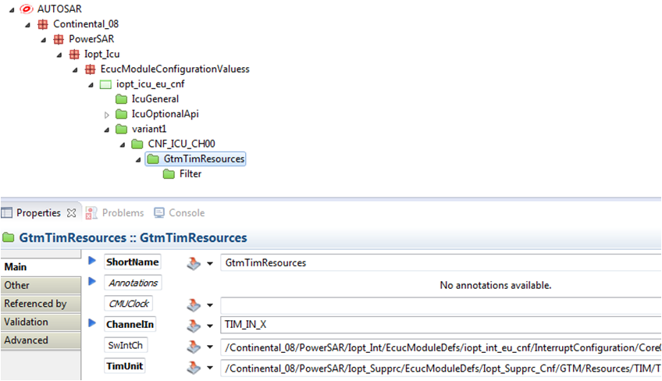
Configuration structure – IcuChannel - ICU_MODE_EDGE_DETECT mode
Notes:
This container contains the configuration (parameters) to set up the GTM TIM resources used by the ICU channel.
TimUnit: Channel address of the TIM channel from the Supprc driver. It defines which TIM cell is used by the driver to measure any signal.
CMUClock: Not used. The timestamping uses the TBU_TS0 clock. A #define IOPT_ICU_CLK_CNF_<channel name> will be generated in the iopt_icu_cnf.h for legacy compatibility. Do not use this define. It will not be generated in the next releases.
IcuSwIntCh: Software interruption channel used to trigger a Signal edge detection notification function or a Timeout notification function.
If a notification is used on the channel, the corresponding SwIntCh has to be selected.

Slide 41
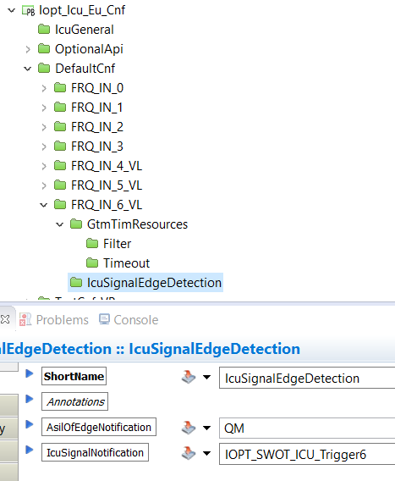
Configuration structure – IcuChannel - ICU_MODE_EDGE_DETECT mode
Notes:
The IcuSignalEdgeDetection container contains the configuration (parameters) for signal edge detection notification.
If the timeout without notification, the timout with notification or the edge detection notification is used for an ICU channel, its interrupt channel have to be enabled. After the ICU driver initialization, this interrupt must be enabled with Iopt_Int_ChangeTriggerState() (see Init & Shutdown).
When a signal edge detection notification is configured, by default it is disabled. It has to be enabled at runtime with Iopt_Icu_EnableEdgeTrigger().
IcuSignalNotification: Edge detection notification function. It is possible to define a "Notification Function" which is called each time the DefaultStartEdge is detected.
This function must have the following prototype patern
void <function name>(void)

Slide 42
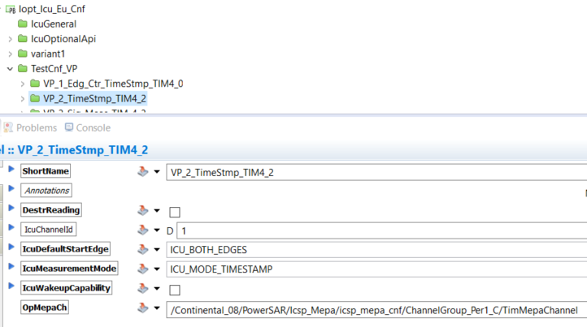
Configuration structure – IcuChannel - ICU_MODE_TIMESTAMP mode

Slide 43
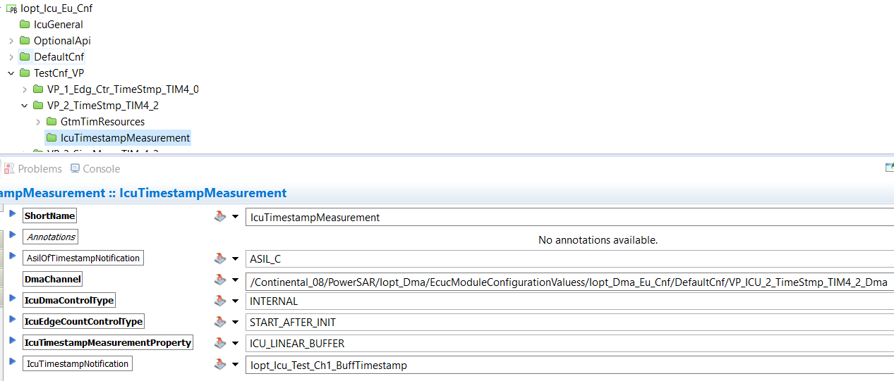
Configuration structure – IcuChannel - ICU_MODE_TIMESTAMP mode

Slide 44
Agenda
1
Functional Description & Features
2
2
APIs
17
3
Integration Highlights
25
4
Configuration
26
4.1
Configuration Structure
4.2
Configuration Example
5
Dependencies
44
6
HW Resources
46
7
Constraints & Limitations
48

Slide 45
Dependencies
Notes:
The following drivers are required by the ICU driver:
IOPT_SUPPRC – required for ICU initialization (TIM Channel Address). No special driver configuration is needed.
IOPT_FUNC – required due to the usage of library (RAM allocation, bit operations, etc) operations. No special driver configuration is needed.
IOPT_GTM – required to access the GTM device. No special driver configuration is needed (except for clocks).
ICSP_PORT – required for port configuration and signal routing. A specific driver configuration is needed.
ICSP_MEPA – required for notifications. A specific driver configuration is needed.
IOPT_INT – required due to the specific interrupts operation and message passing. A specific driver configuration is needed.

Slide 46
Agenda
1
Functional Description & Features
2
2
APIs
17
3
Integration Highlights
25
4
Configuration
26
4.1
Configuration Structure
4.2
Configuration Example
5
Dependencies
44
6
HW Resources
46
7
Constraints & Limitations
48

Slide 47
HW Resources
This implementation of the ICU driver uses several hardware resources of the TC3XX microcontroller via their dedicated drivers.
The input signal is connected to a GPIO port of the microcontroller.
Then this signal is routed to the GTM. The Port to GTM submodule allows connecting the signal to several TIM unit. Notice the GPIO and the Port to GTM GTM submodule are handled by the Iopt_Port driver.
The signal is processed by the GTM.
If there are configured notifications, the GTM generate an interrupt which is managed by the IR module. Then the interrupt is routed to the CPU0.

Slide 48
Agenda
1
Functional Description & Features
2
2
APIs
17
3
Integration Highlights
25
4
Configuration
26
4.1
Configuration Structure
4.2
Configuration Example
5
Dependencies
44
6
HW Resources
46
7
Constraints & Limitations
48

Slide 49
Constraints & Limitations
The driver cannot be initialized without any channel configured. At least one channel must be defined.

Slide 50
Document History
Revision | Changes | Valid for
1.0 | Initial version for ECU17 | FS_0G01_TC3XX_ICU_1.2.0
2.0 | Release Aligned to FIRMWARE D.2.0 | FS_0G019_TC3XX_ICU_1.3.0

