Slide 1

PORT Driver Training Slides
ECU17
www.continental-corporation.com
Rev. 1.0 / 09-Aug-2018 / P ES SE EEA BSWP

Slide 2
Agenda
1
Functional Description & Features
2
2
APIs
6
3
Integration Highlights
8
4
Configuration
10
4.1
Configuration Structure
4.2
Configuration Example
5
Dependencies
13
6
HW Resources
15
7
Constraints & Limitations
17

Slide 3
Functional Description & Features
PORT driver initializes…
The port pin direction (input, output)
Alternate function (GPIO, port pin specific functions)
Initial pin level value (CMOS, TTL or AUTOMOTIVE)
Characteristics (push pull, open drain)
Pad output driver strength and slew rate (speed grade)
Pull devices (pull up, pull down, no pull)
Processor specific port pin properties (emergency stop)
PORT driver provides an interface to set/get the port pin alternate function, direction, pad level and characteristics. It also provides an interface to enable/disable the emergency stop feature.
PORT driver provides an end user configuration to configure the port pin functionalities and features.
PORT driver also initializes the multiplexer settings for GTM to MSC, VADC and DSADC.

Slide 4
Agenda
1
Functional Description & Features
2
2
APIs
6
3
Integration Highlights
8
4
Configuration
10
4.1
Configuration Structure
4.2
Configuration Example
5
Dependencies
13
6
HW Resources
15
7
Constraints & Limitations
17

Slide 5
APIs
Iopt_Port_Init: It initializes the port pin configuration.
Iopt_Port_InitPorts: It initializes the individual port container of the configuration.
Iopt_Port_SetPinFunction: It sets the port pin alternate function.
Iopt_Port_GetPinFunction: It gets the port pin alternate function.
Iopt_Port_SetPinDirection: It sets the port pin direction.
Iopt_Port_GetPinDirection: It gets the port pin direction.
Iopt_Port_SetPinPadCharacteristic: It sets the port pin characteristics .
Iopt_Port_GetPinPadCharacteristic: It gets the port pin characteristics.
Iopt_Port_SetPinLevels: It sets the port pin levels of multiple pins of the same port.
Iopt_Port_GetPinLevels: It gets the port pin levels of multiple pins of the same port.
Iopt_Port_EmergencyStop: It enables/disables the emergency stop feature of a port pin.
Iopt_Port_GetPinOutputData: It returns output data register value (e.g Pn_OUT in tricore) of given channel

Slide 6
Agenda
1
Functional Description & Features
2
2
APIs
6
3
Integration Highlights
8
4
Configuration
10
4.1
Configuration Structure
4.2
Configuration Example
5
Dependencies
13
6
HW Resources
15
7
Constraints & Limitations
17

Slide 7
Integration Highlights
PORT driver is not dependent on any other driver configuration.
PORT driver can be initialized in the start up sequence.

Slide 8
Agenda
1
Functional Description & Features
2
2
APIs
6
3
Integration Highlights
8
4
Configuration
10
4.1
Configuration Structure
4.2
Configuration Example
5
Dependencies
13
6
HW Resources
15
7
Constraints & Limitations
17

Slide 9
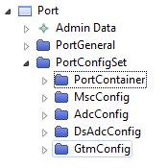
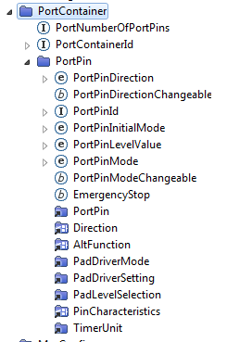
Configuration Structure

Slide 10
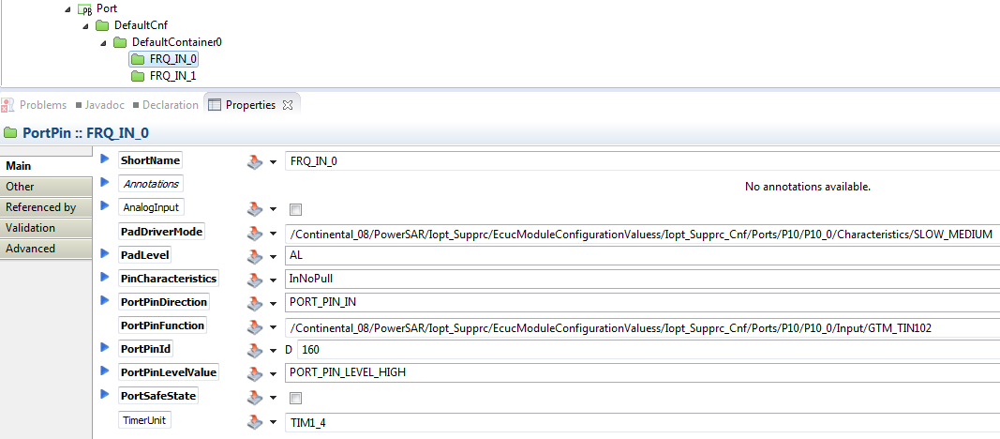
Configuration Example

Slide 11
Agenda
1
Functional Description & Features
2
2
APIs
6
3
Integration Highlights
8
4
Configuration
10
4.1
Configuration Structure
4.2
Configuration Example
5
Dependencies
13
6
HW Resources
15
7
Constraints & Limitations
17

Slide 12
Dependencies

Slide 13
Agenda
1
Functional Description & Features
2
2
APIs
6
3
Integration Highlights
8
4
Configuration
10
4.1
Configuration Structure
4.2
Configuration Example
5
Dependencies
13
6
HW Resources
15
7
Constraints & Limitations
17

Slide 14
HW Resources
General Purpose I/O Ports and Peripheral I/O Lines (Ports)
GTM to MSC, VADC and DSADC related multiplexers

Slide 15
Agenda
1
Functional Description & Features
2
2
APIs
6
3
Integration Highlights
8
4
Configuration
10
4.1
Configuration Structure
4.2
Configuration Example
5
Dependencies
13
6
HW Resources
15
7
Constraints & Limitations
17

Slide 16
Constraints & Limitations
No function is protected against interrupt. Therefore the user has to take care to protect the function from interrupts.
The function for setting the level of the port pins via function ‘Iopt_Port_SetPinLevels’ can be applied for pins of a single port only. It is not possible to set the levels of pins of different ports with one call.

Slide 17
Document History
Revision | Changes | Valid for
1 | First version for ECU17 | PORT_2.2.0

