Slide 1

PWM Driver Training Slides
ECU17
www.continental-corporation.com
Rev. 0.1 / 01-Iune-2018 / P ES SE SW BSW

Slide 2
Agenda
1
Functional Description & Features
2
2
APIs
15
3
Integration Highlights
24
4
Configuration
26
4.1
Configuration Structure
4.2
Configuration Example
5
Dependencies
34
6
HW Resources
36
7
Constraints & Limitations
38

Slide 3
Functional Description & Features
The PWM driver manages the PWM signal output.
It allows generating repetitive PWM signals with requested duty cycle, period, active level on duty cycle.
Additionally it supports software signals at end of period and/or end of duty, synchronized PWM outputs with fixed configurable delay, dynamic switching between 2 phase and 3 phase signals and ADC hardware trigger synchronized with a PWM channel.

Slide 4
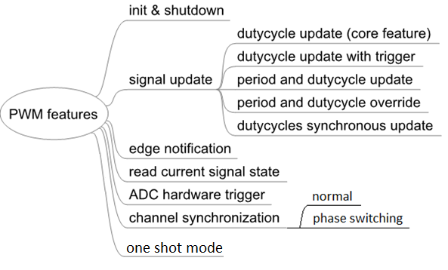
Functional Description & Features

Slide 5
Feature - Dutycycle update
With this feature you can update the dutycycle of a PWM channel at the next signal period.

Slide 6
Feature - Dutycycle update with notification
With this feature you can update the dutycycle of a PWM channel at the next signal period and calling a callback function when the updated period begins.

Slide 7
Feature – Update period and dutycycle
With this feature you can update the period and the dutycycle of a PWM channel at the next signal period.

Slide 8
Feature – Override period and dutycycle
With this feature you can force immediately a new period with new period and dutycycle values without waiting the end of the current period.

Slide 9
Feature – Update several dutycycle synchronously
With this feature you can update synchronously the dutycycle of several PWM channels at the next signal period.

Slide 10
Feature – Recurring edge notification
It is possible to call a callback function at each the end of active time or/and end of period. This will be a direct call.

Slide 11
Feature – Generate synchronized PWM signal
It is possible to synchronize the starting edge of several PWM channels.

Slide 12
Feature – Generate ADC hardware trigger
This feature allows an ADC acquisition to be triggered synchronously with a PWM signal.

Slide 13
Feature – Phase switch
With this feature you can switch between 2 phase and 3 phase synchronous signals.

Slide 14
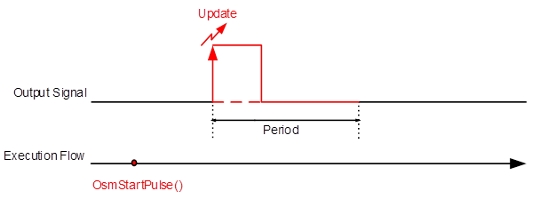
Feature – One shot mode
This feature allows to generate a single pulse.

Slide 15
Agenda
1
Functional Description & Features
2
2
APIs
15
3
Integration Highlights
24
4
Configuration
26
4.1
Configuration Structure
4.2
Configuration Example
5
Dependencies
34
6
HW Resources
36
7
Constraints & Limitations
38

Slide 16
APIs - Init & Shutdown
PWM driver has to be initialized with Iopt_Pwm_Init() and stopped with Iopt_Pwm_Shutdown()

Slide 17
APIs – Signal update
Iopt_Pwm_SetDutycycle(uint8 Ch, uint16 Dutycycle) updates the dutycycle of a PWM channel at the next PWM period.
Iopt_Pwm_SetDutycycleWithTrig(uint8 Ch, uint16 Dutycycle) updates the dutycycle of a PWM channel at the next PWM period and call a callback function at the beginning of the period for which the dutycycle was changed.
Iopt_Pwm_SetPeriodAndDuty(uint8 Ch, uint16 Dutycycle, uint32 Period) updates coherently the period and dutycycle of the PWM signal at the next period.
Iopt_Pwm_OverridePeriodAndDuty(uint8 Ch, uint16 Dutycycle, uint32 Period) stops immediately the current PWM signal and starts it again with the new requested period and dutycycle.

Slide 18
APIs – Synchronous signals update
Iopt_Pwm_SetDutyCyclesSync(uint8 Size, Iopt_Pwm_DutycycleType * PtrDutyCycles) updates synchronously the dutycycles of several PWM channels at the next PWM period.

Slide 19
APIs – One shot mode
Iopt_Pwm_OsmStartPulse(uint16 Ch) starts the generation of a single pulse.

Slide 20
APIs – Enable/disable notifications
After driver initialization, notifications are disabled (See Init & Shutdown). The interface Iopt_Pwm_EnableTrigger() must be called in order to enable the edge notifications for rising edges/falling edges/both egdes/none.

Slide 21
APIs – Enable/disable ADC trigger
After driver initialization, ADC hardware triggers are disabled (See Init & Shutdown). The interface Iopt_Pwm_EnableAdcHwTrigger() must be called in order to enable/disable the ADC hardware triggers generation.

Slide 22
APIs – Read input state
Iopt_Pwm_GetOutputState() returns the current signal state on 1-bit.

Slide 23
APIs – Phase switch
Iopt_Pwm_PhaseSwitch(RefChNo, 2)switches from 3 phase to 2 phase signal generation.
Note: The third channel goes to its idle state in 2-phase operation. Ie. Only the reference channel and Slave1 are functional in 2-phase operation.
Iopt_Pwm_PhaseSwitch(RefChNo, 3)switches from 2 phase to 3 phase signal generation.
RefChNo- Reference Channel Number.

Slide 24
Agenda
1
Functional Description & Features
2
2
APIs
15
3
Integration Highlights
24
4
Configuration
26
4.1
Configuration Structure
4.2
Configuration Example
5
Dependencies
34
6
HW Resources
36
7
Constraints & Limitations
38

Slide 25

Integration Highlights
All dependent drivers has to be available. (Refer, 5. Dependencies)
Memory switches of PWM driver needs to be configured in MEMMAP configuration file.

Slide 26
Agenda
1
Functional Description & Features
2
2
APIs
15
3
Integration Highlights
24
4
Configuration
26
4.1
Configuration Structure
4.2
Configuration Example
5
Dependencies
34
6
HW Resources
36
7
Constraints & Limitations
38

Slide 27
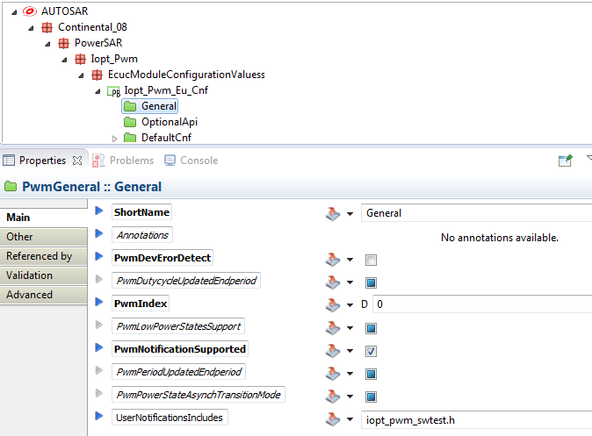
Configuration structure – General
Notes:
PwmIndex: Specifies the Instance Id of this module instance. If only one instance is present it shall have the Id 0.
This driver implementation does not support multiple instances. PwmIndex always has to be set to 0.
PwmDutycycleUpdatedEndperiod: Switch for enabling the update of the duty cycle parameter at the end of the current period when Pwm_SetDutyCycle( ) is called.
TRUE: update of duty cycle is done at the end of period of currently generated waveform (current waveform is finished).
FALSE: update of duty cycle is done immediately (just after service call, current waveform is cut).
This parameter is only present for Autosar compliance. It has no effect for Powersar.
PwmPeriodUpdatedEndperiod: Switch for enabling the update of the period parameter at the end of the current period when Pwm_SetPeriodAndDuty( ) is called.
TRUE: update of period/duty cycle is done at the end of period of currently generated waveform (current waveform is finished).
FALSE: update of period/duty cycle is done immediately (just after service call, current waveform is cut).
This parameter is only present for Autosar compliance. It has no effect for Powersar.
PwmNotificationSupported: Switch to indicate that the End of period notifications or the Dutycycle notifications are supported.
PwmDevErorDetect: Switch for enabling the development error detection.
ResetReason: Value logged by the function Iopt_Eeh_ForceReset in case of a bad behavior of the driver. The driver forces a reset only if the allocation of the buffer fails.
PwmLowPowerStatesSupport: Adds / removes all power state management related APIs (PWM_SetPowerState, PWM_GetCurrentPowerState, PWM_GetTargetPowerState, PWM_PreparePowerState, PWM_Main_PowerTransitionManager), indicating if the HW offers low power state management.
This is an Autosar standard parameter. It is not considered by the PWM driver and user does not need to configure it.
PwmPowerStateAsynchTransitionMode: Enables / disables support of the PWM Driver to the asynchronous power state transition.
This is an Autosar standard parameter. It is not considered by the PWM driver and user does not need to configure it.
UserNotificationsIncludes: Header with callbacks prototypes.

Slide 28
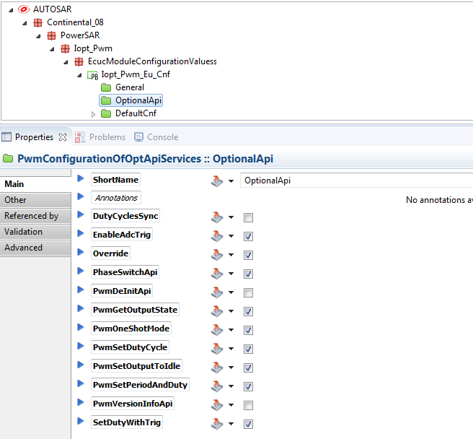
Configuration structure – PwmConfigurationOfOptApiServices
Notes:
ShortName : Name of the container. Could be any name.
Feature : Every feature used by at least one channel of this device should be ticked in order to be mapped. If not, a call to the operations from unticked features will produce a reset.
PwmDeInitApi: This feature is not scalable. This parameter is only present for Autosar compliance. It has no effect.
DutyCyclesSync: check it if you use operation Iopt_Pwm_SetDutyCyclesSync()
PwmSetDutyCycle: This feature is not scalable. This parameter is only present for Autosar compliance. It has no effect.
PwmSetPeriodAndDuty: check it if you use operation Iopt_Pwm_XtomPerDuty_SetPeriodAndDuty() on this device
Override: check it if you use operation Iopt_Pwm_XtomOvri_OverridePeriodAndDuty() on this device
PwmSetOutputToIdle: This feature is not available. This parameter is only present for Autosar compliance. It has no effect.
SetDutyWithTrig: check it if you use operation Iopt_Pwm_XtomDutyTrig_SetDutycycleWithTrig() on this device
PwmGetOutputState: check it if you use operation Iopt_Pwm_XtomOutState_GetOutputState() on this device
EnableAdcTrig: check it if you use operation Iopt_Pwm_XtomAdcTrig_EnableAdcHwTrigger() on this device
PwmVersionInfoApi: This feature is not available. This parameter is only present for Autosar compliance. It has no effect.
PhaseSwitchApi: check it if you use operation Iopt_Pwm_PhaseSwitch()
PwmOneShotMode: check it if you use operation Iopt_Pwm_OsmStartPulse()

Slide 29
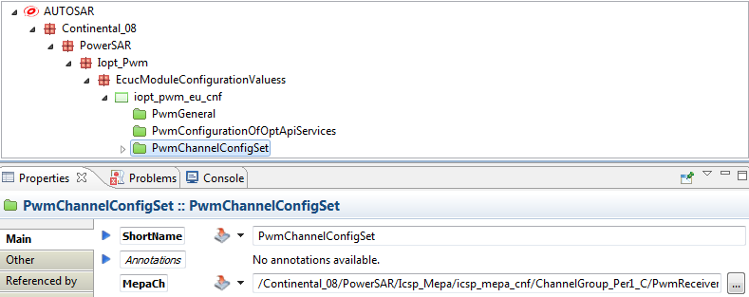
Configuration structure – PwmChannelConfigSet
Notes:
ShortName : Name of the channel configuration set. Could be any name. In case of multiple configuration (several configurations used within the same ECU software), there is one PwmChannelConfigSet for each variant. The ShortName has to be unique (several PwmChannelConfigSets cannot have the same ShortName).
MepaCh: Mepa channel used by the driver to pass operations parameters to the implementation core. For this MEPA channel please look at also in the MEPA integration manual, but this channel must have these characteristics:
The message send and receive type shall be Complex, which means trough the MEPA channel we must send/receive a buffer
The called operation shall be Iopt_Pwm_Receiver()
The interrupt level shall be chosen depending on the desired latency from system allocated interrupt for message sending channel

Slide 30
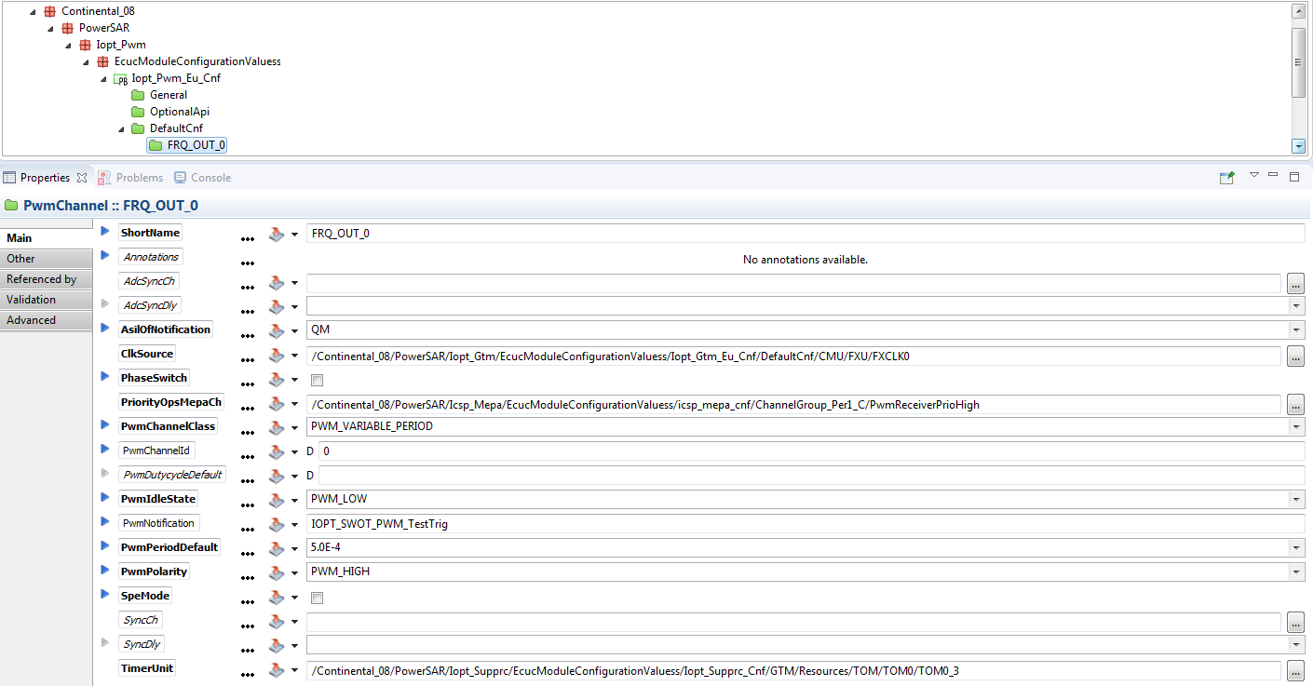
Configuration structure – PwmChannel
Notes:
ShortName : Name of the channel. Could be any name. It could be “Channelx”, where x is the channel index or functional name identifier.
Channels must always have different names. In case of multiple configurations (several configurations used within the same ECU software), channels from different configurations cannot share the same names.
PwmChannelId: Channel Id of the PWM channel. This value will be assigned to the symbolic name derived of the PwmChannel container short name. This parameter is only present for Autosar compliance. It has no effect.
PwmChannelClass: Class of PWM Channel.
PWM_FIXED_PERIOD: Only the dutycycle can be changed. This channel class has to be used for the reference channel of synchronized channels group.
PWM_FIXED_PERIOD_SHIFTED: Only the dutycycle can be changed. The period of this channel is shifted of a fixed delay regarding the reference channel. This channel class has to be used for slave channels of synchronized channels group.
PWM_FIXED_PERIOD_CENTER_ALIGNED: Only the dutycycle can be changed. The period is center-aligned regarding the reference channel. This channel class has to be used for slave channels of synchronized channels group.
PWM_VARIABLE_PERIOD: Dutycycle and period can be changed.
PwmPolarity: Defines the starting polarity of each PWM channel.
PWM_HIGH: The PWM channel output is high at the beginning of the cycle and then goes low when the duty count is reached.
PWM_LOW: The PWM channel output is low at the beginning of the cycle and then goes high when the duty count is reached.
PwmIdleState: the output level after initialization.
PWM_LOW: channel output on low level after initialization
PWM_HIGH: channel output on high level after initialization
PwmDutyCycleDefault: The PWM dutycycle after driver initialization.
0 represents 0%
0x8000 represents 100%
This parameter is only required for the Autosar API. It is not used for Powersar API. Leave it empty and it will not be taken into account.
PwmPeriodDefault: The PWM period in microseconds after driver initialization. Note that if it is configured as 0, the dutycycle is forced to 0%, independent of the InitLevel setting.
PwmNotification: End of period callback function and/or dutycycle callback function. This parameter is optional (leave it empty if not used).
NotifMapping: MEMMAP parameters of the PwmNotification function. This parameter is only needed when a PwmNotification function is defined (leave it empty if not used).
SyncDly: The synchronization delay in microseconds between this channel and the one chosen in SyncCh field. This field is optional and shall be filled just in case SyncCh field is filled, otherwise leave it empty.
AdcSyncDly: the ADC hardware trigger delay in microseconds between the reference signal and the hardware trigger signal. This field is optional and shall be filled just in case AdcSyncCh field is filled, otherwise leave it empty.
SpeMode: Enable the control of the PWM channel by the SPE GTM module. For usual PWM channel please uncheck the box.
TimerUnit: TOM or ATOM HW channel number
ClkSource: There are two groups of clock lines: CLK0..7 lines and FXCLK0..4 lines, depending on the TimerUnit field which identifies the HW channel. A TOM channel has to use one clock of FXCLK0..4 clock sources and an ATOM channel has to use one clock of CLK0..7 clock sources.
The FXCLK0..4 clock sources use fixed dividers which divide the GTM frequency. For this frequency please check the GTM configuration. The dividers are listed below, but they are 16 power of clock source number:
divider for FXCLK0 = 1
divider for FXCLK1 = 16
divider for FXCLK2 = 256
divider for FXCLK3 = 4096
divider for FXCLK4 = 65536
The CLK0..7 clock sources have configurable frequencies which can be found in GTM configuration.
Note: there is a balance between the resolution of a PWM signal and the maximum period supported by this channel. For a long period, a slow clock must be used. For a shorter period a faster clock could be used. The TOM channels are implemented on 16-bit comparators/timers and ATOM channels are implemented on 24-bit comparators/timers. Therefore with a same clock, an ATOM channel allows to generate a signal with a wider-ranging frequency than a TOM channel. Please take care that for a long period you must choose a fast clock source which does not produce overflow on channel timer.
NotifMepaCh: MEPA channel used to trigger PwmNotification function trough a MEPA wrapper function. MEPA wrapper function is generated into the iopt_pwm_cnf.c/h files. The NotifMepaCh configuration has to be filled with the wrapper function name, and the file where it is declared (iopt_pwm_cnf.h). Please look on the MEPA integration manual for more information. This parameter is only needed when a PwmNotification function is defined (leave it empty if not used).
SyncCh: the synchronization channel used as synchronization reference for this channel. The synchronized channels shall be consecutive in the configuration and all of the synchronized channels shall be synchronized with the first channel from the group. There is no limit for the number of synchronized channels groups. This field is optional and it shall be filled just for a synchronized channel, otherwise leave it empty.
AdcSyncCh: the ADC hardware trigger channel. This field is optional and it shall be configured just in case there is an associated ADC hardware trigger linked to this PWM channel, otherwise leave it empty. The AdcSyncCh channel is be synchronized with the AdcSyncDly delay with:
the TimerUnit of this PWM channel, for a single channel.
the TimerUnit of the master (reference) PWM channel, for a slave channel of a synchronized channels group.
AdcSyncCh and TimerUnit TOM or ATOM channels shall be on the same TOMx or ATOMy module. The best is to be consecutive, if not the user have the responsibility to make all the bypass between these two xTOM channels (route TRIG_[x-1] to TRIG_[x]).
AsilOfNotification: Asil level (QM, ASIL_A, ASIL_B, ASIL_C, ASIL_D) defined for end of period and/or dutycycle callback function used with [PwmNotification] parameter. This parameter is mandatory if [PwmNotification] parameter is used.

Slide 31
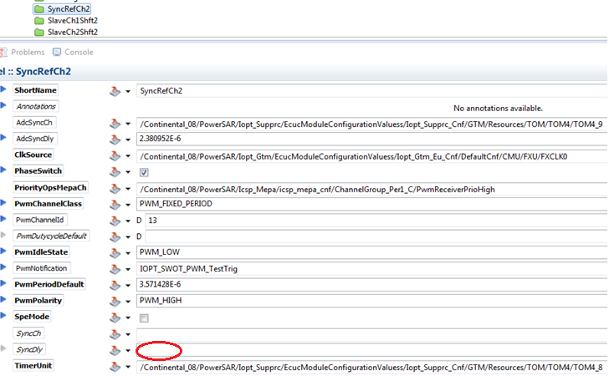
Configuration example – Phase switch
Reference channel configuration: PWM polarity HIGH, init level LOW, Required Frequency= 280 KHz, ie. period 3.571428 us, HW channel TOM4_8, duty/end of period notification, along with ADC sync delay.
Notes:
ShortName : Name of the channel. Could be any name. It could be “Channelx”, where x is the channel index or functional name identifier.
Channels must always have different names. In case of multiple configurations (several configurations used within the same ECU software), channels from different configurations cannot share the same names.
PwmChannelId: Channel Id of the PWM channel. This value will be assigned to the symbolic name derived of the PwmChannel container short name. This parameter is only present for Autosar compliance. It has no effect.
PwmChannelClass: Class of PWM Channel.
PWM_FIXED_PERIOD: Only the dutycycle can be changed. This channel class has to be used for the reference channel of synchronized channels group.
PWM_FIXED_PERIOD_SHIFTED: Only the dutycycle can be changed. The period of this channel is shifted of a fixed delay regarding the reference channel. This channel class has to be used for slave channels of synchronized channels group.
PWM_FIXED_PERIOD_CENTER_ALIGNED: Only the dutycycle can be changed. The period is center-aligned regarding the reference channel. This channel class has to be used for slave channels of synchronized channels group.
PWM_VARIABLE_PERIOD: Dutycycle and period can be changed.
PwmPolarity: Defines the starting polarity of each PWM channel.
PWM_HIGH: The PWM channel output is high at the beginning of the cycle and then goes low when the duty count is reached.
PWM_LOW: The PWM channel output is low at the beginning of the cycle and then goes high when the duty count is reached.
PwmIdleState: the output level after initialization.
PWM_LOW: channel output on low level after initialization
PWM_HIGH: channel output on high level after initialization
PwmDutyCycleDefault: The PWM dutycycle after driver initialization.
0 represents 0%
0x8000 represents 100%
This parameter is only required for the Autosar API. It is not used for Powersar API. Leave it empty and it will not be taken into account.
PwmPeriodDefault: The PWM period in microseconds after driver initialization. Note that if it is configured as 0, the dutycycle is forced to 0%, independent of the InitLevel setting.
PwmNotification: End of period callback function and/or dutycycle callback function. This parameter is optional (leave it empty if not used).
NotifMapping: MEMMAP parameters of the PwmNotification function. This parameter is only needed when a PwmNotification function is defined (leave it empty if not used).
SyncDly: The synchronization delay in microseconds between this channel and the one chosen in SyncCh field. This field is optional and shall be filled just in case SyncCh field is filled, otherwise leave it empty.
AdcSyncDly: the ADC hardware trigger delay in microseconds between the reference signal and the hardware trigger signal. This field is optional and shall be filled just in case AdcSyncCh field is filled, otherwise leave it empty.
SpeMode: Enable the control of the PWM channel by the SPE GTM module. For usual PWM channel please uncheck the box.
TimerUnit: TOM or ATOM HW channel number
ClkSource: There are two groups of clock lines: CLK0..7 lines and FXCLK0..4 lines, depending on the TimerUnit field which identifies the HW channel. A TOM channel has to use one clock of FXCLK0..4 clock sources and an ATOM channel has to use one clock of CLK0..7 clock sources.
The FXCLK0..4 clock sources use fixed dividers which divide the GTM frequency. For this frequency please check the GTM configuration. The dividers are listed below, but they are 16 power of clock source number:
divider for FXCLK0 = 1
divider for FXCLK1 = 16
divider for FXCLK2 = 256
divider for FXCLK3 = 4096
divider for FXCLK4 = 65536
The CLK0..7 clock sources have configurable frequencies which can be found in GTM configuration.
Note: there is a balance between the resolution of a PWM signal and the maximum period supported by this channel. For a long period, a slow clock must be used. For a shorter period a faster clock could be used. The TOM channels are implemented on 16-bit comparators/timers and ATOM channels are implemented on 24-bit comparators/timers. Therefore with a same clock, an ATOM channel allows to generate a signal with a wider-ranging frequency than a TOM channel. Please take care that for a long period you must choose a fast clock source which does not produce overflow on channel timer.
NotifMepaCh: MEPA channel used to trigger PwmNotification function trough a MEPA wrapper function. MEPA wrapper function is generated into the iopt_pwm_cnf.c/h files. The NotifMepaCh configuration has to be filled with the wrapper function name, and the file where it is declared (iopt_pwm_cnf.h). Please look on the MEPA integration manual for more information. This parameter is only needed when a PwmNotification function is defined (leave it empty if not used).
SyncCh: the synchronization channel used as synchronization reference for this channel. The synchronized channels shall be consecutive in the configuration and all of the synchronized channels shall be synchronized with the first channel from the group. There is no limit for the number of synchronized channels groups. This field is optional and it shall be filled just for a synchronized channel, otherwise leave it empty.
AdcSyncCh: the ADC hardware trigger channel. This field is optional and it shall be configured just in case there is an associated ADC hardware trigger linked to this PWM channel, otherwise leave it empty. The AdcSyncCh channel is be synchronized with the AdcSyncDly delay with:
the TimerUnit of this PWM channel, for a single channel.
the TimerUnit of the master (reference) PWM channel, for a slave channel of a synchronized channels group.
AdcSyncCh and TimerUnit TOM or ATOM channels shall be on the same TOMx or ATOMy module. The best is to be consecutive, if not the user have the responsibility to make all the bypass between these two xTOM channels (route TRIG_[x-1] to TRIG_[x]).

Slide 32
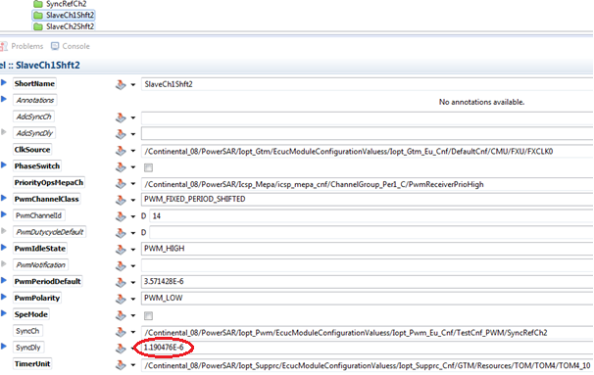
Configuration example – Phase switch
Slave Channel 1 channel configuration: PWM polarity LOW, init level HIGH, period 3.571428 us, HW channel TOM4_10, 120 deg phase shift/ sync delay.
Notes:
ShortName : Name of the channel. Could be any name. It could be “Channelx”, where x is the channel index or functional name identifier.
Channels must always have different names. In case of multiple configurations (several configurations used within the same ECU software), channels from different configurations cannot share the same names.
PwmChannelId: Channel Id of the PWM channel. This value will be assigned to the symbolic name derived of the PwmChannel container short name. This parameter is only present for Autosar compliance. It has no effect.
PwmChannelClass: Class of PWM Channel.
PWM_FIXED_PERIOD: Only the dutycycle can be changed. This channel class has to be used for the reference channel of synchronized channels group.
PWM_FIXED_PERIOD_SHIFTED: Only the dutycycle can be changed. The period of this channel is shifted of a fixed delay regarding the reference channel. This channel class has to be used for slave channels of synchronized channels group.
PWM_FIXED_PERIOD_CENTER_ALIGNED: Only the dutycycle can be changed. The period is center-aligned regarding the reference channel. This channel class has to be used for slave channels of synchronized channels group.
PWM_VARIABLE_PERIOD: Dutycycle and period can be changed.
PwmPolarity: Defines the starting polarity of each PWM channel.
PWM_HIGH: The PWM channel output is high at the beginning of the cycle and then goes low when the duty count is reached.
PWM_LOW: The PWM channel output is low at the beginning of the cycle and then goes high when the duty count is reached.
PwmIdleState: the output level after initialization.
PWM_LOW: channel output on low level after initialization
PWM_HIGH: channel output on high level after initialization
PwmDutyCycleDefault: The PWM dutycycle after driver initialization.
0 represents 0%
0x8000 represents 100%
This parameter is only required for the Autosar API. It is not used for Powersar API. Leave it empty and it will not be taken into account.
PwmPeriodDefault: The PWM period in microseconds after driver initialization. Note that if it is configured as 0, the dutycycle is forced to 0%, independent of the InitLevel setting.
PwmNotification: End of period callback function and/or dutycycle callback function. This parameter is optional (leave it empty if not used).
NotifMapping: MEMMAP parameters of the PwmNotification function. This parameter is only needed when a PwmNotification function is defined (leave it empty if not used).
SyncDly: The synchronization delay in microseconds between this channel and the one chosen in SyncCh field. This field is optional and shall be filled just in case SyncCh field is filled, otherwise leave it empty.
AdcSyncDly: the ADC hardware trigger delay in microseconds between the reference signal and the hardware trigger signal. This field is optional and shall be filled just in case AdcSyncCh field is filled, otherwise leave it empty.
SpeMode: Enable the control of the PWM channel by the SPE GTM module. For usual PWM channel please uncheck the box.
TimerUnit: TOM or ATOM HW channel number
ClkSource: There are two groups of clock lines: CLK0..7 lines and FXCLK0..4 lines, depending on the TimerUnit field which identifies the HW channel. A TOM channel has to use one clock of FXCLK0..4 clock sources and an ATOM channel has to use one clock of CLK0..7 clock sources.
The FXCLK0..4 clock sources use fixed dividers which divide the GTM frequency. For this frequency please check the GTM configuration. The dividers are listed below, but they are 16 power of clock source number:
divider for FXCLK0 = 1
divider for FXCLK1 = 16
divider for FXCLK2 = 256
divider for FXCLK3 = 4096
divider for FXCLK4 = 65536
The CLK0..7 clock sources have configurable frequencies which can be found in GTM configuration.
Note: there is a balance between the resolution of a PWM signal and the maximum period supported by this channel. For a long period, a slow clock must be used. For a shorter period a faster clock could be used. The TOM channels are implemented on 16-bit comparators/timers and ATOM channels are implemented on 24-bit comparators/timers. Therefore with a same clock, an ATOM channel allows to generate a signal with a wider-ranging frequency than a TOM channel. Please take care that for a long period you must choose a fast clock source which does not produce overflow on channel timer.
NotifMepaCh: MEPA channel used to trigger PwmNotification function trough a MEPA wrapper function. MEPA wrapper function is generated into the iopt_pwm_cnf.c/h files. The NotifMepaCh configuration has to be filled with the wrapper function name, and the file where it is declared (iopt_pwm_cnf.h). Please look on the MEPA integration manual for more information. This parameter is only needed when a PwmNotification function is defined (leave it empty if not used).
SyncCh: the synchronization channel used as synchronization reference for this channel. The synchronized channels shall be consecutive in the configuration and all of the synchronized channels shall be synchronized with the first channel from the group. There is no limit for the number of synchronized channels groups. This field is optional and it shall be filled just for a synchronized channel, otherwise leave it empty.
AdcSyncCh: the ADC hardware trigger channel. This field is optional and it shall be configured just in case there is an associated ADC hardware trigger linked to this PWM channel, otherwise leave it empty. The AdcSyncCh channel is be synchronized with the AdcSyncDly delay with:
the TimerUnit of this PWM channel, for a single channel.
the TimerUnit of the master (reference) PWM channel, for a slave channel of a synchronized channels group.
AdcSyncCh and TimerUnit TOM or ATOM channels shall be on the same TOMx or ATOMy module. The best is to be consecutive, if not the user have the responsibility to make all the bypass between these two xTOM channels (route TRIG_[x-1] to TRIG_[x]).

Slide 33
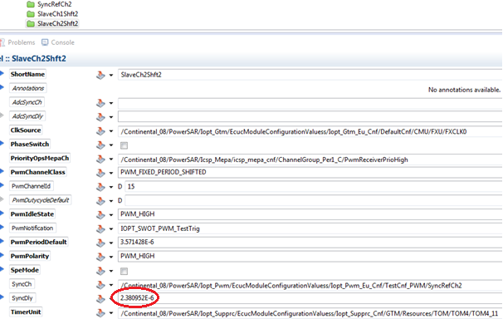
Configuration example – Phase switch
Slave Channel 2 channel configuration: PWM polarity HIGH, init level LOW, period 3.571428 us, HW channel TOM4_11, 240 deg phase shift/ sync delay.
Notes:
ShortName : Name of the channel. Could be any name. It could be “Channelx”, where x is the channel index or functional name identifier.
Channels must always have different names. In case of multiple configurations (several configurations used within the same ECU software), channels from different configurations cannot share the same names.
PwmChannelId: Channel Id of the PWM channel. This value will be assigned to the symbolic name derived of the PwmChannel container short name. This parameter is only present for Autosar compliance. It has no effect.
PwmChannelClass: Class of PWM Channel.
PWM_FIXED_PERIOD: Only the dutycycle can be changed. This channel class has to be used for the reference channel of synchronized channels group.
PWM_FIXED_PERIOD_SHIFTED: Only the dutycycle can be changed. The period of this channel is shifted of a fixed delay regarding the reference channel. This channel class has to be used for slave channels of synchronized channels group.
PWM_FIXED_PERIOD_CENTER_ALIGNED: Only the dutycycle can be changed. The period is center-aligned regarding the reference channel. This channel class has to be used for slave channels of synchronized channels group.
PWM_VARIABLE_PERIOD: Dutycycle and period can be changed.
PwmPolarity: Defines the starting polarity of each PWM channel.
PWM_HIGH: The PWM channel output is high at the beginning of the cycle and then goes low when the duty count is reached.
PWM_LOW: The PWM channel output is low at the beginning of the cycle and then goes high when the duty count is reached.
PwmIdleState: the output level after initialization.
PWM_LOW: channel output on low level after initialization
PWM_HIGH: channel output on high level after initialization
PwmDutyCycleDefault: The PWM dutycycle after driver initialization.
0 represents 0%
0x8000 represents 100%
This parameter is only required for the Autosar API. It is not used for Powersar API. Leave it empty and it will not be taken into account.
PwmPeriodDefault: The PWM period in microseconds after driver initialization. Note that if it is configured as 0, the dutycycle is forced to 0%, independent of the InitLevel setting.
PwmNotification: End of period callback function and/or dutycycle callback function. This parameter is optional (leave it empty if not used).
NotifMapping: MEMMAP parameters of the PwmNotification function. This parameter is only needed when a PwmNotification function is defined (leave it empty if not used).
SyncDly: The synchronization delay in microseconds between this channel and the one chosen in SyncCh field. This field is optional and shall be filled just in case SyncCh field is filled, otherwise leave it empty.
AdcSyncDly: the ADC hardware trigger delay in microseconds between the reference signal and the hardware trigger signal. This field is optional and shall be filled just in case AdcSyncCh field is filled, otherwise leave it empty.
SpeMode: Enable the control of the PWM channel by the SPE GTM module. For usual PWM channel please uncheck the box.
TimerUnit: TOM or ATOM HW channel number
ClkSource: There are two groups of clock lines: CLK0..7 lines and FXCLK0..4 lines, depending on the TimerUnit field which identifies the HW channel. A TOM channel has to use one clock of FXCLK0..4 clock sources and an ATOM channel has to use one clock of CLK0..7 clock sources.
The FXCLK0..4 clock sources use fixed dividers which divide the GTM frequency. For this frequency please check the GTM configuration. The dividers are listed below, but they are 16 power of clock source number:
divider for FXCLK0 = 1
divider for FXCLK1 = 16
divider for FXCLK2 = 256
divider for FXCLK3 = 4096
divider for FXCLK4 = 65536
The CLK0..7 clock sources have configurable frequencies which can be found in GTM configuration.
Note: there is a balance between the resolution of a PWM signal and the maximum period supported by this channel. For a long period, a slow clock must be used. For a shorter period a faster clock could be used. The TOM channels are implemented on 16-bit comparators/timers and ATOM channels are implemented on 24-bit comparators/timers. Therefore with a same clock, an ATOM channel allows to generate a signal with a wider-ranging frequency than a TOM channel. Please take care that for a long period you must choose a fast clock source which does not produce overflow on channel timer.
NotifMepaCh: MEPA channel used to trigger PwmNotification function trough a MEPA wrapper function. MEPA wrapper function is generated into the iopt_pwm_cnf.c/h files. The NotifMepaCh configuration has to be filled with the wrapper function name, and the file where it is declared (iopt_pwm_cnf.h). Please look on the MEPA integration manual for more information. This parameter is only needed when a PwmNotification function is defined (leave it empty if not used).
SyncCh: the synchronization channel used as synchronization reference for this channel. The synchronized channels shall be consecutive in the configuration and all of the synchronized channels shall be synchronized with the first channel from the group. There is no limit for the number of synchronized channels groups. This field is optional and it shall be filled just for a synchronized channel, otherwise leave it empty.
AdcSyncCh: the ADC hardware trigger channel. This field is optional and it shall be configured just in case there is an associated ADC hardware trigger linked to this PWM channel, otherwise leave it empty. The AdcSyncCh channel is be synchronized with the AdcSyncDly delay with:
the TimerUnit of this PWM channel, for a single channel.
the TimerUnit of the master (reference) PWM channel, for a slave channel of a synchronized channels group.
AdcSyncCh and TimerUnit TOM or ATOM channels shall be on the same TOMx or ATOMy module. The best is to be consecutive, if not the user have the responsibility to make all the bypass between these two xTOM channels (route TRIG_[x-1] to TRIG_[x]).

Slide 34
Agenda
1
Functional Description & Features
2
2
APIs
15
3
Integration Highlights
24
4
Configuration
26
4.1
Configuration Structure
4.2
Configuration Example
5
Dependencies
34
6
HW Resources
36
7
Constraints & Limitations
38

Slide 35
Dependencies
Notes:
The following drivers are required by the ICU driver:
IOPT_SUPPRC – required for ICU initialization (TIM Channel Address). No special driver configuration is needed.
IOPT_FUNC – required due to the usage of library (RAM allocation, bit operations, etc) operations. No special driver configuration is needed.
IOPT_GTM – required to access the GTM device. No special driver configuration is needed (except for clocks).
ICSP_PORT – required for port configuration and signal routing. A specific driver configuration is needed.
ICSP_MEPA – required for notifications. A specific driver configuration is needed.
IOPT_INT – required due to the specific interrupts operation and message passing. A specific driver configuration is needed.
IOPT_EEH – required for error notifications. A specific driver configuration is needed.

Slide 36
Agenda
1
Functional Description & Features
2
2
APIs
15
3
Integration Highlights
24
4
Configuration
26
4.1
Configuration Structure
4.2
Configuration Example
5
Dependencies
34
6
HW Resources
36
7
Constraints & Limitations
38

Slide 37
HW Resources
Several hardware resources of the TC3XX microcontroller are used via their dedicated drivers.
The Iopt_Pwm driver sets up the GTM register to generate the requested PWM signal via the Iopt_Gtm driver interfaces.
This signal is routed out of GTM through the Port to GTM submodule, which allows connecting the signal to several GPIO ports. Notice the GPIO and Port to GTM’ GTM submodule are handled by Iopt_Port driver.
If there is end of period notification configured, the GTM generates an interrupt which is managed by the IR module. Then the interrupt is routed to the CPU0.

Slide 38
Agenda
1
Functional Description & Features
2
2
APIs
15
3
Integration Highlights
24
4
Configuration
26
4.1
Configuration Structure
4.2
Configuration Example
5
Dependencies
34
6
HW Resources
36
7
Constraints & Limitations
38

Slide 39
Constraints & Limitations
Interfaces Availability-
The PWM driver APIs are available on every core, but implementation is located on one core. The interfaces are routed through several global MEPA channels (configurable for each PWM channel) to the implementation core. Interrupt priority of used MEPA channels decide the priority of operations execution.
Multicore Constraints-
A delay is possible in operations execution and it depends on, load of implementation core, used MEPA interrupt level and other users of MEPA on same level as of PWM.
The call order of PWM operation on one channel is respected, but is not guaranteed that the order is kept in between the multiple PWM channels or for multi-drivers call.

Slide 40
Document History
Revision | Changes | Valid for
1 | Initial version, draft | PWM A.0.0
2 | Revised for ECU17 | PWM 1.1.0
3 | Added One Shot Mode feature | PWM 1.2.0

