Slide 1

SPI Driver
ECU17
Aristeidis Dikefalos

Slide 2
Agenda
1
Functional Description & Features
3
2
APIs
7
3
Integration Highlights
10
4
Configuration
12
4.1
Configuration Structure
4.2
Configuration Example
5
Dependencies
15
6
HW Resources
17
7
Constraints & Limitations
19

Slide 3
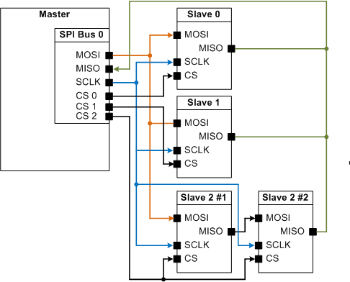
SPI Driver Functional Description & Features
The SPI (Serial Peripheral Interface) has a 4-wire synchronous serial interface. Data communication is enabled with a Chip select wire (CS). Data is transmitted with a 3-wire interface consisting of wires for serial data output (MOSI), serial data input (MISO) and serial clock (CLOCK).
Daisy Chain

Slide 4
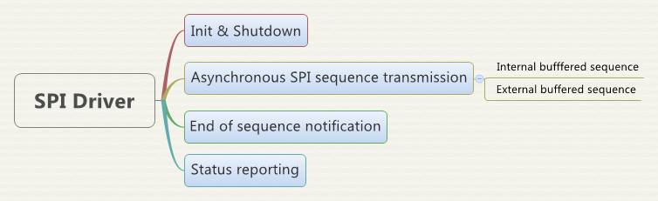
SPI Driver Functional Description & Features – continued (2)
Each channel supports all features

Slide 5
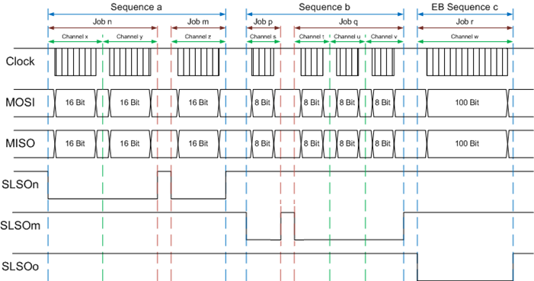
SPI Driver Functional Description & Features – continued (3)
A sequence contains one or more jobs.
A job contains one or more channels.
With the Job the CS is active low.
IB Channel width is 1..32 bit. EB channel width as much as user wants

Slide 6
SPI Driver Functional Description & Features – continued (4)

Slide 7
Agenda
1
Functional Description & Features
2
2
APIs
7
3
Integration Highlights
10
4
Configuration
12
4.1
Configuration Structure
4.2
Configuration Example
5
Dependencies
15
6
HW Resources
17
7
Constraints & Limitations
19

Slide 8
SPI Driver APIs
Iopt_Spi_WriteSequence Write data which has to be transmitted for IB
Iopt_Spi_ReadSequence Read received SPI response for IB
Iopt_Spi_SetupEb Setup external buffering. Transmit buffer pointer, Receive buffer pointer and length of channel. (Buffer is outside of SPI driver)
Iopt_Spi_AsyncTransmit Request sequence transmission. Sequence is transmitted when the configured sequence priority is on turn.
Iopt_Spi_GetSequenceResult Reports the status of the sequence („OK“, „PENDING“, „FAILED“)

Slide 9
SPI Driver AUTOSAR APIs
Function | Explanation
Spi_Init (Iopt_Spi_Init) | Initializes the SPI driver
Spi_DeInit (Iopt_Spi_Shutdown) | Shutdown of the SPI driver
Spi_SetupEB (Iopt_Spi_SetupEb) | Sets up the external buffer data transmission handling for the given channel.
Spi_WriteIB (Iopt_Spi_WriteIb Channel) | Writes the given value to the SPI internal transmit buffer. This operation is only working for internal buffered (IB) channels. If the given data pointer is null the default value will be transmitted.
Spi_ReadIB (Iopt_Spi_ReadIb Channel) | Reads a value from the SPI internal receive buffer and stores it to the given area

Slide 10
SPI Driver AUTOSAR APIs
Function | Explanation
Spi_AsyncTransmit (Iopt_Spi_Async Transmit) | Starts a communication on the related SPI device.
Spi_SyncTransmit (Iopt_Spi_Async Transmit) | Starts a communication on the related SPI device.
Spi_GetSequenceResult (Iopt_Spi_GetSequence Result) | Returns the status of the last transmission result of the specified sequence
Spi_GetHWUnitStatus (Iopt_Spi_GetHWUnit Status) | Returns the status of the given HW device.
Spi_Cancel (Iopt_Spi_Cancel) | Cancels the given on-going sequence transmission without canceling any job transmission and set the sequence result to canceled.
Notes:
Iopt_Spi_AsyncTransmit
The operation starts a communication on the related SPI device:
The operation does:
- start the transmission if the device related scheduler is empty then immediately
- if the device related scheduler is not empty add the request to the scheduler according priority
(highest priority next, within one priority: first requested)
- the order of transmit jobs: first job within the sequence .. .. .. last job within the sequence
- after the sequence has been send (last job transmitted) the configured callback shall be called
(in case of callback signal is configured)
- starting external or internal buffered sequences based on configuration
- treating independent hw-devices independent in parallel
The operation is
- re-entrant for a different sequence
- executable on every core

Slide 11
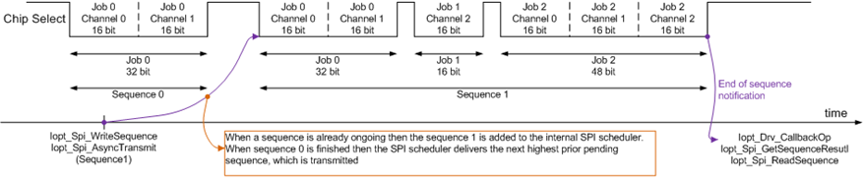
SPI Driver API usage example
The SPI user wants to send an internal buffered sequence (e.g. „Sequence 1“).
Before the transmission the user has to provide the SPI driver the data, which has to be transmitted.
The user can call Iopt_Spi_Asynctransmit even when a SPI sequence is ongoing . „Sequence 1“ will be added to the scheduler. When the SPI bus is free the scheduler delivers the next highest prior pending sequence.
When „Sequence 1“ is transmitted the SPI driver calls the callback operation of the user.
The user then can check the state of the sequence and read /evaluate the received response.

Slide 12
Agenda
1
Functional Description & Features
2
2
APIs
7
3
Integration Highlights
10
4
Configuration
12
4.1
Configuration Structure
4.2
Configuration Example
5
Dependencies
15
6
HW Resources
17
7
Constraints & Limitations
19

Slide 13
SPI Driver Integration Highlights
MEPA is internally
One MEPA channel to transmit a sequence
DMA channels are used for transmission and reception

Slide 14
Agenda
1
Functional Description & Features
2
2
APIs
7
3
Integration Highlights
10
4
Configuration
12
4.1
Configuration Structure
4.2
Configuration Example
5
Dependencies
15
6
HW Resources
17
7
Constraints & Limitations
19

Slide 15
SPI Driver Configuration Structure

Slide 16
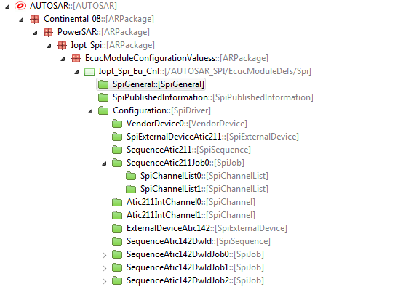
SPI Driver Configuration Structure
One sequence contains one or more jobs.
One job contains one or more channels.
All Jobs contained by a Sequence will have the same Sequence properties during transmission.
All Channels contained by a Job will have the same Job properties during transmission

Slide 17
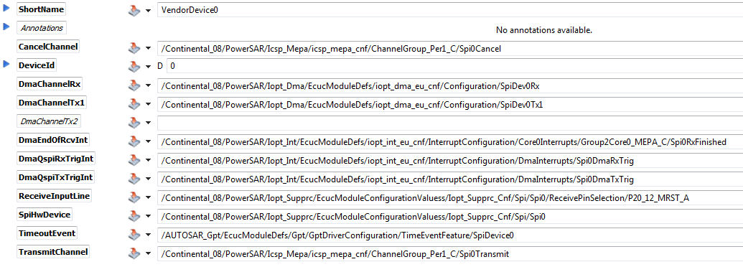
SPI Driver Configuration Example Vendor Device
The SPI driver needs for each device two mandatory MEPA signals one for routing the communication transmit requests to primary core and one to route the cancel requests to primary core.
SPI Device ID, used as parameter in SPI API functions. Automatically filled by SPI Eu2Sw Plugget.
Each SPI device needs three DMA channels. Two DMA channels used in daisy chain for transmission (DmaTx1, DmaTx2). One DMA channel for reception. Rx Channel has highest priority than Tx channels and DmaTx1 has to be exactly one priority higher than DmaTx2. Tx2 it’s optional.
Each SPI device needs three Interrupts, which have to be configured. Two interrupts for triggering the DMA transmission/reception and one interrupt, which calls the ISR of the SPI driver. If more than one Spi device is used all interrupts should have the same group level
For each SPI device the GPT timeout event needs a MEPA channel to be configured. Refer to DIM for configuration

Slide 18
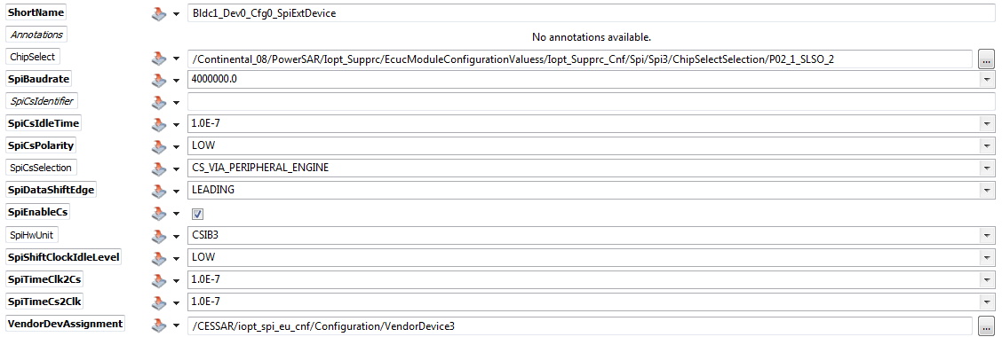
SPI Driver Configuration Example SPI External Device (1)
The chip select is attached to the Job. At the beginning of the Job the CS will be activated and at the end of the Job the CS will be deactivated. Hint!: Always verify if the pin is configured in the port driver
This parameter is the communication baudrate - This parameter allows using a range of values, from the point of view of configuration tools, from Hz up to MHz.
Chip select idle time in seconds. Minimum time between two active chip select levels - This parameter allows to use a range of values from 0 up to 0.0001 seconds. The real configuration value used in software BSW-SPI is calculated out of this by the generator-tools.
The PowerSAR driver supports only chip selects driven by the peripheral engine because Infineon Aurix micros already have a lot of chip selects (up to 16 CS per QSPI device) driven by the SPI peripheral engine.
Assignment of the used vendor device.

Slide 19
SPI Driver Configuration Example SPI External Device (2)
This parameter defines the active polarity of Chip Select.
Timing between clock and chip select and opposite (trailing delay in seconds) as well the minimum time between two active chip select levels (CsIdleTime). Range of values from 0 up to 0.0001 seconds. The real configuration values used in software BSW-SPI are calculated out of this by the generator-tools.

Slide 20
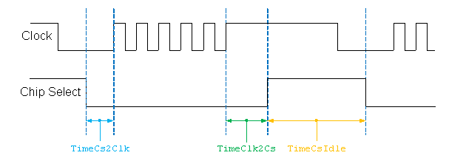
SPI Driver Configuration Example SPI External Device (3)
Timing between clock and chip select and opposite (trailing delay in seconds) as well the minimum time between two active chip select levels (CsIdleTime). Range of values from 0 up to 0.0001 seconds. The real configuration values used in software BSW-SPI are calculated out of this by the generator-tools.

Slide 21
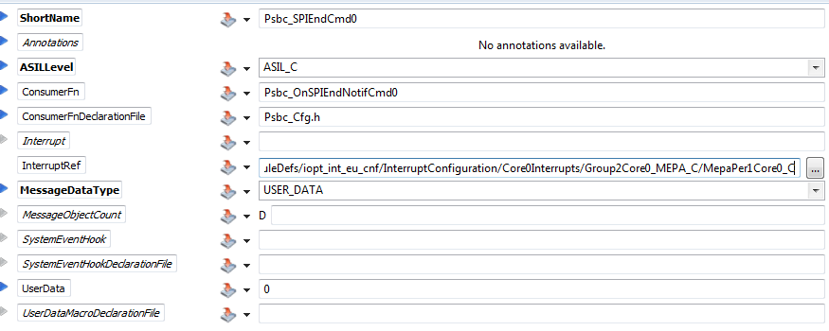
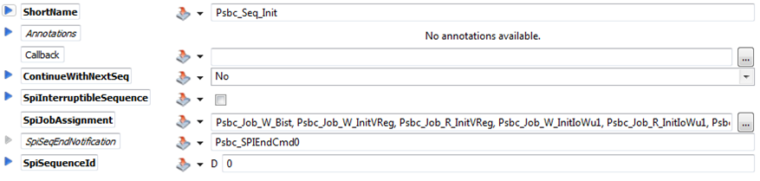

SPI Driver Configuration Example SPI Sequence Structure
A Callback signal (via direct function call) is raised at the end of the sequence communication.
No: No continued sequence
Interruptible: In case the user requests the transmission of this sequence the SPI driver automatically transmit the next configured sequence after this sequence. In case you select Interruptible a higher prior sequence can interrupt.
Non Interruptible: By selecting NonInterruptible you link the next sequence together. This means no other (higher prior) sequence can interrupt.
SpiInterruptibleSequence [False]: In case a sequence is configured as "non interruptible" an already started sequence will be always finished without interruption of a higher prior pending sequence.
SpiInterruptibleSequence [True]: In case a sequence is configured as "interruptible" an already started sequence can be interrupted by a higher prior pending sequence at the end of the job.
A sequence references several jobs, which are executed during a communication sequence.
Is filled automatically by Eu2Sw Plugget

Slide 22
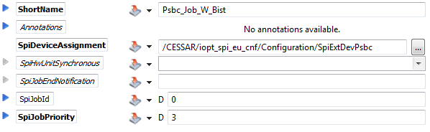
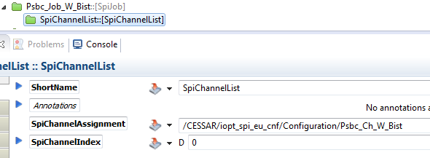
SPI Driver Configuration Example SPI Job
Reference to the external device used by this job.
Priority of the job. Extended compared to AutoSAR.
From 0 (lowest priority) to 31 (highest priority)
A job reference to a SPI channel.
This parameter specifies the order of Channels within the Job. In case of multiple channels a Channel list is required for ach Channel. The index number should be increased.

Slide 23
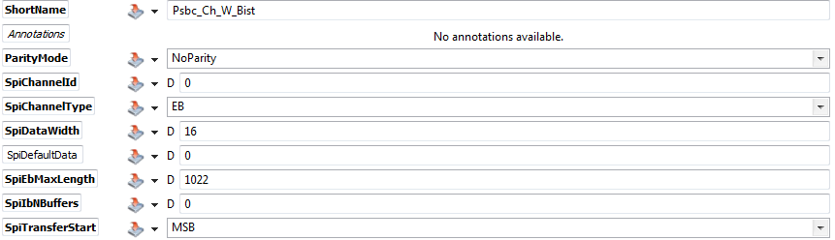
SPI Driver Configuration Example SPI Channel
Parity Mode: NoParity, EvenParity and OddParity mode
Internal buffered channels (IB). The buffers for SPI transmission reception are stored inside the SPI driver.
External buffered channels (EB). The buffers for SPI transmission/reception are provided by the user.
The advantage of EB channel is that for large SPI stream communications microcontroller memory can be saved. But for short communications EB channels can lead to more interrupt/CPU load as each channel is saved in a separate memory area (which is passed over Iopt_Spi_SetupEb operation). Here the usage of e.g. DMA channels to reduce CPU load is not as efficient as for IB channels.
This parameter is the width of a transmitted data unit.
This parameter contains the maximum size (in bytes) of data buffers in case of EB Channels and only.
This parameter defines the first starting bit for transmission.
In AutoSAR there are configuration attributes on channel level. This means in one job the channels could have a different e.g LSB/MSB setting. The PowerSAR driver does not support this.

Slide 24
Agenda
1
Functional Description & Features
2
2
APIs
7
3
Integration Highlights
10
4
Configuration
12
4.1
Configuration Structure
4.2
Configuration Example
5
Dependencies
15
6
HW Resources
17
7
Constraints & Limitations
19

Slide 25
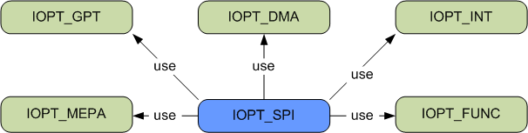
SPI Driver Dependencies

Slide 26
Agenda
1
Functional Description & Features
2
2
APIs
7
3
Integration Highlights
10
4
Configuration
12
4.1
Configuration Structure
4.2
Configuration Example
5
Dependencies
15
6
HW Resources
17
7
Constraints & Limitations
19

Slide 27
SPI Driver HW Resources
SPI peripheral

Slide 28
Agenda
1
Functional Description & Features
2
2
APIs
7
3
Integration Highlights
10
4
Configuration
12
4.1
Configuration Structure
4.2
Configuration Example
5
Dependencies
15
6
HW Resources
17
7
Constraints & Limitations
19

Slide 29
SPI Driver Constraints & Limitations
Deviations from AutoSAR SPI
External buffered channels per job
Currently only one external buffered channel per job is allowed. The length of the channel can be dynamically set by the Iopt_Spi_SetupEb operation.
Sequences with jobs on different SPI buses
All jobs of one sequence have to belong to the same SPI bus.
Handling of configuration attributes on job level
In AutoSAR many configuration attributes are handled at channel level or at job level. The PowerSAR driver handles these attributes on a higher level.
The following parameters needs to be the same for all channels in one job:
SpiChannelType
SpiDataWidth
SpiTransferStart

Slide 30
SPI Driver APIs
The following AUTOSAR interfaces are not supported
Spi_GetStatus
Spi_GetJobResult
Spi_GetVersionInfo
Spi_SetAsyncMode

Slide 31
Thank you!

Slide 32
SPI Driver AUTOSAR APIs
Function | Explanation | Deviation from AUTOSAR
Spi_Init (Iopt_Spi_Init) | Initializes the SPI driver | Job result state is not set Not supported LEVEL 2, enhanced behavior
Spi_DeInit (Iopt_Spi_Shutdown) | Shutdown of the SPI driver | Return value E_NOT_OK is not supported Spi_DeInit is not rejected if the status of SPI handler/Driver is SPI_BUSY Driver state to set SPI_UNINIT is not supported

Slide 33
SPI Driver AUTOSAR APIs
Function | Explanation | Deviation from AUTOSAR
Spi_SetupEB (Iopt_Spi_SetupEb) | Sets up the external buffer data transmission handling for the given channel. | Channel type is an alias type from Iopt_Spi driver instead of unit8 Return value E_NOT_OK is not supported Not supported pre-compile time configurable by the parameter SpiChannelBuffersAllowed
Spi_WriteIB (Iopt_Spi_WriteIb Channel) | Writes the given value to the SPI internal transmit buffer. This operation is only working for internal buffered (IB) channels. If the given data pointer is null the default value will be transmitted. | Channel type is an alias type from Iopt_Spi driver instead of unit8 Return value E_NOT_OK is not supported Not supported pre-compile time configurable by the parameter SpiChannelBuffersAllowed DataBufferPtr is null and default transmit value are not supported
Spi_ReadIB (Iopt_Spi_ReadIb Channel) | Reads a value from the SPI internal receive buffer and stores it to the given area | Channel type is an alias type from Iopt_Spi driver instead of unit8 Return value E_NOT_OK is not supported Not supported pre-compile time configurable by the parameter SpiChannelBuffersAllowed
Notes:
Iopt_Spi_SetupEb
Sets up the external buffer data transmission handling for the given channel. When a transmission for the given channel is requested then the data given by PtrSourceBuffer is transmitted and the response is stored to PtrDestinationBuffer. The operation is only working for external buffered (EB) channels
Iopt_Spi_WriteIbChannel
Writes the given value to the SPI internal transmit buffer. This operation is only working for internal buffered (IB) channels. If the given data pointer is null the default value will be transmitted.
Depending on the channel configuration attribute SpiDataWidth the operation will use the following casting to access the data from the user.
uint8 for SpiDataWidth <= 8
uint16 for 8 < SpiDataWidth <= 16
uint32 for 16 < SpiDataWidth
Uses pass by reference: yes for PtrSourceBuffer
Re-entrant: yes for a different channel
Executable on every core
Operation properties:
Pre condition: The channel shall not be written during an ongoing communication of the channel to ensure data consistency.
Iopt_Spi_ReadIbChannel
Reads a value from the SPI internal receive buffer and stores it to the given area determined by PtrDestinationBuffer.
The operation is only working for internal buffered (IB) channels.
Depending on the channel configuration attribute SpiDataWidth the operation will use the following casting to store the data to the user.
uint8 for SpiDataWidth <= 8
uint16 for 8 < SpiDataWidth <= 16
uint32 for 16 < SpiDataWidth
Uses pass by reference: yes for PtrDestinationBuffer
Re-entrant: yes for a different channel
Executable on every core
Operation properties:
Pre condition:
The channel shall not be read during an ongoing communication of the channel to ensure data consistency.

Slide 34
SPI Driver AUTOSAR APIs
Function | Explanation | Deviation from AUTOSAR
Spi_AsyncTransmit (Iopt_Spi_Async Transmit) | Starts a communication on the related SPI device. | Sequence type is an alias type from Iopt_Spi driver instead of unit8 To set job status is not supported Pre compile time selectable by SpiLevelDelivered not supported
Spi_SyncTransmit (Iopt_Spi_Async Transmit) | Starts a communication on the related SPI device. | Sequence type is an alias type from Iopt_Spi driver instead of unit8 To set job status is not supported Destination data pointer with NULL and ignore receiving data is not supported Notification call back is not supported. It is provided over MEPA. Pre compile time selectable by SpiLevelDelivered not supported Pre compile time selectable by SPI_SUPPORT_CONCURRENT_SYNC_TRANSMIT not supported
Notes:
Iopt_Spi_AsyncTransmit
The operation starts a communication on the related SPI device:
The operation does:
- start the transmission if the device related scheduler is empty then immediately
- if the device related scheduler is not empty add the request to the scheduler according priority
(highest priority next, within one priority: first requested)
- the order of transmit jobs: first job within the sequence .. .. .. last job within the sequence
- after the sequence has been send (last job transmitted) the configured callback shall be called
(in case of callback signal is configured)
- starting external or internal buffered sequences based on configuration
- treating independent hw-devices independent in parallel
The operation is
- re-entrant for a different sequence
- executable on every core

Slide 35
SPI Driver AUTOSAR APIs
Function | Explanation | Deviation from AUTOSAR
Spi_GetSequenceResult (Iopt_Spi_GetSequence Result) | Returns the status of the last transmission result of the specified sequence | Sequence type is an alias type from Iopt_Spi driver instead of unit8
Spi_GetHWUnitStatus (Iopt_Spi_GetHWUnit Status) | Returns the status of the given HW device. | Pre-compile time configurable parameter SpiHwStatusApi not supported
Spi_Cancel (Iopt_Spi_Cancel) | Cancels the given on-going sequence transmission without canceling any job transmission and set the sequence result to canceled. | Sequence type is an alias type from Iopt_Spi driver instead of unit8 Sequence notification call-back function is not supported

