Slide 1

Mobile Chat application
BY the FLUPC programmers

Slide 2

INTRODUCTION
-Team members
-Purpose of our application
-Overview
-Introduction
-General explanation
-Authentication screen
-Bluetooth/Nearby Connection Mode
-Main screen
-Message screen
-Settings screen
-Final statement

Slide 3
Authentication
Flutter
Flutter is a free and open-source UI Software development
Develop cross platform apps for Android and iOS
Language Use
Dart (Similar to many programming Language)
Flutter uses widgets in creating UI (Buttons, Color, etc)
Features
Runs, Test, Debug
Supported OS
Windows
Mac

Slide 4
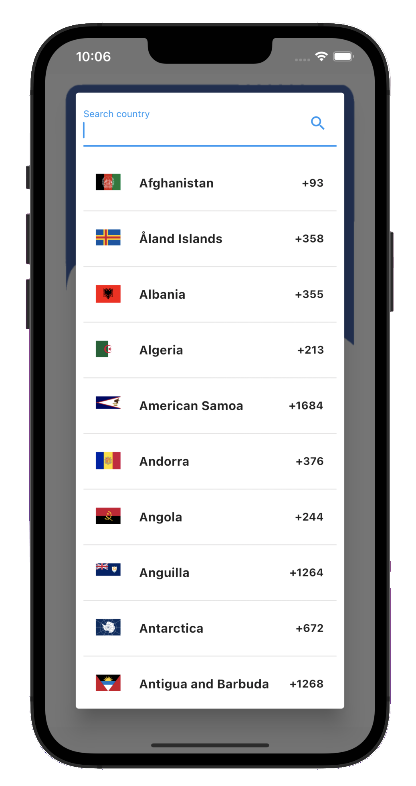
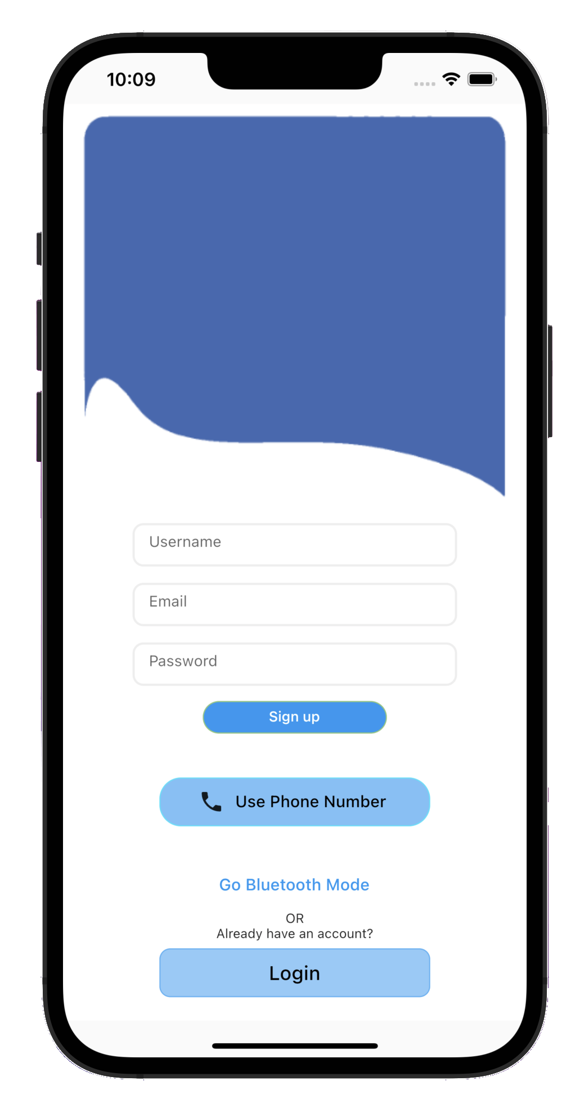
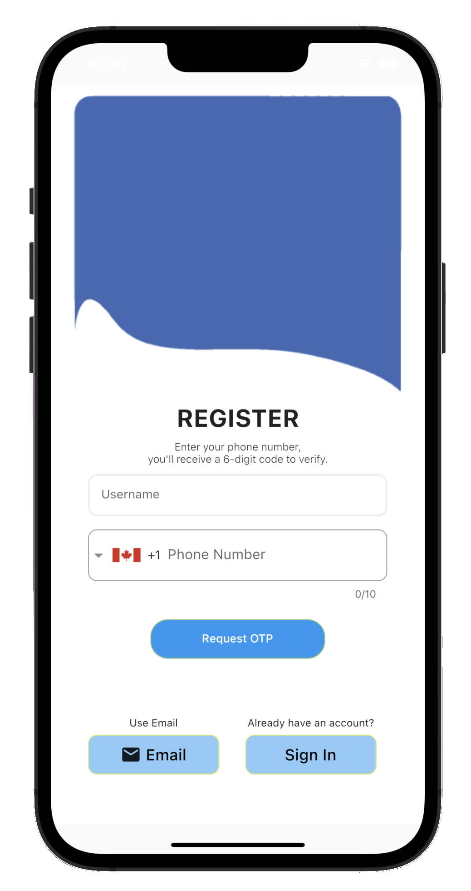
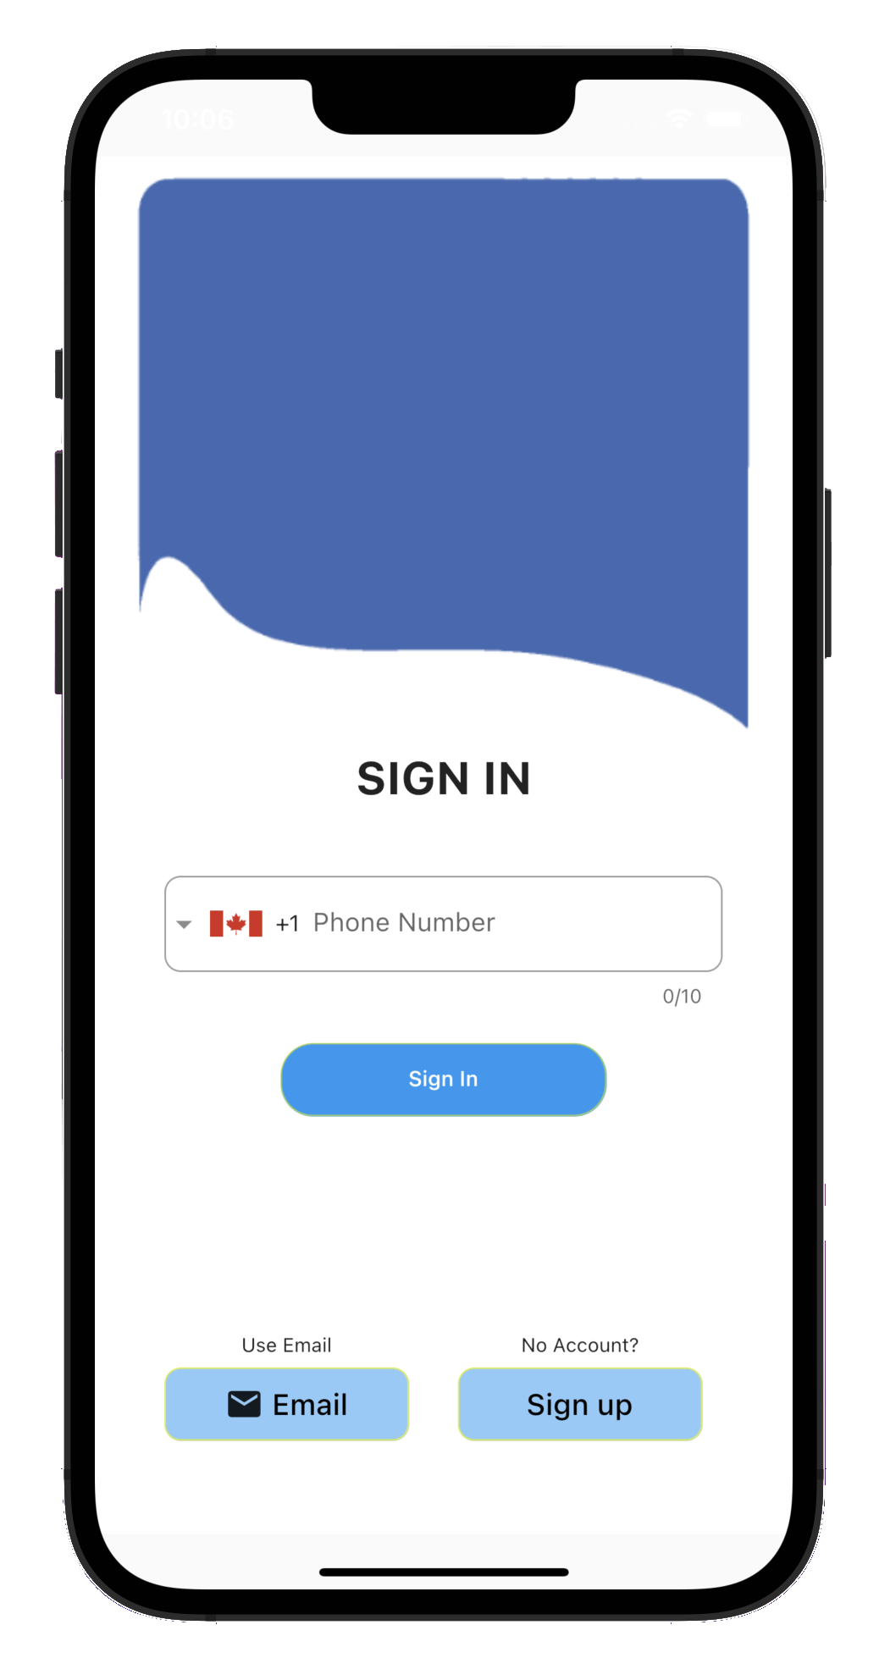
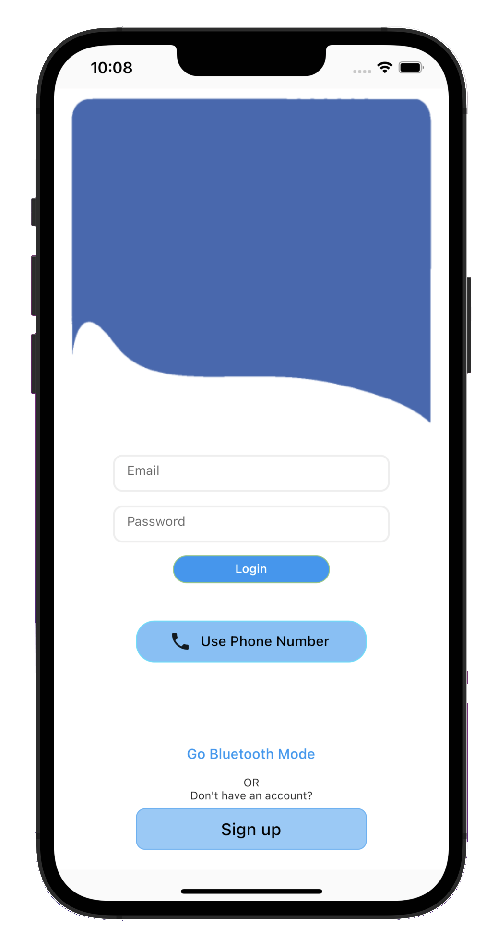
Authentication
Authentication uses Firebase to implement two different ways of authenticating a user:
Email
Phone Number
Email Authentication
Phone Authentication
Sign In
Email and Password
Sign In
User’s Phone Number
Sign Up
Username and User’s Phone Number
Users can register any phone number
Sign Up
Username, Email, and Password

Slide 5
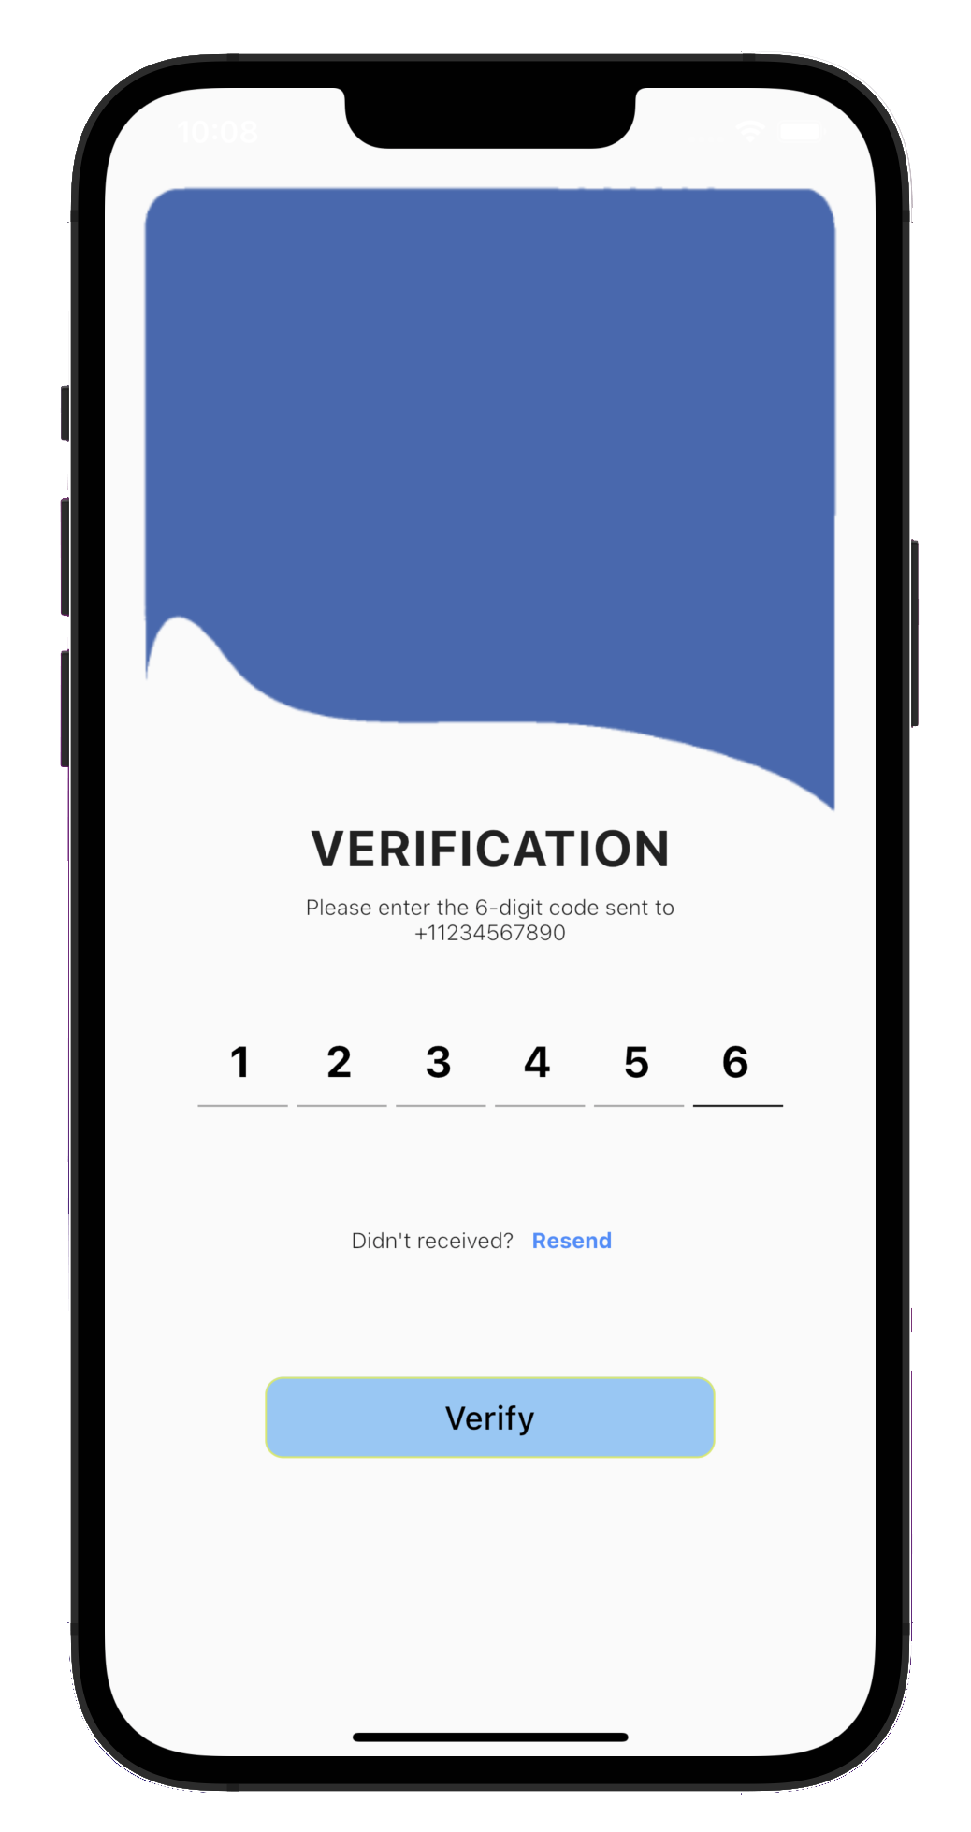
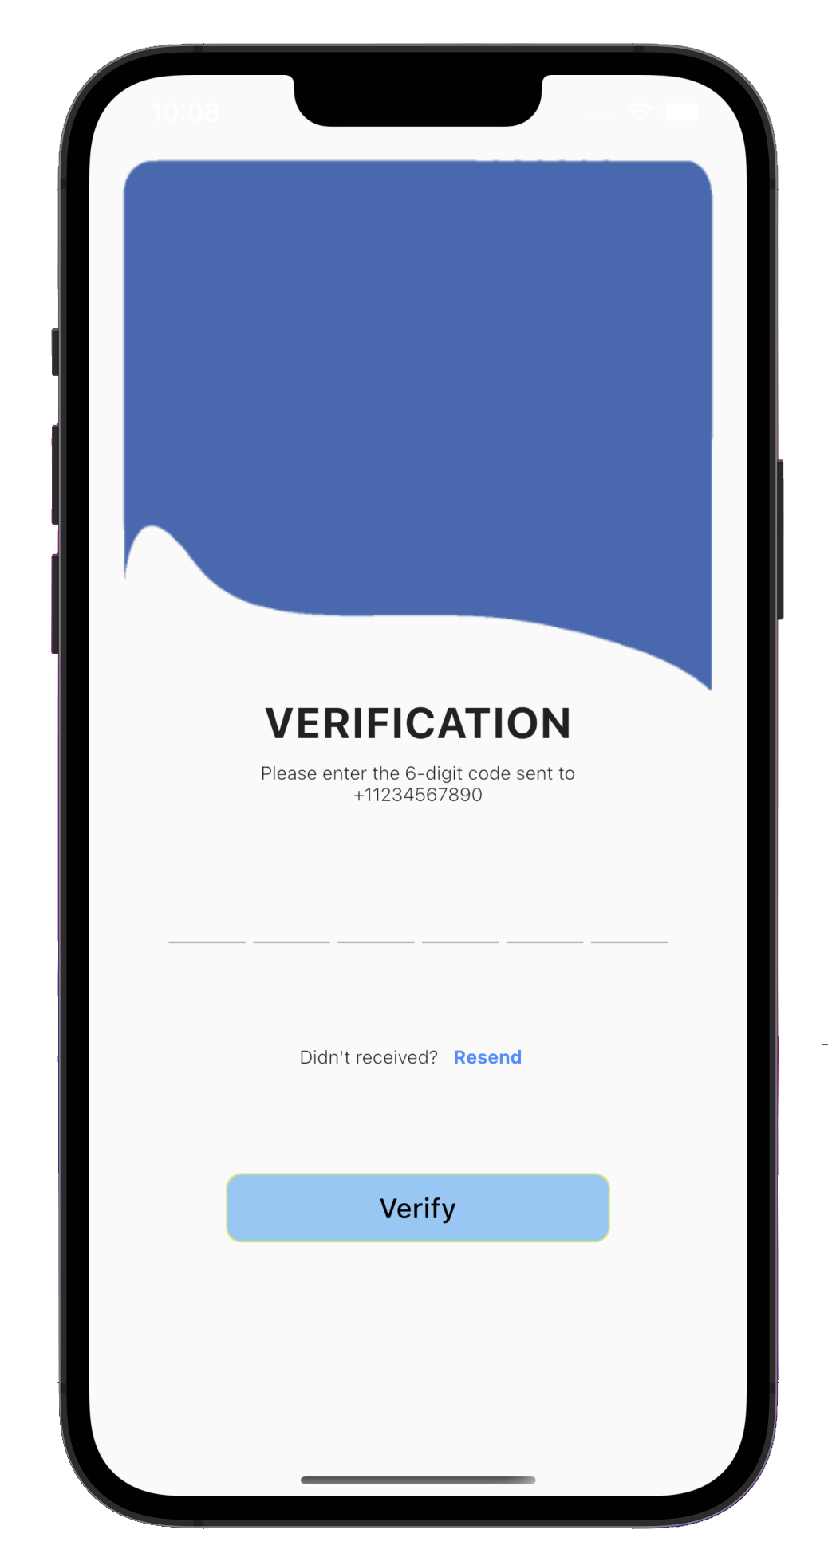
Authentication
Authentication uses Firebase to implement two different ways of authenticating a user:
Email
Phone Number
Phone Number Verification
Sends a 6-Digits code to user’s Phone Number
Users needs to enter the exact code
If users didn’t receive the code, they may press the resend button
Pass? Redirect to main Screen

Slide 6
Authentication 1.1
Logo
Authenticate
Validation
Switch Method
Nearby/Bluetooth Connection
Create
Account

Slide 7
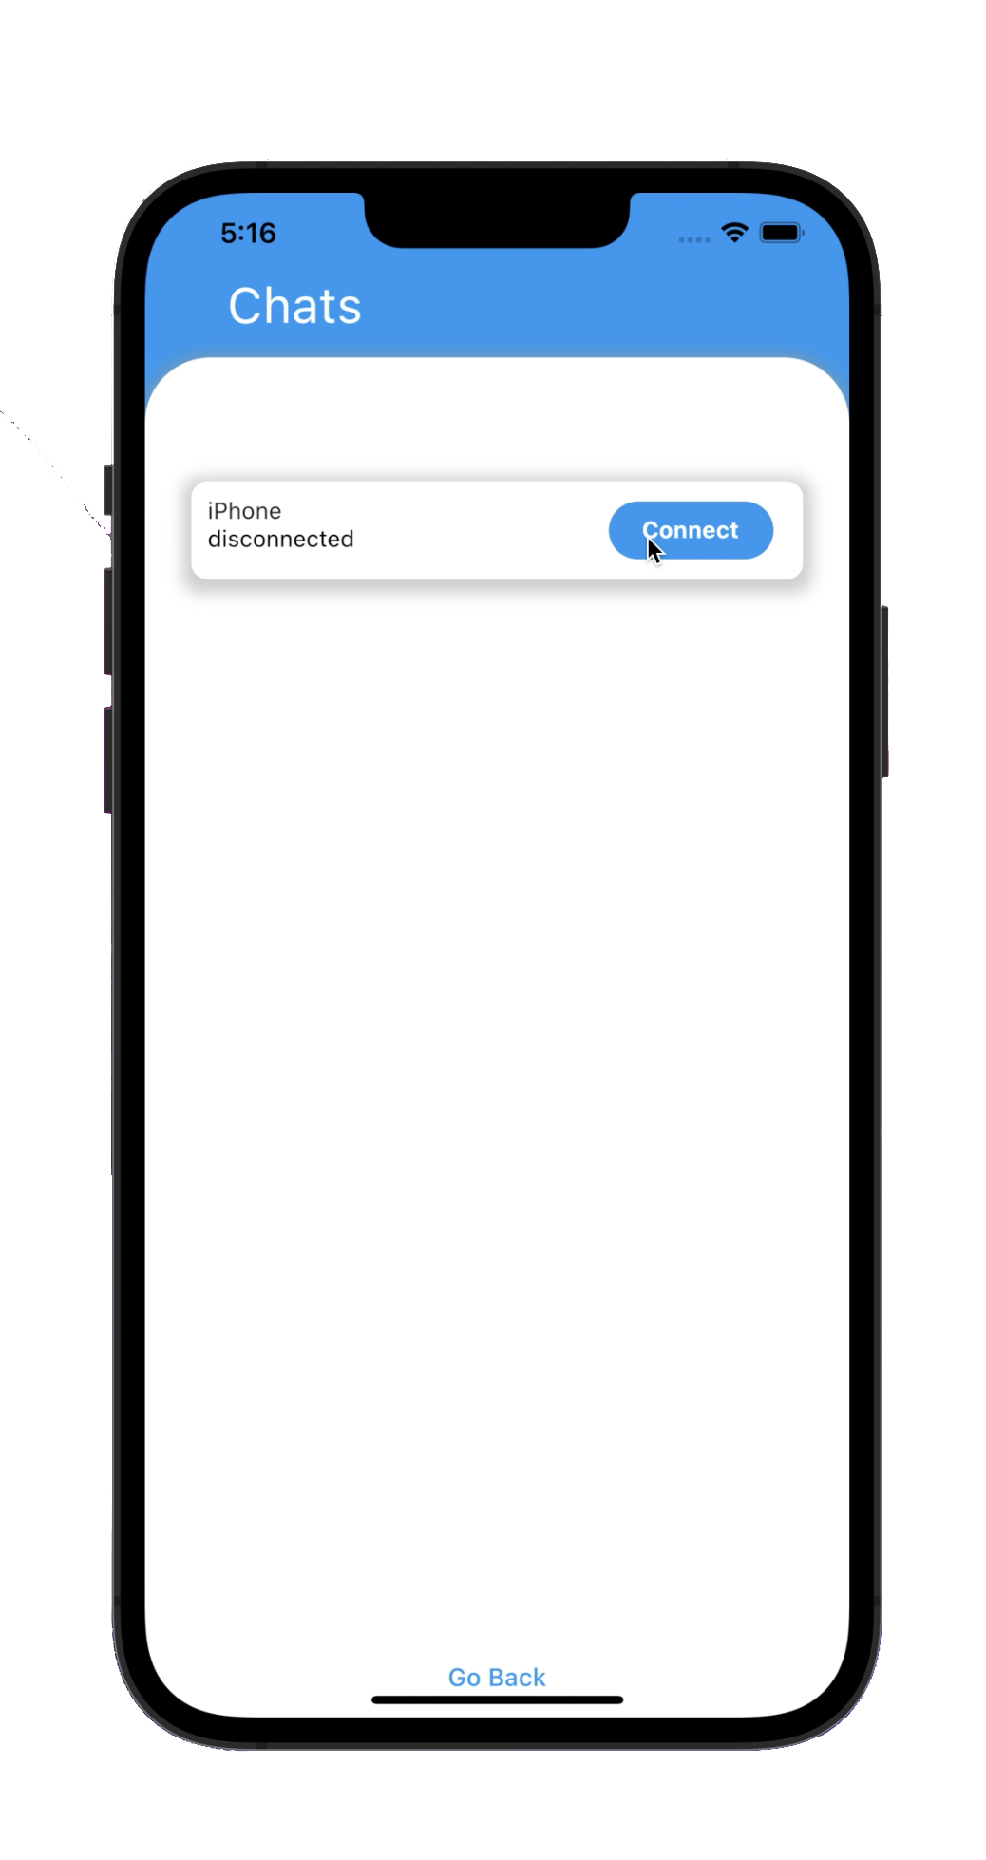
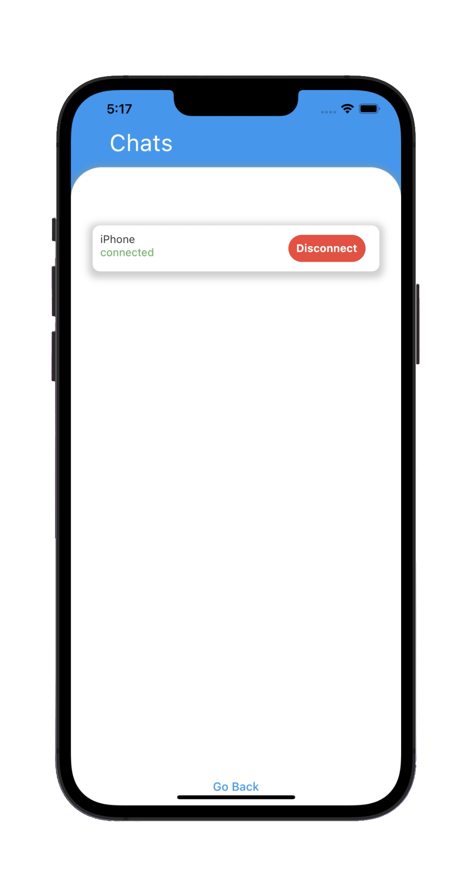
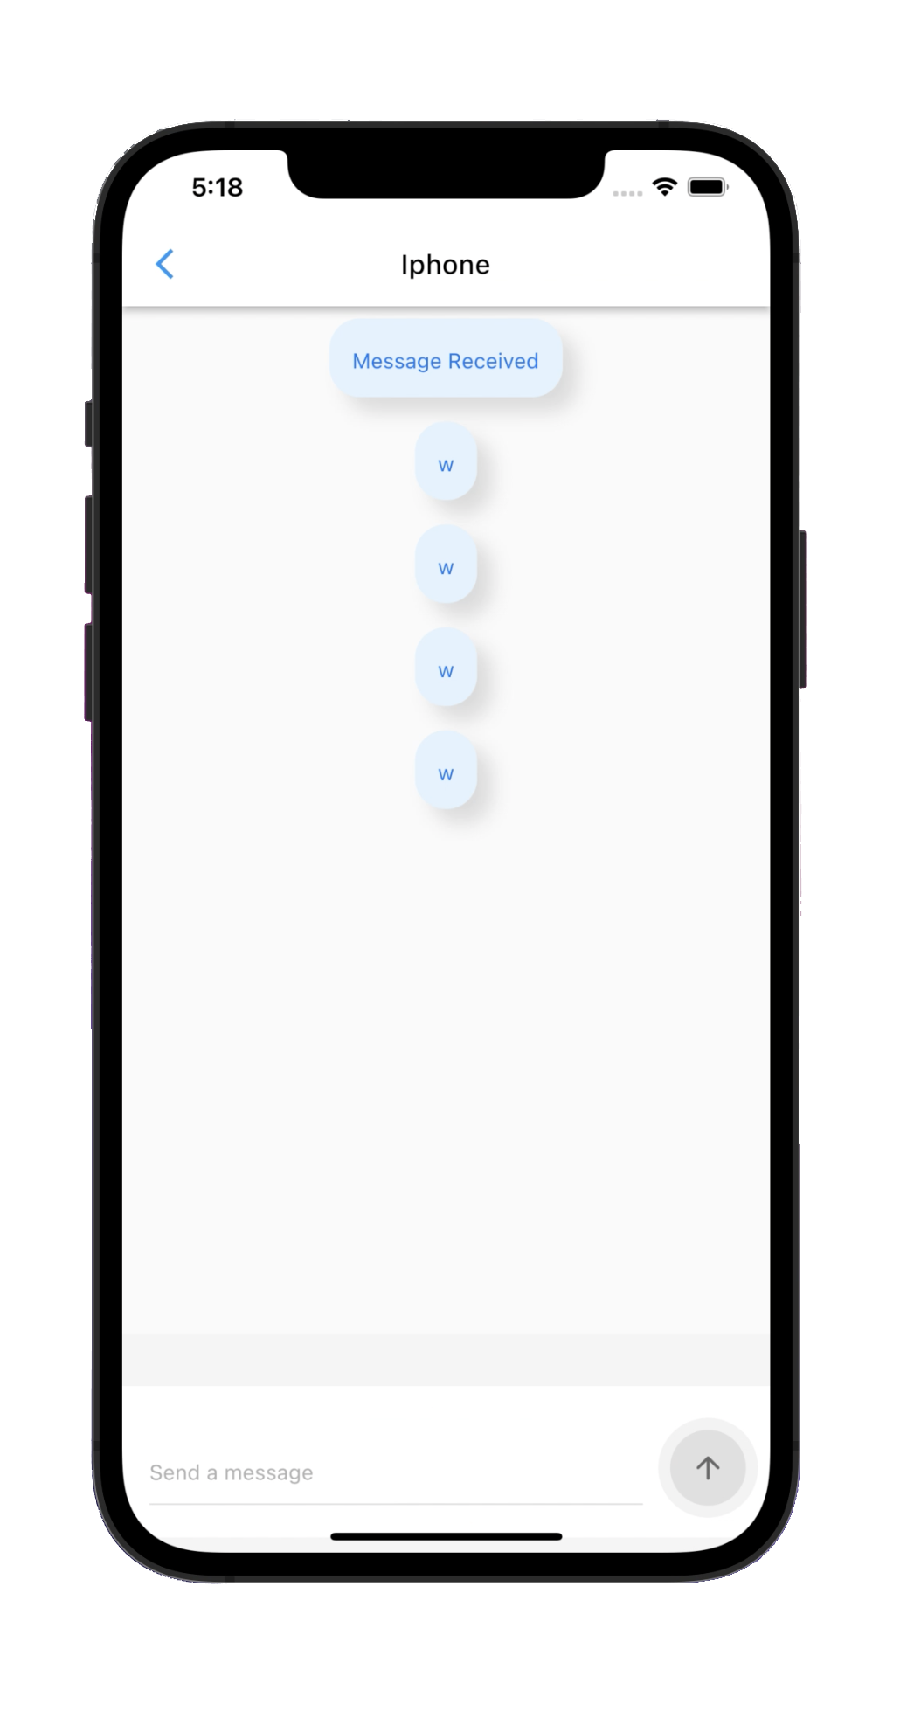
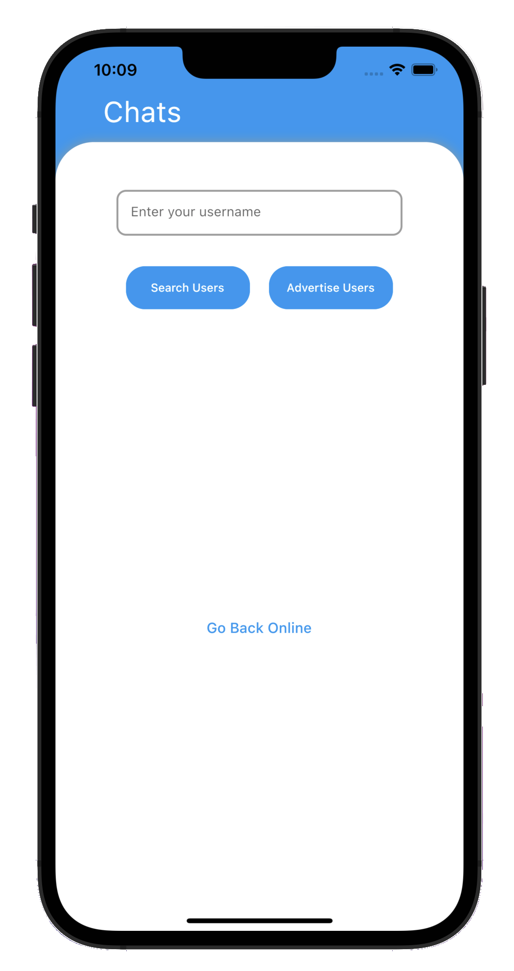
Bluetooth/Nearby connection
Our chat application uses a flutter package called Flutter Nearby Connections.
Flutter Nearby Connections
Open-Source Package
Implements peer-to-peer connectivity
Implements discover nearby devices
Supports Android/iOS
Browser
Main Screen
Advertiser
Message Screen
Listens to browsers
Starts Advertising Peer immediately
If user press disconnect
Stops Advertising Peer immediately
Users can enter their username
Advertiser – Listens to Browsers
Browser – Search for Advertisers
Able to return to Online mode
One way chat messages
Send/Receive
Fast and responsive
Chats are not stored in database
Able to navigate back
Search for Advertisers
Starts Browsing For Peers immediately
If user press disconnect
Disconnects to connected device

Slide 8
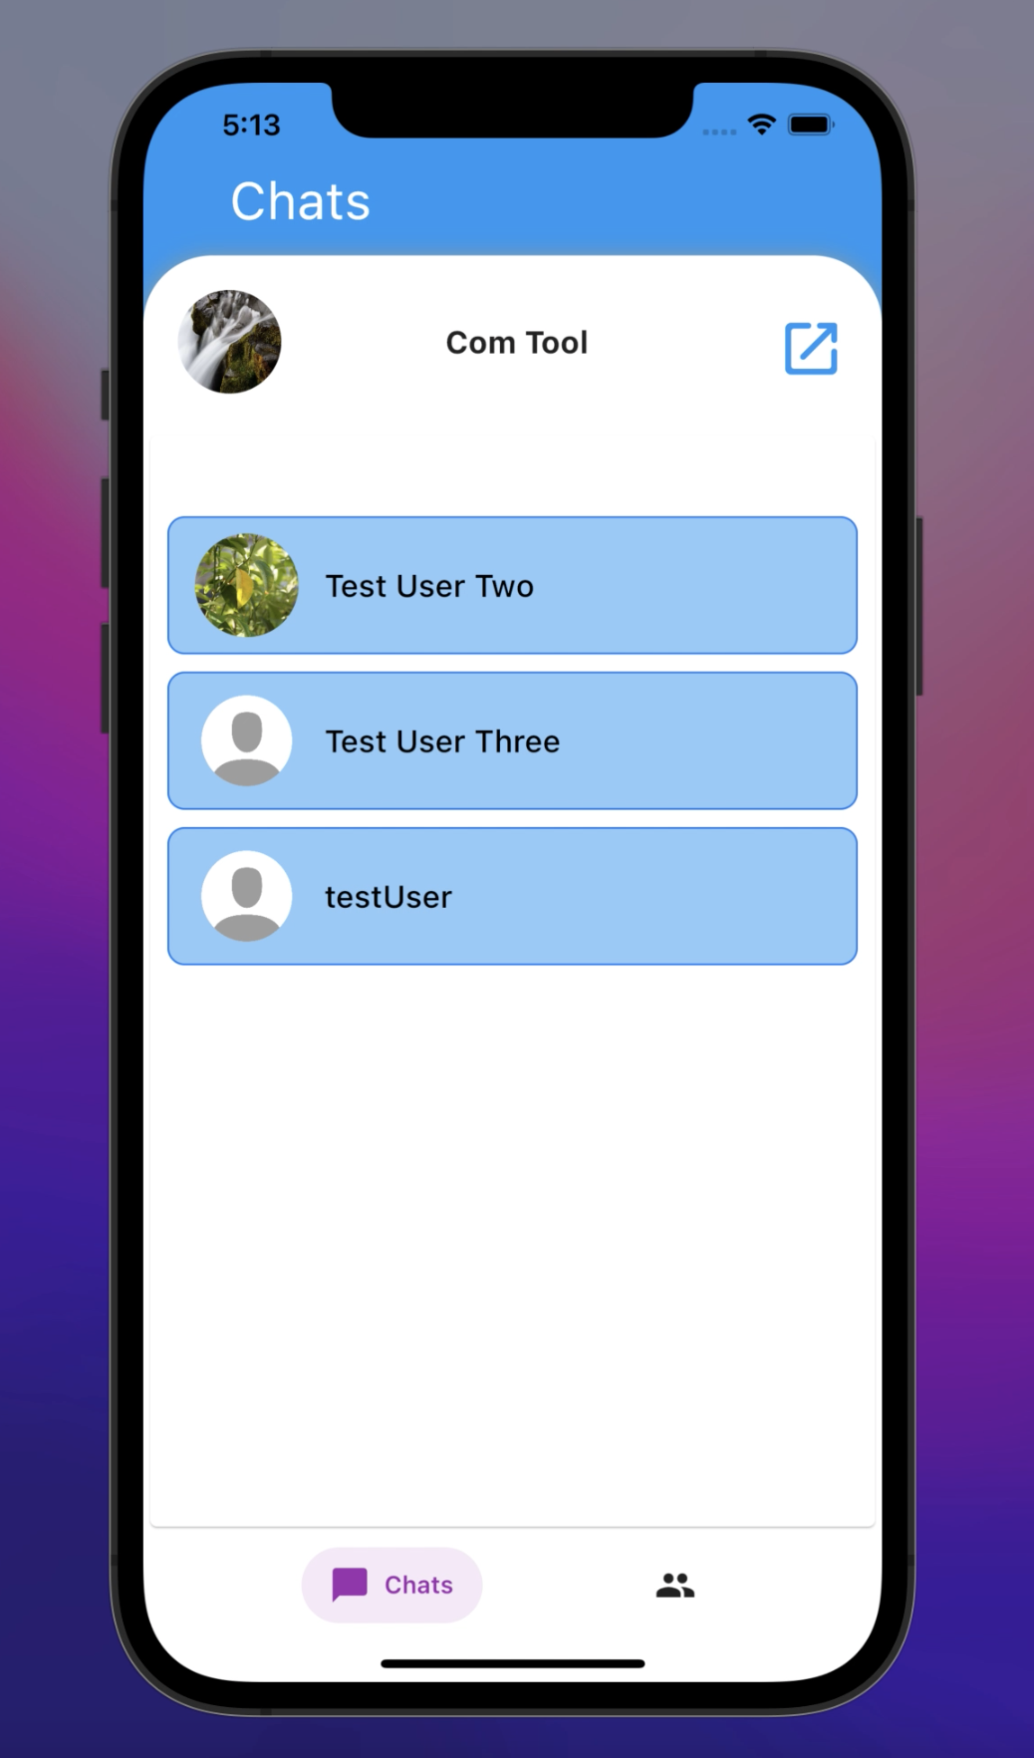
Main page
The main page plays a critical function in our application, including the following key roles:
Showing contacts
It will help to create new contacts
User can access settings page
Fire base makes our work easy for data backups.

Slide 9
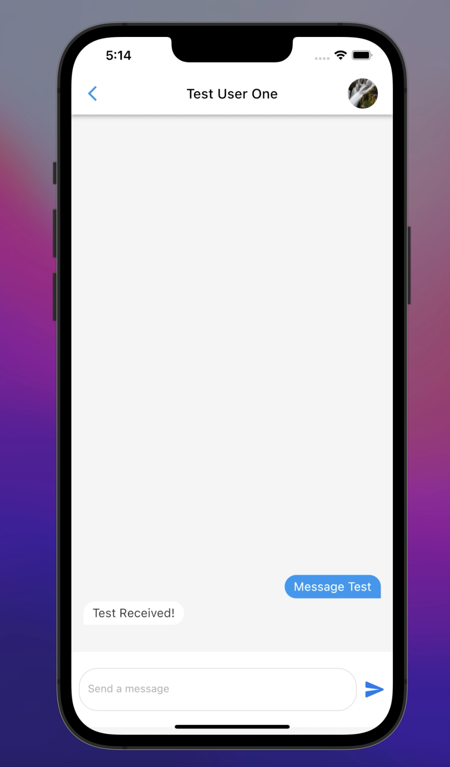
Message page
Now we'll talk about the importance of the message page in our application. Helps to retrieve old chats
Sending and receiving Text messages.
You can see each others profile.
Easy to use.

Slide 10
Design for both the pages
As we move forward, I'd like to talk about the general style of our home page and message page.
It's incredibly user-friendly in terms of comprehension, so anyone starting at the age of six may benefit from it on a regular basis.
Because you can send messages over Bluetooth, it provides you an extra length. As a result, you don't have to be concerned about the internet.

Slide 11
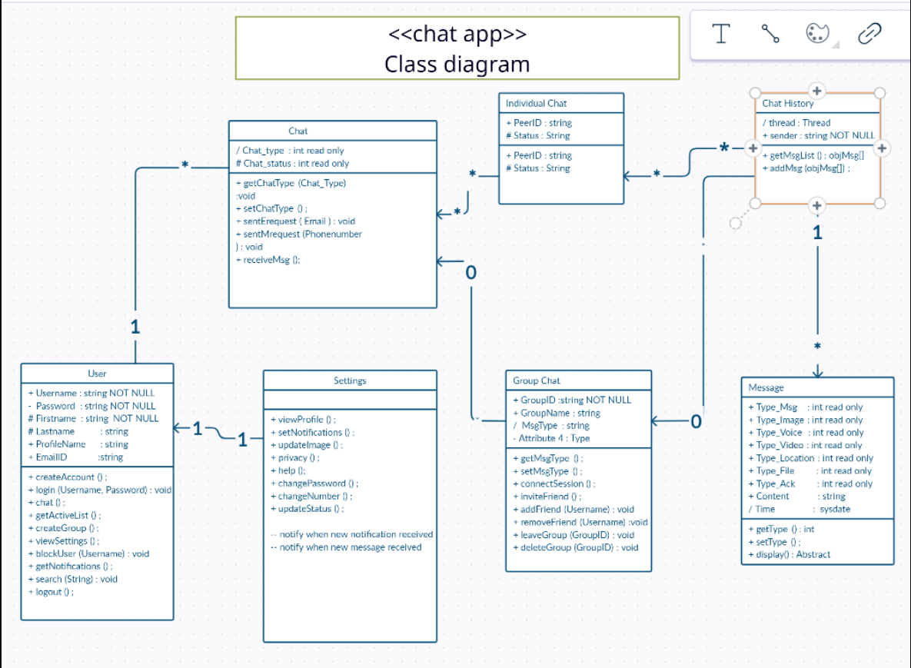
UML

Slide 12
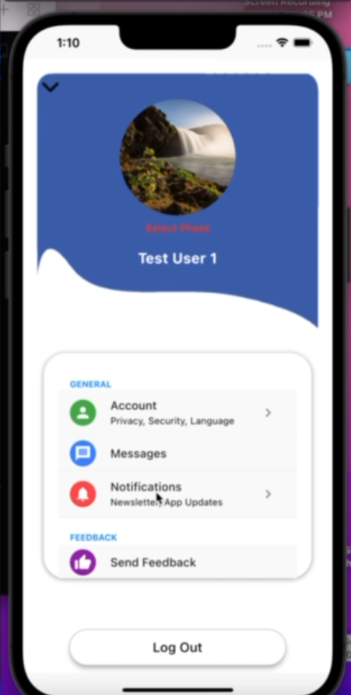
Settings screen
Settings screen is one the features part of the mobile chart FLUPC programmers has developed that governs the app beside the fact the users can send each other message either offline, Bluetooth or online modes.
Settings screen is grouped into 3 categories:
General
Feedback
Support
About

Slide 13
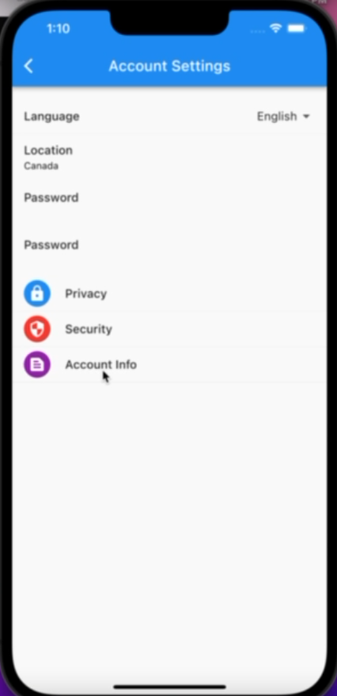
General: Account Settings
Under General, there are different features that are related to Account settings such as :
*Language
*Location
*Password
*Privacy
*Security
*Account info

Slide 14
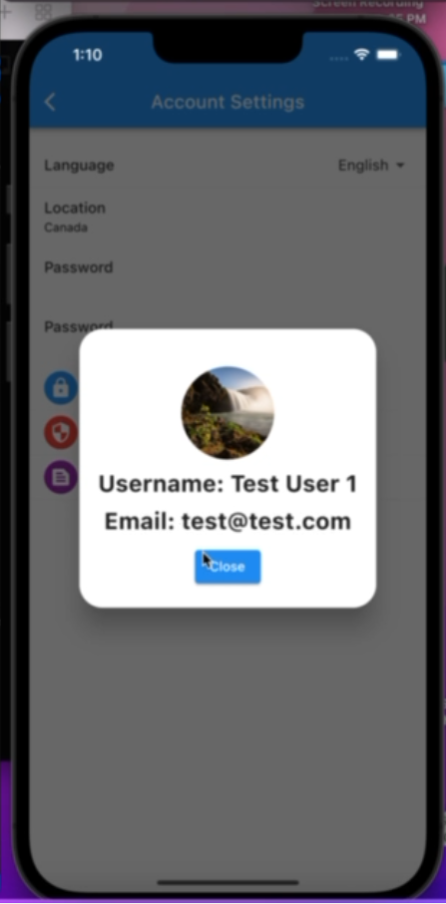
Account info
It shows who is logged in

Slide 15
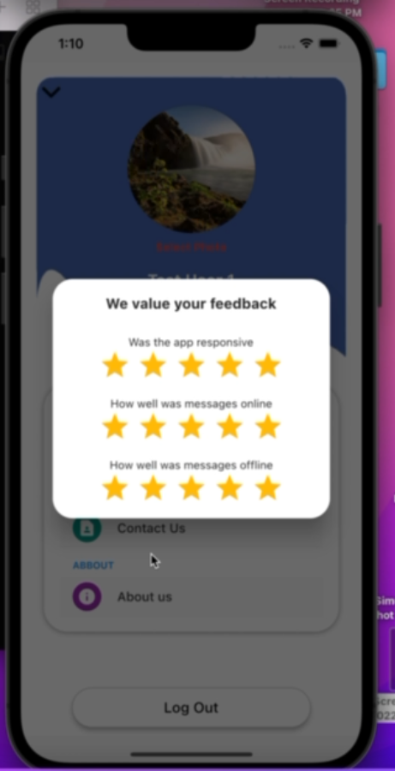
Message
My colleague has talked about message in depth, so I will not repeat it.
Feedback
User can send feedback to developer team so that they can improve the performance of the application.

Slide 16
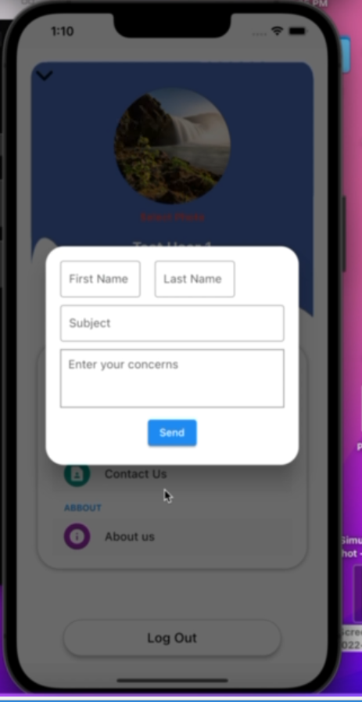
Support
This feature allows users to request support from the developer team in case there is an issue with the app. To help developer team better understand the issue, users have to provide detailed concerns or issues and the team will address the issue for effectiveness of the app.

Slide 17
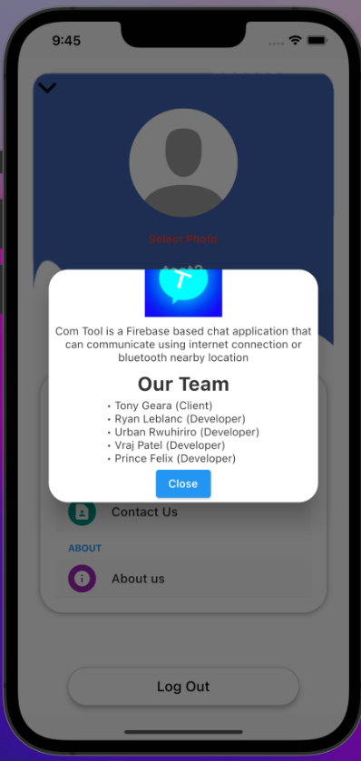
About
This category once clicked on, How com Tool was developed and what kind of database used for online mode and Flutter as framework used as well to build the application. The team that made this mobile application possible is composed of :
*Client: Tony Geara
Developer team:
Ryan Leblanc
Urbain Rwuhiriro
Vraj Patel
Prince Felix

Slide 18
Final statement
We want to express our gratitude to Tony Geara for helping us getting the essence of how the application would run once implemented and his support along the way.
To my fellow student programmers, it wouldn’t happen if each and everyone of you didn’t involve at all level of developing this chat app, you are amazing team anyone would wish to work with.
Last not the least, to our ENG and ENL prof, thank you for your support on this journey. Words cannot express how we are feeling today, you are one of the masterpiece of this work we presented today.
FLUPC programmers, we say Thank you.

