Slide 1

Notes:
<number>

Slide 2
ATS
Notes:
<number>

Slide 3
98%
Notes:
<number>

Slide 4
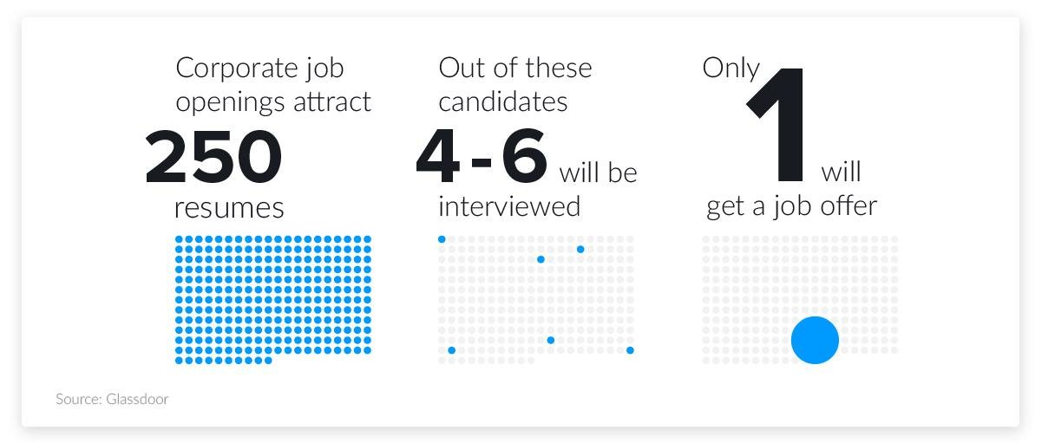
Notes:
<number>

Slide 5
Gale-Shapley Matching Algorithm

Slide 6
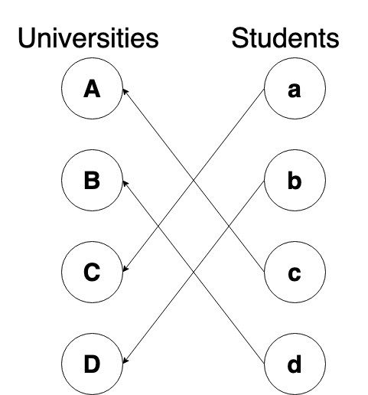

Slide 7




START
Create Account
Upload Resume
Find Your Job
Save and Apply

Slide 8
Inception
Forming ideas
1st Round AWS Deployment Architecture
Auto-scaling feature
Proof of Concept
Test the concept with real JDs and resumes
2nd Round AWS Deployment Architecture
Front-end development
Back-end development
Moderate security
Performant
Scalable
Resilient
Secure

Slide 9
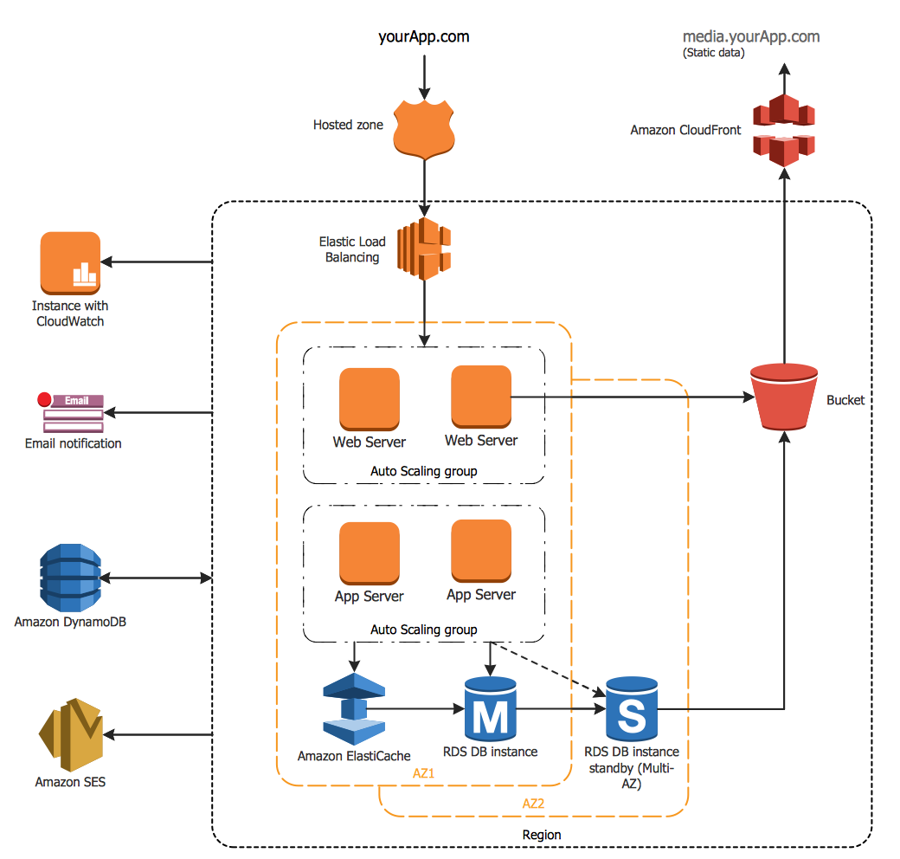
1st Round AWS Deployment Architecture
1st Round AWS Deployment Architecture

Slide 10
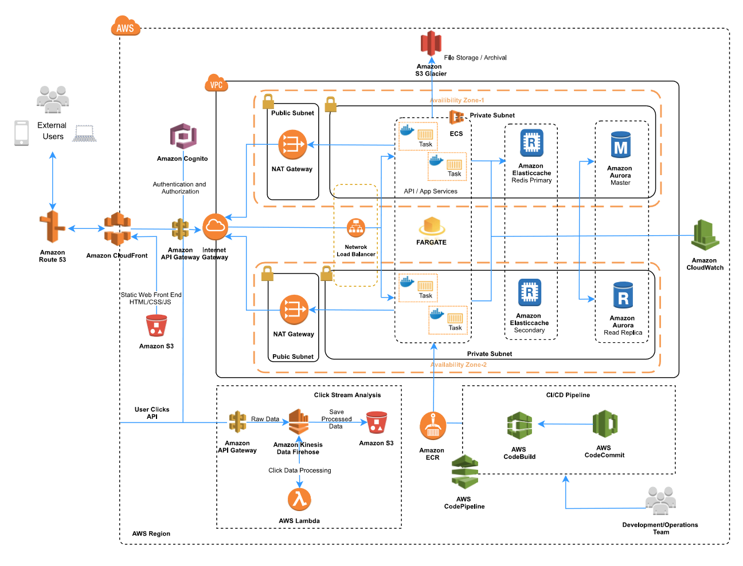
2nd Round AWS Deployment Architecture

Slide 11



