Slide 1



SMART INDIA HACKATHON 2026
TITLE PAGE
  Problem Statement ID – 26034
  Problem Statement Title - Software System to check compliance of Packaged Commodities under Legal Metrology(Packaged Commodities) Rules, 2011 by scanning products, images and labels.
  Theme- Agriculture, FoodTech & Rural Development
  PS Category- Software
  Team Name - AlgNite

Slide 2
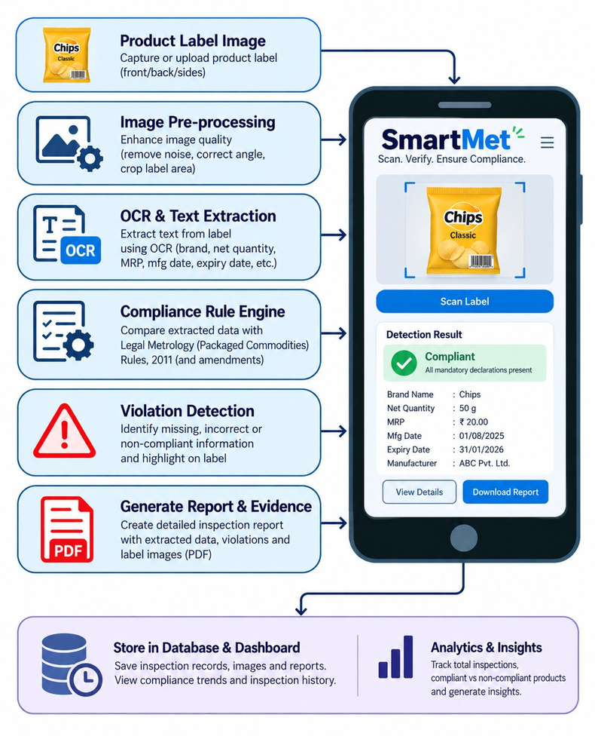
SmartMet AI
AlgNite
Proposed Solution
A computer-assisted inspection platform that automatically extracts, measures, and validates packaged-product labels against Legal Metrology rules, detects violations, generates evidence-backed inspection reports, and maintains a centralized inspection history.
Features :
  Automated Label Scanning - Automatically scans product labels using images/camera for inspection
  OCR & Declaration Detection - Extracts text using OCR and identifies mandatory product declarations.
  Compliance Rule Engine - Compares extracted information with applicable BIS/standards compliance rules.
  Violation Detection - Detects missing, incorrect, or non-compliant information on the label.
  Evidence Generation - Highlights violations on the label and provides supporting evidence for each finding.
  Inspection History & Dashboard - Stores previous inspections and displays compliance trends, violations, and inspection statistics.
@SIH Idea submission-Template
2

Slide 3
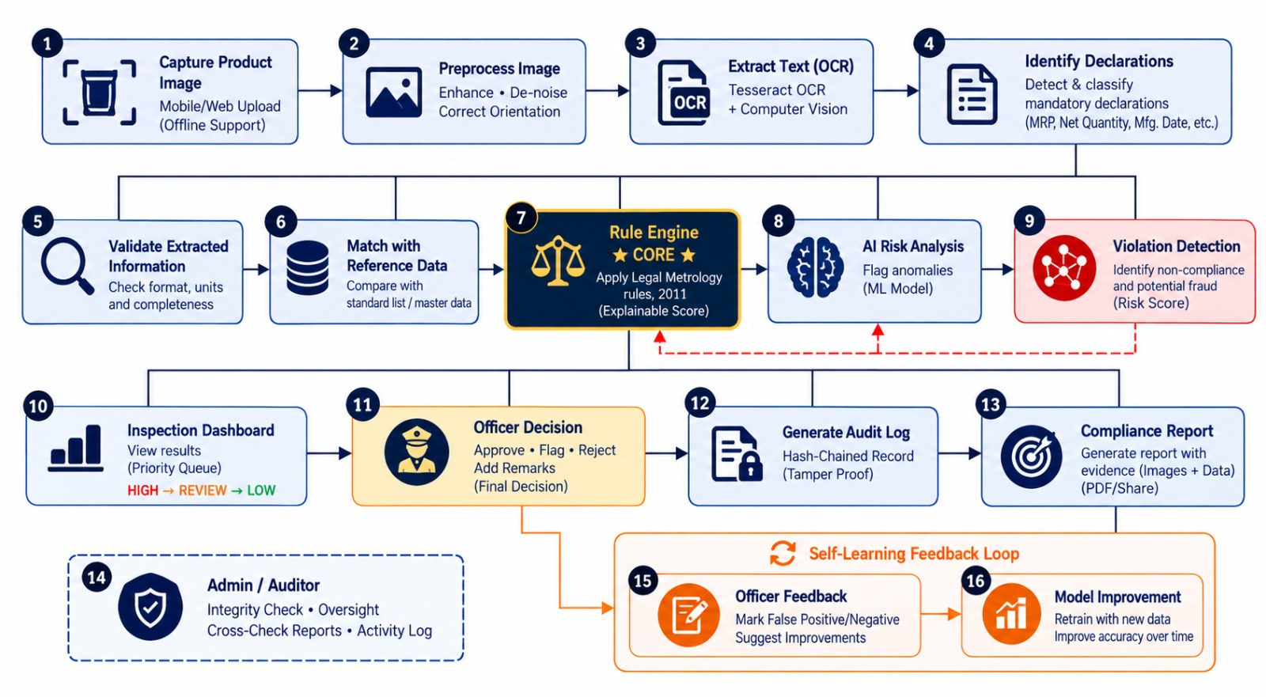
TECHNICAL APPROACH
AlgNite
Tech Stack
Website Frontend: React | Java script | Tailwind CSS
Website Backend:Supabase | PostgreSQL Edge Functions
OCR / CV: Tessreact.js | OpenCV.js
AI / ML: TensorFlow | ONNX Running Web
Compliance Engine: Typescript | JSON Rule Engine
Database & storage : Supabase
Reports & Documents: jsPDF | JWT | ROW Level Security
Security & auth. : Supabase auth | JWT
Deployment & Devops: VS CODE | GIT | Docker
@SIH Idea submission- Template
3

Slide 4
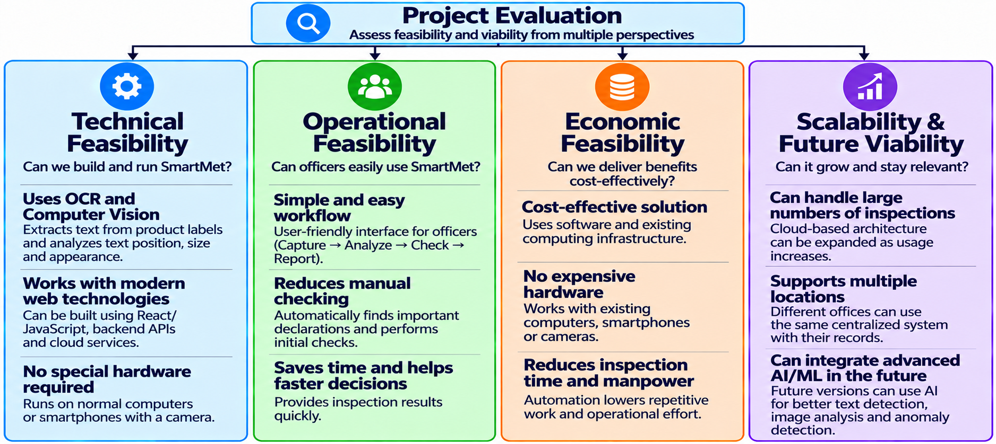
FEASIBILITY AND VIABILITY
AlgNite
@SIH Idea submission- Template
4

Slide 5
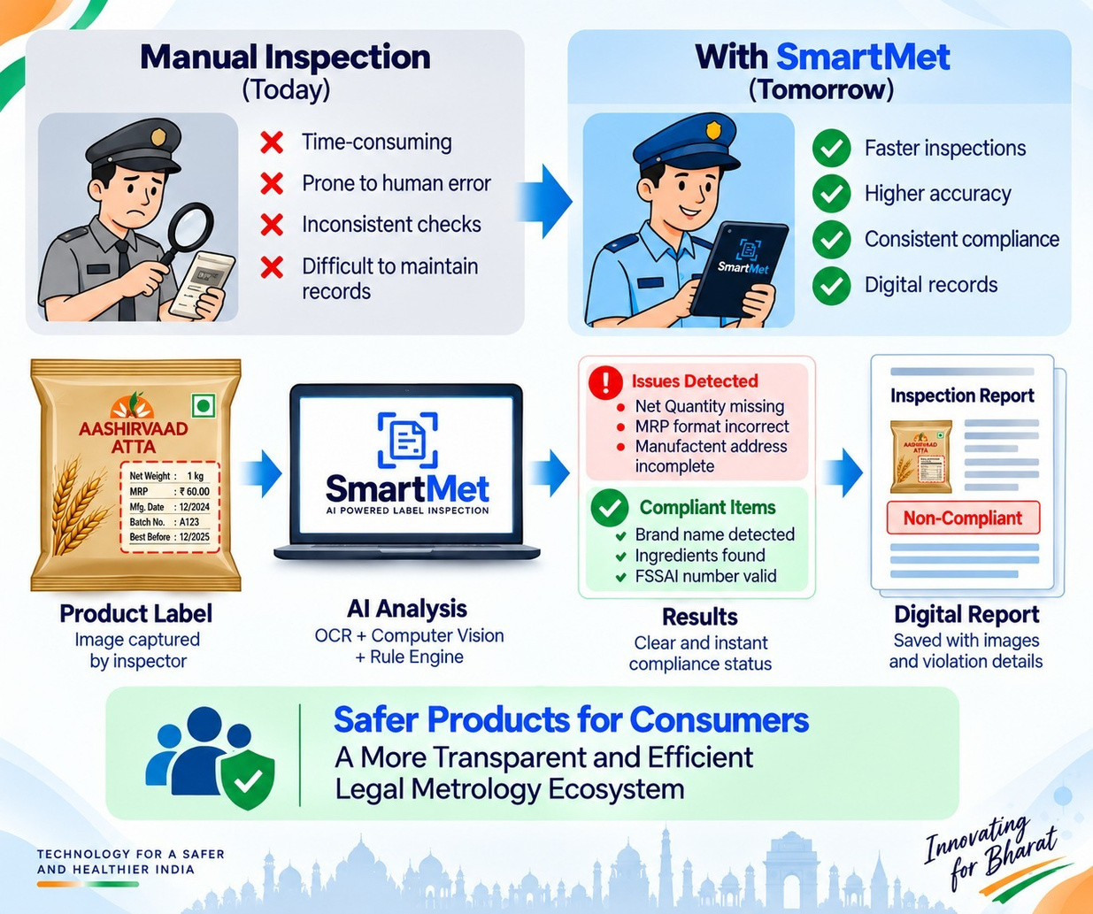
IMPACT AND BENEFITS
AlgNite
Benefits
Faster Inspections : SmartMet reduces the time spent checking product labels manually and helps officers complete the initial inspection quickly.
Higher Accuracy : OCR and Computer Vision help find missing or incorrect declarations, reducing the chances of human mistakes.
Consistent Rule Checking : SmartMet applies Legal Metrology rules in the same way for every inspection, making the process more consistent.
Evidence-Based Enforcement : The system highlights violations and connects them with product images, making the findings easier to verify.
Digital Inspection Records : All product details, violations, photographs, and reports are stored together for easy access and future reference.
@SIH Idea submission- Template
5

Slide 6
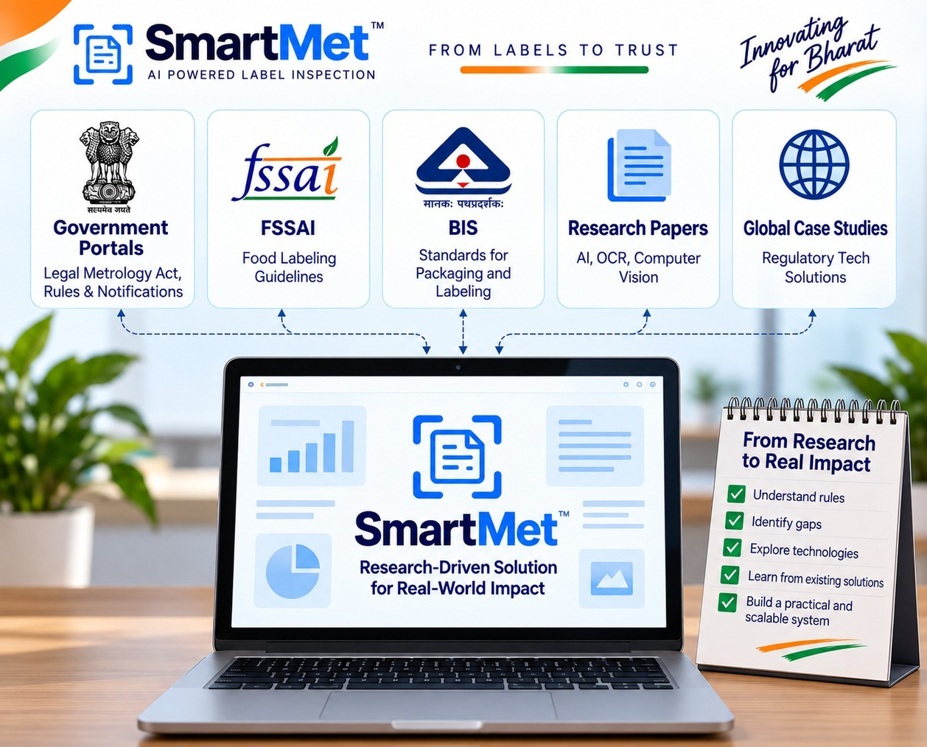
RESEARCH AND REFERENCES
AlgNite
Research Sources
  Legal Metrology Act, 2009 — Legal framework for weights, measures and consumer protection.
  Legal Metrology (Packaged Commodities) Rules, 2011 — Mandatory declarations and packaging compliance requirements.
  BIS Standards & Guidelines — Standards related to packaging, labelling and product information.
  AI/OCR & Computer Vision Research — Studied technologies for text extraction, image analysis and automated inspection.
  Existing Regulatory-Tech Solutions — Studied digital inspection approaches to identify gaps and design a practical SmartMet workflow.
  Department of Consumer Affairs — Government procedures, clarifications, notifications and enforcement context.
@SIH Idea submission- Template
6

