Slide 1

IBM SkillsBuild Bob Hackathon Showcase – Gujarat, 2026
“Exploring the Power of Agentic AI with IBM Granite and IBM Bob”

Slide 2



Project Title – FLOODGUARD AI
Domain of Project – Urban Infrastructure & Disaster Management
Student Name | Recent Passport Photo | Email ID | Mobile number [WhatsApp]
Prince Jain |  | Princejjain566@gmail.com | 9753995851
Alka Raikwar |  | alkaraikbar755@gamil.com | 6207020293
Aniket Jaiswal |  | officialaniket56@gmail.com | 6267168690

Slide 3
Problem Statement
The Challenge
Rapid urbanization in Ahmedabad and Surat is putting increasing pressure on existing stormwater drainage infrastructure. During heavy monsoon rainfall, this can lead to:
Heavy Rainfall:
Intense rainfall can overwhelm urban drainage systems.
Drainage Bottlenecks:
Blocked or inadequate drainage can cause localized waterlogging.
Fragmented Information:
Rainfall, flood history, drainage conditions, and citizen reports are scattered across different sources.
Delayed Response:
Authorities may struggle to identify high-risk locations and prioritize critical response actions quickly.
The Core Challenge:
How can fragmented flood information be transformed into fast, localized, and actionable decisions for civic authorities?
Our Goal:
FloodGuard AI bridges the gap between flood-risk detection and coordinated civic response.

Slide 4
Proposed Solution: FLOODGUARD AI
FLOODGUARD AI is a multi-agent urban flood intelligence platform built using IBM Bob, IBM Granite, IBM Cloud, Machine Learning, and Geospatial Intelligence. It converts rainfall, drainage, historical flood, and citizen data into localized risk insights and prioritized response recommendations.
The system combines Machine Learning for flood-risk prediction with IBM Granite-powered Agentic AI for incident understanding, risk explanation, summarization, and grounded recommendations.
Multi-Agent System
  Flood Risk Prediction Agent — Predicts flood risk using rainfall, historical flooding, drainage, and incident data.
  Drainage Maintenance Agent — Identifies vulnerable drains and prioritizes maintenance.
  Citizen Flood Report Agent — Understands Gujarati, Hindi, and English reports and classifies severity.
  Civic Response Agent — Combines agent insights and generates prioritized response plans with human approval for critical actions.
Command Centre Dashboard
Provides an interactive view of risk zones, rainfall, active incidents, drainage priorities, citizen reports, response teams, and AI recommendations.
IBM Technology
  IBM Bob — Application & agent workflow
  IBM Granite — Reasoning, summarization & recommendations
  IBM Cloud — IBM ecosystem integration and cloud-ready architecture
  Machine Learning — Flood-risk prediction
  Geospatial Intelligence — Location-based visualization
Urban Flood Command Centre
  WHERE is flooding likely?
  WHY is the area at risk?
  WHAT should be done next?

Slide 5
Technology Used
IBM Bob — Full-stack Agentic AI application development
and workflow orchestration.
IBM Cloud — Cloud infrastructure and integration support for the solution architecture for FLOODGUARD AI.
Grounded AI — Provides application data as context to Granite
for reliable, data-grounded responses.
IBM Granite — Multilingual understanding, reasoning,
incident summarization, and recommendation generation.
Geospatial Intelligence — Interactive risk map showing
flood zones, incidents, drainage locations, and
response areas.
Machine Learning — Flood-risk prediction using rainfall, drainage,
historical incidents, and citizen-report features.
Prototype Data Note
• FloodGuard AI currently uses synthetic/demo data for hackathon demonstration.
Production deployment can integrate real rainfall, drainage, GIS, and historical flood datasets from authorized sources.

Slide 6
Core Components Used –
1) Citizen Input – Interface for text, optional voice and image-based flood reports.
2) IBM Granite Agent – Understands reports, summarizes incidents and generates grounded recommendations.
3) IBM Granite Model – Used for multilingual understanding, reasoning and explanation.
4) AI Output – Displays risk explanations, incident summaries and recommended actions.
5) Data Layer – Stores rainfall, incidents, drains, reports, risk predictions and audit logs.
6) Interactive Map & Dashboard – Visualizes flood risk, incidents, drainage and response activity.

Slide 7
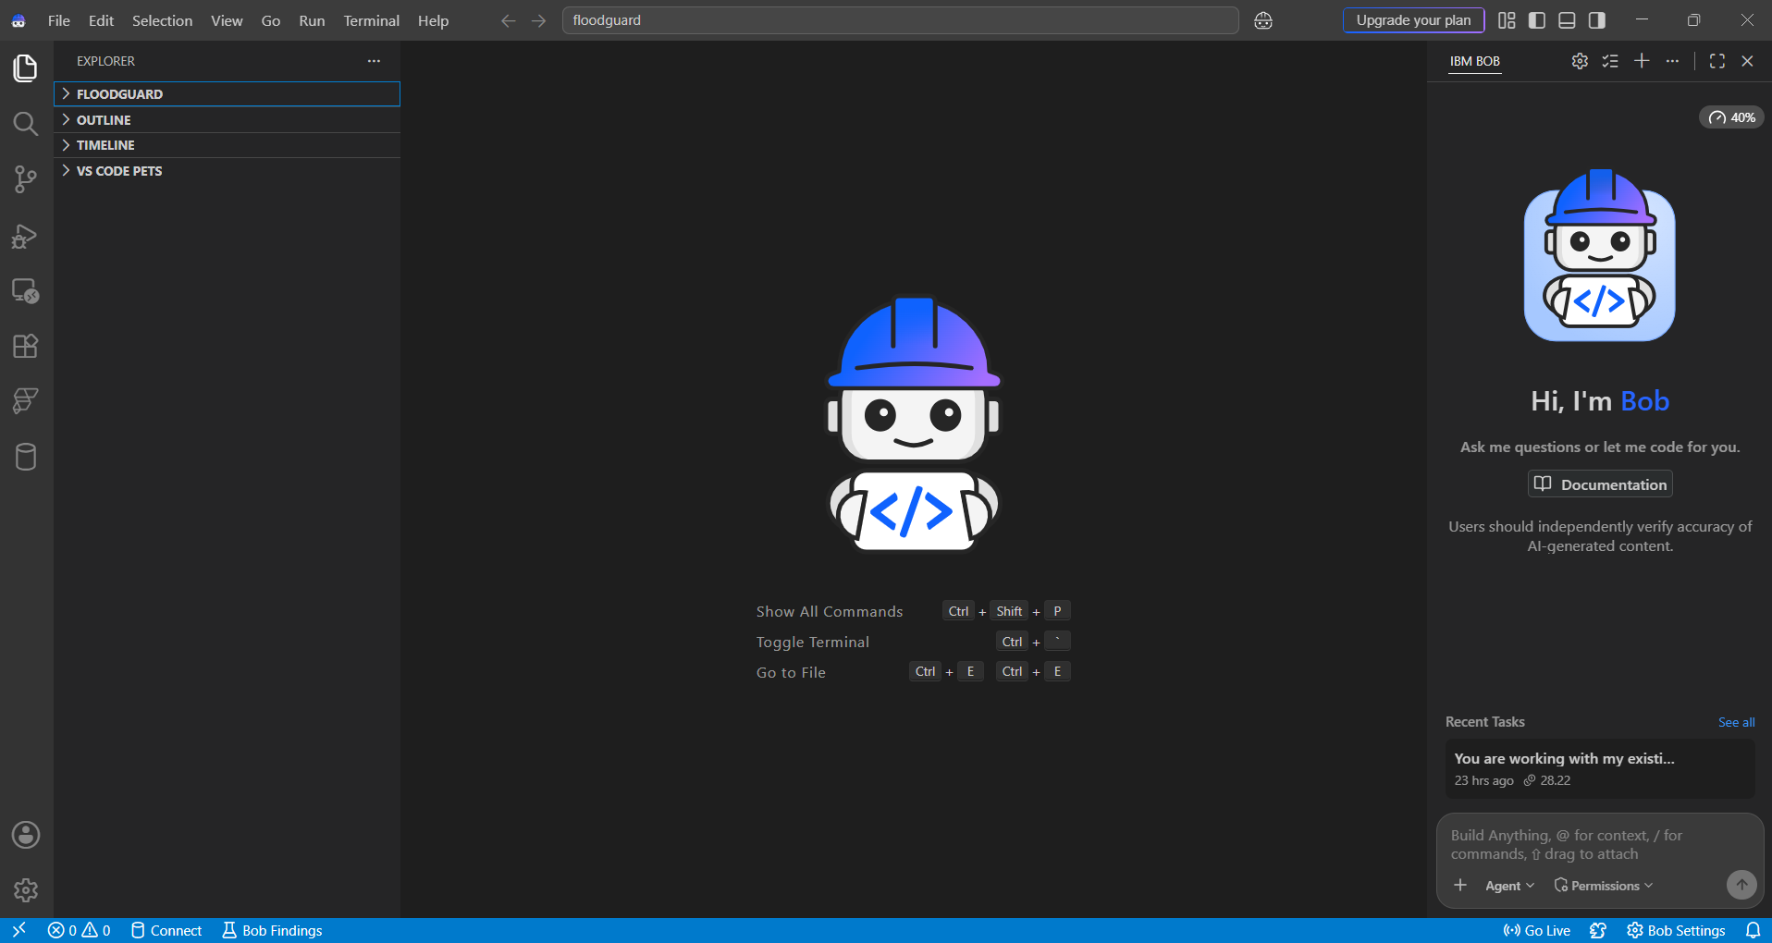

Slide 8
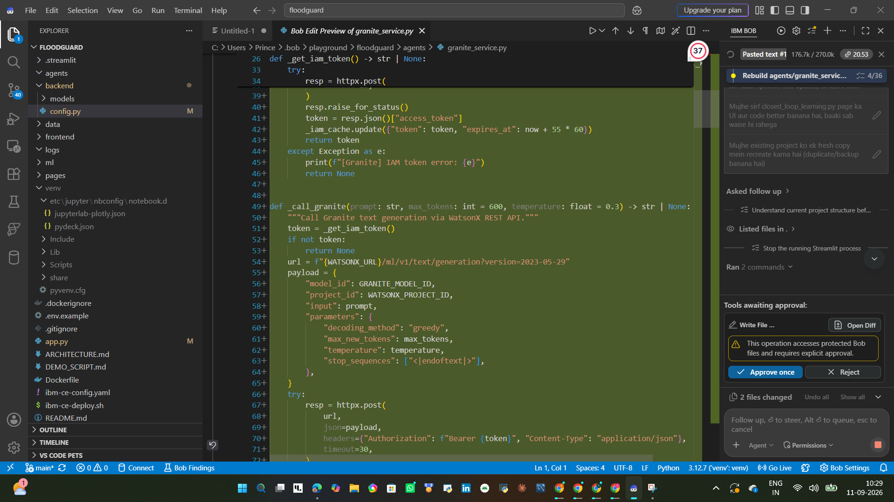

Slide 9
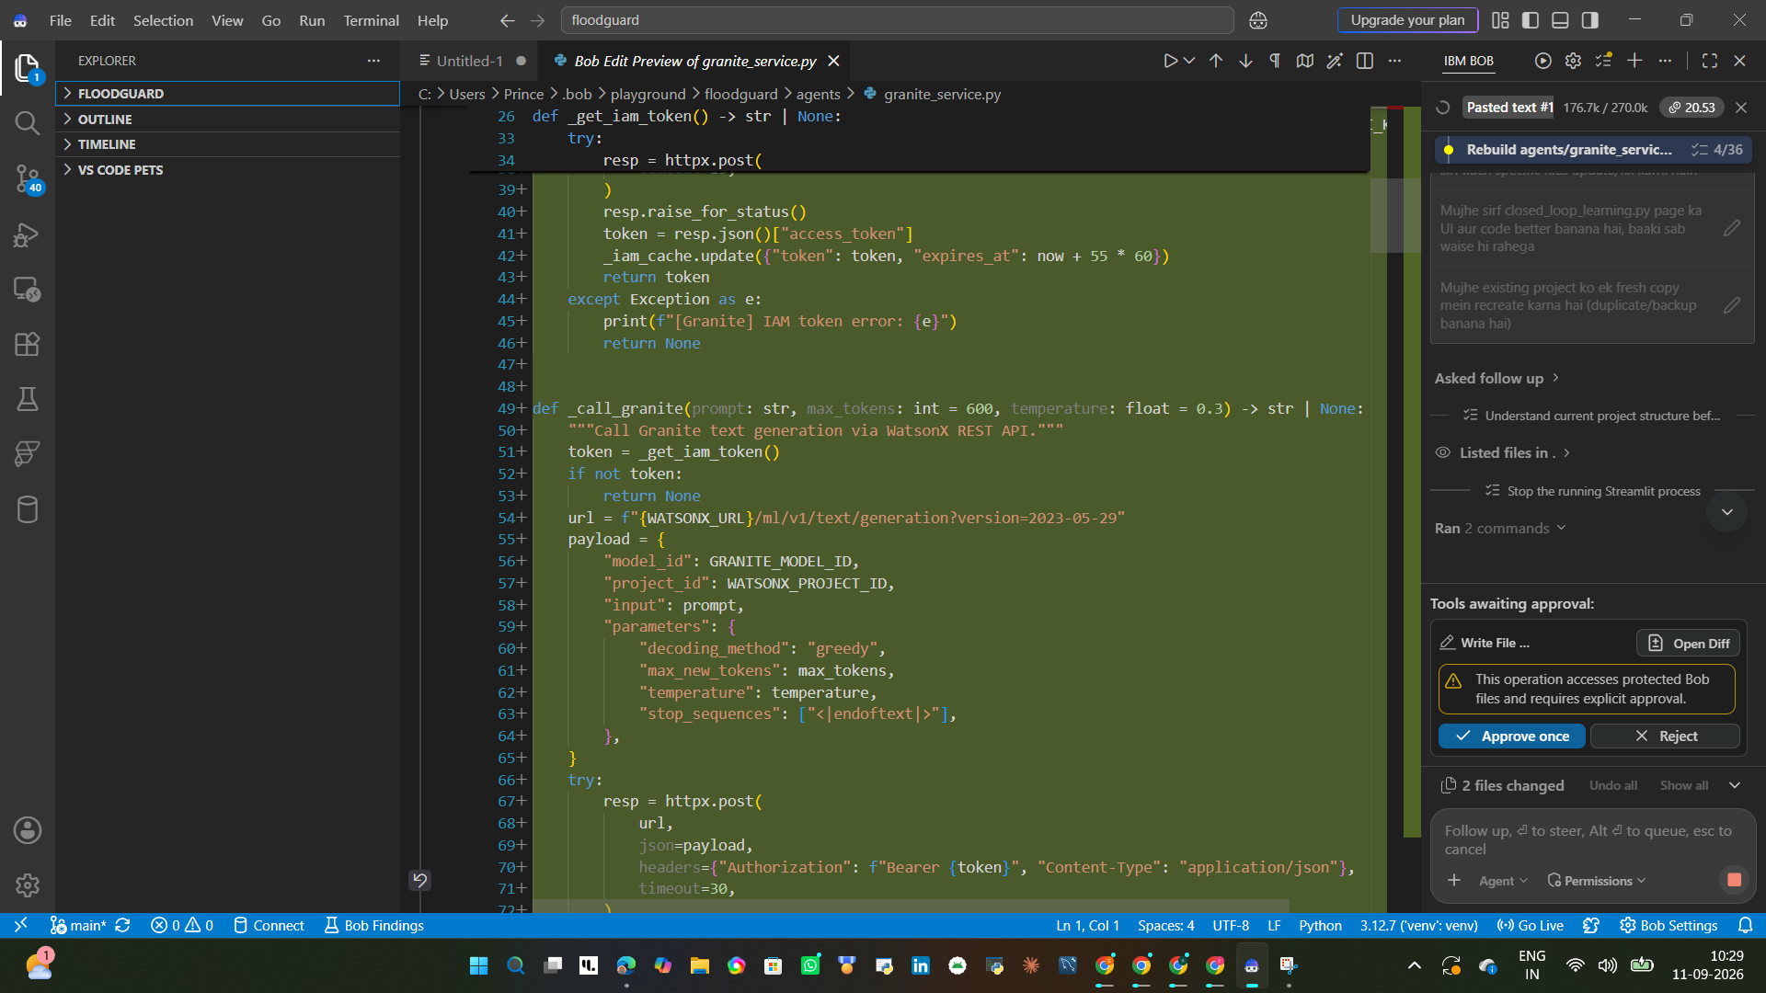

Slide 10
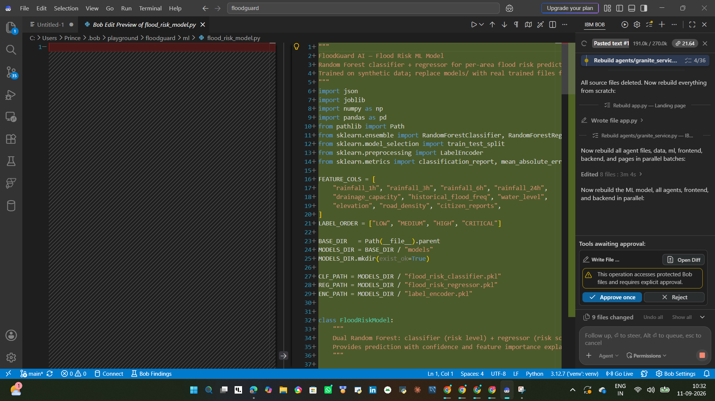

Slide 11
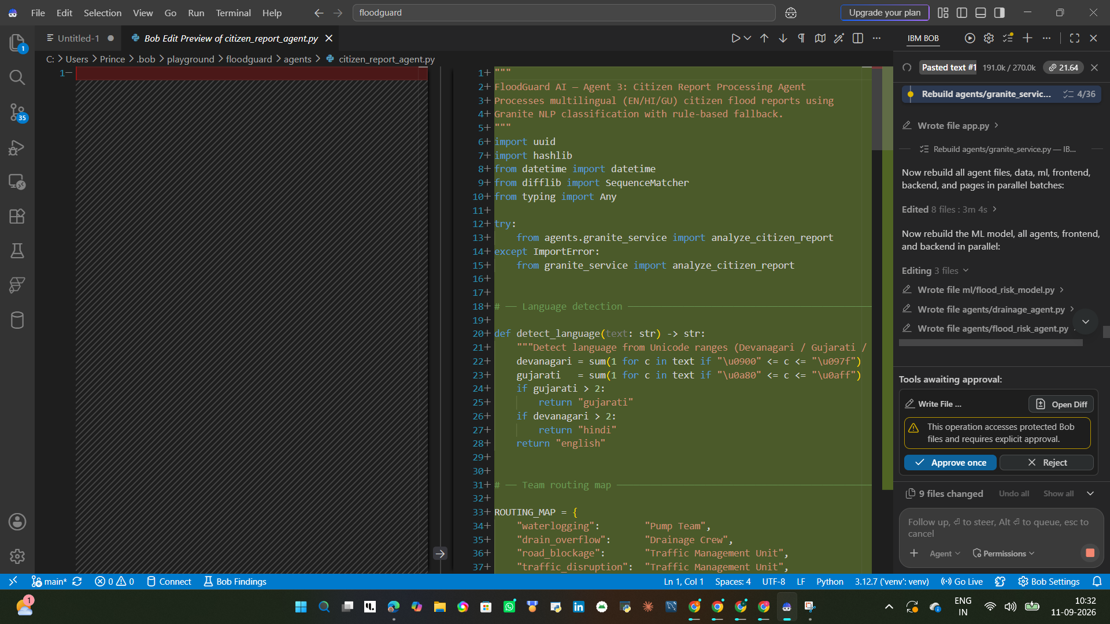

Slide 12
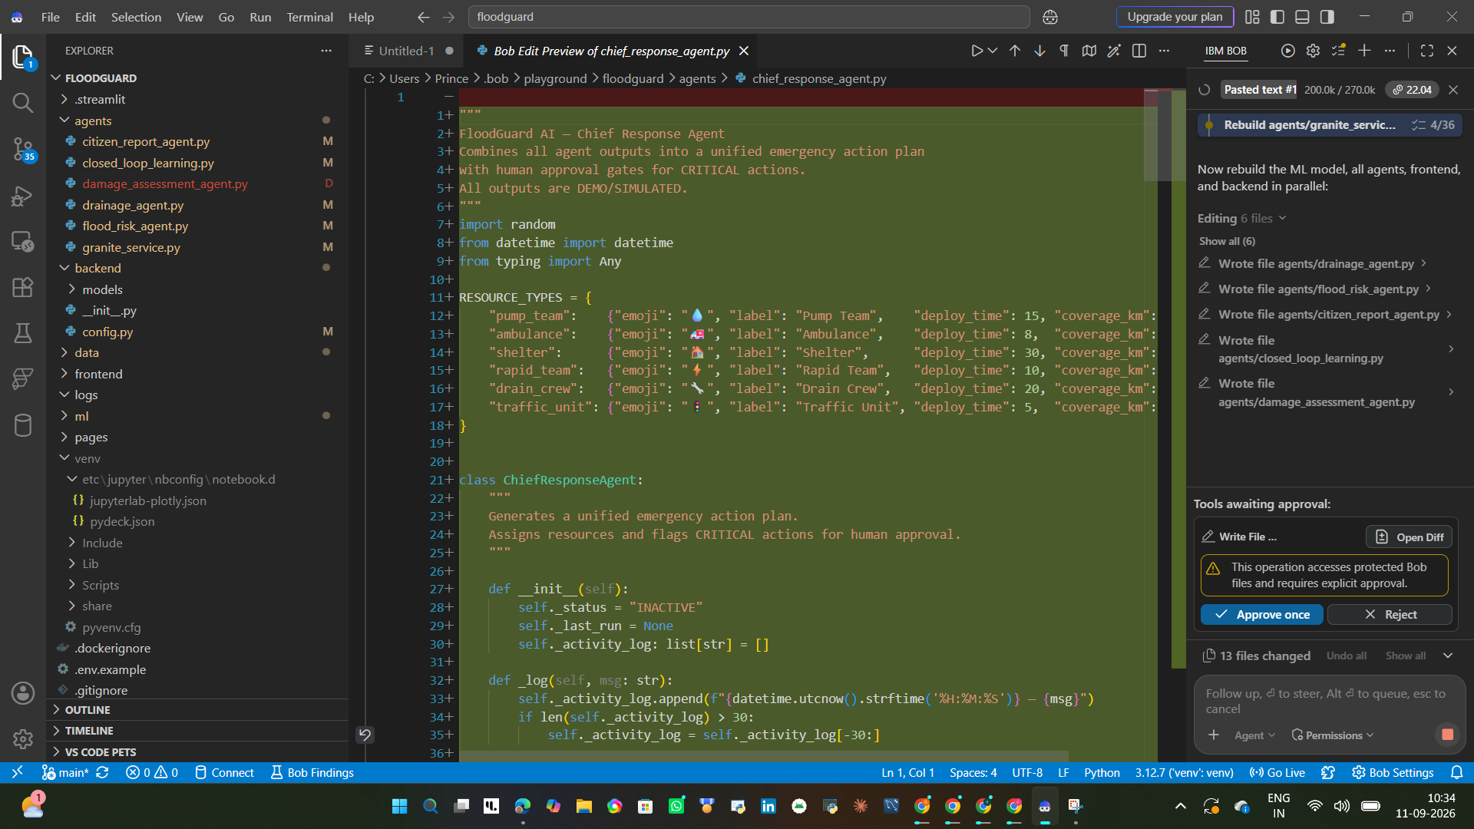

Slide 13
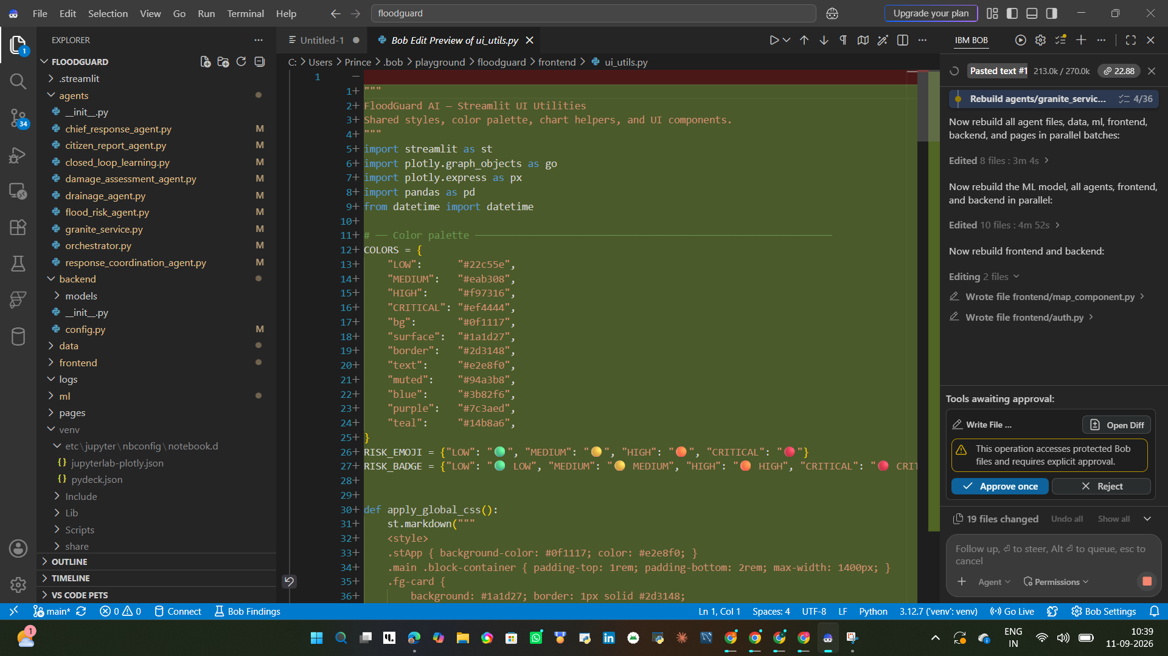

Slide 14
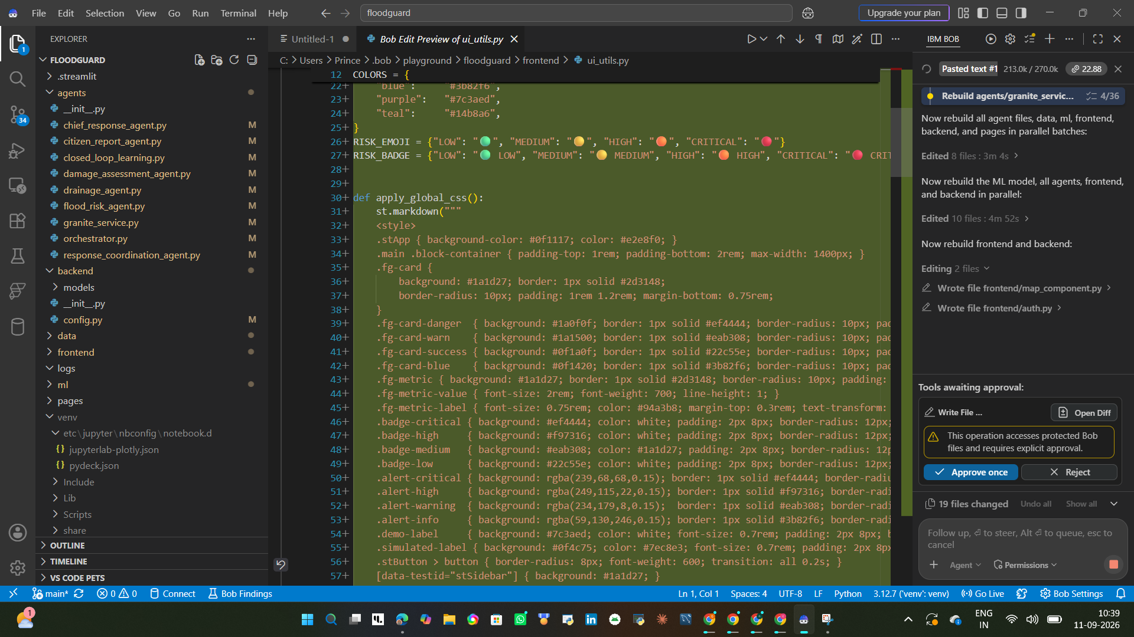

Slide 15
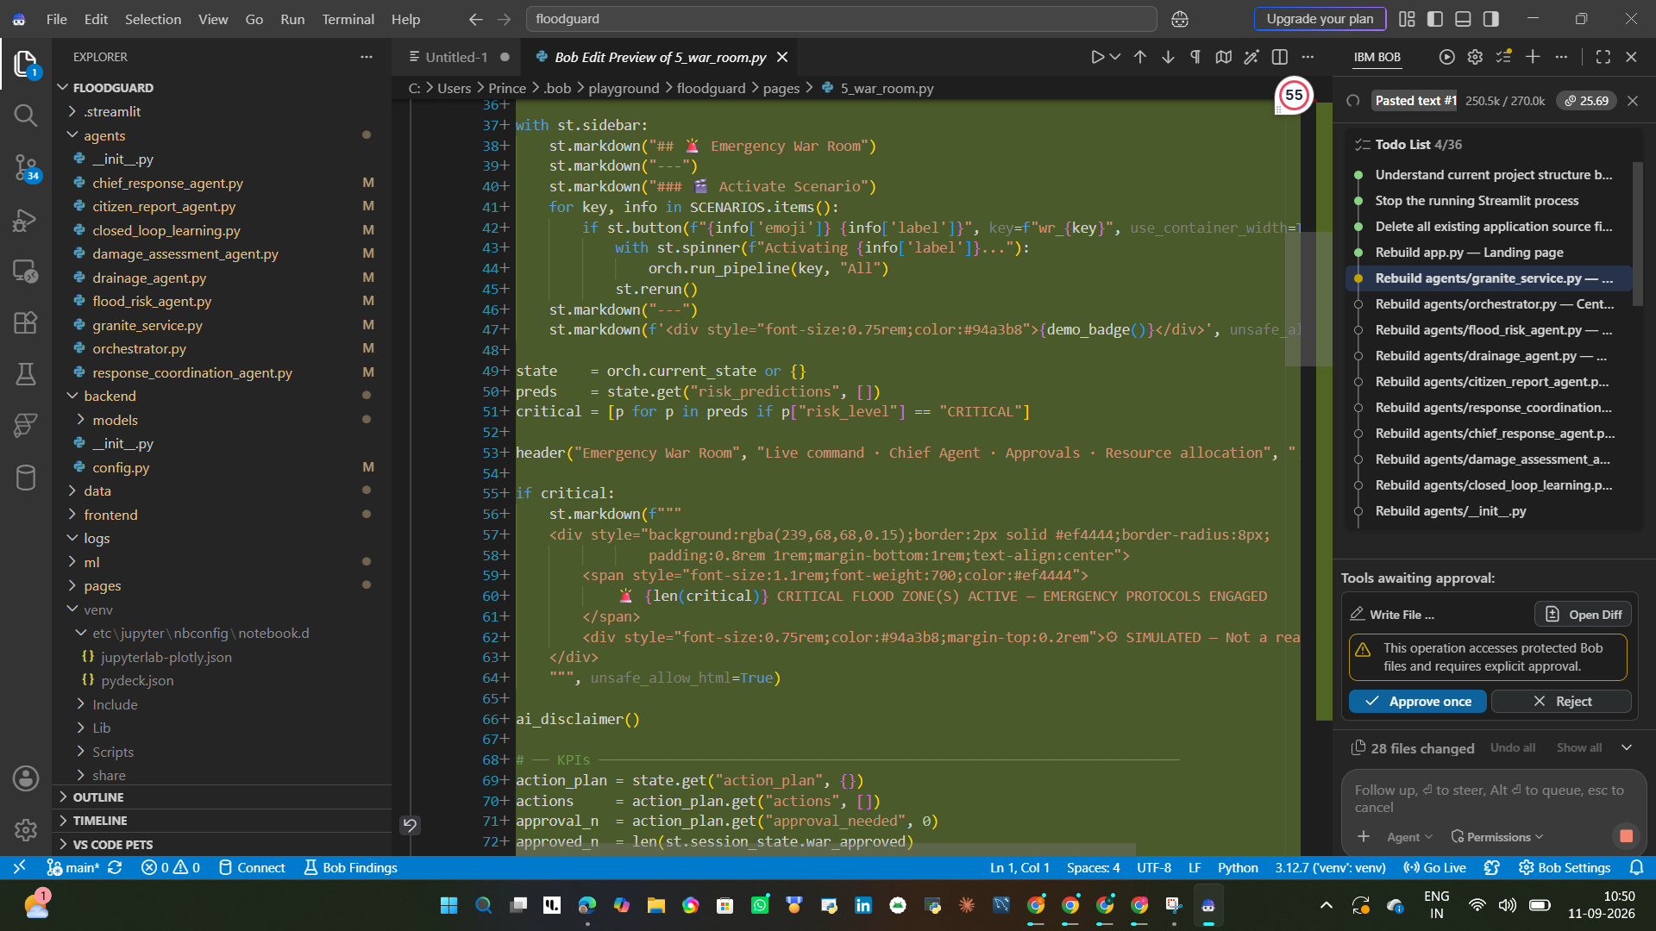

Slide 16
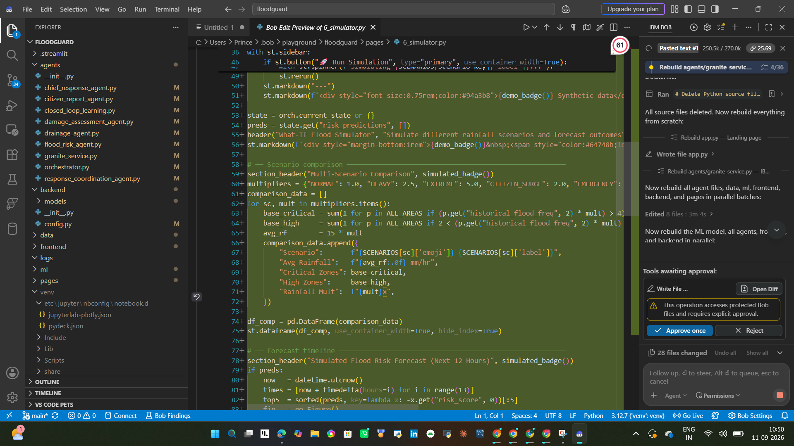

Slide 17
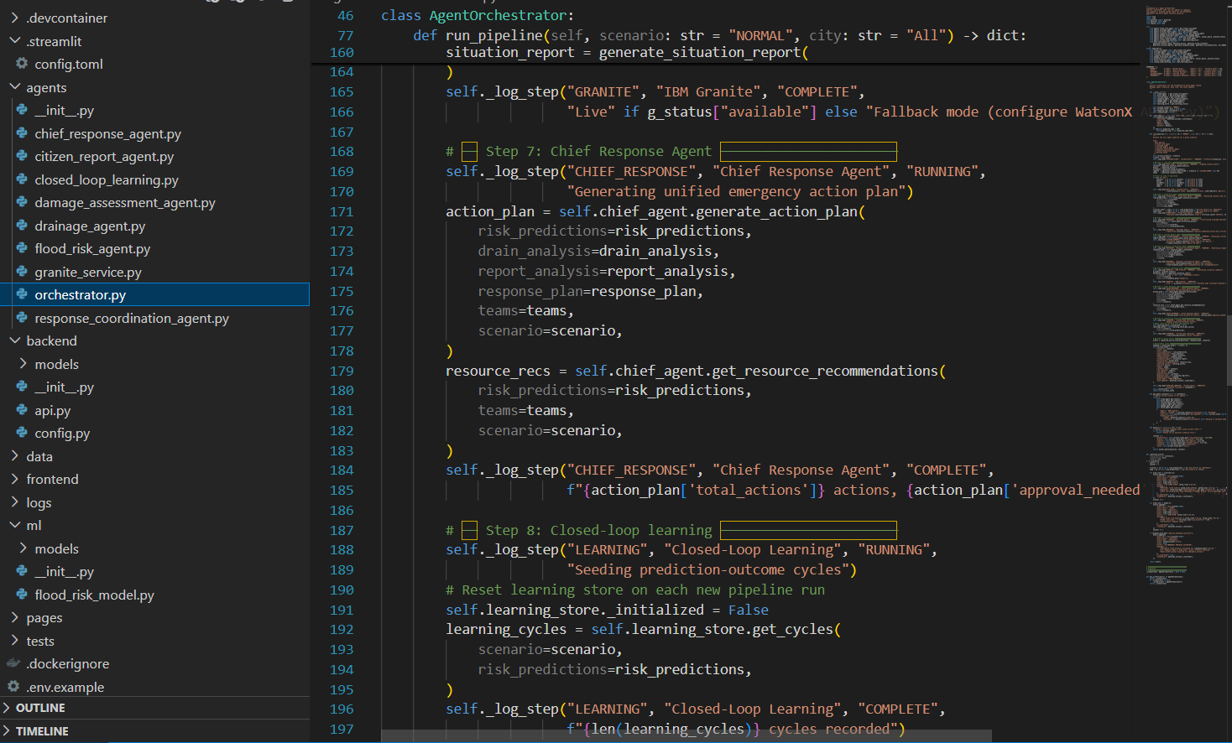

Slide 18
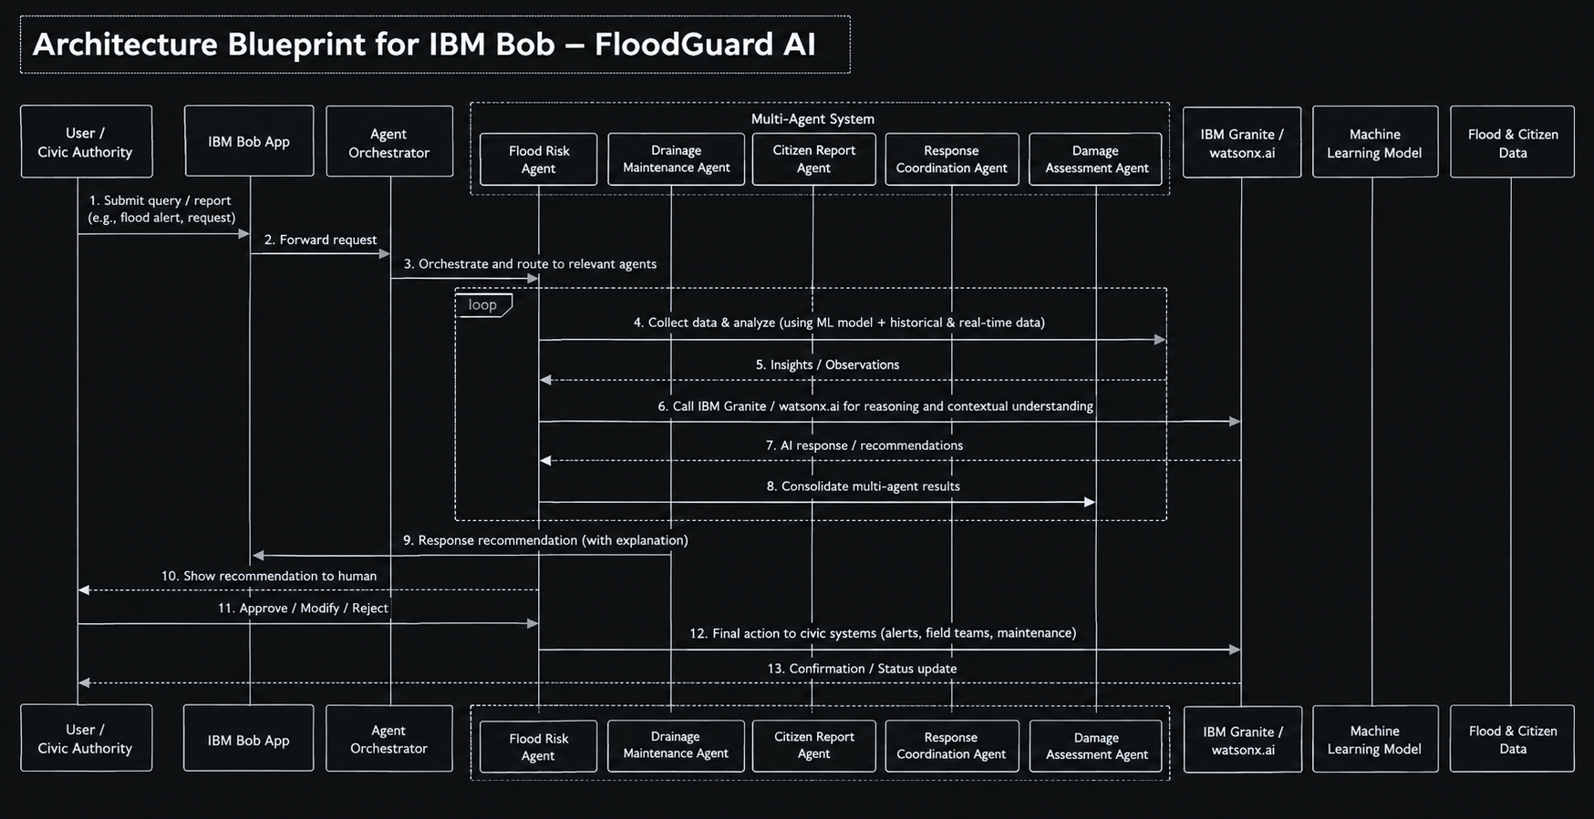

Slide 19

Role of Agentic AI in the solution
  Agentic AI turns FLOODGUARD AI into a coordinated decision-support system where specialized agents collaborate through an orchestration layer.
  Each agent performs a specific role:
  Risk Prediction – Identifies changing flood-risk levels.
  Drainage Prioritization – Finds vulnerable drainage locations.
  Citizen Report Understanding – Classifies and analyzes flood reports.
  Civic Response Planning – Converts agent insights into prioritized actions.
  The system is context-aware, allowing new rainfall data, citizen reports, and drainage conditions to update risk and recommendations. IBM Granite provides grounded explanations using application data.
  Through agent collaboration, FLOODGUARD AI moves from:
Detection → Analysis → Prioritization → Recommendation → Human Approval → Response
“FloodGuard AI doesn't just predict flooding. It converts prediction + citizen reports + drainage information into prioritized actions.”

Slide 20
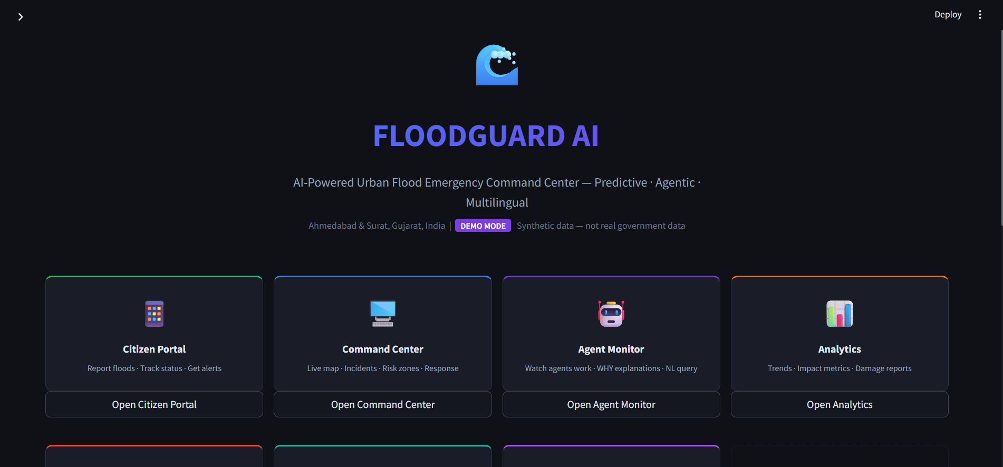

Slide 21
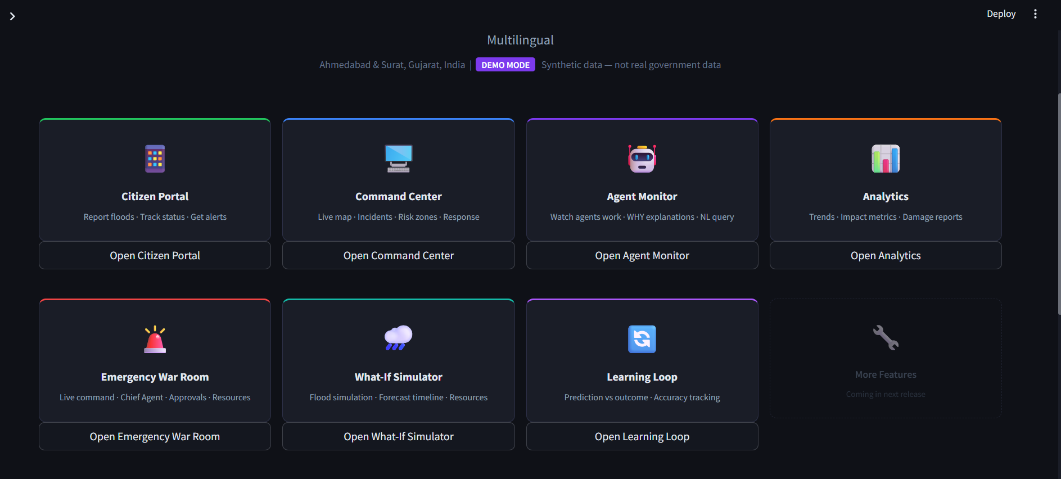

Slide 22
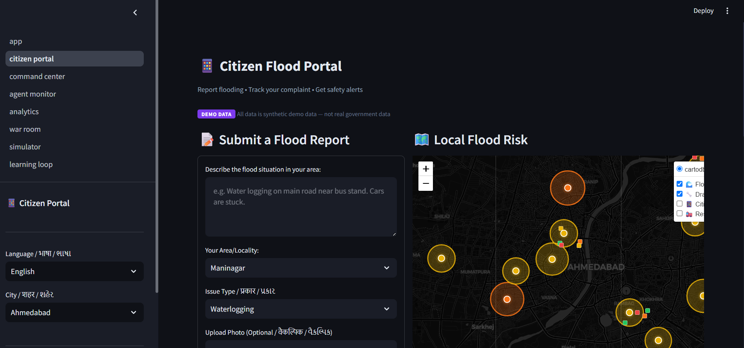

Slide 23
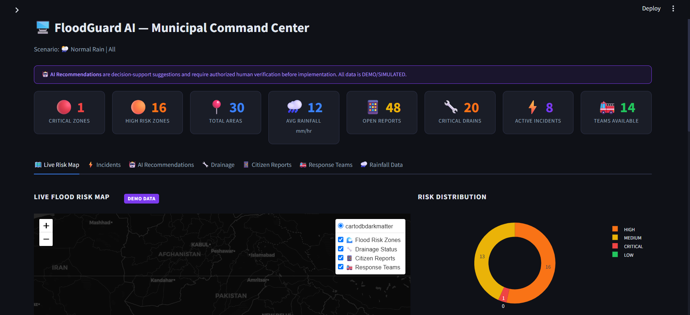

Slide 24
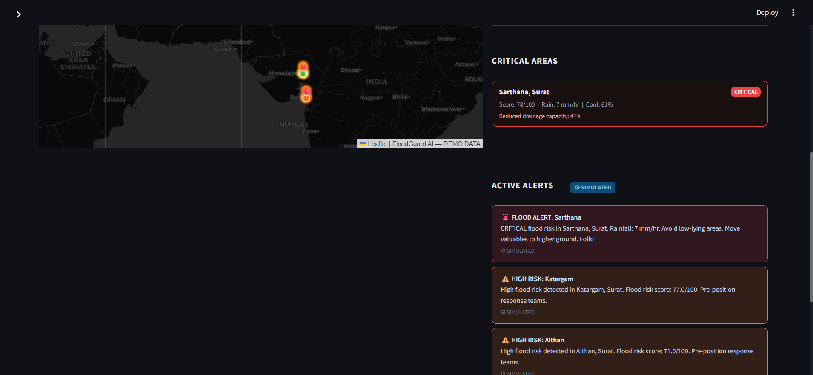

Slide 25
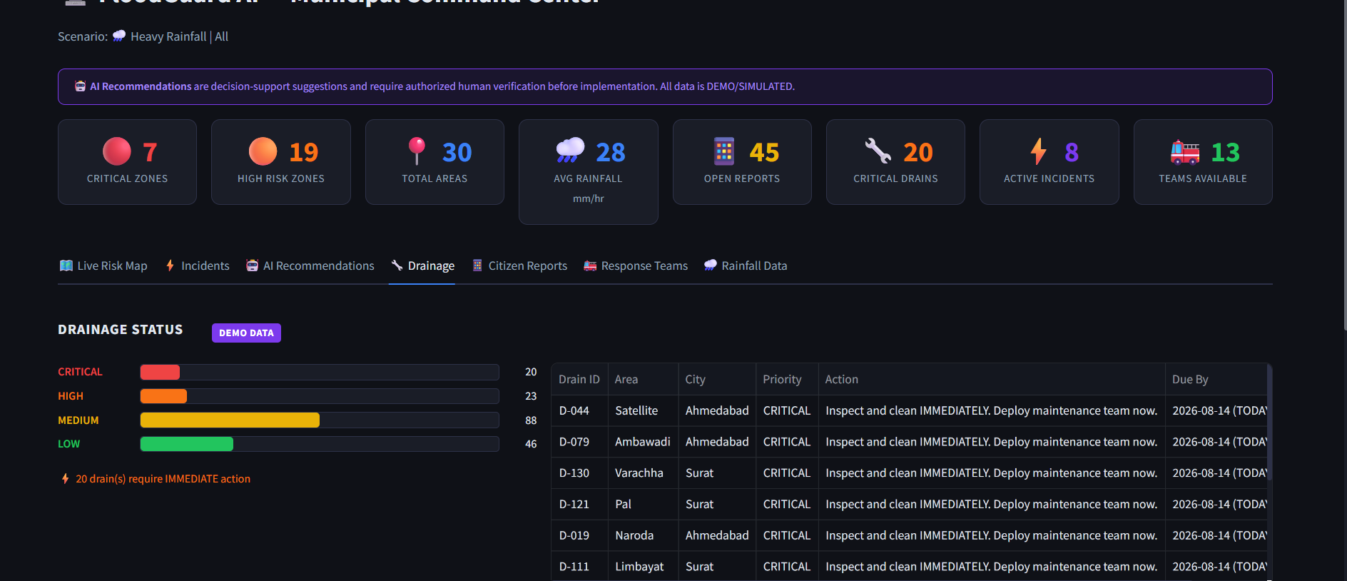

Slide 26
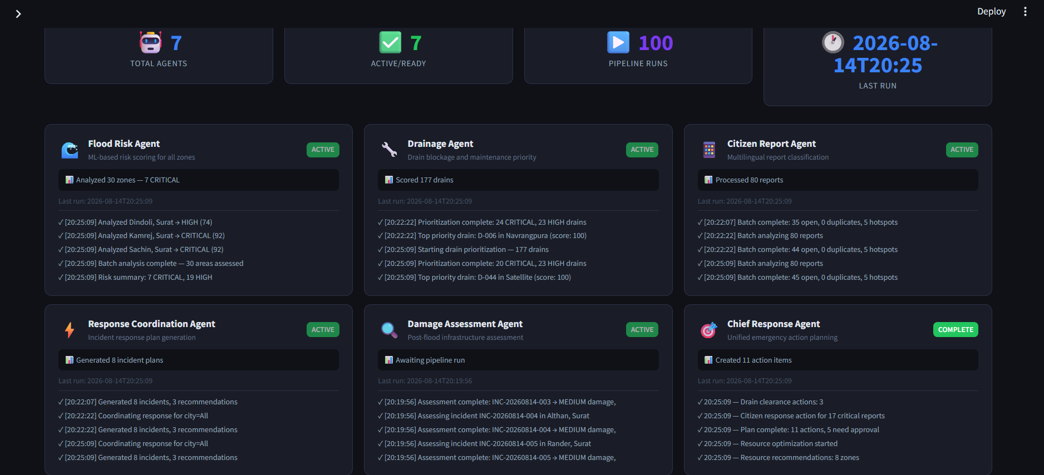

Slide 27
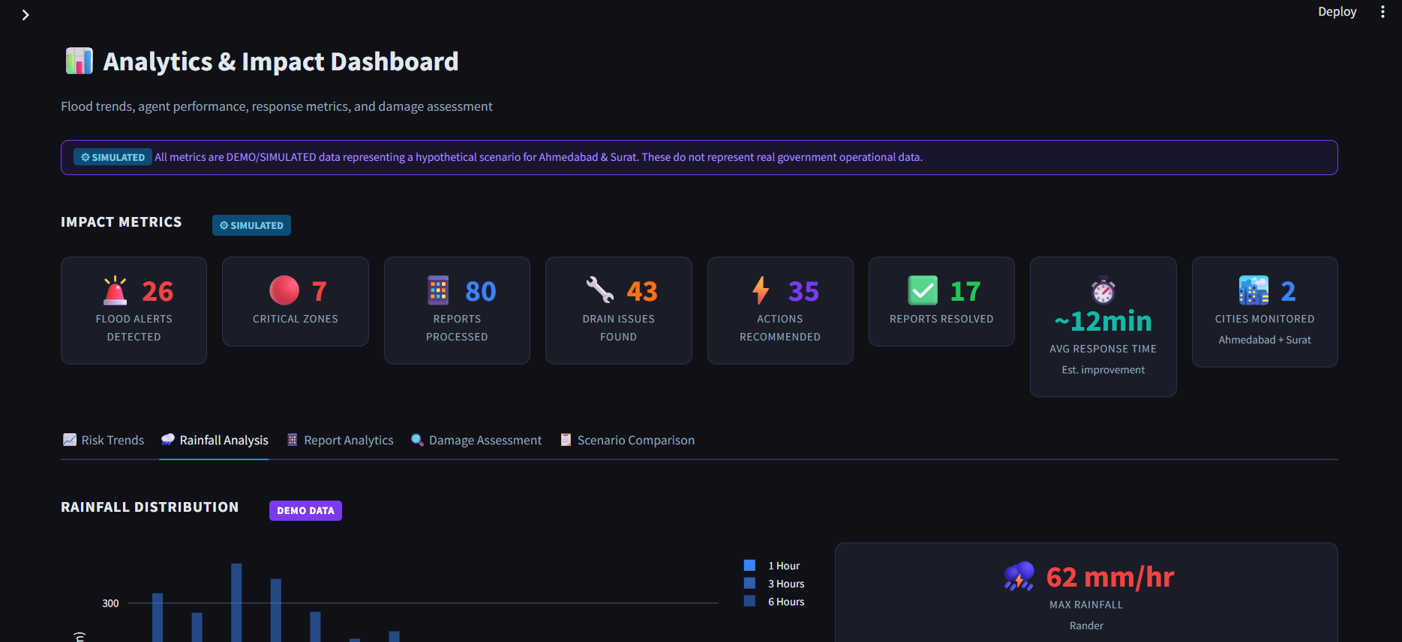

Slide 28
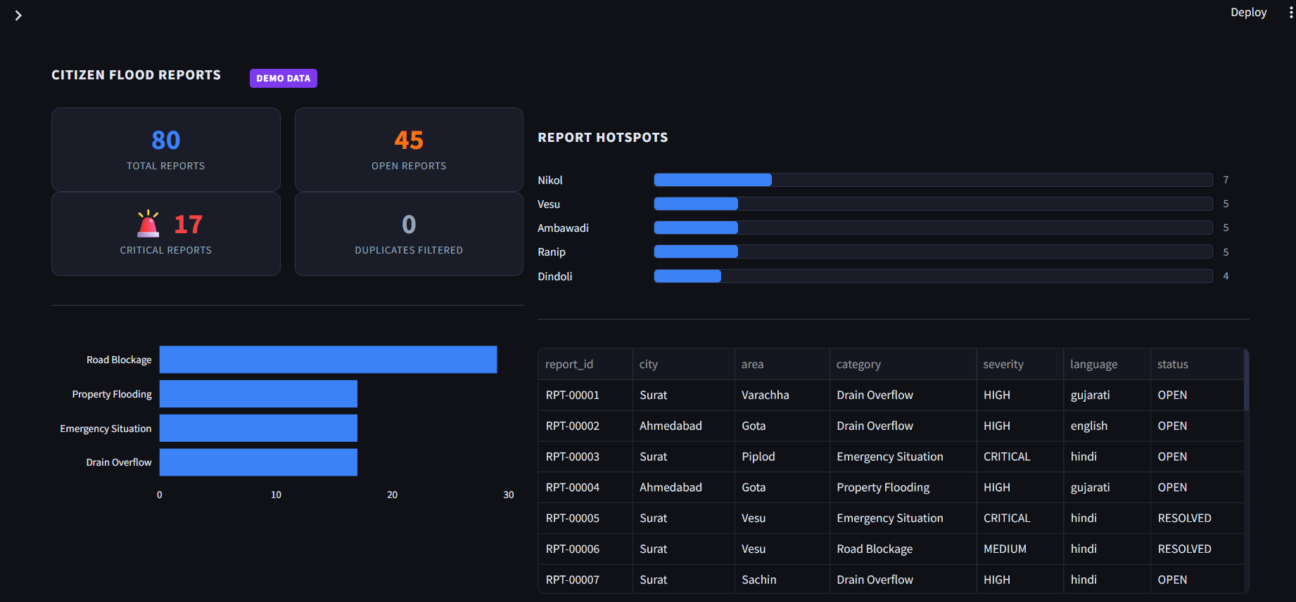

Slide 29
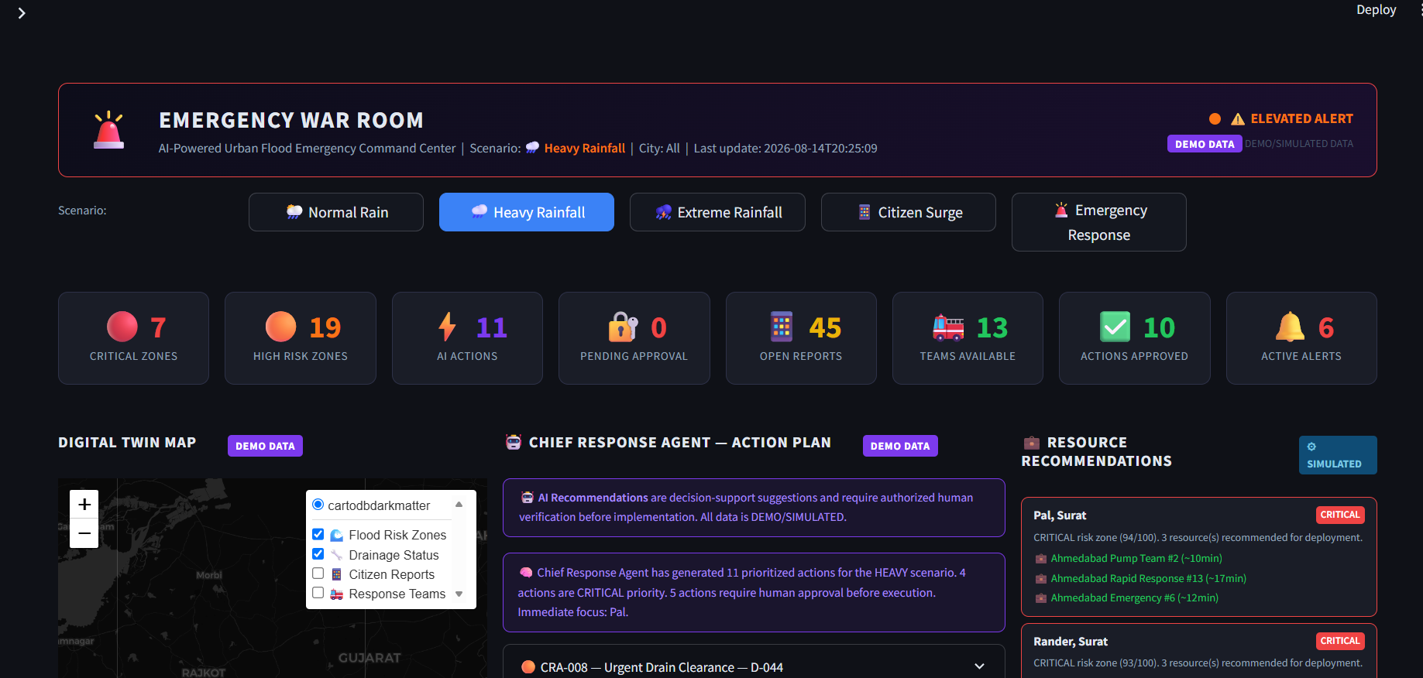

Slide 30
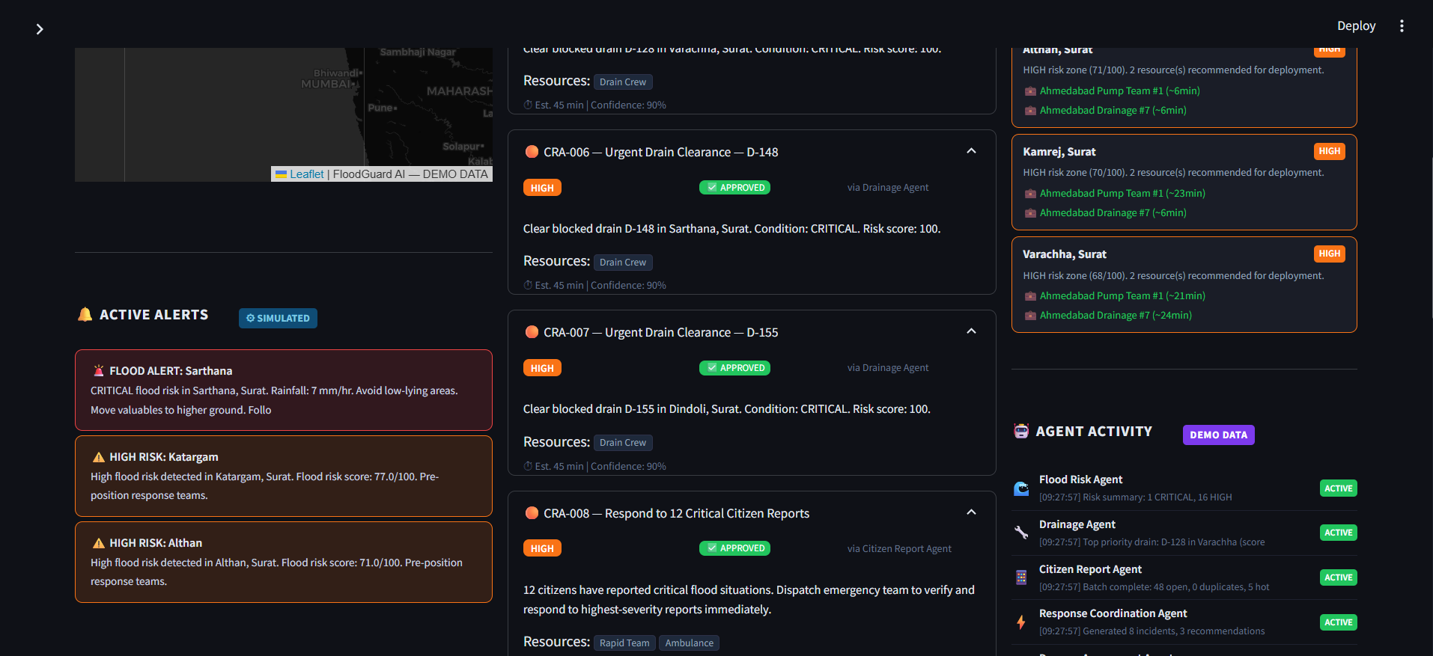

Slide 31
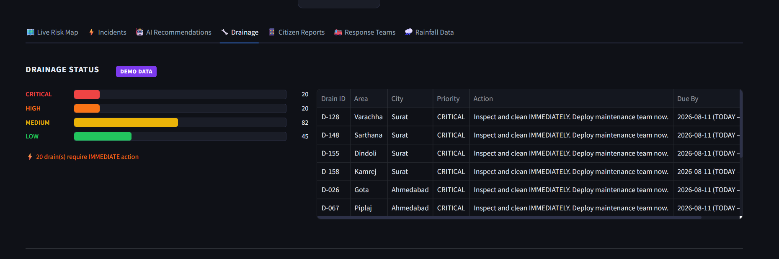

Slide 32
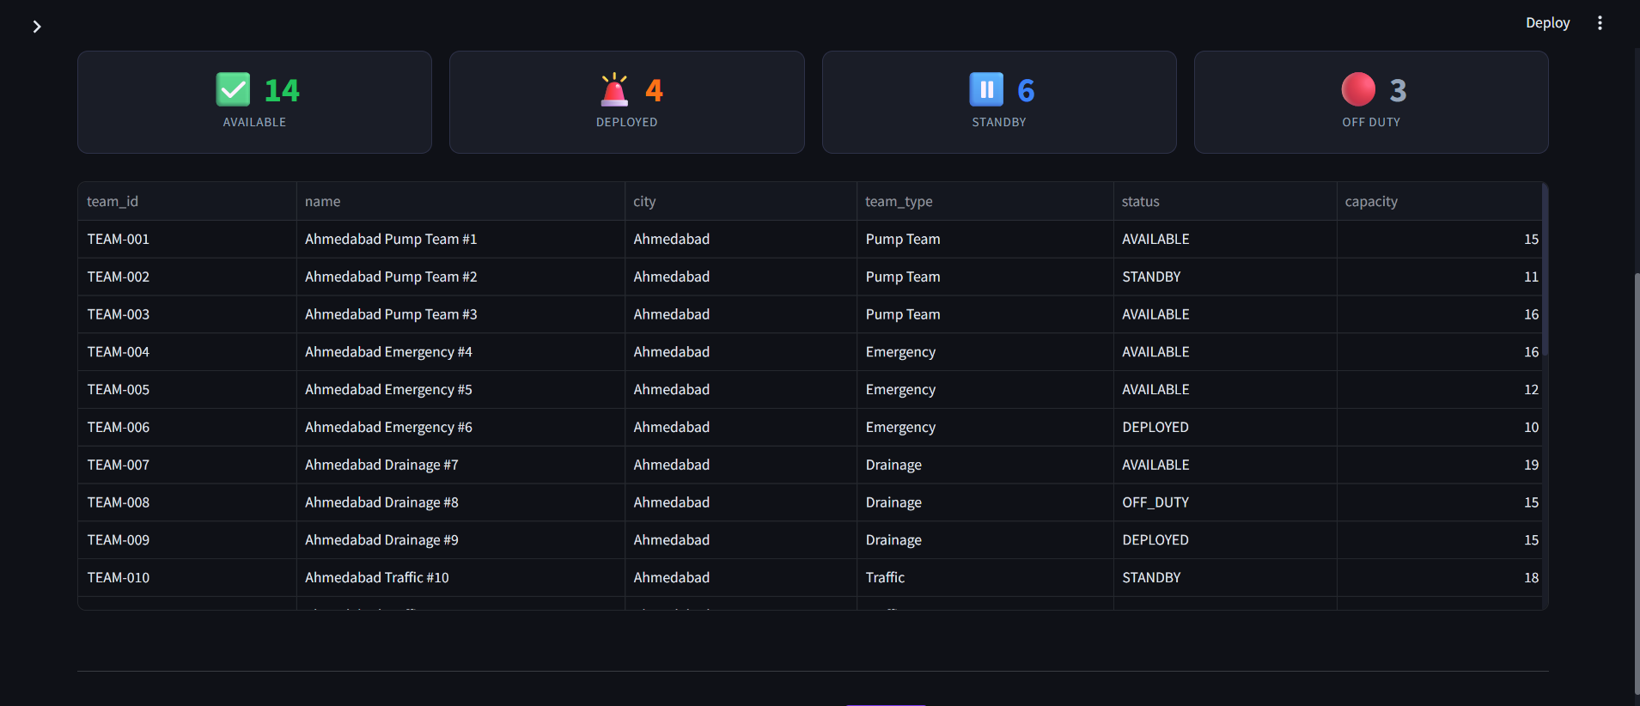

Slide 33
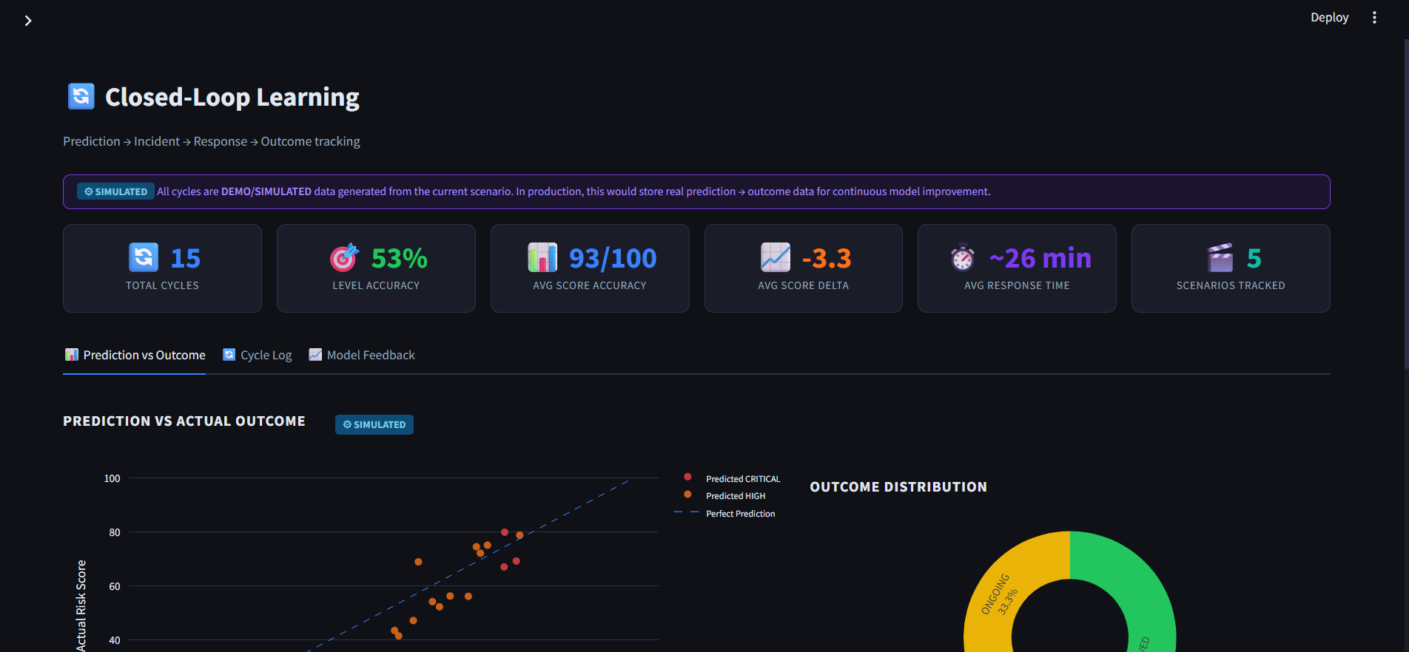

Slide 34
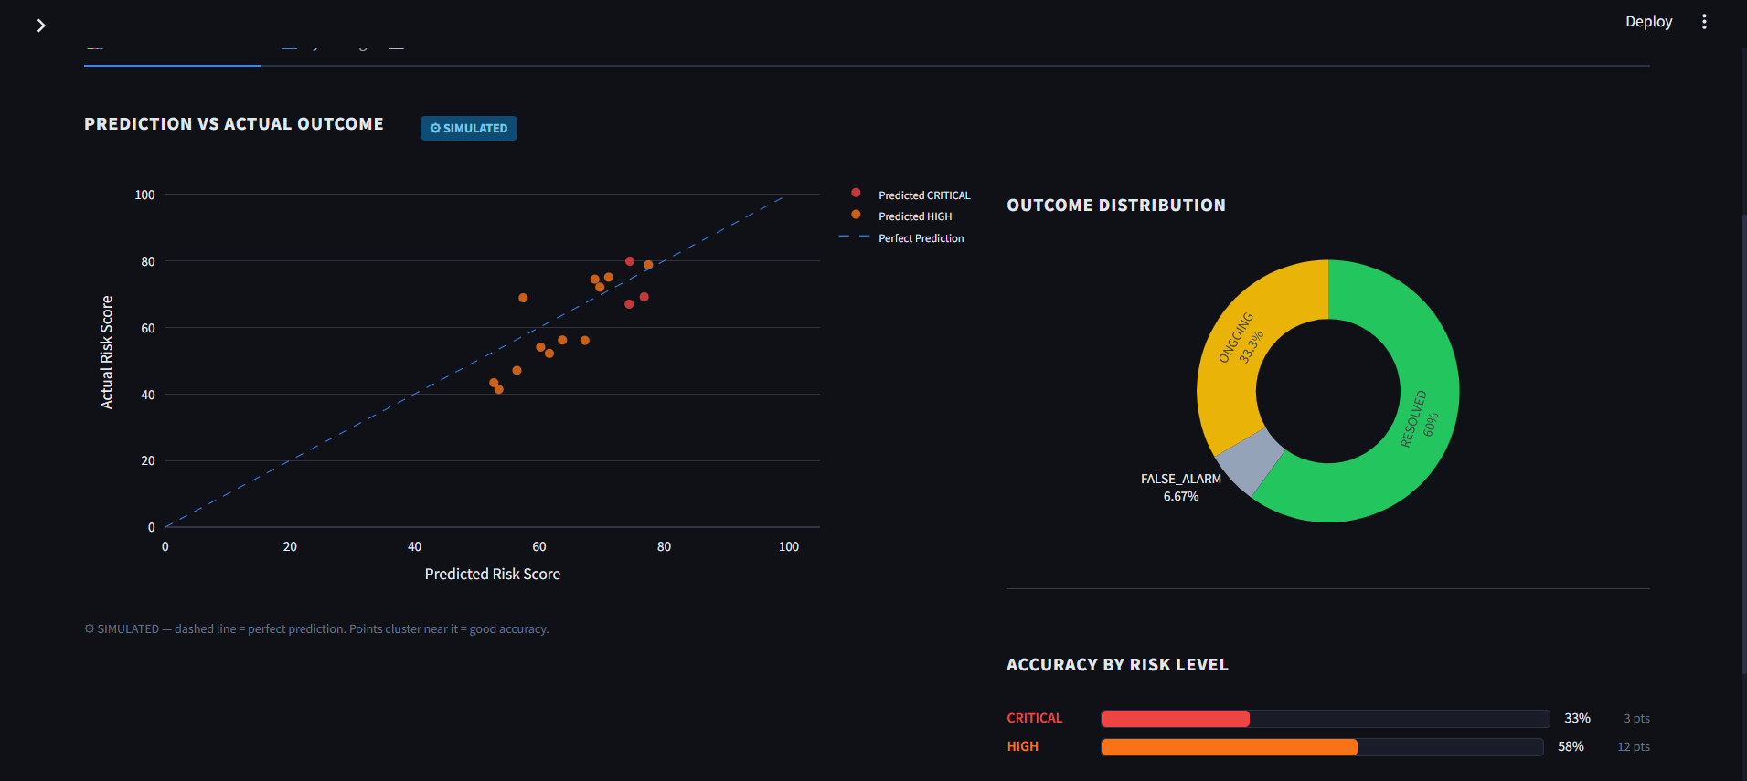

Slide 35
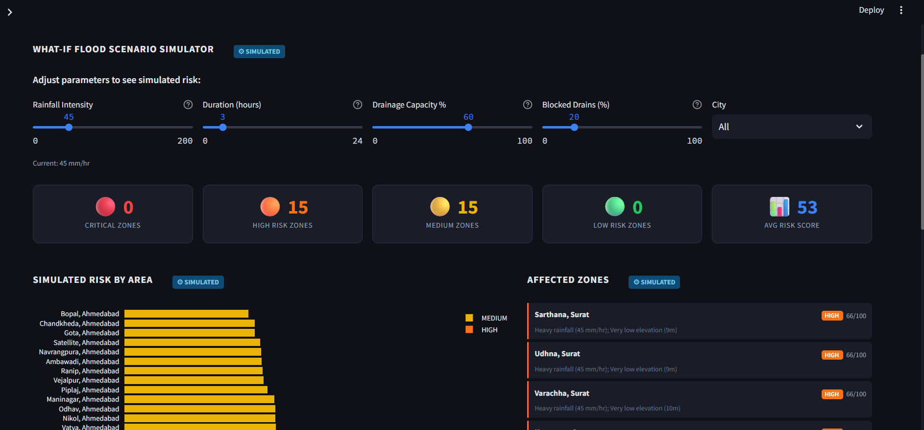

Slide 36
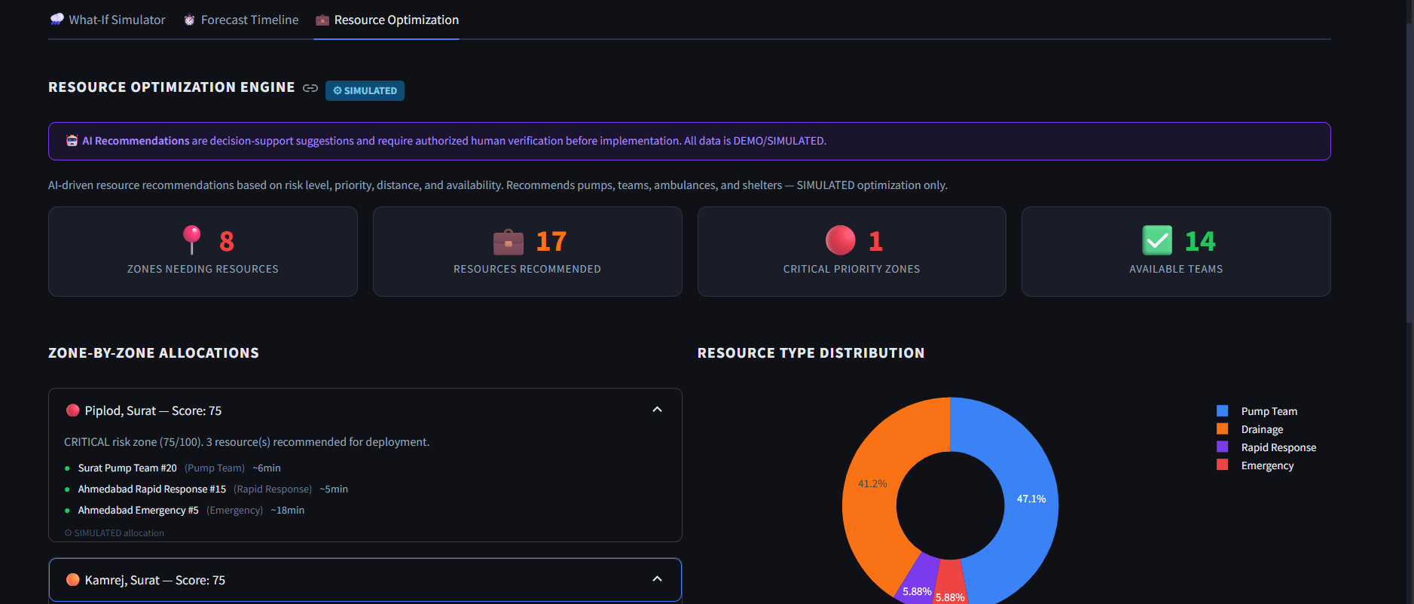

Slide 37
Novelty and Uniqueness
FLOODGUARD AI combines Machine Learning, Agentic AI, Geospatial Intelligence, and multilingual citizen interaction to transform urban flood data into actionable civic decisions for Ahmedabad and Surat..
Multi-Agent Intelligence
Specialized agents collaborate across flood-risk prediction, drainage prioritization, citizen reports, response coordination, and damage assessment.
Hyper-Localized Intelligence
Designed specifically around urban flooding, drainage conditions, rainfall, historical incidents, and citizen inputs relevant to Ahmedabad and Surat.
Grounded AI Recommendations
IBM Granite uses application context to generate situation summaries, explanations, and prioritized recommendations.
Human-in-the-Loop & Auditability
Critical recommendations can pass through human approval, creating a safer and more accountable decision-support workflow.
Dynamic Decision Loop
New rainfall and citizen-report inputs can update risk insights and response priorities.
“FLOODGUARD AI is not just a flood dashboard or chatbot—it is an agentic decision-support platform that helps civic teams detect risk, understand situations, prioritize actions, and decide what to do next.”

Slide 38
Future Scope
1. Real-Time IoT & Weather Integration
Integrate live rainfall, water-level, weather and drainage sensors for continuous flood-risk monitoring and early warnings.
2. City-Wide & Multi-City Expansion
Extend FLOODGUARD AI beyond Ahmedabad and Surat using advanced GIS, satellite data and richer historical flood datasets
3. Intelligent Emergency Response
Enable real-time alerts, response-team coordination and AI-assisted evacuation or traffic-management recommendations with human approval.
4. AI-Based Damage Assessment
Use image-based AI analysis to assess post-flood damage to roads, drainage infrastructure and public assets for faster recovery planning.
5. Multilingual Citizen & Civic Communication
Expand Gujarati, Hindi and English support through mobile, WhatsApp/SMS and voice-based citizen reporting and emergency communication.

Slide 39
Git Hub Link
GitHub Repository
Public Repository:
https://github.com/PrinceJain2006/floodguard-ai
The repository contains the complete FLOODGUARD AI source code, Agentic AI implementation, IBM integration, documentation, and required submission materials.
Repository Contents
  Complete Source Code – Streamlit application, Agentic AI modules, ML model, backend, frontend and project files
  Agentic AI Implementation – Flood Risk, Drainage, Citizen Report, Response Coordination and Damage Assessment components
  IBM Integration – IBM Granite / watsonx and IBM Cloud related configuration
  Machine Learning – Flood-risk prediction and supporting ML components
  Documentation – README, architecture and demo documentation
  Problem Statement PDF – Official Challenge 7 problem statement
  Project Presentation PPTX – Final hackathon presentation
  Deployment Files – Deployed using Streamlit Community Cloud
Working GitHub URL:
https://github.com/PrinceJain2006/floodguard-ai

Slide 40
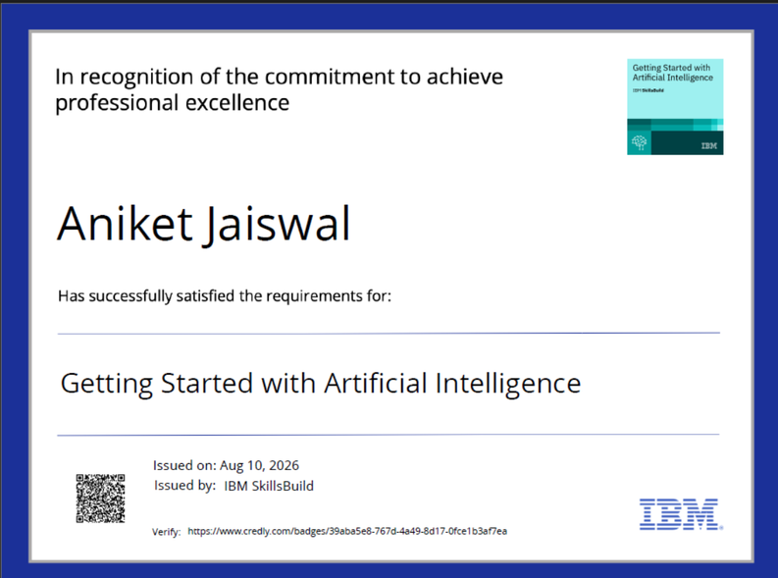
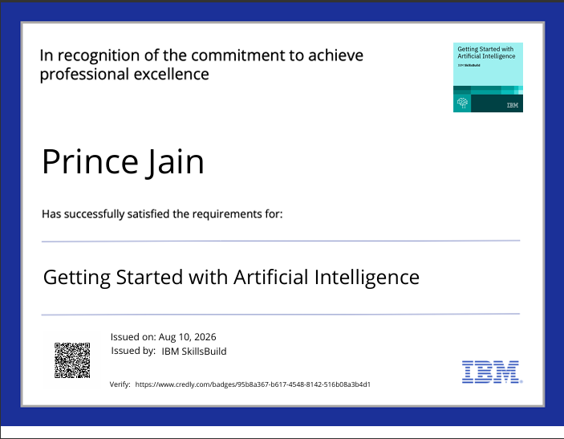
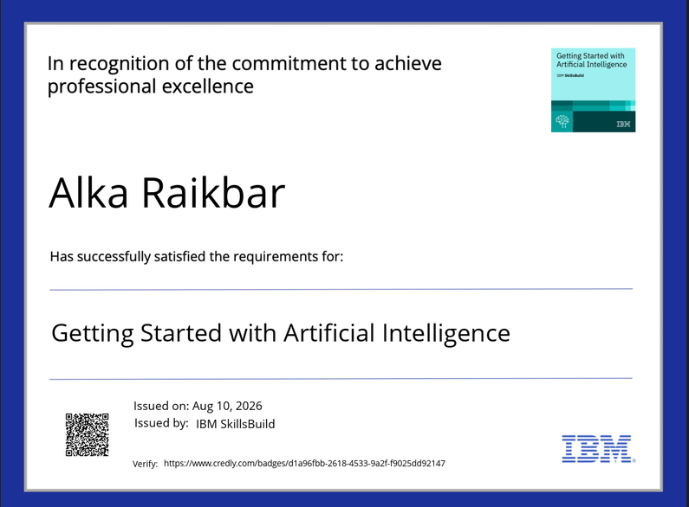
Certificates Earned:

Slide 41
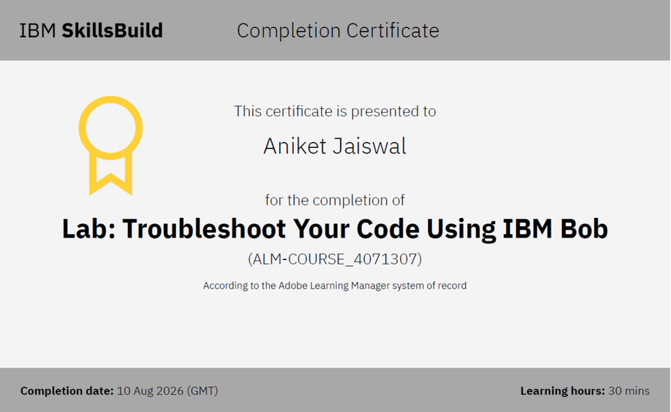
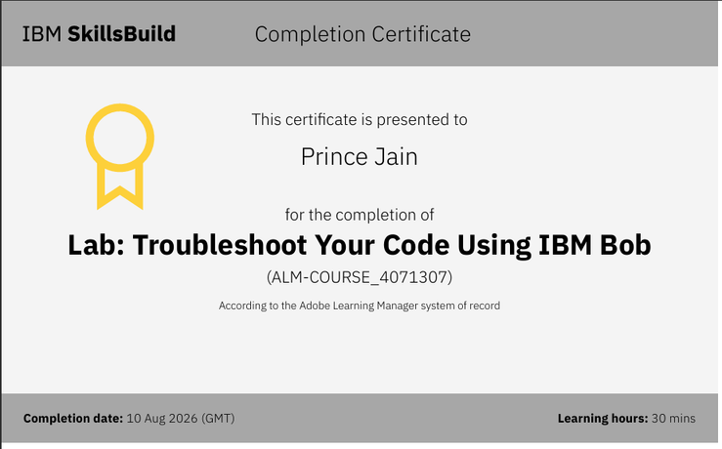
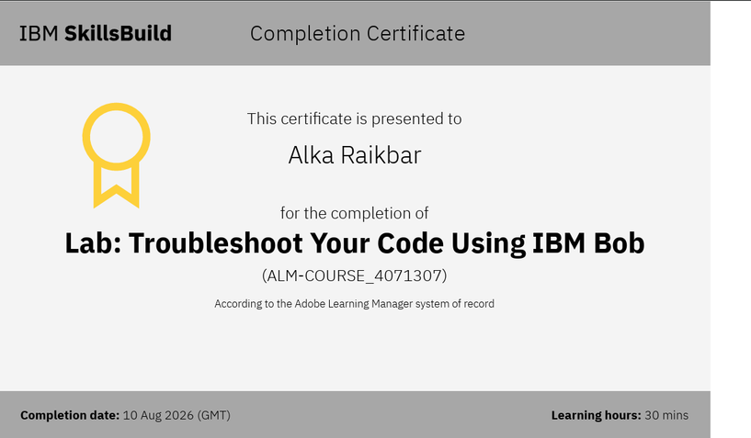
Certificates Earned:​

Slide 42


