Slide 1

Group ID: ETC_10
Development of a TinyML-based ECG and fall detection system
Arjoyeeta Chakraborty -2304014
Sadhika Das- 2304113
Prince Kumar- 2304105
Project Supervisor
Dr. Nirmal Kumar Rout
School of Electronics Engineering
KIIT Deemed to be University, Bhubaneswar

Slide 2

TOPICS TO BE COVERED
Introduction
ECG Signal & Processing
Literature Survey
Limitations
Objectives
Innovation in the project
Working Principle of the proposed system
Block Diagram of the proposed system
Hardware & Software Requirements
Cost Estimation
Future Scope
Conclusion
Timeline
References

Slide 3
INTRODUCTION
ECG is one of the most widely used diagnostic tools in medicine
Used in hospitals, ambulances, surgeries, and now wearables (smartwatches)
Measures the heart's own electrical signal, beat by beat
Most cardiac arrests occur outside hospitals, often unwitnessed
Survival drops sharply with every minute of delayed response
Need for continuous and portable cardiovascular monitoring
Existing systems often focus on individual health parameters or depend on cloud-based processing

Slide 4
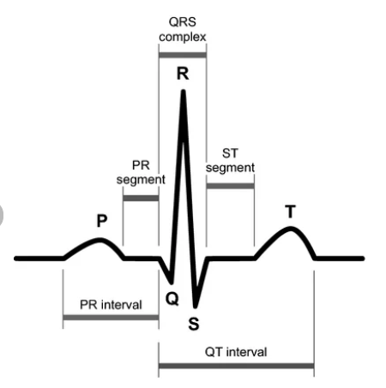
ECG Signal & Signal Processing
ECG Signal
P wave → contraction of upper heart chambers
QRS complex → main pumping action, strongest part of signal
T wave → heart's electrical reset before next beat
R-to-R interval → used to calculate heart rate & detect arrhythmia
Irregular R-R spacing indicates abnormal rhythm
ECG Signal Processing
Raw ECG Signal Noise Removal Baseline Wander Removal
Band-Pass / Notch Filtering
Heart-Rate (BPM) Calculation
Future Extension
R-Peak / QRS Detection
Features for ECG Analysis

Slide 5
Literature Survey...
➢ Nagarajan & Polachan (2026) — Built an autoencoder-based TinyML model (ArrythML) running on an ESP32-S3 for arrhythmia detection, achieving 84% recall with just 9 ms inference time and a small ~180 KB model size. Used R-R interval segmentation instead of heavy QRS detection to keep it lightweight.
Gap: Only detects normal vs. abnormal — doesn't classify the specific arrhythmia type, and struggles with certain rhythm patterns [1].
➢ Zambrano-de la Torre et al. (2026) — Deployed a quantized 1D-CNN on a low-cost Arduino UNO (under $25), achieving 97.6% accuracy in a 24 KB memory footprint.
Gap: Only tested on benchmark data, not real patients — no fall detection or multi-signal fusion [2].

Slide 6
Literature Survey
➢ Chhoton & Sharma (2024) — Reviewed IoMT-based wearable cardiac systems, showing rapid growth in this field (32% rise in publications by 2022), especially for arrhythmia and heart-failure monitoring.
Gap: Most devices lack power-efficient hardware and don't adapt to individual patients [3].
➢ Moshawrab et al. (2023) — Reviewed 87 studies on smart wearables for cardiovascular detection, finding most ECG systems achieve 95–99% accuracy but depend on cloud processing.
Gap: No reviewed study used on-device explainable AI, and none combined multiple data sources (like ECG + patient history) for better accuracy [4].

Slide 7
Limitations...
Limited integration: Many existing systems primarily focus on ECG monitoring, while relatively few combine ECG, SpO₂and fall detection in one portable embedded device.
Cloud dependency: Some AI-based monitoring systems rely on cloud processing, creating challenges related to latency, connectivity and continuous operation. Recent TinyML research highlights on-device inference as an approach for real-time cardiovascular monitoring.
Limited offline intelligence: Continuous offline AI monitoring on low-resource embedded platforms remains an active research area.

Slide 8
Limitations
Cost and portability: Commercial cardiac-monitoring solutions can be expensive, creating scope for low-cost, portable embedded healthcare systems.
Need for intelligent emergency detection: Existing monitoring approaches provide an opportunity to combine cardiac abnormalities, vital signs and fall events into a unified emergency-detection mechanism

Slide 9
OBJECTIVES
Design a portable, battery-powered device that continuously reads a person's ECG in real time using chest electrodes.
Process the raw ECG signal on an STM32 microcontroller using digital filtering, and calculate heart rate and detect rhythm irregularities.
Develop and deploy a lightweight on-device AI (TinyML) model to classify heart rhythm as normal
or abnormal, with finer classification as a stretch goal.
Integrate a motion sensor to detect fall events in real time from the body's motion signal.
Design a decision-fusion mechanism that raises a higher-priority alert when an abnormal rhythm
and a fall are detected together.
Display real-time status on an on-device screen and trigger a local alarm, with no dependency on
internet or a paired computer for detection.
Evaluate the system's own measured accuracy, response time, and power consumption against relevant published work.

Slide 10
Innovation in the project...
Multi-parameter monitoring: Integration of ECG, SpO₂and fall detection in a single system.
Real-time ECG analysis: Digital ECG processing including filtering, R-peak detection, and heart-rate calculation.
Edge AI / TinyML: Local ECG analysis and abnormality detection on the embedded platform, reducing dependence on cloud processing

Slide 11
Innovation in the project
Intelligent emergency detection: Fusion of cardiac, vital-sign, and fall-detection information for emergency identification.
Portable operation: Battery-powered embedded implementation for continuous monitoring.
Emergency communication: GPS and GSM integration can be added for patient location and emergency alerts as a future extension.

Slide 12
Working Principle of Proposed System
ECG Acquisition
ECG electrodes acquire the cardiac signal through the AD8232 ECG front-end.
Signal Processing
TinyML Analysis
Vital Monitoring
Processed ECG data is analyzed using a lightweight Edge-AI model for cardiac abnormality detection.
MAX30102 measures SpO₂ and pulse rate
STM32 performs ECG filtering, R-peak detection and heart-rate calculation.
Fall Detection
Decision Fusion
Alert Generation
Future Extension
LSM6DSO monitors motion and orientation to detect possible falls.
ECG, vital-sign and fall-detection results are combined to identify emergency conditions.
Emergency conditions trigger the TFT display, buzzer and LED alerts.
GPS/GSM can provide patient location and remote emergency communication.

Slide 13
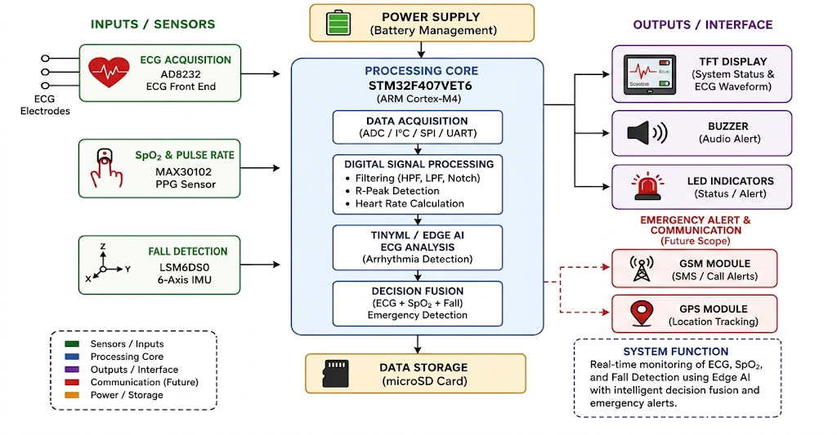
Block Diagram of Proposed System

Slide 14
Hardware & Software Requirements
HARDWARE REQUIREMENTS | SOFTWARE/Tool REQUIREMENTS
STM32F407VET6 ARM Cortex-M4 | STM32CubeIDE
2.8-inch SPI TFT Display, 240 × 320 without touch | STM32Cube Programmer
ST-LINK/V2 Programmer & Debugger | STM32 HAL Library
LSM6DSO 6-DOF | TensorFlow Lite Micro
MAX30102 Pulse Oximeter | NumPy,Pandas,Matplotlib
AD8232 ECG Sensor Module Kit | Tensor Flow Lite Micro/Edge Impulse
Digital Storage Oscilloscope

Slide 15
Cost Estimation
Component | Indicative Cost (₹)
STM32F407VET6 | 1800
ST LINK V2 | 400
AD8232 | 729
2.8 inch TFT Display | 559
LSM6DSO | 379
MX30102 | 259
SOS + Buzzer + LED | 50-150
Miscellaneous Components | 500
Total Estimated Cost | 5000 (Approx)

Slide 16

Future Scope
GPS-based patient location tracking using the NEO-6M GPS module during an escalated emergency.
GSM-based remote emergency notification using the SIM800L to send an automatic SMS or initiate a call containing the patient's location and alert type.
Compact PCB implementation by moving from the breadboard prototype to a custom/perfboard layout.
Improved ECG hardware design with better analog signal routing, grounding, power-noise control and isolation.
Further TinyML optimization for deployment on the STM32 and improvement of model performance.
Enclosure development to convert the prototype into a compact portable device.
Further system evaluation based on classification accuracy, response latency, false-alarm rate and battery life/power consumption.
Remote-notification capability as an optional extension after the core ECG + TinyML + fall-fusion system is fully functional.

Slide 17
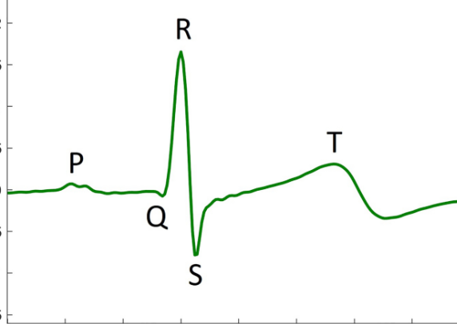
Conclusion
The project proposes a portable, battery-powered embedded cardiac-fall monitoring system based on an STM32 microcontroller.
The system combines real-time ECG acquisition, digital signal processing and on-device TinyML rhythm classification.
A fusion and escalation mechanism is designed to raise a higher-priority alert when abnormal rhythm, abnormal vital signs and/or a fall occur within a defined time window.
The core system is intended to operate fully offline, without dependence on internet connectivity, cloud processing or a paired computer.
The project aims to progress from a breadboard-level prototype to a compact, integrated and battery-operated system, followed by performance evaluation.

Slide 18
Timeline...
7th Semester:
(Week 1): ECG acquisition using AD8232 and STM32 ADC interfacing.
(Week 2): Implement ECG signal processing, including noise/baseline-wander removal, filtering, R-peak detection and real-time heart-rate calculation.
(Week 3): Integrate LSM6DSO for motion-based fall detection.
(Week 4): Integrate MAX30102 for SpO₂/pulse monitoring and DS18B20 for body-temperature monitoring.
(Week 5): Develop the supporting hardware, including TFT display, buzzer/LED alarm, SOS button and battery/charging circuit.
(Week 6): Prepare ECG data from the MIT-BIH Arrhythmia Database and begin TinyML model development for normal/abnormal rhythm classification.
(Week 7): Develop fusion/escalation logic and complete the breadboard-level prototype.

Slide 19
Timeline
8th Semester:
(Week 1): Integrate the TinyML model with STM32 firmware and move towards a compact perfboard/custom-board implementation.
(Week 2): Deploy and optimize the TinyML model on the device and finalize the enclosure.
(Week 3): Perform end-to-end testing and evaluate classification accuracy, response latency, false-alarm rate and battery life.
(Optional): Add NEO-6M GPS and SIM800L GSM for remote emergency notification.
Final Stage: Complete documentation, final report and project demonstration.
7th_Semester_Project_Presentation

Slide 20
References
[1] S. Nagarajan and K. Polachan, "ArrythML: An autoencoder-based TinyML approach for on-device arrhythmia detection on resource-constrained embedded systems," arXiv preprint arXiv:2606.02256, Jun. 2026.
[2] M. Zambrano-de la Torre, S. Guzman-Alfaro, A. Acuña-Correa, M. A. Soto-Murillo, M. Guzmán-Fernández, R. Robles-Ortiz, K. E. Villagrana-Bañuelos, J. G. Arceo-Olague, C. H. Espino-Salinas, A. G. Sánchez-Reyna, and E. O. Cuevas-Rodriguez, "Real-time cardiac arrhythmia classification using TinyML on ultra-low-cost microcontrollers: A feasibility study for resource-constrained environments," Bioengineering, vol. 13, no. 5, p. 532, May 2026, doi: 10.3390/bioengineering13050532.
[3] A. C. Chhoton and A. K. Sharma, "Internet of Medical Things: A revolution in healthcare for enhancing cardiac monitoring and patient-care through wearables," in Proc. 2024 3rd Edition of IEEE Delhi Section Flagship Conf. (DELCON), 2024, doi: 10.1109/DELCON64804.2024.10866524.
[4] M. Moshawrab, M. Adda, A. Bouzouane, H. Ibrahim, and A. Raad, "Smart wearables for the detection of cardiovascular diseases: A systematic literature review," Sensors, vol. 23, no. 2, p. 828, Jan. 2023, doi: 10.3390/s23020828.

