Slide 1


AI Computer Vision Hand Gesture Snake Game

Slide 2
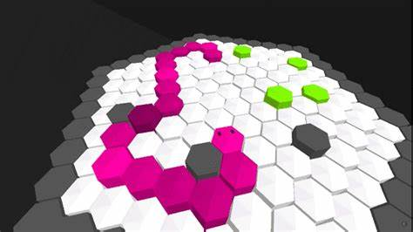
Introduction
The most beloved and common game ‘The Snake’ invented in 1970’s was the most famous game at that time and is still played by many people. This game was first introduced in Nokia phones. We will use libraries and algorithms to build a virtual game where you can play game by using your hand motions. The algorithm track your hand and take the decision in the real time scenario.
Goal:
The snake begins with length 1. It can go all directions.
There are few sorts of sustenance in the game. Eating
The donuts which increases the length of snake by 1.
There is constantly one donuts will appear in the game.
As soon as the snake eats the respective donuts, a new
donuts gets generated at any randomized position on
the game window. The goal of our play is to augment
the score.

Slide 3
Hardware Requirements
We need some set of hardware for implementing our backend. As like for capturing image or real time video we need camera and for show case our input and output we need display, these are:
Display: We use monitor as display for visual representation.
Camera: We use camera for interact with the game.
Processing Unit: It takes input from camera, process the information and display it to the monitor.

Slide 4
Software Requirement
We have uses python version 3.9.10 for the seamless experience and better responsiveness of game. We have uses python libraries and algorithms for hand motion tracking and donuts for snake appears random position on the screen, these are:
math | Math library containing functions for most common functions like geometry, trigonometry etc. used for calculation
Random | It is used for generate the random values within the define range or from whole numbers
Cvzone | This is a Computer vision package that makes its easy to run Image processing and AI functions. At the core it uses OpenCV and Mediapipe libraries.
Cv2 | OpenCV-Python is a library of Python bindings designed to solve computer vision problems. cv2. imread() method loads an image from the specified file.
Numpy | NumPy, which stands for Numerical Python, is a library consisting of multidimensional array objects and a collection of routines for processing those arrays. Using NumPy, mathematical and logical operations on arrays can be performed.
HandTrackingModule from cvzone | The module uses extensive libraries such as OpenCV 4.6 for best results and Mediapipe 0.8 to track hand movements and points more specifically.

Slide 5
Thank You

