Slide 1

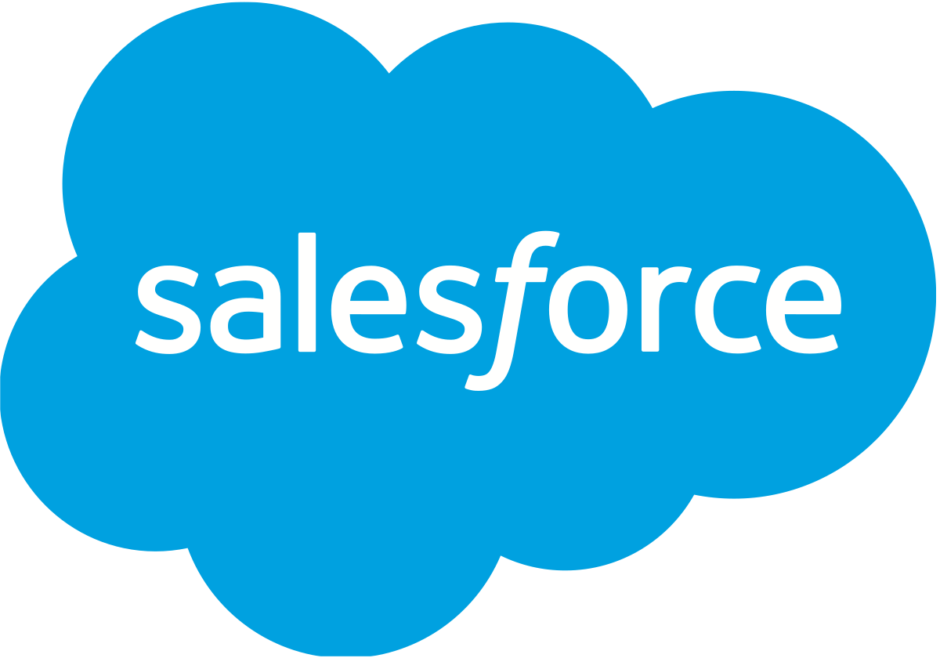


v
v
v
SDK will invoke
API
v
Gamification API
Genesys Cloud for
Salesforce Integration
Update the score
of the agent
Record-Triggered Flow
will execute and invoke the
Apex Class method.
Agent resolves a Case
Agent

