Slide 1


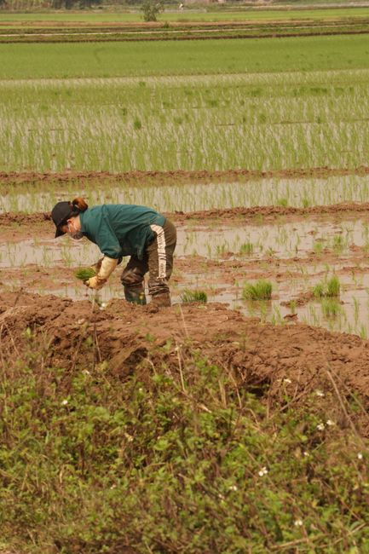

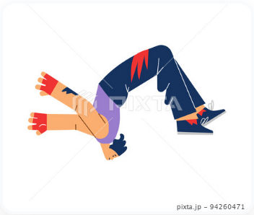
cultivate
/ˈkʌl.tɪ.veɪt/
To prepare and use land for growing crops or plants.
जोतना,
കൃഷിചെയ്യുക, பயிரிடு
cultivate cultivates cultivated
1/3
█████░░░░░░

Slide 2
cultivate
/ˈkʌl.tɪ.veɪt/
To prepare and use land for growing crops or plants.
जोतना,
കൃഷിചെയ്യുക, பயிரிடு
cultivate cultivates cultivated
The local family cultivated organic vegetables on their small farm last year.
1/3
█████░░░░░░

Slide 3
cultivate
/ˈkʌl.tɪ.veɪt/
To prepare and use land for growing crops or plants.
जोतना,
കൃഷിചെയ്യുക, பயிரிடு
cultivate cultivates cultivated
The local family cultivated organic vegetables on their small farm last year.
Farmers cultivate the fertile soil every spring to prepare for planting crops.
1/3
█████░░░░░░

Slide 4
cultivate
/ˈkʌl.tɪ.veɪt/
To prepare and use land for growing crops or plants.
जोतना,
കൃഷിചെയ്യുക, பயிரிடு
cultivate cultivates cultivated
The local family cultivated organic vegetables on their small farm last year.
Farmers cultivate the fertile soil every spring to prepare for planting crops.
Next season, our community will cultivate a large field of sweet corn.
1/3
█████░░░░░░

Slide 5
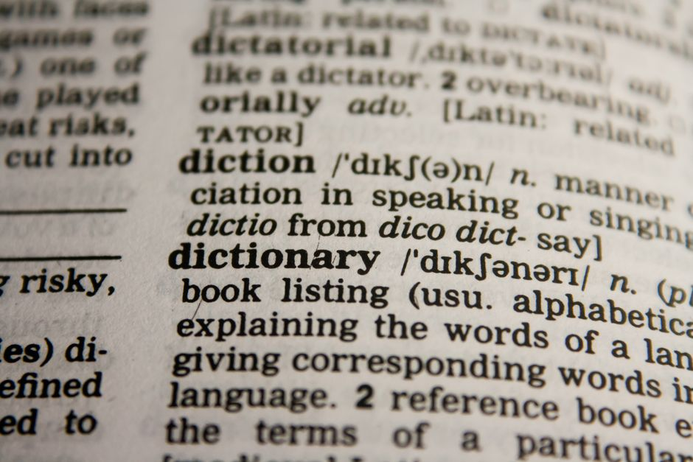
harvest
/ˈhɑːr.vəst/
To gather a ripe crop from the fields.
फसल काटना,
വിളവെടുക്കുക, அறுவடை செய்
harvest harvests harvested
2/3
█████░░░░░░

Slide 6
harvest
/ˈhɑːr.vəst/
To gather a ripe crop from the fields.
फसल काटना,
വിളവെടുക്കുക, அறுவடை செய்
harvest harvests harvested
The tired farmers harvested all the wheat before the heavy rain started.
2/3
█████░░░░░░

Slide 7
harvest
/ˈhɑːr.vəst/
To gather a ripe crop from the fields.
फसल काटना,
വിളവെടുക്കുക, அறுவடை செய்
harvest harvests harvested
The tired farmers harvested all the wheat before the heavy rain started.
Workers harvest fresh apples from the orchard early in the morning.
2/3
█████░░░░░░

Slide 8
harvest
/ˈhɑːr.vəst/
To gather a ripe crop from the fields.
फसल काटना,
വിളവെടുക്കുക, அறுவடை செய்
harvest harvests harvested
The tired farmers harvested all the wheat before the heavy rain started.
Workers harvest fresh apples from the orchard early in the morning.
They will harvest the golden grain when it becomes completely ripe tomorrow.
2/3
█████░░░░░░

Slide 9
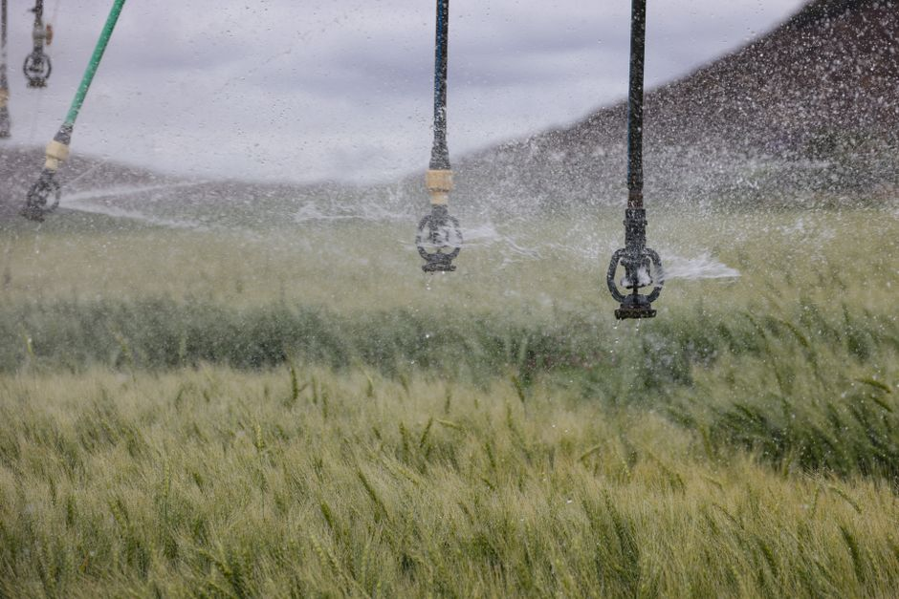
irrigation
/ˌɪr.əˈɡeɪ.ʃən/
The supply of water to land or crops to help growth.
सिंचाई,
ജലസേചനം, பாசனம்
3/3
█████░░░░░░

Slide 10
irrigation
/ˌɪr.əˈɡeɪ.ʃən/
The supply of water to land or crops to help growth.
सिंचाई,
ജലസേചനം, பாசனம்
The old irrigation system supplied water to all farms in the valley.
3/3
█████░░░░░░

Slide 11
irrigation
/ˌɪr.əˈɡeɪ.ʃən/
The supply of water to land or crops to help growth.
सिंचाई,
ജലസേചനം, பாசனம்
The old irrigation system supplied water to all farms in the valley.
Modern irrigation provides enough water for crops during dry weather conditions.
3/3
█████░░░░░░

Slide 12
irrigation
/ˌɪr.əˈɡeɪ.ʃən/
The supply of water to land or crops to help growth.
सिंचाई,
ജലസേചനം, பாசனம்
The old irrigation system supplied water to all farms in the valley.
Modern irrigation provides enough water for crops during dry weather conditions.
A new irrigation project will help farmers grow crops during dry summer.
3/3
█████░░░░░░

