Slide 1

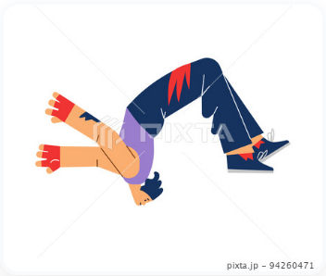

{{HINDI}}, {{MALAYALAM}}, {{TAMIL}}
{{WORD}}
{{ABC}}
{{MEANING}}
{{HINDI}},
{{MALAYALAM}}, {{TAMIL}}
{{BASE_FORM}}, {{PRESENT_FORM}}, {{PAST_FORM}}
{{WORD_NUMBER}}
{{WORD_NUMBER}} █████░░░░░░

Slide 2
{{WORD}}
{{ABC}}
{{MEANING}}
{{HINDI}},
{{MALAYALAM}}, {{TAMIL}}
{{BASE_FORM}}, {{PRESENT_FORM}}, {{PAST_FORM}}
{{PAST_SENTENCE}}
{{WORD_NUMBER}}
{{WORD_NUMBER}} █████░░░░░░

Slide 3
{{WORD}}
{{ABC}}
{{MEANING}}
{{HINDI}},
{{MALAYALAM}}, {{TAMIL}}
{{BASE_FORM}}, {{PRESENT_FORM}}, {{PAST_FORM}}
{{PAST_SENTENCE}}
{{PRESENT_SENTENCE}}
{{WORD_NUMBER}}
{{WORD_NUMBER}} █████░░░░░░

Slide 4
{{WORD}}
{{ABC}}
{{MEANING}}
{{HINDI}},
{{MALAYALAM}}, {{TAMIL}}
{{BASE_FORM}}, {{PRESENT_FORM}}, {{PAST_FORM}}
{{PAST_SENTENCE}}
{{PRESENT_SENTENCE}}
{{FUTURE_SENTENCE}}
{{WORD_NUMBER}}
{{WORD_NUMBER}} █████░░░░░░

Slide 5
{{HINDI}}, {{MALAYALAM}}, {{TAMIL}}
{{WORD}}
{{ABC}}
{{MEANING}}
{{HINDI}},
{{MALAYALAM}}, {{TAMIL}}
{{BASE_FORM}}, {{PRESENT_FORM}}, {{PAST_FORM}}
{{WORD_NUMBER}}
{{WORD_NUMBER}} █████░░░░░░

