Slide 1

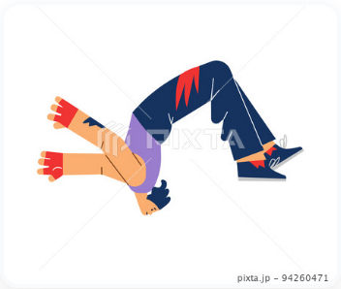

{{WORD}}
{{ABC}}
{{MEANING}}
{{HINDI}},
{{MALAYALAM}}, {{TAMIL}}
{{BASE_FORM}}, {{PRESENT_FORM}}, {{PAST_FORM}}
{{WORD_NUMBER}}
█████░░░░░░

Slide 2
{{WORD}}
{{ABC}}
{{MEANING}}
{{HINDI}},
{{MALAYALAM}}, {{TAMIL}}
{{BASE_FORM}}, {{PRESENT_FORM}}, {{PAST_FORM}}
{{PAST_SENTENCE}}
{{WORD_NUMBER}}
█████░░░░░░

Slide 3
{{WORD}}
{{ABC}}
{{MEANING}}
{{HINDI}},
{{MALAYALAM}}, {{TAMIL}}
{{BASE_FORM}}, {{PRESENT_FORM}}, {{PAST_FORM}}
{{PAST_SENTENCE}}
{{PRESENT_SENTENCE}}
{{WORD_NUMBER}}
█████░░░░░░

Slide 4
{{WORD}}
{{ABC}}
{{MEANING}}
{{HINDI}},
{{MALAYALAM}}, {{TAMIL}}
{{BASE_FORM}}, {{PRESENT_FORM}}, {{PAST_FORM}}
{{PAST_SENTENCE}}
{{PRESENT_SENTENCE}}
{{FUTURE_SENTENCE}}
{{WORD_NUMBER}}
█████░░░░░░

Slide 5
{{WORD}}
{{ABC}}
{{MEANING}}
{{HINDI}},
{{MALAYALAM}}, {{TAMIL}}
{{BASE_FORM}}, {{PRESENT_FORM}}, {{PAST_FORM}}
{{WORD_NUMBER}}
█████░░░░░░

Slide 6
{{WORD}}
{{ABC}}
{{MEANING}}
{{HINDI}},
{{MALAYALAM}}, {{TAMIL}}
{{BASE_FORM}}, {{PRESENT_FORM}}, {{PAST_FORM}}
{{PAST_SENTENCE}}
{{WORD_NUMBER}}
█████░░░░░░

Slide 7
{{WORD}}
{{ABC}}
{{MEANING}}
{{HINDI}},
{{MALAYALAM}}, {{TAMIL}}
{{BASE_FORM}}, {{PRESENT_FORM}}, {{PAST_FORM}}
{{PAST_SENTENCE}}
{{PRESENT_SENTENCE}}
{{WORD_NUMBER}}
█████░░░░░░

Slide 8
{{WORD}}
{{ABC}}
{{MEANING}}
{{HINDI}},
{{MALAYALAM}}, {{TAMIL}}
{{BASE_FORM}}, {{PRESENT_FORM}}, {{PAST_FORM}}
{{PAST_SENTENCE}}
{{PRESENT_SENTENCE}}
{{FUTURE_SENTENCE}}
{{WORD_NUMBER}}
█████░░░░░░

