Slide 1






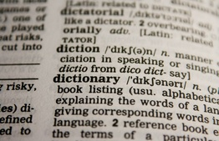






English Vocabulary
premiere

