Slide 1


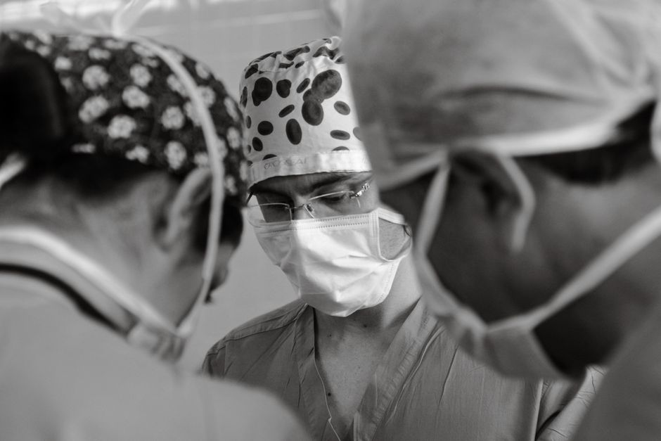

surgeon
/ˈsɜː.dʒən/
A doctor who is specially trained to perform medical operations.
शल्य चिकित्सक,
ശസ്ത്രക്രിയാവിദഗ്ദ്ധൻ, அறுவை சிகிச்சை நிபுணர்
1/1
█████░░░░░░

Slide 2
surgeon
/ˈsɜː.dʒən/
A doctor who is specially trained to perform medical operations.
शल्य चिकित्सक,
ശസ്ത്രക്രിയാവിദഗ്ദ്ധൻ, அறுவை சிகிச்சை நிபுணர்
The surgeon completed the complex heart surgery successfully late last night.
1/1
█████░░░░░░

Slide 3
surgeon
/ˈsɜː.dʒən/
A doctor who is specially trained to perform medical operations.
शल्य चिकित्सक,
ശസ്ത്രക്രിയാവിദഗ്ദ്ധൻ, அறுவை சிகிச்சை நிபுணர்
The surgeon completed the complex heart surgery successfully late last night.
The experienced surgeon performs critical operations at the hospital every morning.
1/1
█████░░░░░░

Slide 4
surgeon
/ˈsɜː.dʒən/
A doctor who is specially trained to perform medical operations.
शल्य चिकित्सक,
ശസ്ത്രക്രിയാവിദഗ്ദ്ധൻ, அறுவை சிகிச்சை நிபுணர்
The surgeon completed the complex heart surgery successfully late last night.
The experienced surgeon performs critical operations at the hospital every morning.
The chief surgeon will explain the procedure to the patient tomorrow.
1/1
█████░░░░░░

