Slide 1


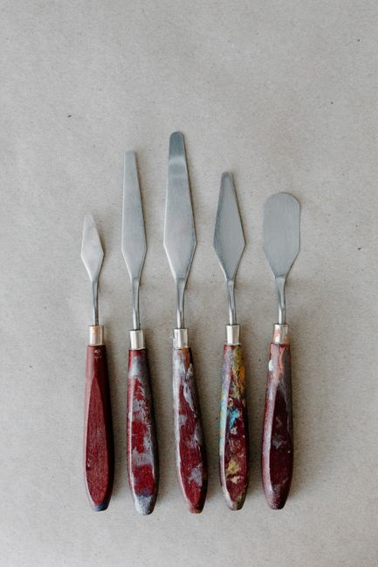

Spatula
/ˈspætʃ.ə.lə/
A broad, flat, flexible blade used to mix, spread, or lift food.
पलटा,
സ്പാറ്റുല, துடுப்பு
1/3
█████░░░░░░

Slide 2
Spatula
/ˈspætʃ.ə.lə/
A broad, flat, flexible blade used to mix, spread, or lift food.
पलटा,
സ്പാറ്റുല, துடுப்பு
He flipped the pancake carefully using a wide wooden spatula yesterday morning.
1/3
█████░░░░░░

Slide 3
Spatula
/ˈspætʃ.ə.lə/
A broad, flat, flexible blade used to mix, spread, or lift food.
पलटा,
സ്പാറ്റുല, துடுப்பு
He flipped the pancake carefully using a wide wooden spatula yesterday morning.
She uses a flexible rubber spatula to scrape the cake batter from the bowl.
1/3
█████░░░░░░

Slide 4
Spatula
/ˈspætʃ.ə.lə/
A broad, flat, flexible blade used to mix, spread, or lift food.
पलटा,
സ്പാറ്റുല, துடுப்பு
He flipped the pancake carefully using a wide wooden spatula yesterday morning.
She uses a flexible rubber spatula to scrape the cake batter from the bowl.
I will buy a heat resistant silicone spatula for baking cookies tomorrow.
1/3
█████░░░░░░

Slide 5
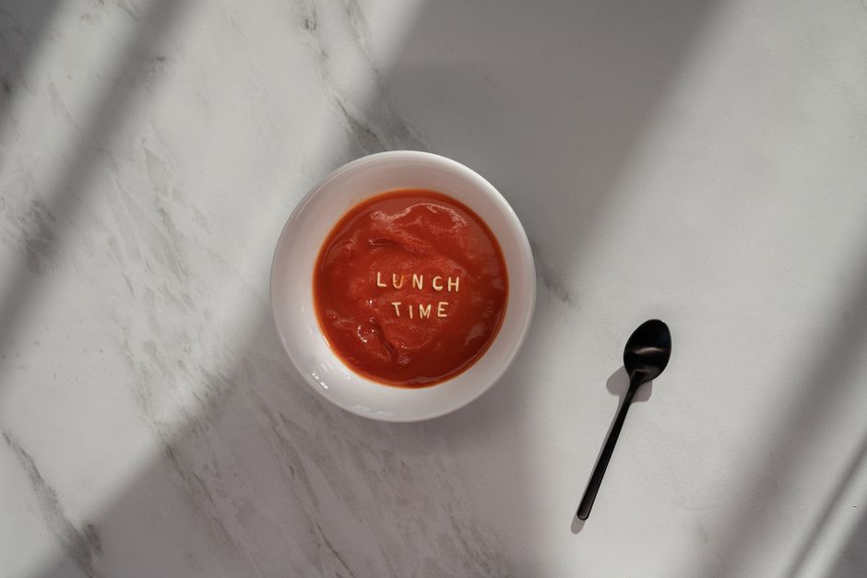
Ladle
/ˈleɪ.dəl/
A large long-handled spoon with a deep bowl for serving soup.
करछुल,
കരണ്ടി, அகப்பை
2/3
█████░░░░░░

Slide 6
Ladle
/ˈleɪ.dəl/
A large long-handled spoon with a deep bowl for serving soup.
करछुल,
കരണ്ടി, அகப்பை
The chef poured warm gravy over the mashed potatoes using a big ladle.
2/3
█████░░░░░░

Slide 7
Ladle
/ˈleɪ.dəl/
A large long-handled spoon with a deep bowl for serving soup.
करछुल,
കരണ്ടി, அகப்பை
The chef poured warm gravy over the mashed potatoes using a big ladle.
She serves hot vegetable soup to the guests with a stainless steel ladle.
2/3
█████░░░░░░

Slide 8
Ladle
/ˈleɪ.dəl/
A large long-handled spoon with a deep bowl for serving soup.
करछुल,
കരണ്ടി, அகப்பை
The chef poured warm gravy over the mashed potatoes using a big ladle.
She serves hot vegetable soup to the guests with a stainless steel ladle.
We will need a large ladle to serve the stew at dinner tonight.
2/3
█████░░░░░░

Slide 9
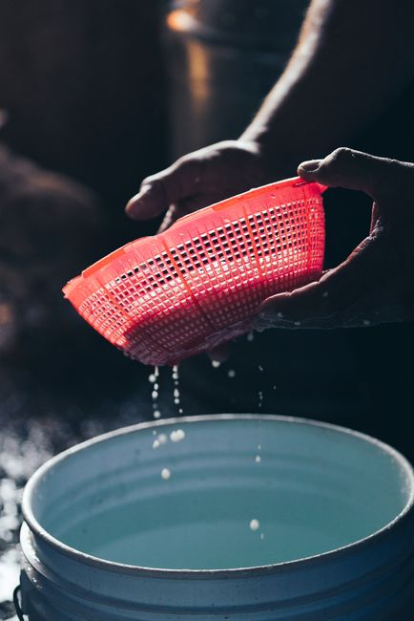
Colander
/ˈkɒl.ɪn.dər/
A perforated bowl used to drain liquid from washed or cooked food.
छलनी,
അരിപ്പ, வடிகட்டி
3/3
█████░░░░░░

Slide 10
Colander
/ˈkɒl.ɪn.dər/
A perforated bowl used to drain liquid from washed or cooked food.
छलनी,
അരിപ്പ, வடிகட்டி
He poured the hot boiled pasta into a metal colander to drain.
3/3
█████░░░░░░

Slide 11
Colander
/ˈkɒl.ɪn.dər/
A perforated bowl used to drain liquid from washed or cooked food.
छलनी,
അരിപ്പ, வடிகட்டி
He poured the hot boiled pasta into a metal colander to drain.
Mom usually rinses fresh berries inside a plastic colander under cold water.
3/3
█████░░░░░░

Slide 12
Colander
/ˈkɒl.ɪn.dər/
A perforated bowl used to drain liquid from washed or cooked food.
छलनी,
അരിപ്പ, வடிகட்டி
He poured the hot boiled pasta into a metal colander to drain.
Mom usually rinses fresh berries inside a plastic colander under cold water.
She will place the washed vegetables in a colander to drain completely.
3/3
█████░░░░░░

