Slide 1
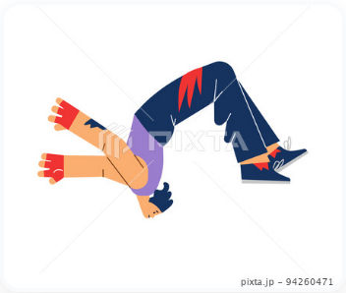


{{WORD}}
{{PRONUNCIATION}}
{{MEANING}}
{{HINDI}}, {{MALAYALAM}}, {{TAMIL}}
{{BASE_FORM}} {{PRESENT_FORM}} {{PAST_FORM}}
{{WORD_NUMBER}}

Slide 2
{{WORD}}
{{PRONUNCIATION}}
{{MEANING}}
{{HINDI}}, {{MALAYALAM}}, {{TAMIL}}
{{BASE_FORM}} {{PRESENT_FORM}} {{PAST_FORM}}
{{PAST_SENTENCE}}
{{WORD_NUMBER}}

Slide 3
{{WORD}}
{{PRONUNCIATION}}
{{MEANING}}
{{HINDI}}, {{MALAYALAM}}, {{TAMIL}}
{{BASE_FORM}} {{PRESENT_FORM}} {{PAST_FORM}}
{{PAST_SENTENCE}}
{{PRESENT_SENTENCE}}
{{WORD_NUMBER}}

Slide 4
{{WORD}}
{{PRONUNCIATION}}
{{MEANING}}
{{HINDI}}, {{MALAYALAM}}, {{TAMIL}}
{{BASE_FORM}} {{PRESENT_FORM}} {{PAST_FORM}}
{{PAST_SENTENCE}}
{{PRESENT_SENTENCE}}
{{FUTURE_SENTENCE}}
{{WORD_NUMBER}}

