Slide 1

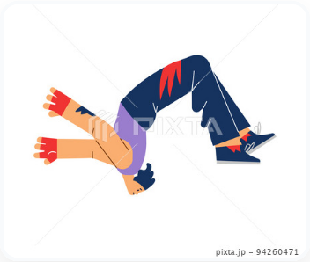

{{WORD}}
{{ABC}}
{{MEANING}}
{{HINDI}},
{{MALAYALAM}},
{{TAMIL}}
{{BASE_FORM}}
{{PRESENT_FORM}}
{{PAST_FORM}}
{{WORD_NUMBER}}
█████░░░░░░

Slide 2
{{WORD}}
{{ABC}}
{{MEANING}}
{{HINDI}},
{{MALAYALAM}},
{{TAMIL}}
{{BASE_FORM}}
{{PRESENT_FORM}}
{{PAST_FORM}}
{{PAST_SENTENCE}}
{{WORD_NUMBER}}
█████░░░░░░

Slide 3
{{WORD}}
{{ABC}}
{{MEANING}}
{{HINDI}},
{{MALAYALAM}},
{{TAMIL}}
{{BASE_FORM}}
{{PRESENT_FORM}}
{{PAST_FORM}}
{{PAST_SENTENCE}}
{{PRESENT_SENTENCE}}
{{WORD_NUMBER}}
█████░░░░░░

Slide 4
{{WORD}}
{{ABC}}
{{MEANING}}
{{HINDI}},
{{MALAYALAM}},
{{TAMIL}}
{{BASE_FORM}}
{{PRESENT_FORM}}
{{PAST_FORM}}
{{PAST_SENTENCE}}
{{PRESENT_SENTENCE}}
{{FUTURE_SENTENCE}}
{{WORD_NUMBER}}
█████░░░░░░

