Slide 1


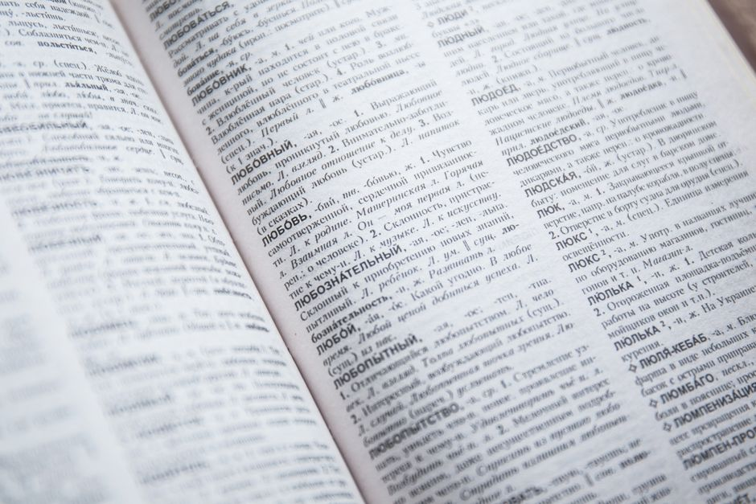

maternal
/məˈtɜːr.nəl/
Relating to or characteristic of a mother.
मातृक,
മാതൃപരമായ, தாய்க்குரிய
1/1
█████░░░░░░

Slide 2
maternal
/məˈtɜːr.nəl/
Relating to or characteristic of a mother.
मातृक,
മാതൃപരമായ, தாய்க்குரிய
The kind woman displayed deep maternal love to the orphaned child.
1/1
█████░░░░░░

Slide 3
maternal
/məˈtɜːr.nəl/
Relating to or characteristic of a mother.
मातृक,
മാതൃപരമായ, தாய்க்குரிய
The kind woman displayed deep maternal love to the orphaned child.
She shows strong maternal instincts toward her young children every day.
1/1
█████░░░░░░

Slide 4
maternal
/məˈtɜːr.nəl/
Relating to or characteristic of a mother.
मातृक,
മാതൃപരമായ, தாய்க்குரிய
The kind woman displayed deep maternal love to the orphaned child.
She shows strong maternal instincts toward her young children every day.
She will express her maternal care when the new baby arrives.
1/1
█████░░░░░░

