Slide 1


Introduction to
Robotic Process Automation
CRYPTOCURRENCY PRICE MONITORING BOT
220701205
Prince Perinbaraj S
Dr.N.Duraimurugan, M.E., Ph.D,
Computer Science and Engineering

Slide 2
Abstract
"A cryptocurrency price monitoring bot is designed using UiPath to automate the real-time tracking of cryptocurrency prices, providing instant alerts and insights for traders and investors. This system demonstrates the use of RPA in the financial domain, ensuring efficiency and accuracy.“
"This project presents a cryptocurrency price monitoring bot built with UiPath to automate real-time price tracking. By integrating with APIs and sending instant alerts based on user-defined conditions, the bot enhances efficiency, reduces manual effort, and supports informed decision-making in cryptocurrency trading."

Slide 3
Need for the Proposed System
Market Volatility: Cryptocurrencies are highly volatile, requiring real-time tracking to seize opportunities.
Manual Effort: Traditional methods of monitoring prices are time-consuming and error-prone.
Decision-Making: Instant updates are crucial for informed trading and investment decisions.
24/7 Market: Cryptocurrency markets never close, making manual monitoring impractical.

Slide 4
Advantages of the Proposed System
Describe benefits such as:
Automation of repetitive tasks.
Accurate and instant alerts.
24/7 operation.
Increased productivity for traders.
Fast Decision Support.

Slide 5
Literature Survey
"Cryptocurrency Price Prediction Using Machine Learning"
Advantages
Uses machine learning to predict price trends, improving market predictions.
Provides valuable insights into the potential for AI integration in cryptocurrency monitoring.
Disadvantages
Relies heavily on historical data, which may not account for sudden market shifts.
Computationally intensive, requiring significant resources.

Slide 6
Main Objective
To develop a cryptocurrency price monitoring bot using UiPath that automates real-time price tracking, generates alerts based on user-defined conditions, and supports traders and investors with accurate, timely insights for informed decision-making in the volatile cryptocurrency market.

Slide 7
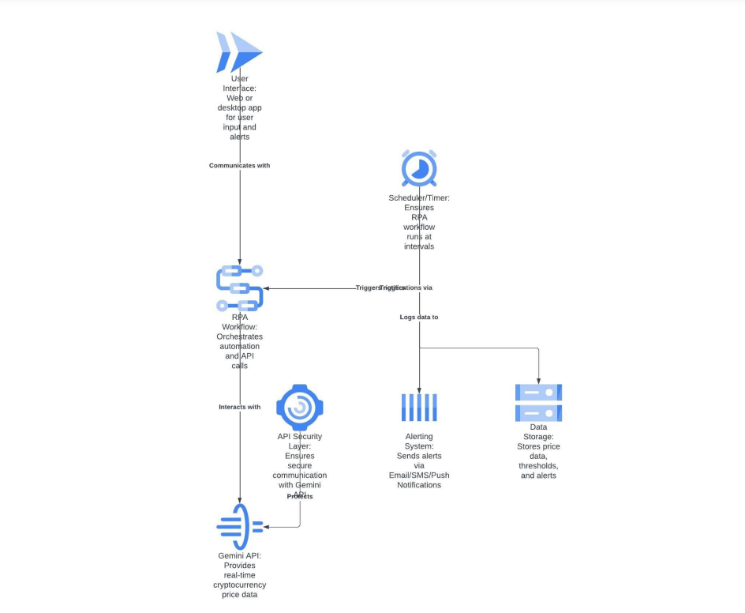
Architecture

Slide 8
System Requirements
List hardware and software needed:
Hardware: Standard PC/Laptop
Software: UiPath Studio, Cryptocurrency API access

Slide 9
Functional Description
Detail modules with diagrams:
Module 1: Data Fetching
Description: Fetch cryptocurrency prices via APIs
Diagram: Activity or Data Flow Diagram
Module 2: Notification Service
Description: Send alerts based on predefined conditions

Slide 10
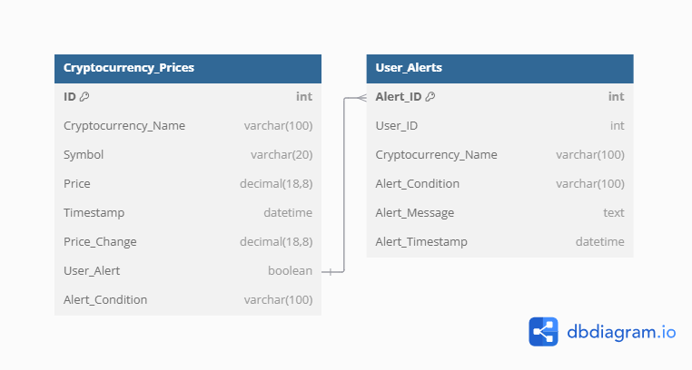
Table Design

Slide 11
Process Design
Main Process
Initialize Bot: Configure conditions and start the UiPath workflow.
Fetch Data: Retrieve real-time prices from APIs.
Process Data: Compare data with user-defined thresholds.
Generate Alerts: Send notifications via email or messaging apps.
Sub Process
API Integration: Fetch and handle cryptocurrency data.
Notification Handling: Deliver clear, timely alerts.
Data Logging: Store price changes for analysis.

Slide 12
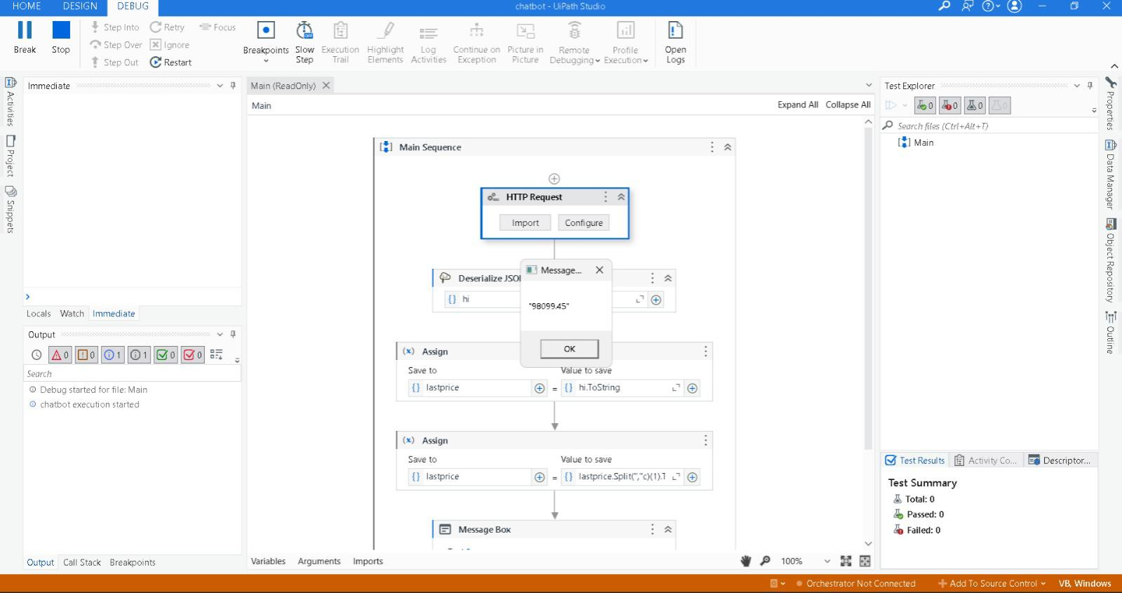
Implementation

Slide 13
Conclusions
The cryptocurrency price monitoring bot efficiently automates real-time tracking and alert generation, improving decision-making speed.
By reducing manual effort and errors, the system increases productivity and accuracy in monitoring volatile markets.
The solution provides scalability and 24/7 operation, ensuring users never miss critical price changes.
Overall, it enhances trading strategies, offering valuable insights for investors and traders in the cryptocurrency space.

Slide 14
Future Enhancement
Predictive Analytics: Implement machine learning for price predictions.
Support for More Exchanges: Monitor additional cryptocurrency exchanges.
Advanced Notifications: Offer more complex alerts based on trends or portfolios.
Mobile App Integration: Provide a mobile app for remote monitoring.
User Interface: Create a real-time dashboard for price tracking and alerts.

Slide 15
References
Journals:
"Blockchain and Cryptocurrency: A Review of the Literature“
"The Role of Robotic Process Automation in Financial Services“
Books:
"Hands-On Robotic Process Automation with UiPath"
Websites:
CoinGecko API Documentation
Binance API Documentation

Slide 16
Queries

Slide 17
Demonstration

Slide 18
Thank You

