Slide 1

What is Docker?
Docker packages applications with their dependencies into portable containers so deployments are consistent across environments.
Write Dockerfile
Build Image
Include Dependencies
Run Container

Slide 2
Installing & Setting Up Docker
Download Docker
Verify Installation
Visit https://www.docker.com/products/docker-desktop
Download Docker Desktop
Run the installer
After installation, open terminal/command prompt and run:
docker --version
docker run hello-world
This confirms Docker is properly installed and working.

Slide 3
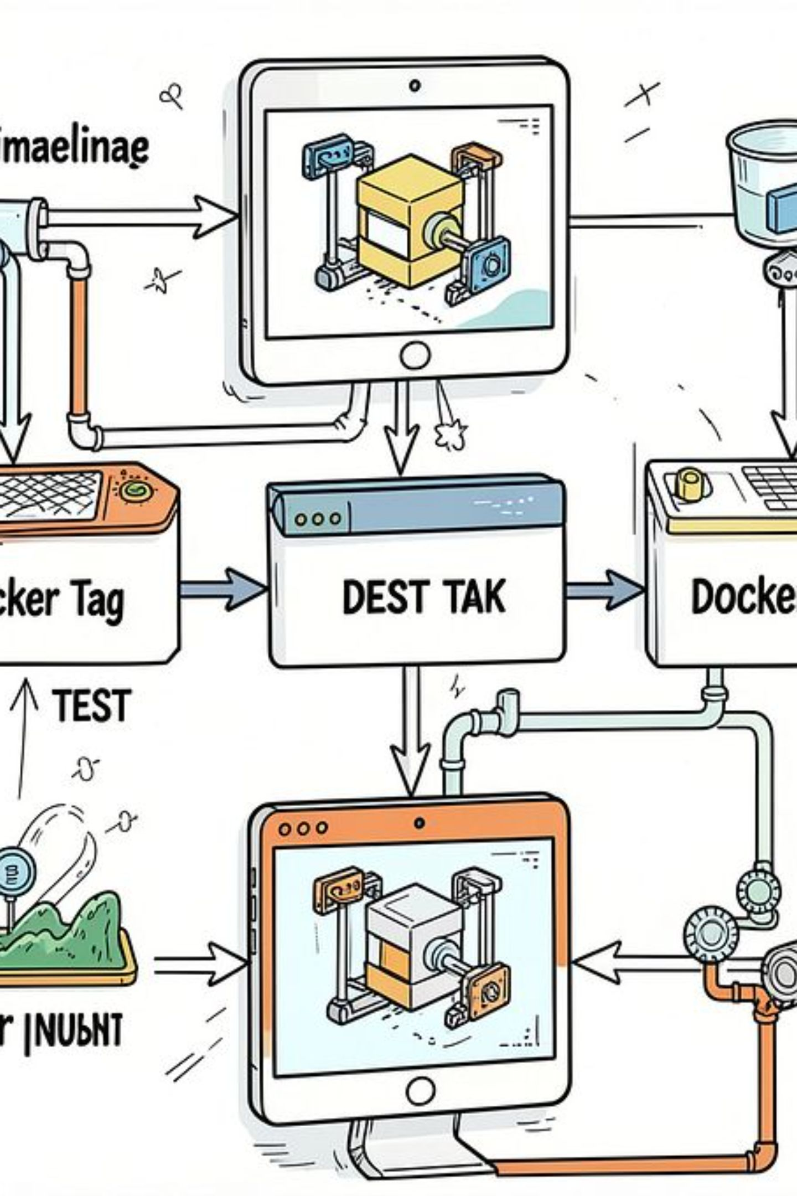
CI/CD Pipeline & Security
Docker Commands in Pipeline
Security Checklist
Use official images
Keep images updated
Avoid running as root
docker login
docker push
docker pull

Slide 4
End-to-End Deployment Example
01
02
03
Build
Run locally
Deploy to server
docker build -t my-app:1.0 .
docker run -d -p 3000:3000 --name my-app my-app:1.0
docker pull username/my-app:1.0
docker run -d -p 3000:3000 username/my-app:1.0

Slide 5
Docker Compose & Orchestration
Overview
Common Commands
Docker Compose simplifies local development by keeping multi-container services consistent across environments.
docker compose up -d
docker compose ps
docker compose down

Slide 6
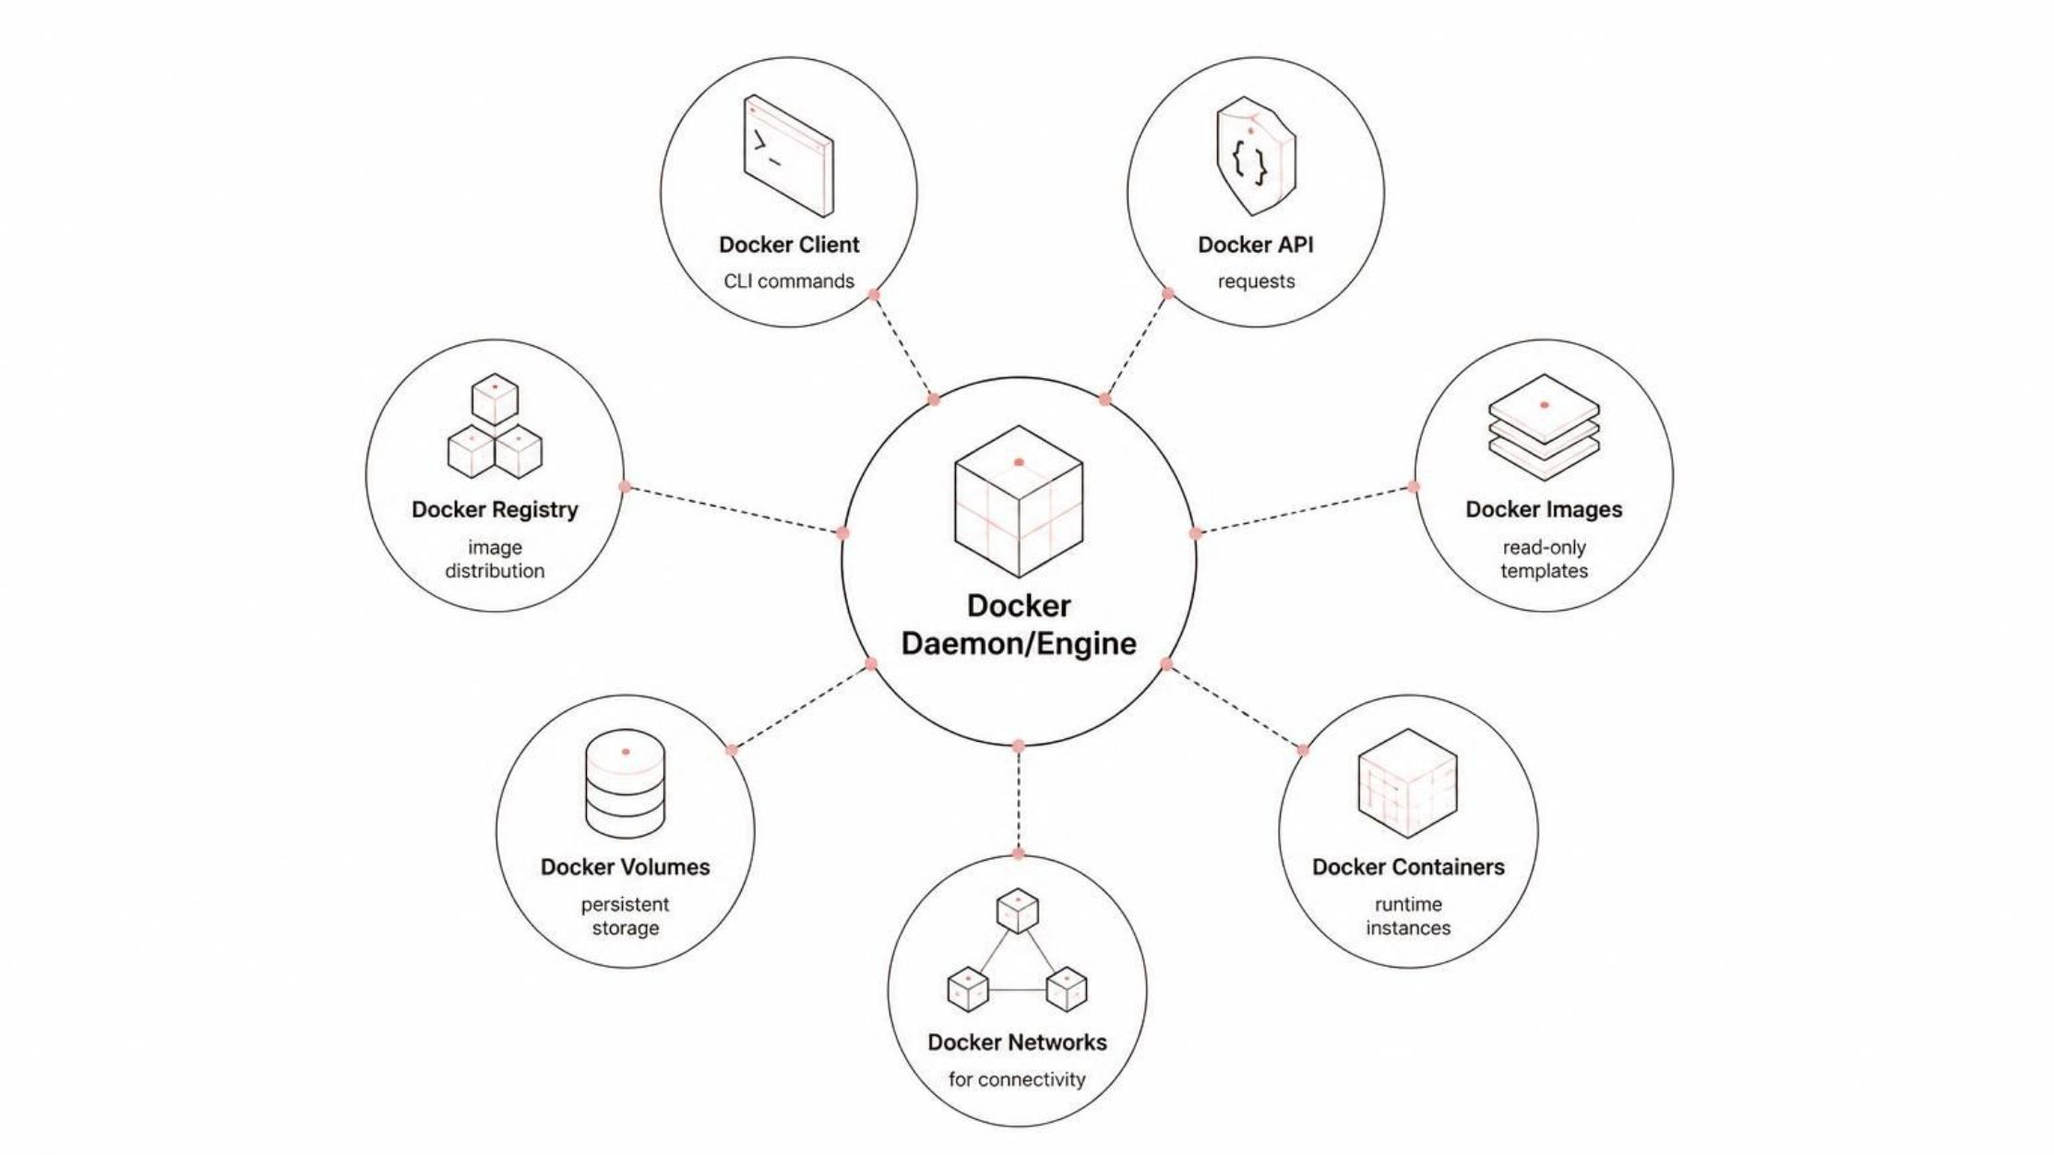
Docker Architecture
Key Components
Docker Client - CLI users use to send commands to the Docker Daemon.
Docker Daemon/Engine - Core host service that manages containers, images, networks, and volumes.
Docker Containers - Lightweight, isolated runtime instances created from images.

Slide 7
Port Mapping & Networking
Port Mapping
Networking
docker run -d -p 3000:3000 --name my-app my-app:1.0
docker network create app-network
docker network inspect app-network

Slide 8

Dockerfile to Container Lifecycle
The Process
Key Information
A Dockerfile defines the environment and dependencies. Docker builds it into an image. The image is then run as an isolated container.
Dockerfile
Build Image
Run Container
Example Node.js Dockerfile
FROM node:20
WORKDIR /app
COPY package*.json ./
RUN npm install
COPY . .
EXPOSE 3000
CMD ["npm", "start"]

Slide 9
Essential Docker Commands
Build, Inspect & Run
Manage & Debug
docker build -t my-app:1.0 .
docker run -d -p 3000:3000 --name my-app my-app:1.0
docker ps
docker logs my-app
docker stop my-app
docker rm my-app

Slide 10

Problems Docker Solves
Works on my machine — no environment drift
Dependency conflicts — isolate app libraries
Portability — run anywhere
Repeatable deployments — CI/CD ready

