Slide 1
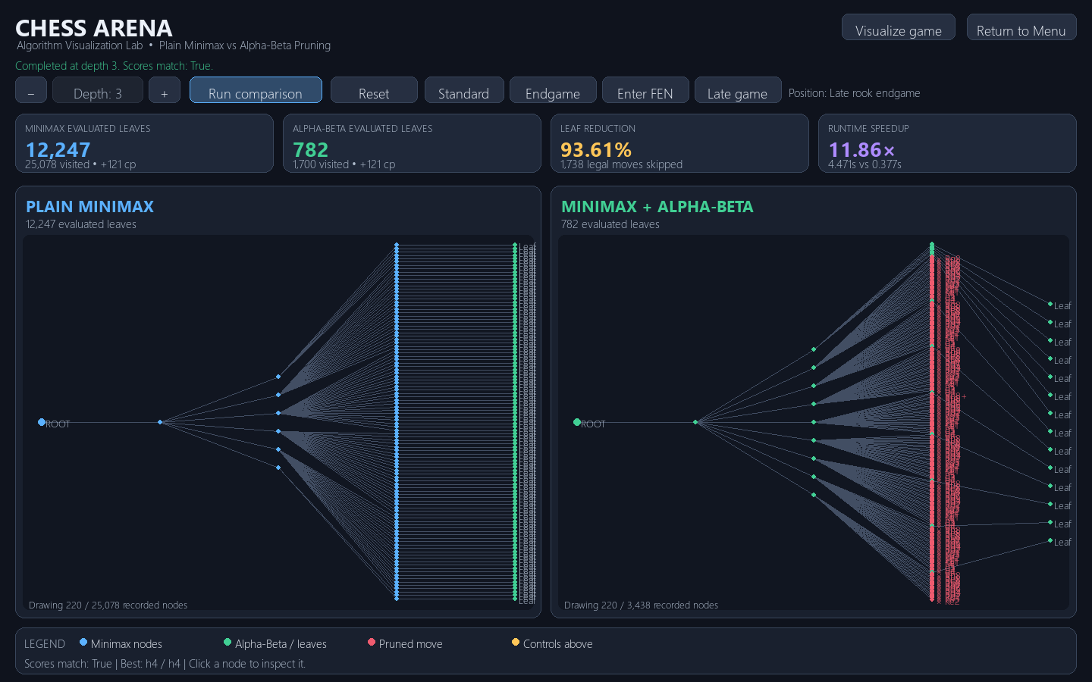
CHESS ARENA
Python chess AI and search visualization
A desktop project comparing Minimax and Alpha-Beta pruning
PROJECT PRESENTATION
Notes:
Introduce Chess Arena as a Python desktop application that makes chess search visible. The dashboard image is captured from the current application after comparing both algorithms at depth 3. Sources: readMe.md, main.py, comparison_ai.py.

Slide 2
The search problem
A chess move creates a new position. Each reply creates more positions.
To choose well, an engine must look ahead. The number of possible lines grows quickly as search depth increases.
PROJECT QUESTION
Can pruning reduce the work while keeping the same best move?
Chess Arena answers this with two custom search algorithms, a shared position and depth, and a visual record of the explored tree.
The user can also play a legal game against Stockfish or ask Minimax to choose a move.
02
Notes:
Frame the engineering question. The comparison uses the same position, depth, evaluation function, and move ordering for Minimax and Alpha-Beta. The project is a teaching and visualization tool, rather than a claim about playing strength. Source: readMe.md and comparison_ai.py.

Slide 3
Application architecture
One interface, two AI paths
Pygame handles interaction and drawing. python-chess owns the board state and legal move rules.
Custom search
Minimax / Alpha-Beta
Pygame interface
input and visualization
python-chess
position and legal moves
Scores, counters
and search tree
Stockfish
play opponent
The comparison mode uses the custom algorithms. Play mode uses Stockfish, with an optional Minimax move for White.
03
Notes:
Walk through the data path: Pygame receives controls and draws boards, python-chess validates and applies moves, custom search powers comparisons and the optional Minimax move, and the bundled Stockfish engine replies in Play with AI. Source: main.py, game_logic.py, ai.py, comparison_ai.py.

Slide 4
Minimax searches the full tree
White maximizes the score. Black minimizes it.
White to move
MAX
The algorithm explores each legal move to the chosen depth, then backs leaf evaluations up the tree.
Black reply
MIN
Black reply
MIN
Evaluation uses material, pawn advancement, and minor-piece centralization. Terminal positions receive mate or draw scores.
+3
+5
+2
+9
Black keeps +3
Black keeps +2
White chooses the better backed-up score: +3
04
Notes:
Explain that each leaf is a position at the depth limit or a terminal position. The numbers in the diagram are illustrative. White selects the largest branch value; Black selects the smallest reply value. The code evaluates positions from White’s perspective. Source: comparison_ai.py.

Slide 5
Alpha-Beta prunes branches safely
It tracks two bounds during the same Minimax search.
MAX
α = 5
α is the best score MAX can already guarantee. β is the best score MIN can already guarantee.
Earlier branch
score = 5
MIN branch
β = 3
When α ≥ β, the remaining branch cannot change the final choice, so the algorithm skips it.
Examined child
score = 3
Remaining replies
pruned
β = 3 ≤ α = 5
05
Notes:
Use the example to explain a cutoff. MAX already has an alternative worth 5. In the MIN branch, finding a reply worth 3 means that branch can never beat MAX’s existing option. Alpha-Beta records the cutoff and skips the remaining legal replies. The pruning changes work, not the Minimax result. Source: comparison_ai.py.

Slide 6
One depth-3 run evaluated 93.6% fewer leaves
Late rook endgame at move 35
Both searches chose h4 at +121 cp
12,247 → 782
leaf evaluations
1,738 legal moves skipped
4.471 s vs 0.377 s
Same score and move. Timings vary by machine.
Single run • depth 3 • nine-piece preset • White to move
06
Notes:
These are actual counters from one run of run_comparison at depth 3 on the application’s default FEN: 8/5pk1/6p1/2r5/3R4/5P2/5KPP/8 w - - 0 35. Both chose h4 with a score of +121 centipawns. Minimax evaluated 12,247 leaves; Alpha-Beta evaluated 782, a 93.61% reduction. Alpha-Beta recorded 1,738 skipped moves. Wall-clock times were 4.471 seconds and 0.377 seconds in this run; the application and slide label these as machine-dependent. Source: comparison_ai.py and main.py.

Slide 7
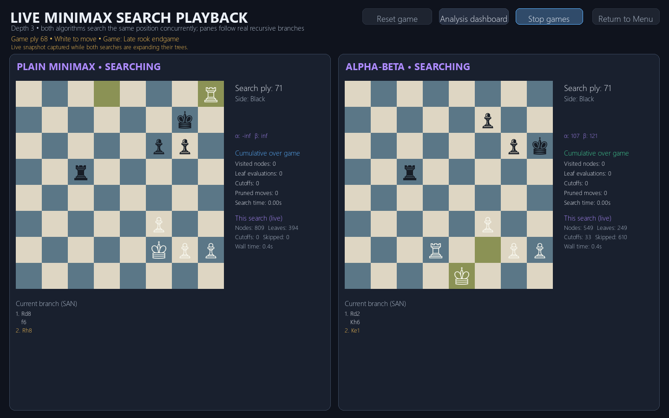
Both search paths run side by side
Shared position
Each algorithm receives the same board and depth.
Separate branches
Each pane follows its own recursive search path on a chessboard.
Live counters
Visited nodes, leaves, cutoffs, skipped moves, and time update during search.
07
Notes:
The screenshot was captured from the running Pygame app while both Minimax and Alpha-Beta search workers were active. Each panel shows its own cursor board and current counters. After both searches finish with matching scores, the shared game advances with Minimax’s selected move. Source: main.py.

Slide 8
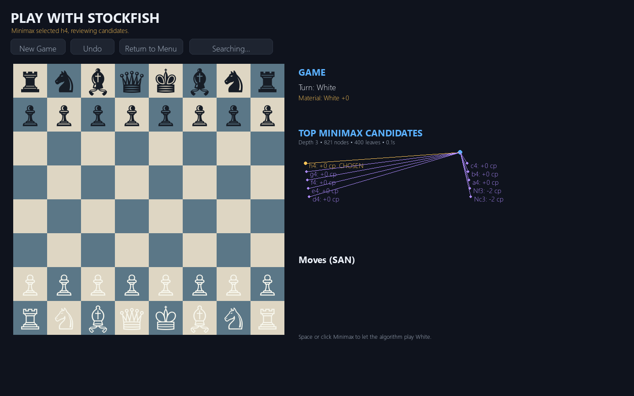
Play with AI has two move paths
Manual play
Click a piece, then a legal destination. Stockfish replies.
Minimax move
Press Space or use the button. The right panel shows up to ten candidate moves, scores each one, and marks the selected move before playing it.
The board and move history remain visible while the candidate diagram is reviewed.
08
Notes:
Describe both routes for White’s move. Manual moves are validated through python-chess and trigger a Stockfish response. Pressing Space starts the project’s own Minimax search; the right panel lists the top ten candidates after scoring, marks the best move as CHOSEN, pauses briefly, and applies it. Source: main.py, game_logic.py, ai.py, comparison_ai.py.

Slide 9
Validation and next steps
Verified in the project
Current limits
Search tests check score agreement, legal moves, board restoration, trace integrity, FEN validation, terminal positions, progress, and cancellation.
Custom search depth is capped at 4. Evaluation is deliberately compact. Stockfish depth and search speed depend on the machine.
Game tests check move legality, SAN history, material balance, new games, and undo. Stockfish integration was also exercised.
Possible extensions
Add transposition tables, iterative deepening, a richer positional evaluation, and repeatable benchmarks across several FENs.
Chess Arena makes the cost and behavior of search visible on a real chessboard.
09
Notes:
Summarize what has been tested and describe reasonable next steps as future work, not as completed features. The custom search is limited to depth 4 and uses a simple hand-coded evaluation. Search time depends on hardware and position. Sources: test_comparison.py, test_game.py, test_ai.py, comparison_ai.py.

