Slide 1
OBJECT DETECTON SYSTEM
with YOLO Algorithm
Prince Timilsina
07/23/2025

Slide 2

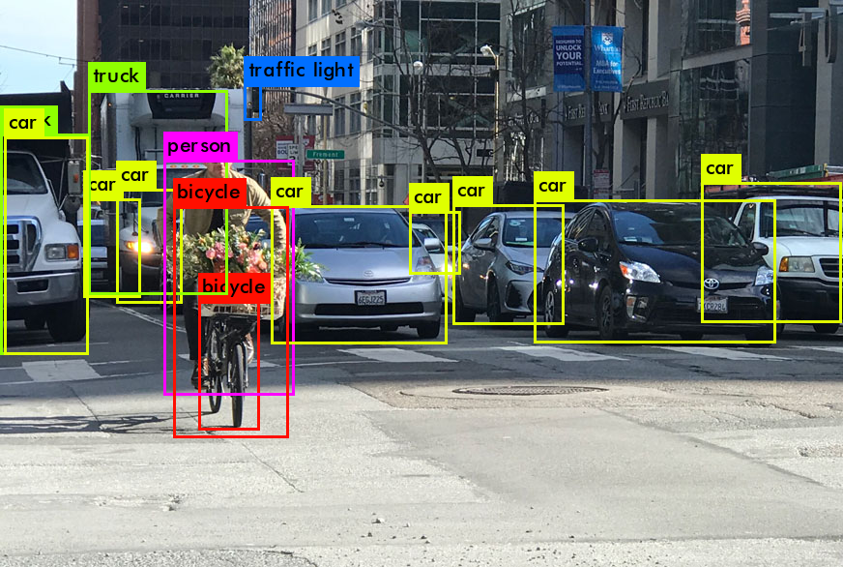
What is Object Detection?
Before
It is a computer vision technique that identifies and locates (like cars, people, or traffic lights) objects
After
REVOLUTION

Slide 3



What is YOLO?
“You only look once”
It is a real-time object detection algorithm that detects multiple objects in a single glance of an image or video frame.
YOLOv5-YOLOv7-YOLOv11

Slide 4
DEMO
Quick-DEMO

Slide 5
Need?
Nepal: Over 2,000 road deaths/year, lack of smart safety tech
Public transport and vehicles lack AI-powered alerts
No affordable detection systems in public transport
Global trend: ADAS (Advanced Driver Assistance Systems) market booming
“Affordable + locally made + practical solution for Nepal”

Slide 6
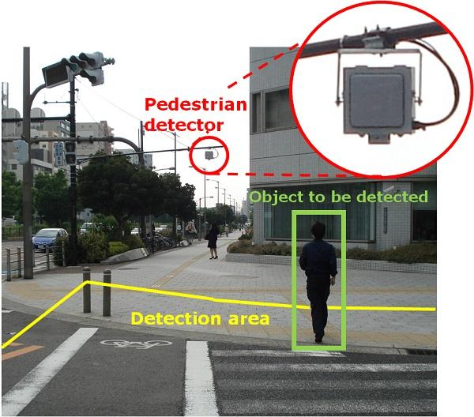
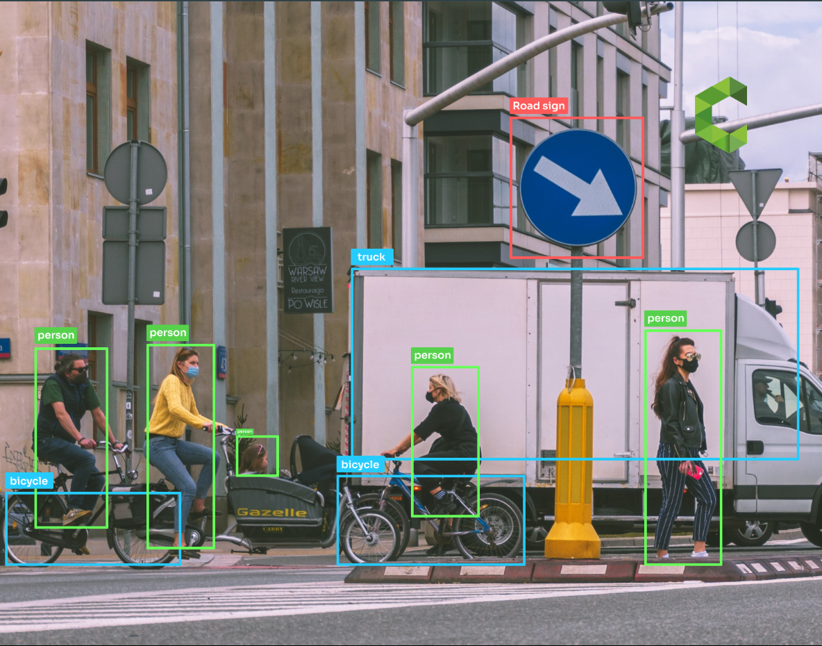
Application
🚌 Buses — Safer public transport 🚕 Taxis — Alerts for distracted driving 🚦 Traffic Lights — Smarter city traffic flow
🏭 Factories — Safety & process monitoring 🛒 Shops — Shelf tracking

Slide 7
Market Size & Opportunity
“A Multi-Billion Dollar Market”
Global market: $10B (2025) → $35B (2030)
Expected to grow at ~18-20% CAGR
South Asia/Nepal: <1% AI vision adoption
Nepal market potential: $2-5M (5 years)

Slide 8
How We’ll Grow??
Pilot projects with local bus companies & taxi unions
Partnerships with government transport and traffic departments
Collaborate with factories and shops for security & automation
Scale through NGOs & social impact funds
GROWTH

Slide 9
Business Model
“How we make money?”
Hardware sales: Camera + embedded system kits
Software subscriptions: Regular updates, cloud analytics (optional)
Licensing: Collaborate with vehicle manufacturers and public transport
Installation & maintenance services for fleets

Slide 10
Future Vision and Expansion
The beginning
Smart Inventory Management
Integrating with Mobile apps for driver safety alerts
Hardware Licensing
Expansion to smart city infrastructure
Traffic Intelligence
The end

Slide 11
Thank you
Do you have any questions?
timilsinaprince07@gmail.com
+977 9842856079
“Seeing is not enough; we must detect, decide, and act that’s the power of real-time vision.”

