Slide 1

eHome
Project By: Team 15

Slide 2
Introduction of Application
eHome is the real estate application which will simplify your home search
Instantly you can search homes for sales, apartments for rent
With the help of high resolution photo galleries and essential information regarding each apartment will bring you one step closer to your dream home

Slide 3
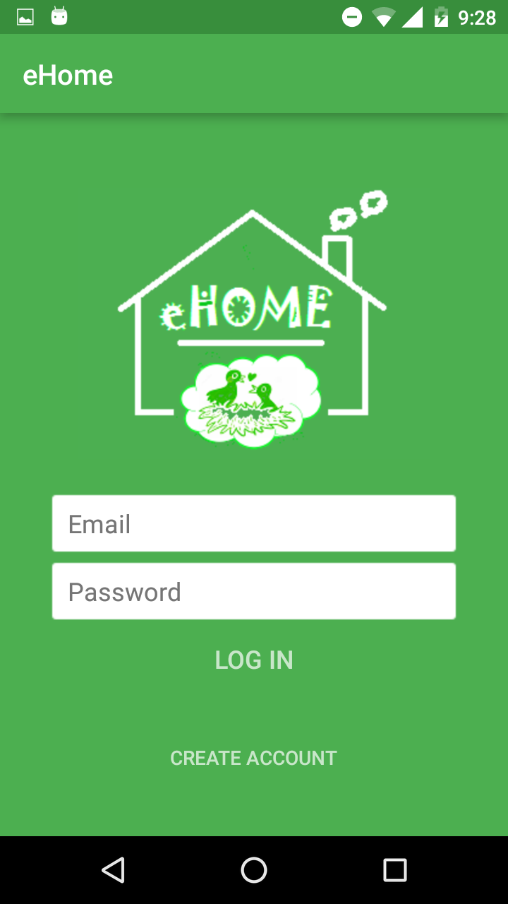
Application Features
Login : eHome

Slide 4
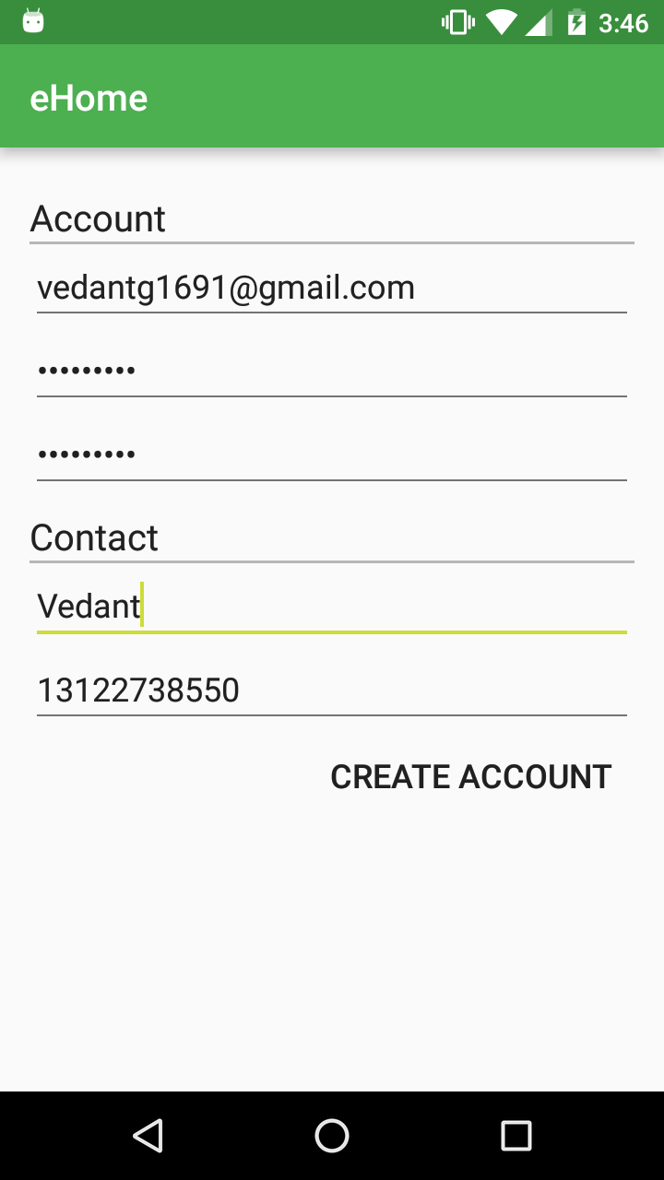
Application Features
User Profile :
Allows user to create an User Profile with his
Preferred email Id and Password
Password Verification against required criteria
Account Settings:
User can update his profile

Slide 5
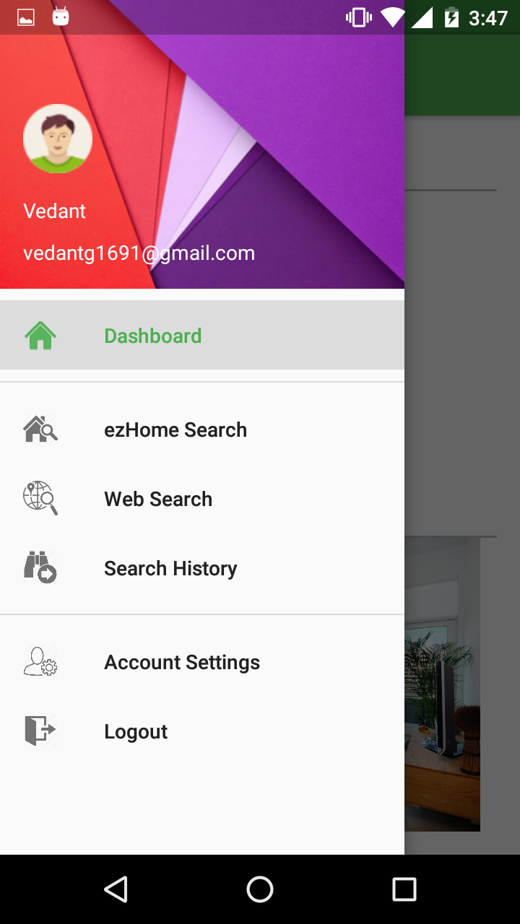
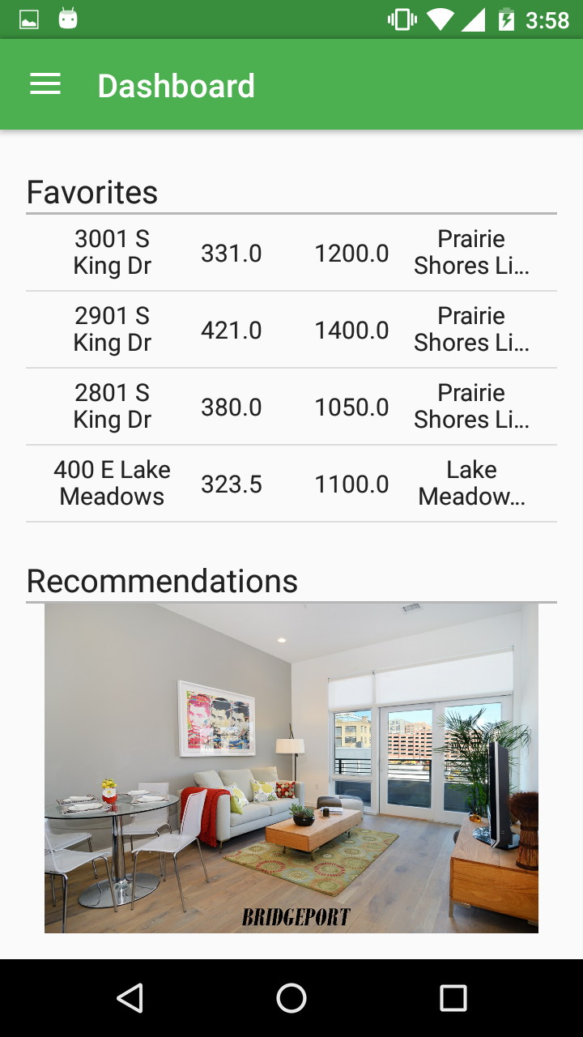
Application Features
Dashboard :
Favorites
Recommendations

Slide 6
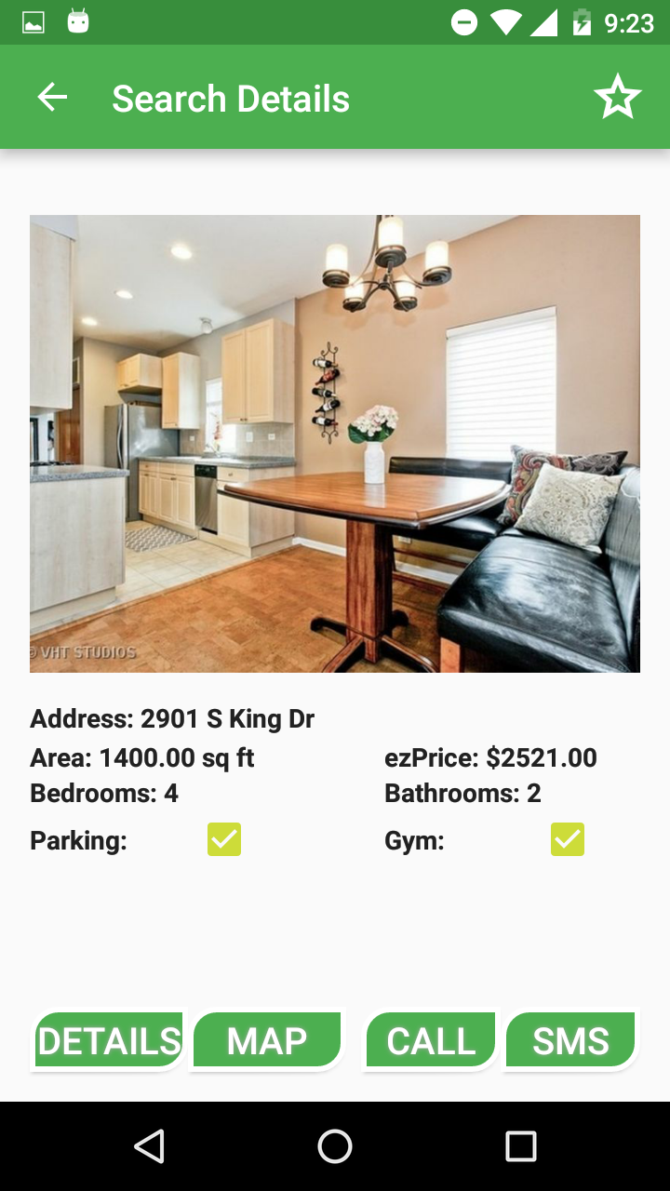
Application Features
ezHome Search :
High Resolution Image Gallery
Apartment Details
Filtering Options
One-Click Call To Owner
One-Click SMS to Owner
Add to favorites
Show location on map

Slide 7
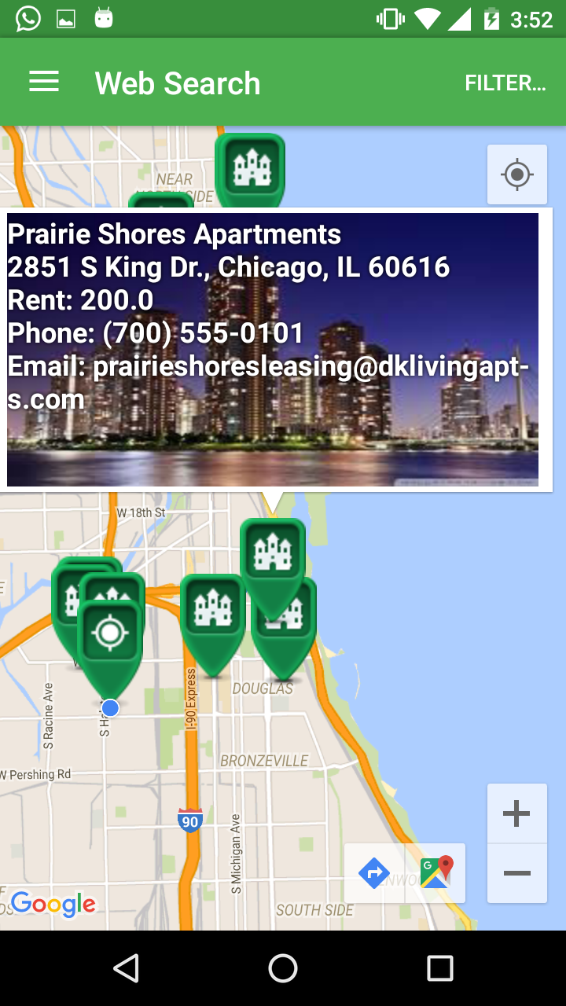
Application Features
Web Search :
User Current Location
Details of each apartment
Filtering Options
One-Click Call To Owner
One-Click SMS to Owner
Add to Favorites

Slide 8
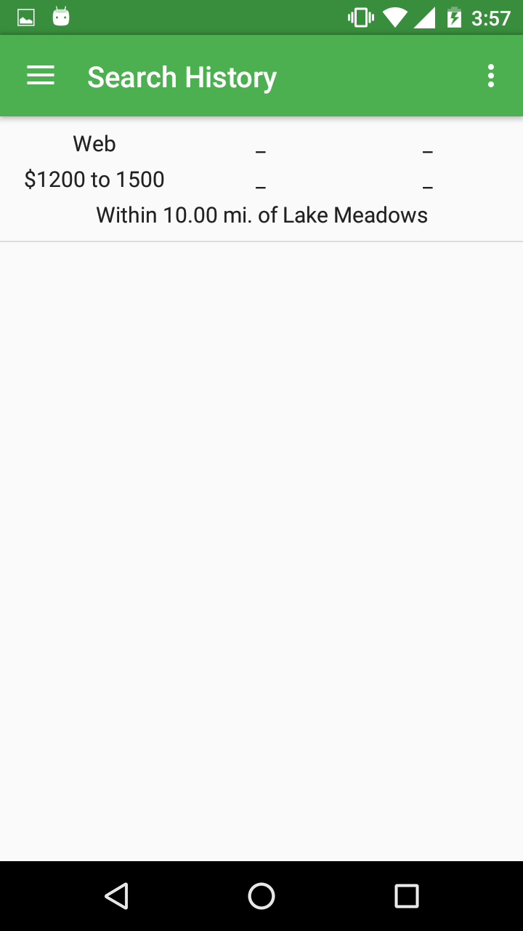
Application Features
Search History :
Keeps track of your searches
User can save their searches
User can clear their search history

Slide 9
User Experiences
Enhanced offline search with list view showing all the required details
Advanced Online Search with search filter
Offline and Online Search Connectivity
Smooth Navigation
Maintains Search History

Slide 10
Why eHome?
On the fly use for searching apartments on rent
Easy navigation through various features
Gives wide variety of options for apartment search
Searching can be done in either ways: Online or Offline
One-click calling
One-click SMS
Online Search within specified radius
Version Compatibility

Slide 11
THANK YOU

