Slide 1
AI-Powered Event Management Platform
Assignment 7 – AI Event Management
Automating the complete event lifecycle with n8n + AI
Registration • Attendance • Communication • Certificates • Feedback • Reporting

Slide 2
Problem Statement
Organizations conduct conferences, workshops, hackathons and training programs with hundreds of participants.
Manual registration, attendance, communication, certificates and feedback create delays and errors.
Organizers also struggle to generate timely event-performance insights.

Slide 3
Business Context & Pain Points
Large participant volumes make manual tracking difficult.
Attendance verification is repetitive and error-prone.
Event updates and reminders require repeated communication.
Certificate creation and distribution consume staff time.
Feedback analysis and reporting are slow when performed manually.

Slide 4
Objectives
Automate participant registration and attendance.
Improve participant and organizer communication.
Generate participation certificates automatically.
Collect feedback and use AI to classify sentiment.
Produce AI-powered event performance reports.

Slide 5
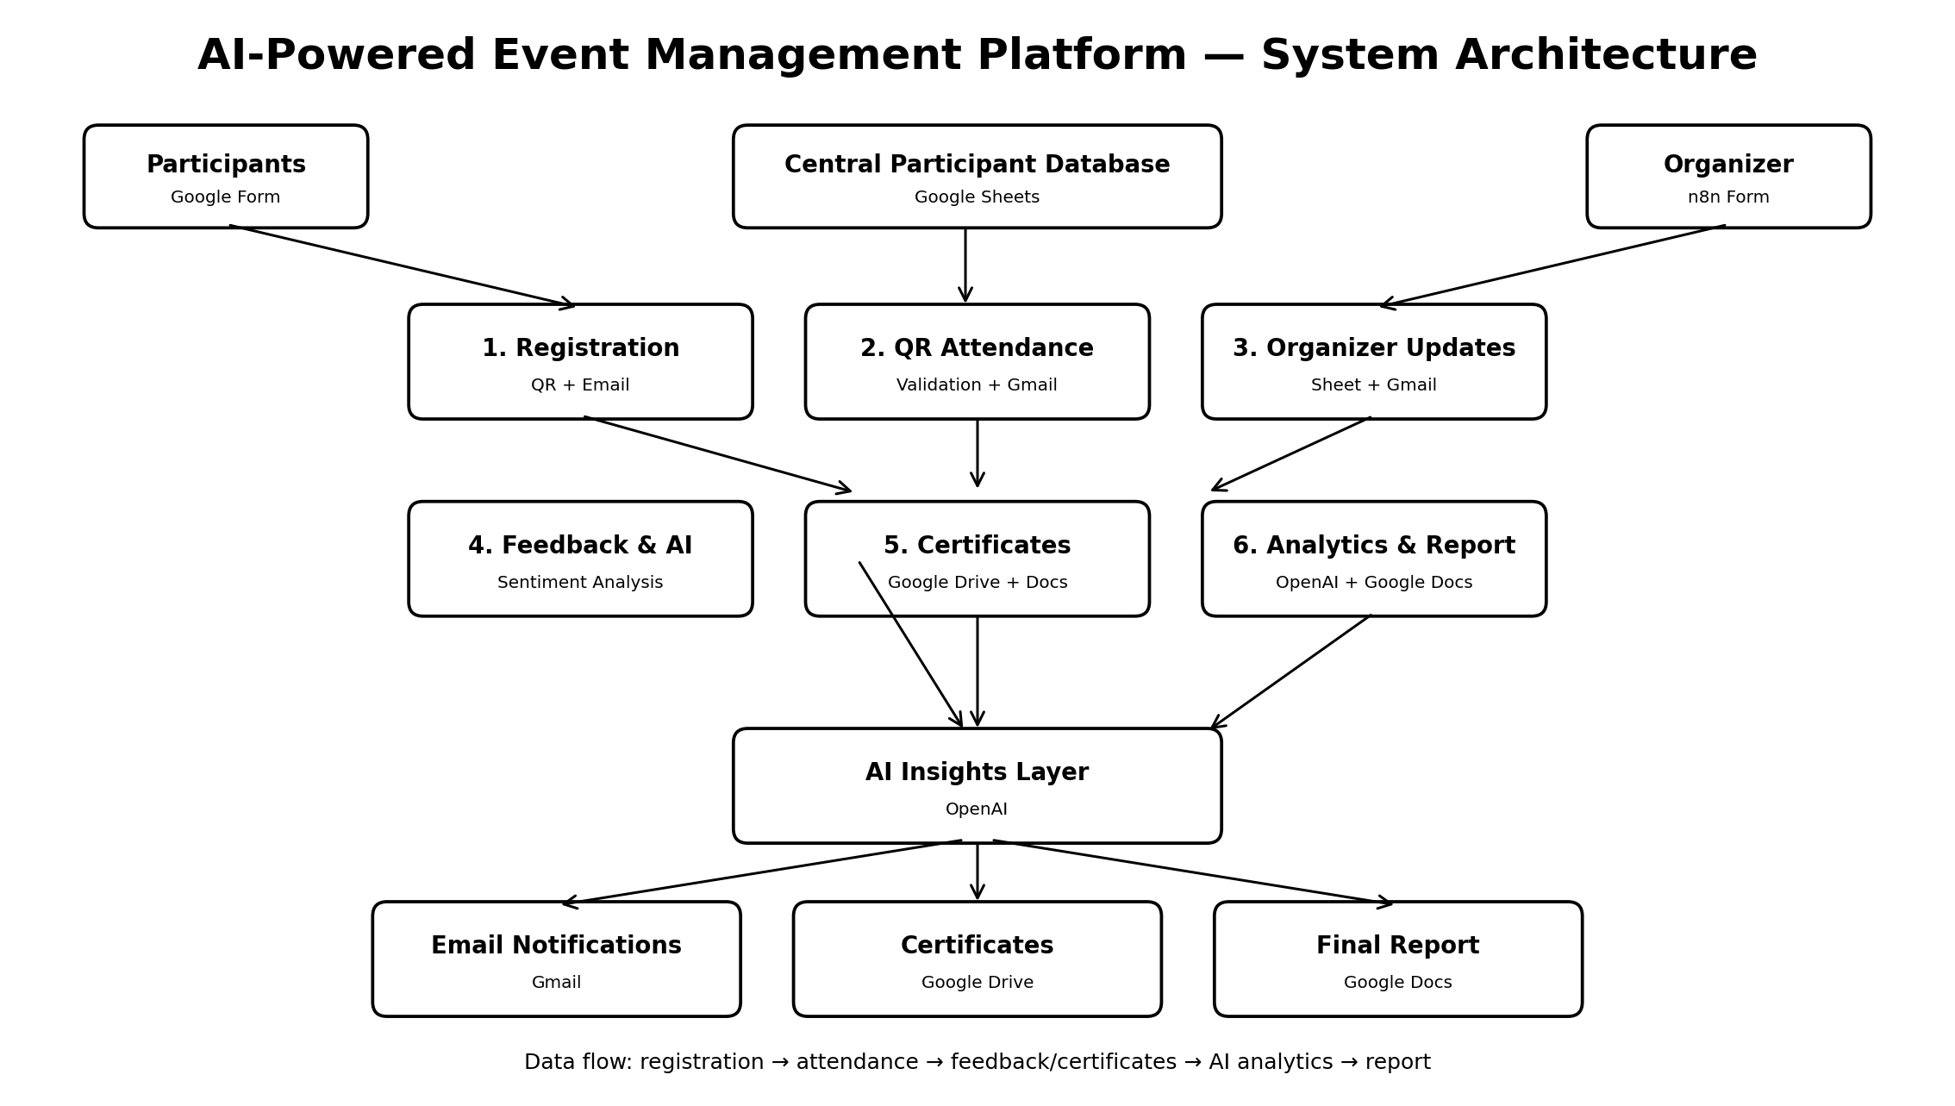
System Architecture

Slide 6
Workflow 1 & 2 — Registration + Attendance
Registration: n8n Form → participant fields → JavaScript → Google Sheets → QR Code API → Gmail.
Attendance: form → Google Sheets lookup → IF validation → mark Present → Gmail.
Conditional branching handles invalid participant submissions.

Slide 7
Workflow 3 — Organizer Event Updates
Organizer submits an event update through a form.
Update is stored in Google Sheets for traceability.
Gmail sends the communication to participants/recipients.
Provides an independent workflow that can run whenever an organizer needs to communicate.

Slide 8
Workflow 4 — Feedback & AI Analytics
Feedback is captured in Google Sheets.
Google Sheets Trigger starts the analysis workflow.
OpenAI classifies feedback sentiment as Positive, Negative or Neutral.
AI analysis is stored back in Google Sheets for later reporting.

Slide 9
Workflow 5 — Certificate Generation
Workflow retrieves participant data from Google Sheets.
Eligibility is checked using an IF condition, such as attendance status.
Certificate template is copied and updated with participant information.
Certificate record/status is written back to Google Sheets.

Slide 10
Workflow 6 — Event Analytics & Report
Final workflow retrieves event data from Google Sheets.
OpenAI summarizes performance, feedback and key insights.
Google Docs is used to create/update the final event report.
AI analysis is also stored in the participant/event data sheet.

Slide 11
Results & Benefits
End-to-end event lifecycle automation.
Faster participant communication and attendance processing.
Automated certificates reduce repetitive administrative work.
AI-powered feedback analysis provides actionable insights.
Centralized Google Sheets data supports auditability and reporting.
Reduced manual effort and fewer data-entry errors.

Slide 12
Conclusion & Future Scope
The platform demonstrates six interconnected n8n workflows covering the core event lifecycle.
Future scope: WhatsApp/SMS, real-time dashboards, payment integration, multi-session events and advanced analytics.
Submission package: workflow JSON files + documentation + architecture + README + demo video + presentation.

