Slide 1
FREEZO TECH

Slide 2
APPLICATION’S AIMS

Slide 3
CREATE A PLATFORM WHERE STUDENTS CAN ACCESS STUDY MATERIALS

Slide 4
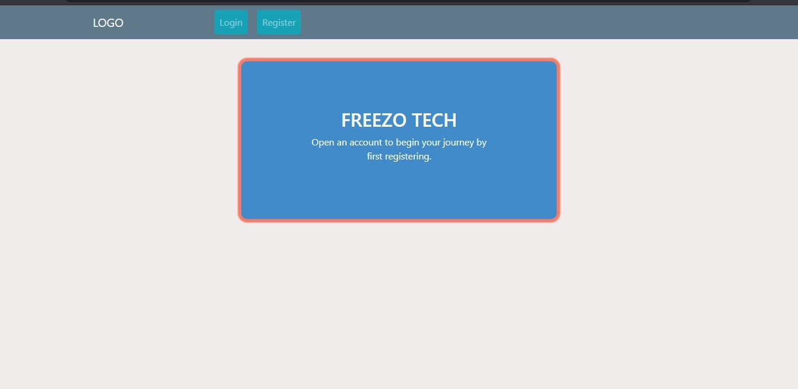
HOW IS THIS GOING TO BE POSSIBLE

Slide 5
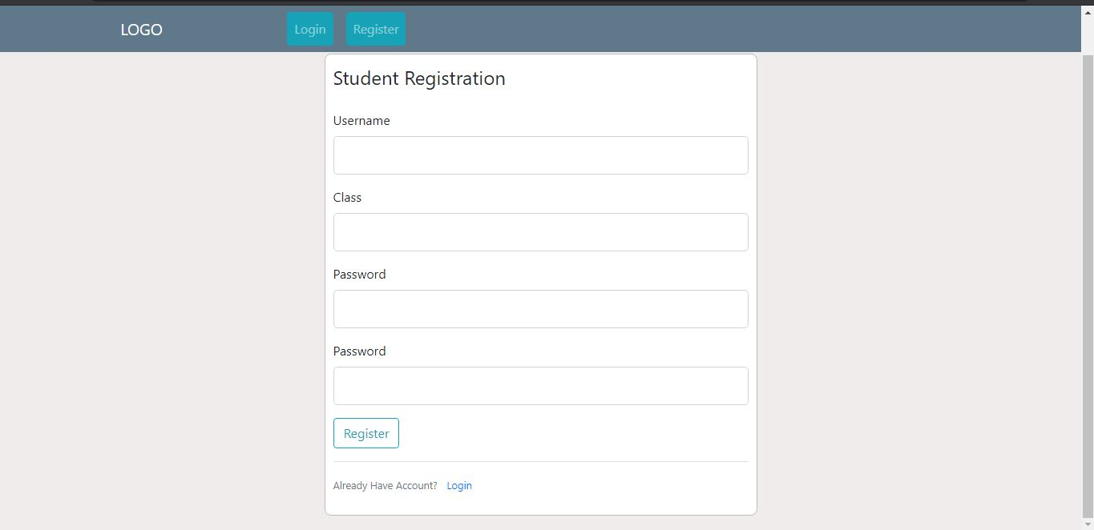
REGISTRATION
USERNAME(STUDENT NAME)
CLASS (FORM 1, 2….)
PASSWORD (ID No OR REG No

Slide 6
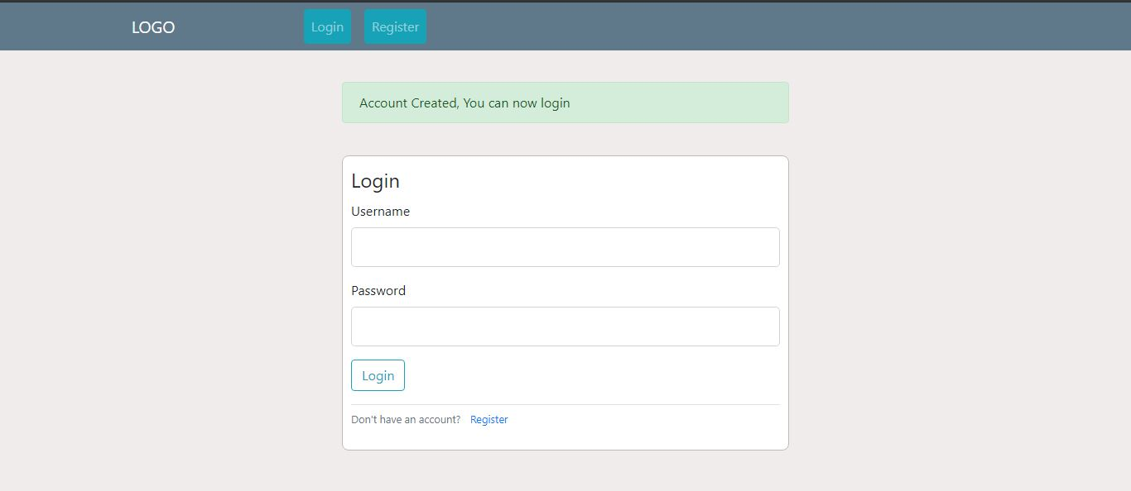
LOGIN PROCESS
USERNAME (NAME USED TO REGISTER)
PASSWORD (THE ONE THEY USED TO REGISTER)

Slide 7
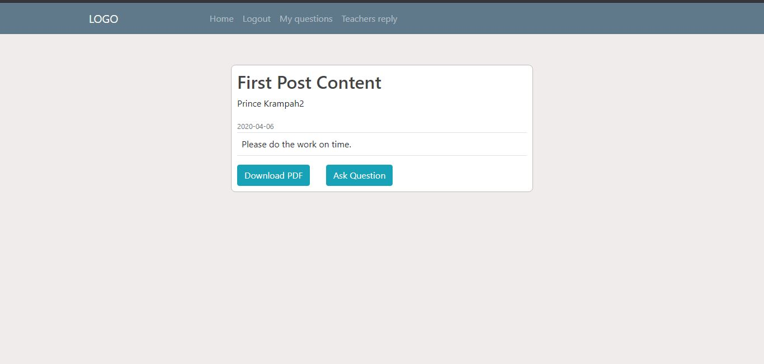
AFTER LOGIN

Slide 8
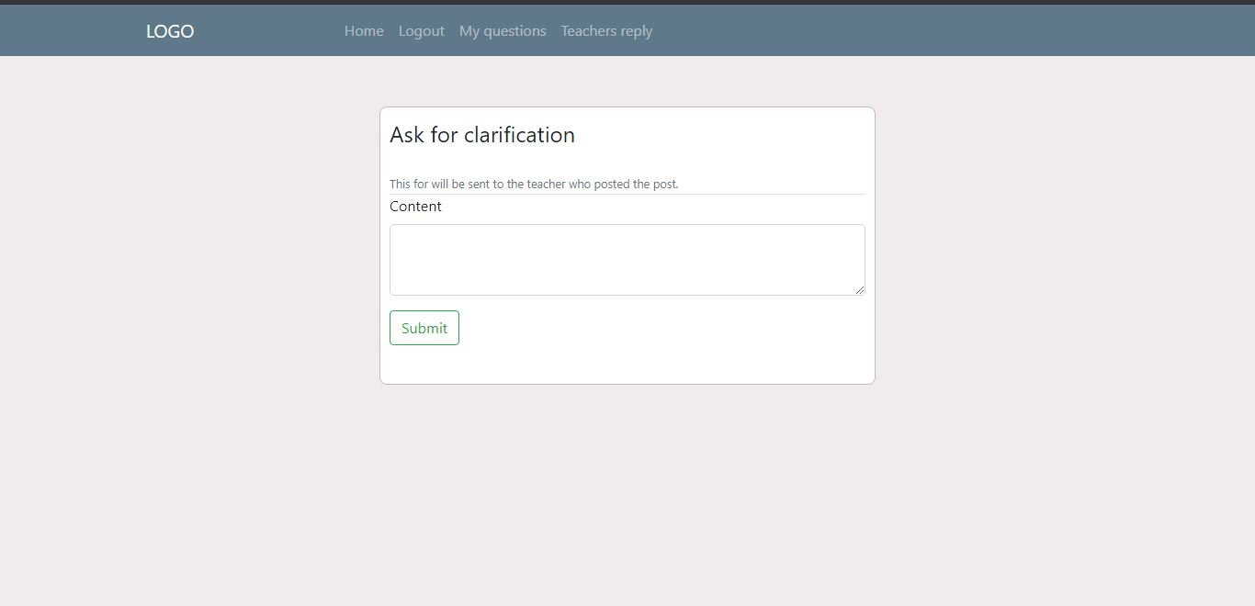
ASK FOR CLARIFICATIONS

Slide 9
STUDENT CONTROLS
HOME
LOGOUT
MY QUESTIONS
TEACHERS REPLY

Slide 10
CREATE A PLATFORM WHERE TEACHERS CAN POST CONTENT AND BE ABLE TO COMMUNICATE WITH STUDENTS

Slide 11
TEACHERS SIDE OF THE COIN

Slide 12
TEACHERS REGISTRATION AND LOGIN PROCEDURES

Slide 13
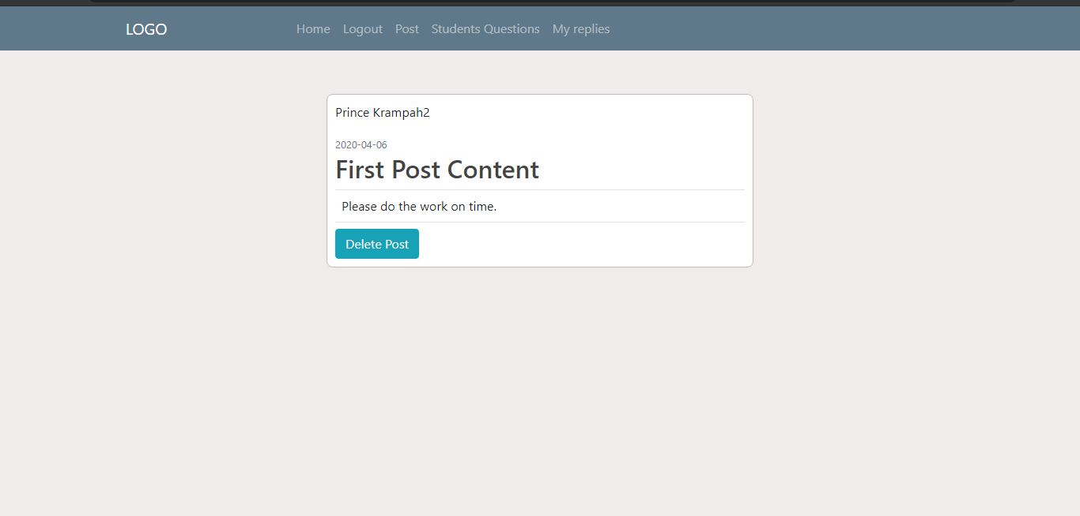
TEACHERS CONTROLS
HOME
LOGOUT
POST
STUDENTS QUESTIONS
MY REPLIES

Slide 14
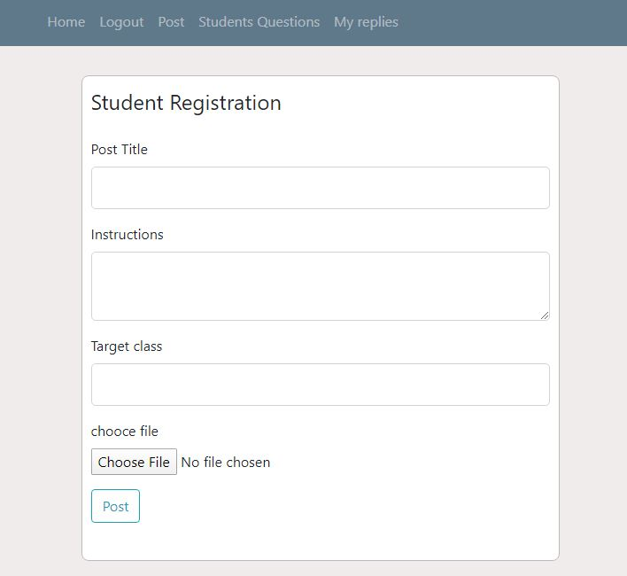
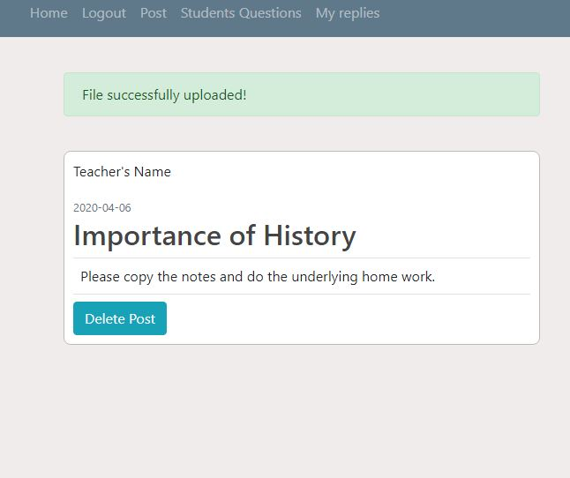
POSTING NOTES PROCEDURES

Slide 15
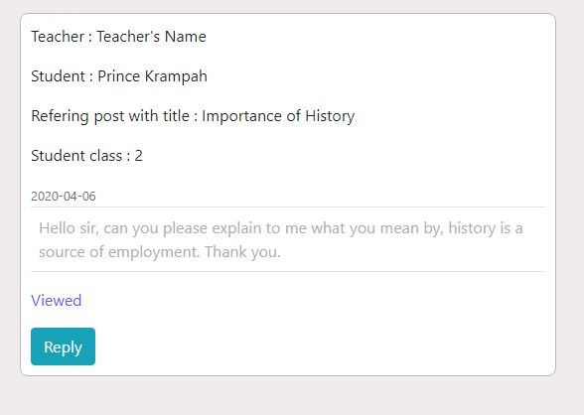
STUDENTS QUESTION
Viewed
Reply

Slide 16
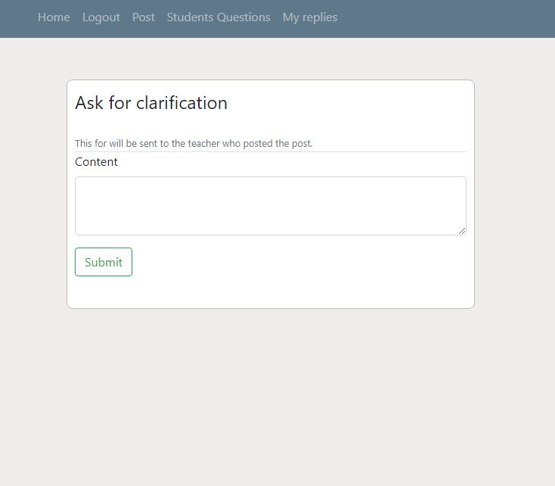
REPLY TO STUDENTS QUESTIONS

Slide 17
THE BACKBONE ( THE ADMINISTRATOR SECTIONS)

Slide 18
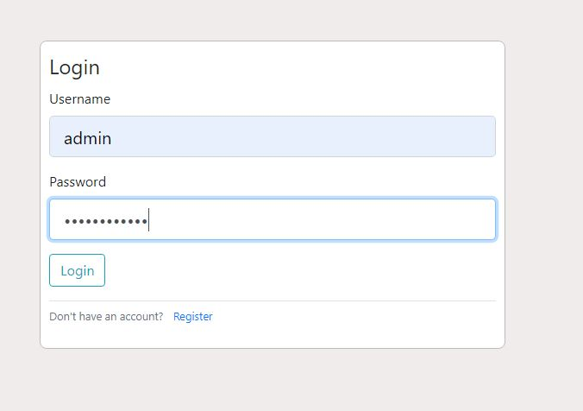
ADMIN LOGIN

Slide 19
ADMIN POWERS AND ROLES
Assigning roles users(students and teachers)
Deleting Posts and inactive users(former students and teachers)
Managing the database system and files on the database as well

Slide 20
That sounds hard right?
Being an admin

Slide 21
Well that is taken cared of by providing a very easy to use and understand user-friendly graphical interface with a documentation section to help even a person with no database knowledge to manage the database efficiently eliminating the need to employ any one to manage the system.

Slide 22
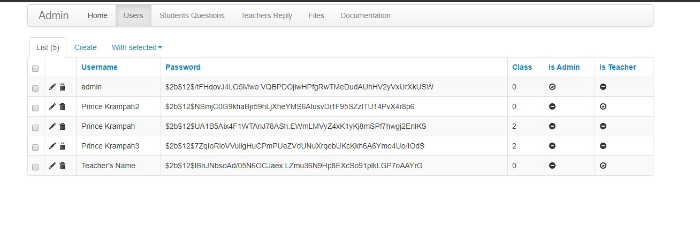

Slide 23
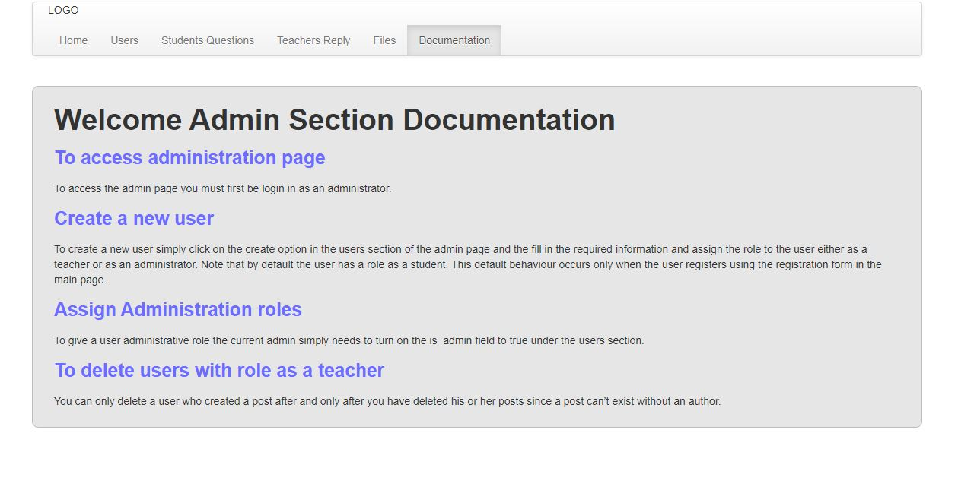
You don’t understand how to use the interface? Well look and the well detailed documentation

Slide 24
DEMONSTRATIONS

Slide 25
Thanks for listening

