Slide 1

SQUAT

Slide 2
PARTICIPANTS

Slide 3
Priy Ranjan Raj (Leader) Prince Kumar Saif Eqbal Abhishek Chaturvedi Prince Prakash

Slide 4



FRONTEND

Slide 5


BACKEND

Slide 6




PLATFORM

Slide 7
SYNOPSIS:-
SQUAT is going to deal with selling ,buying and renting of land or home
This website will make selling and renting of land or home conveniently
This website will make buying and hiring of land or home conveniently
In which any registered user can upload for their land or home
While any user can get information about those land or home which are open for sell and rent
User can confirm open for sell of any home or land after entering otp which he received on his mobile number
User can view any property detail only after logging it

Slide 8
HOMEPAGE

Slide 9
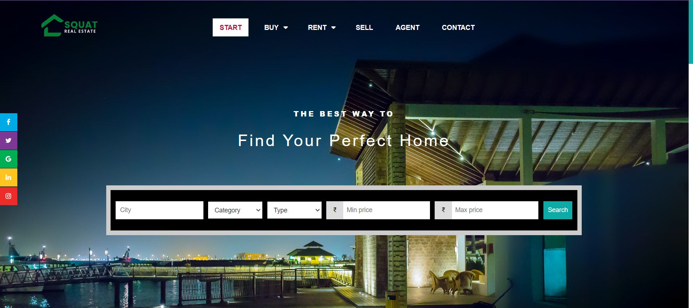
Homepage

Slide 10
On the left corner there is the icon of our website
In the mid there is a menu bar , in which there are six sections
And these sections are :-
Home
Buy
Rent
Sell
Agent
About
Slightly right to the menu there is a login section
In the center there is a filter by which you can find your desired property

Slide 11
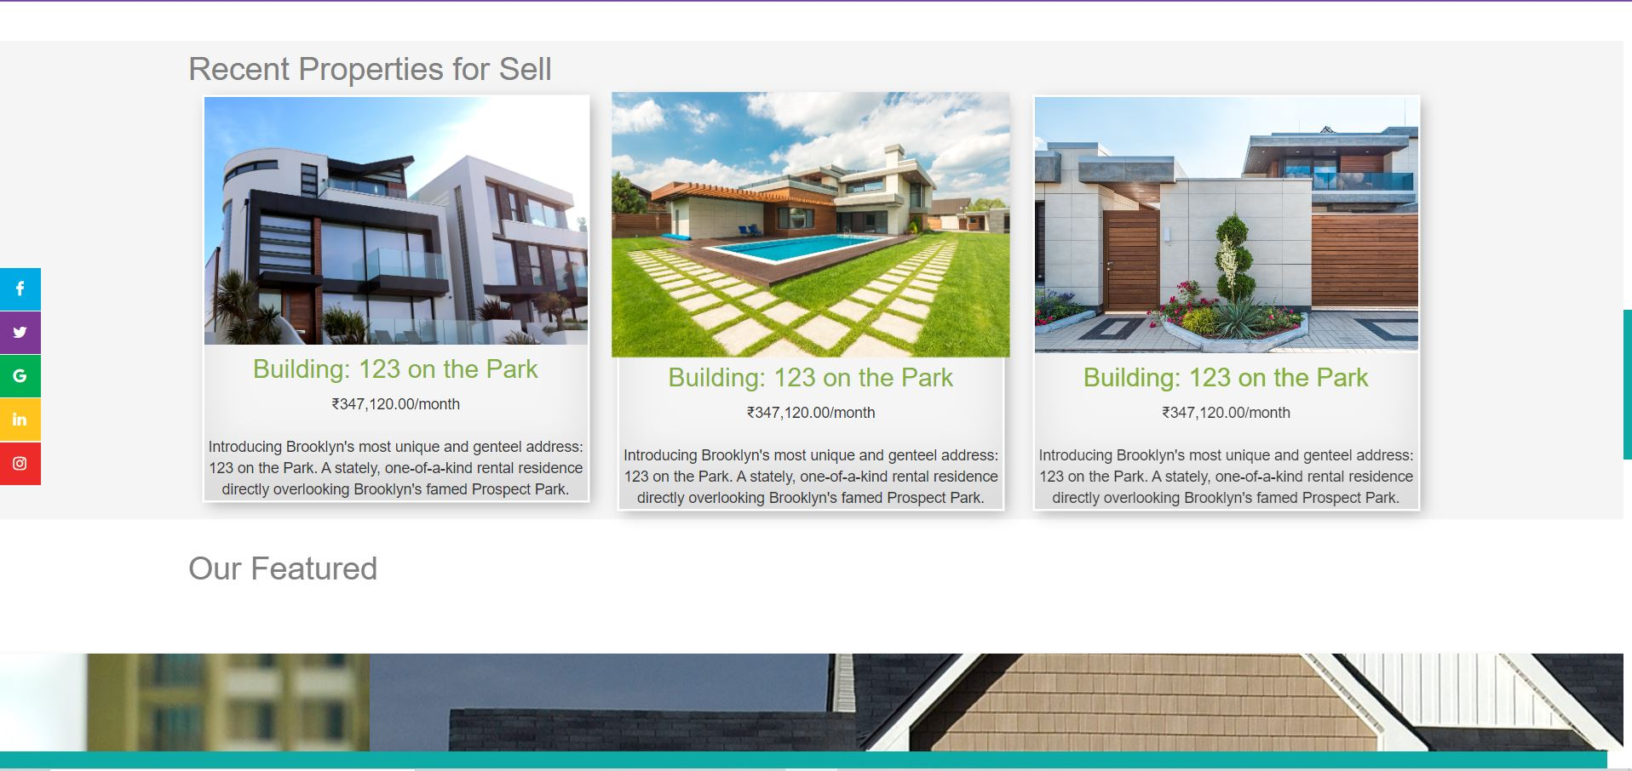
There is advertisement of some property

Slide 12
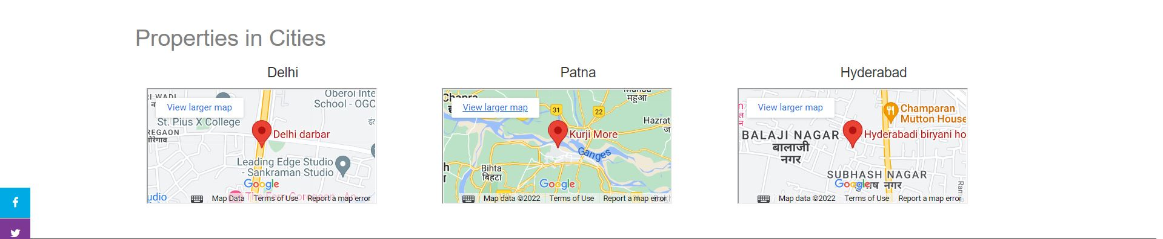
This section will give option to search directly into their desired city

Slide 13
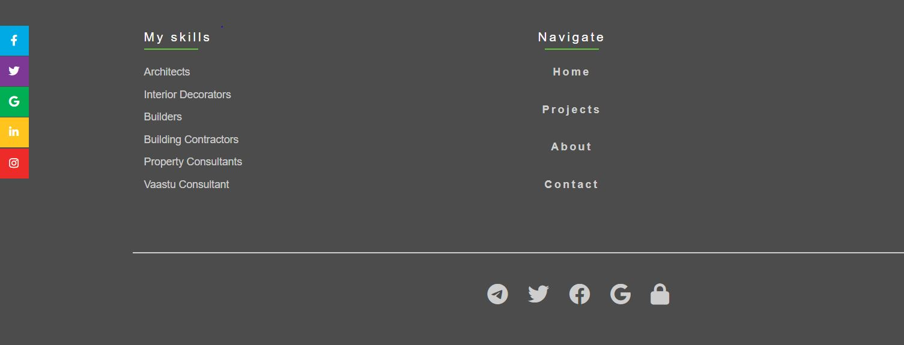
This is footer section of our homepage

Slide 14
SELL

Slide 15
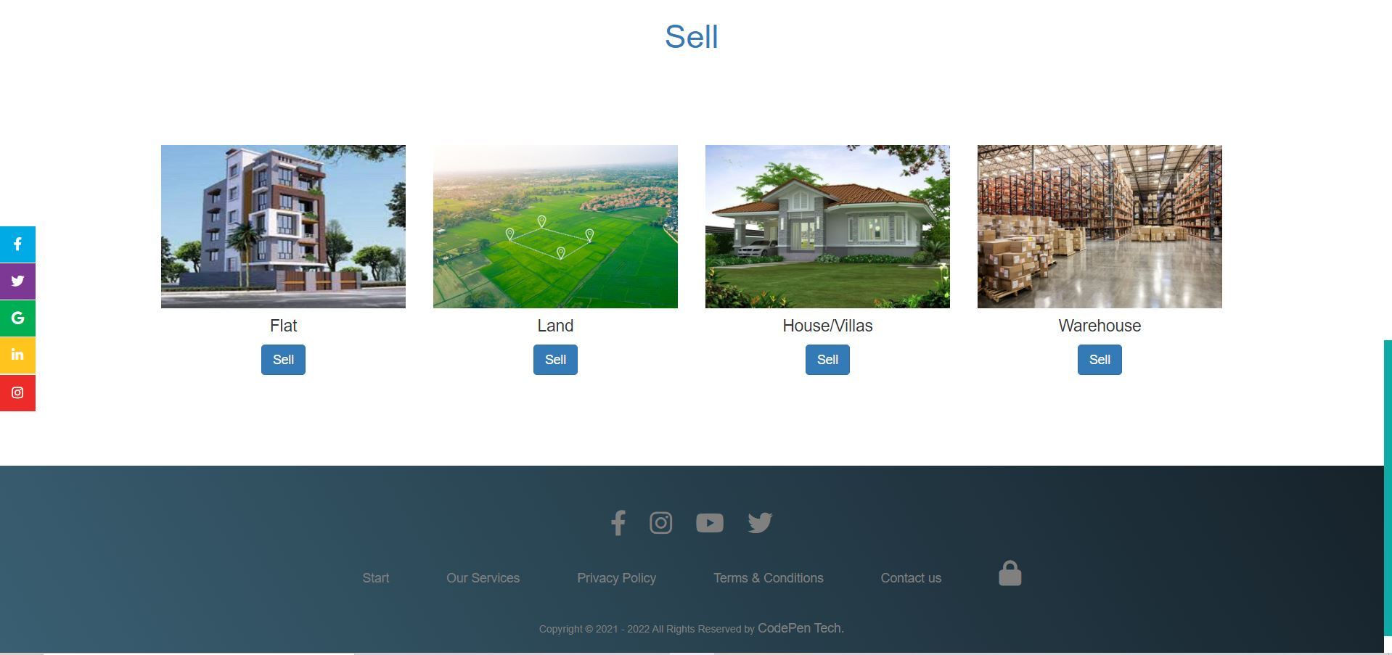

Slide 16
SELL
After clicking on sell section from menu user will see this interface , it will give them option to choose which property you want to sell
Suppose if user click on flat section then user will move to a form where he will be about complete details of that property
After entering all the details of flat, he will be asked to enter the otp which he will receive on his registered mail for confirming the sell

Slide 17
BUY

Slide 18
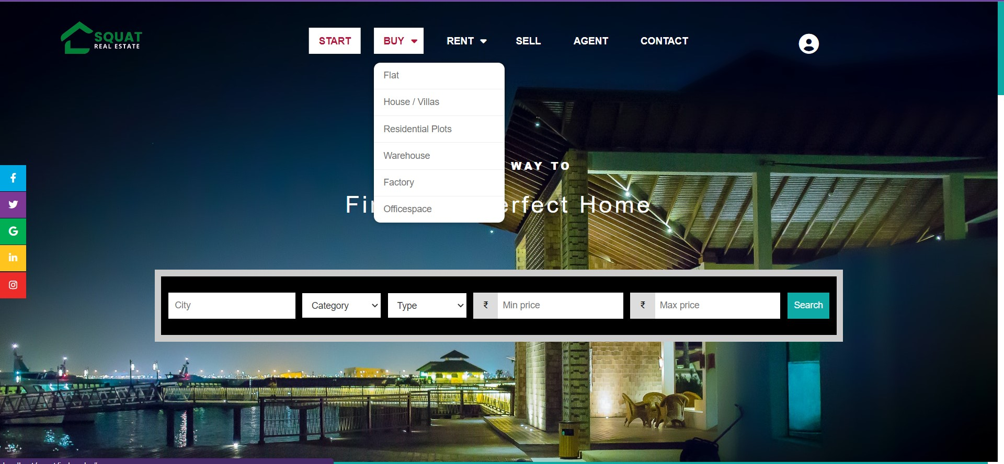
From this section user can choose which kind of property they want to buy ,after clicking on any section user can see the only that kind of property which are open for sell

Slide 19
AGENT

Slide 20
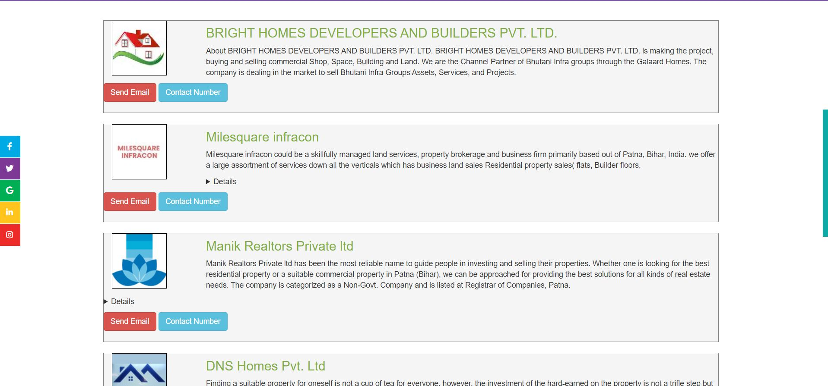
AGENT
After clicking on agent from menu then it will show the list of authorized agent by which you can get suggestion before buying,selling or renting any property

Slide 21
RENT

Slide 22
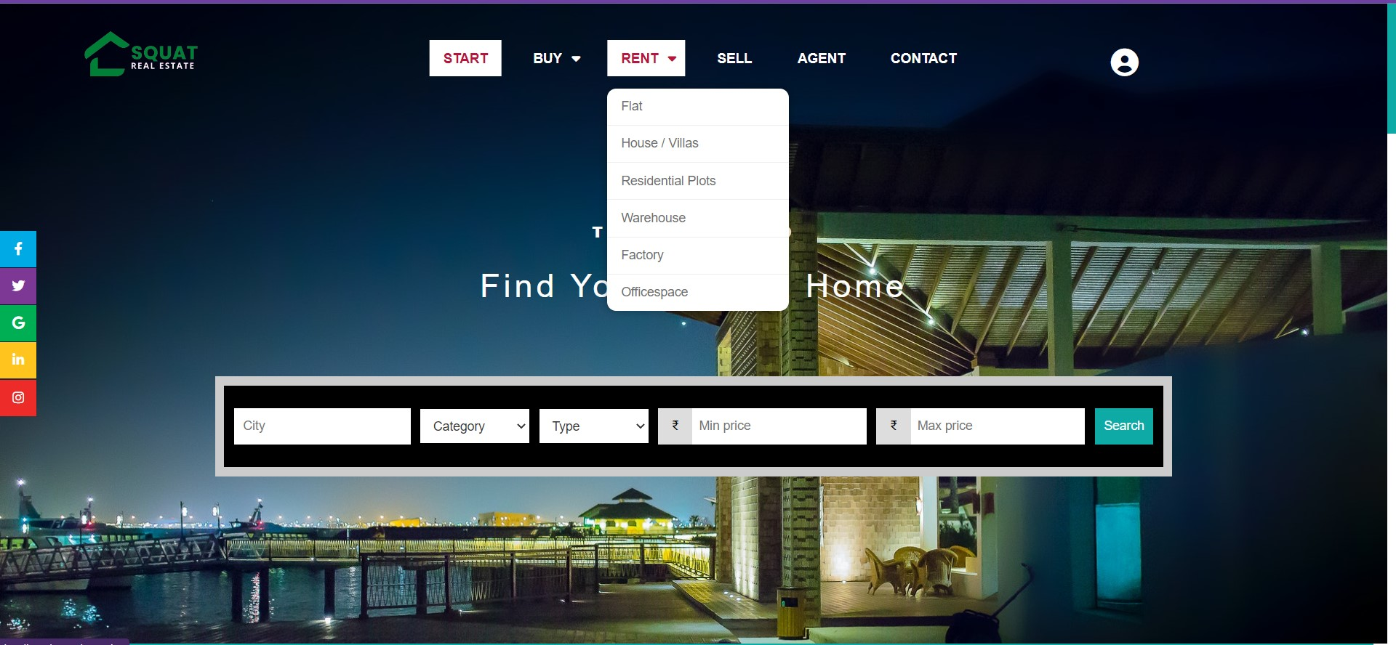

Slide 23
RENT
After clicking on this section it will ask whether you are a owner or a hirer
For owner it will give form for complete details of the property to be rented
After filling the form it will verify your account by sending otp on registered mail
After filling the otp , your property will be visible for those , those who want to hire property

Slide 24
CONTACT US

Slide 25
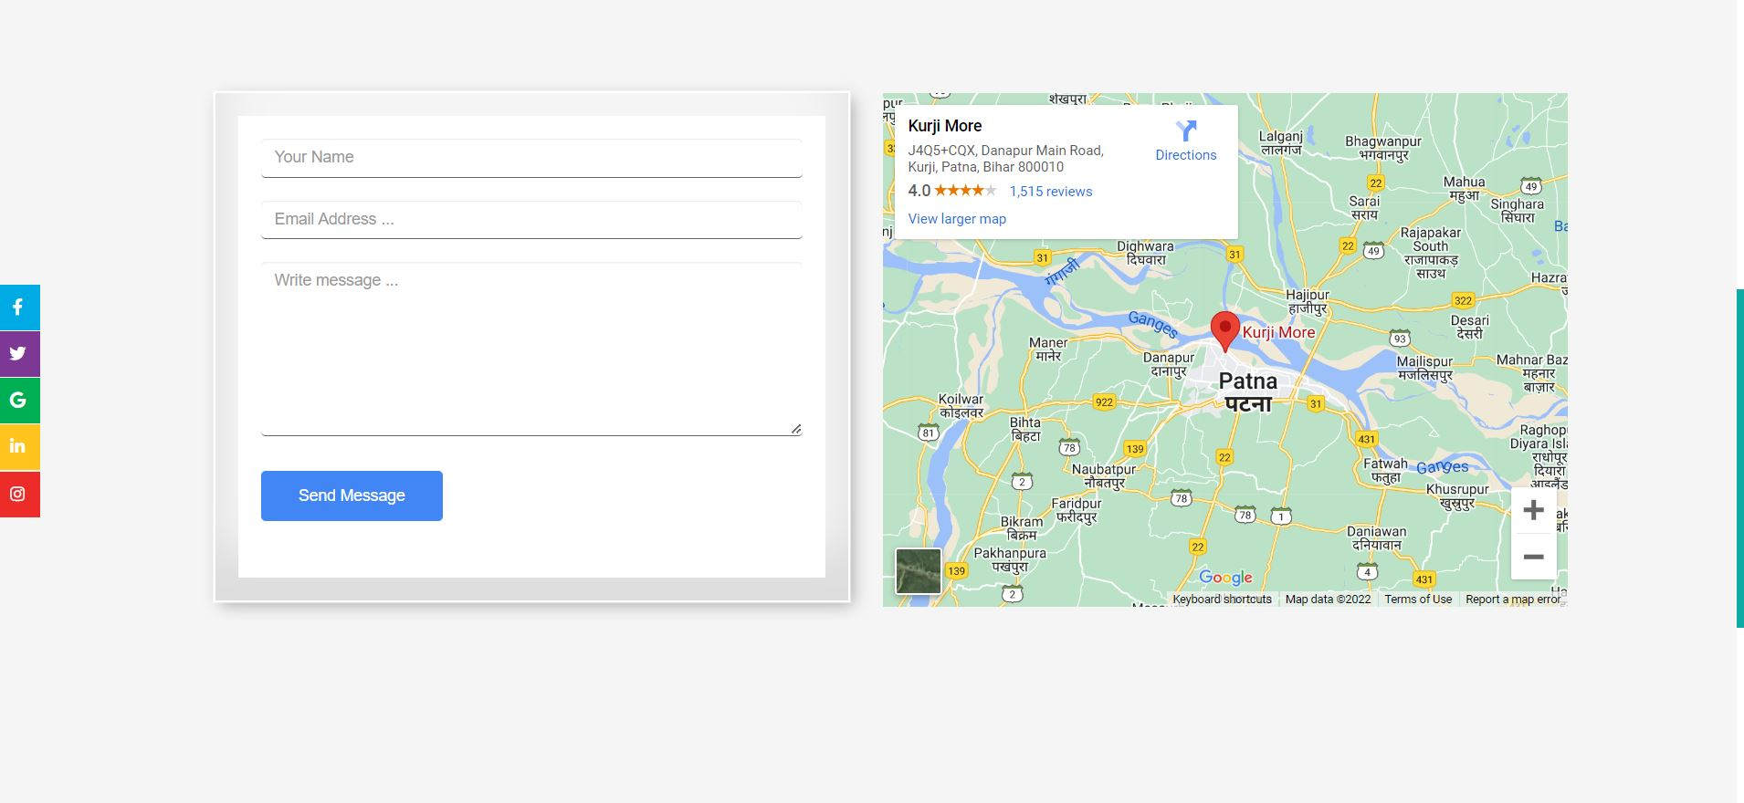
CONTACT US
By this section user will be able to contact to us may be by visting our office or by chats.

Slide 26
LOG IN OR REGISTER

Slide 27
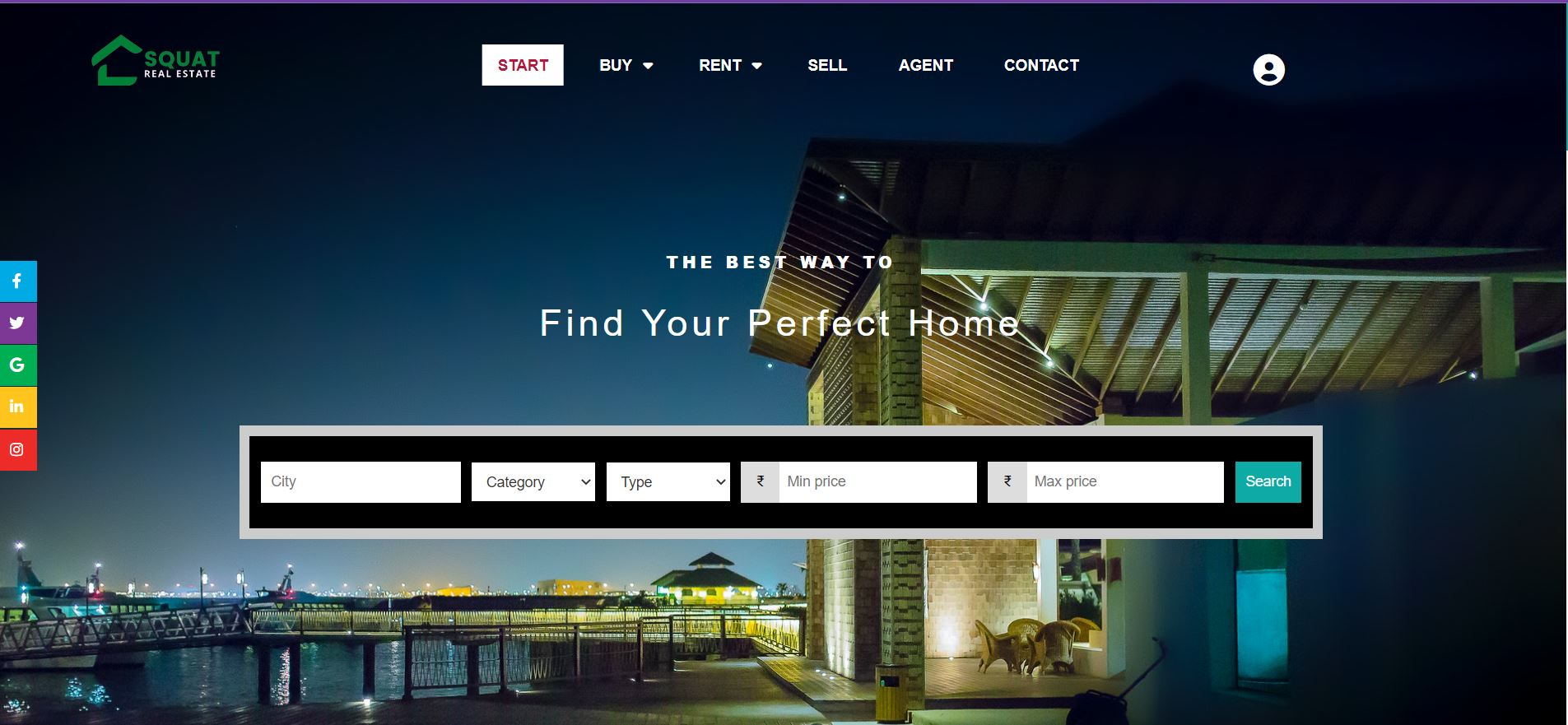
Login/Signup

Slide 28
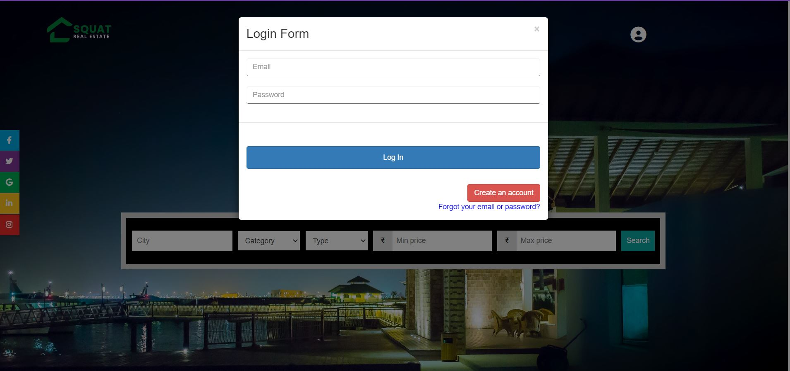
LOGIN
After clicking on that icon user will be asked to enter their email and password which is used during creation of new account
After entering correct email and password you will be logged in into your account

Slide 29
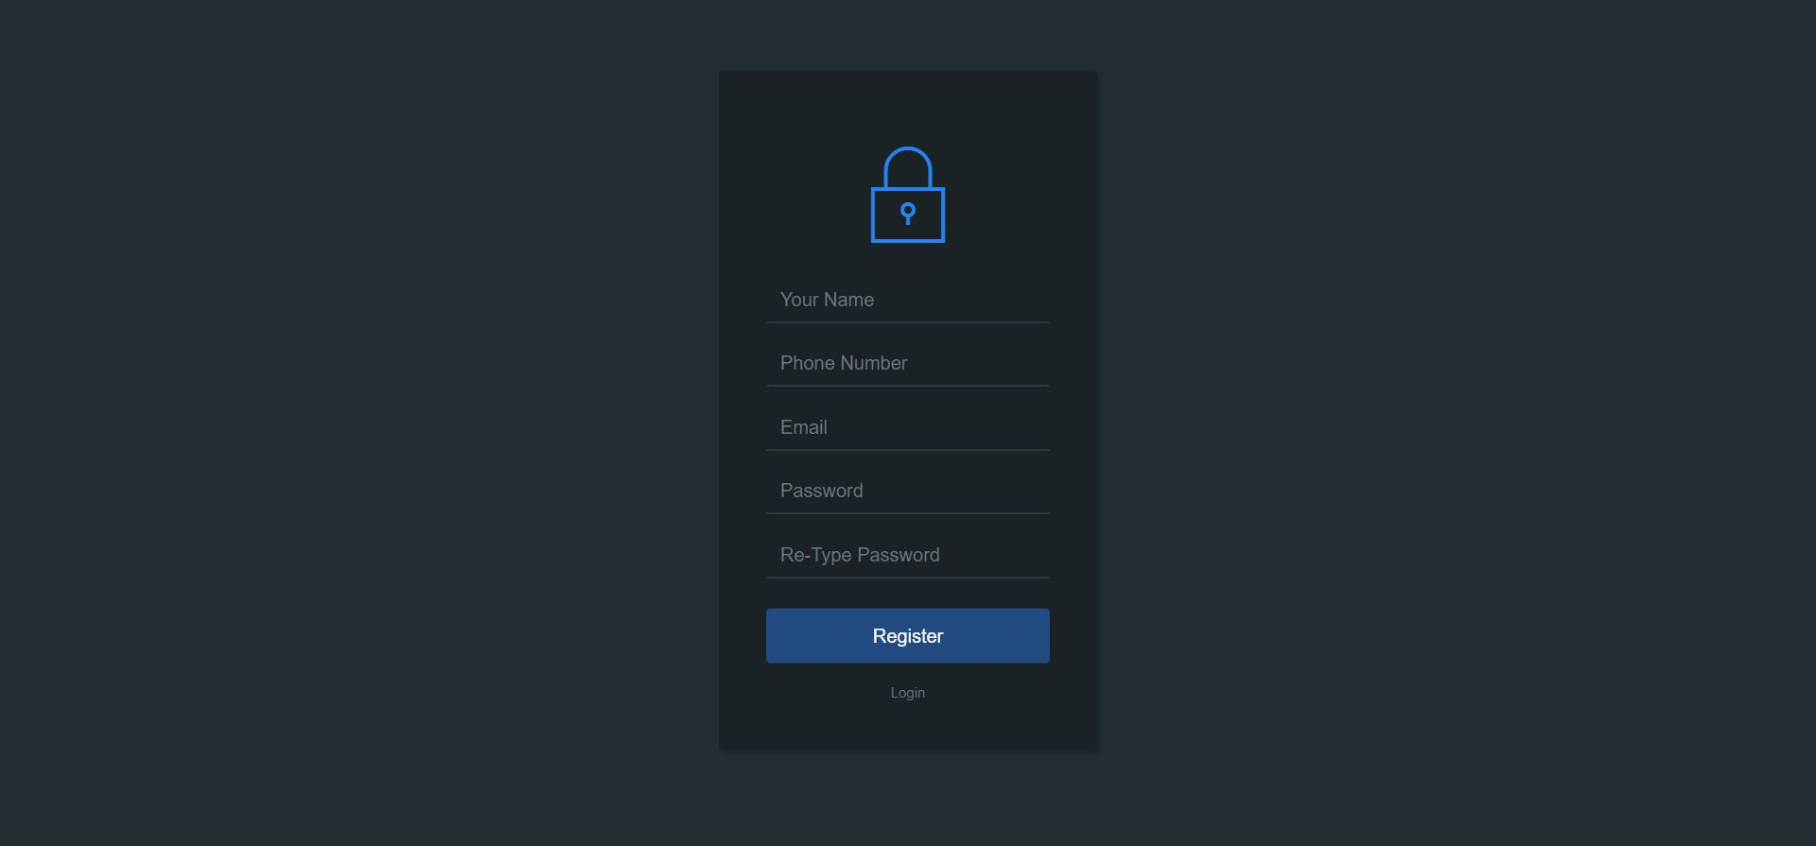
SIGN UP
If you are a new user then you need to create account
User will be asked to enter all these necessary details
After filling all the details then after clicking on register you will be asked to enter otp which you will receive on your email
And then user a/c will be created successfully

Slide 30
ADMIN PANEL

Slide 31
After clicking on lock icon user will be move admin section

Slide 32
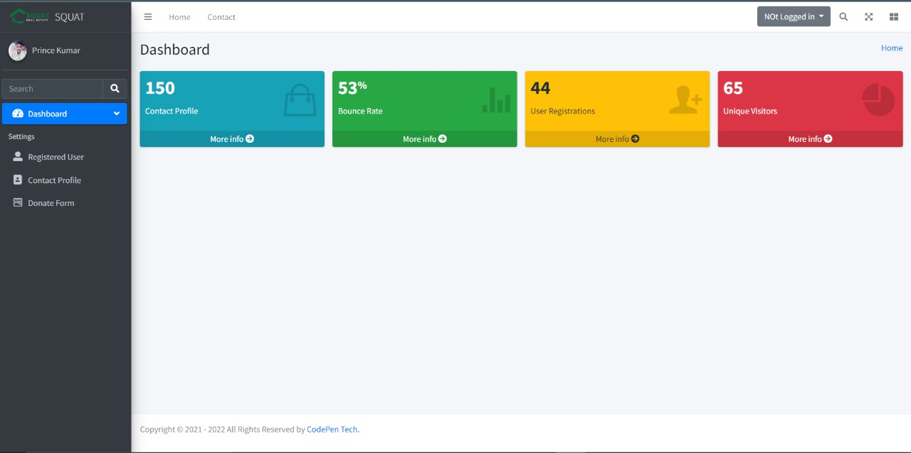
DASHBOARD OF ADMIN PANEL

Slide 33
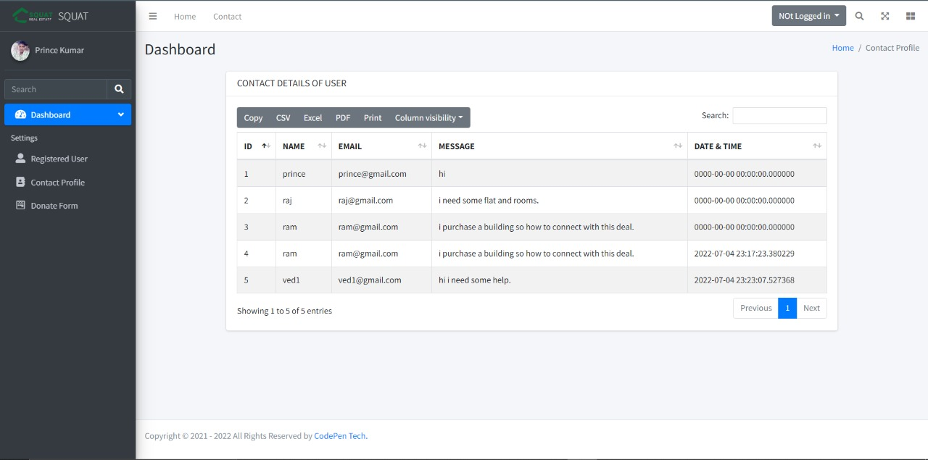
CONTACT DETAILS IN ADMIN PANEL

Slide 34
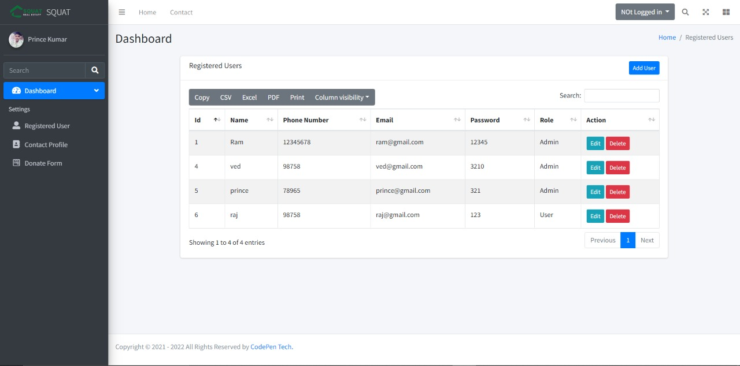
List of registered user

Slide 35
ER Diagram

Slide 36
ER DIAGRAM
PROPERTY
DETAILS
PASSWORD
EMAIL
EMAIL
PASSWORD
NAME
Send
details
SELLER
ADMIN
BETWEEN SELLER AND ADMIN

Slide 37
ER DIAGRAM
PASSWORD
EMAIL
PASSWORD
EMAIL
NAME
MOBILE NO.
Send
details
ADMIN
BUYER
BETWEEN ADMIN AND BUYER

Slide 38
DATA FLOW DIAGRAM

Slide 39
DATA FLOW DIAGRAM
RECEIVE PROPERTY DETAILS
SELLING REQUEST
SELLER
PROPERTY DETAILS
ADMIN
CONFIRMATION
RECEIVE REQUEST
RECEIVE PROPERTY DETAILS
BUYER
APPROVE REQUEST
PROPERTY DETAILS WITH LOCATION
DFD LEVEL 0

Slide 40
THANK YOU

