Slide 1
.Net TraiNING Week 4

Slide 2
AGENDA
Introduction to WEB API
- Creating an API in .NET Core
- Working with Controllers and Action methods
- Routing
- Http Verbs (Get, Post)
- Return Types
- Testing/Debugging API from Postman/Swagger
Understanding WEB API folder structure
- Understanding WEB API folder structure
- Data transfer objects
- Entities
- Using Services & Interfaces (Dependency Injection)

Slide 3
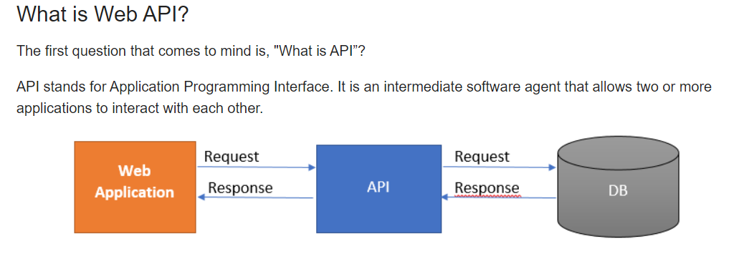
API
API-Application Programming Interface

Slide 4
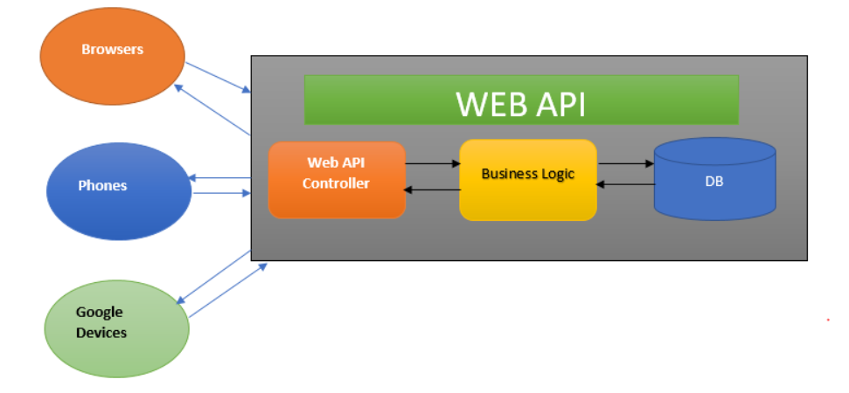
Working of API

Slide 5
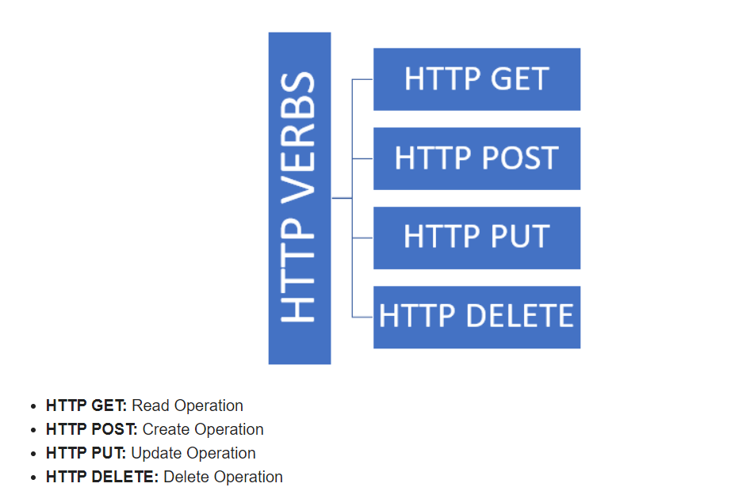
HTTP Verbs

Slide 6
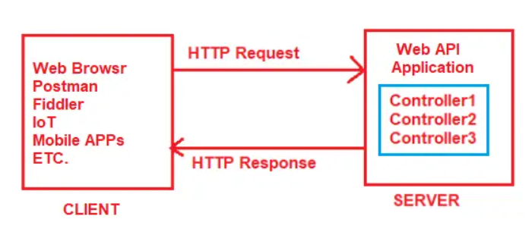
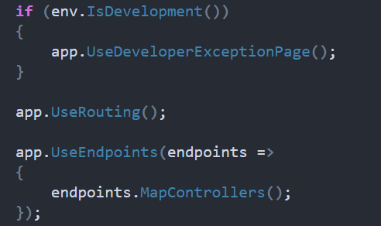
Routing in ASP.NET Core Web API
Routing in ASP.NET Core Web API application is the process of mapping the incoming HTTP Request (URL) to a particular resource i.e. controller action method.
Controller Routing
Action Routing - .Net 7 not allowed

Slide 7
Azure Cosmos DB Emulator
It is a tool provided by Microsoft to locally develop and test application that use Azure Cosmos DB.
Allows you to create and manage database, containers, items
Run queries on local instance.
Manages large scale data.
Cloud based NoSQL db.
Serves PAAS(Platform As A Service).
*Download : https://aka.ms/cosmosdb-emulator

Slide 8
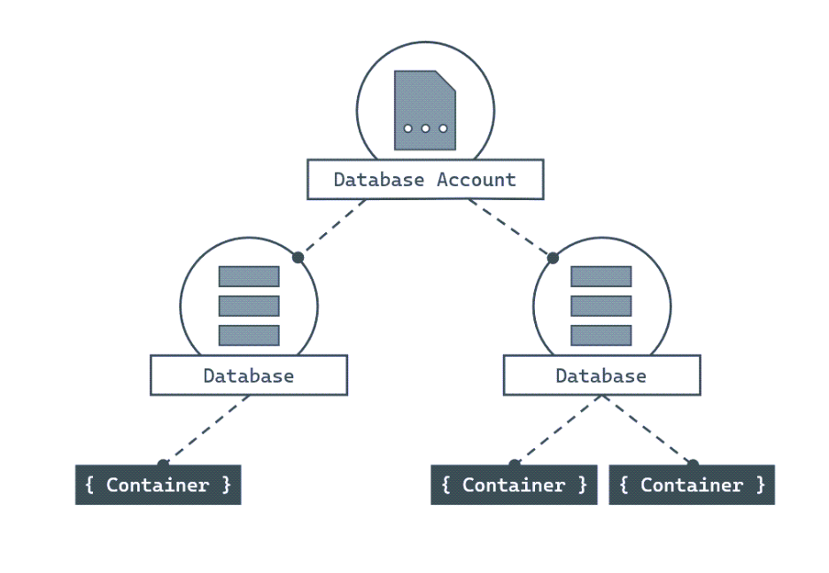
Azure Cosmos DB Emulator

Slide 9
Azure Cosmos DB Emulator
Important Points
URI
Primary Key
Database Name
Container Name

Slide 10
Azure Cosmos DB Emulator
Cosmos Client ?
Database
Container
Item

Slide 11
IActionResult
provides a flexible way to return various types of results.

Slide 12
HTTP methods
HttpGet
HttpPost
HttpPut
HttpPatch
HttpDelete

Slide 13
Thank You

