Slide 1
.Net TraiNING Week 5

Slide 2
AGENDA
Classes Classification
- Data transfer objects
- Entities
- Models
- Base Entity
-CRUD
WEB API Architecture
- Understanding WEB API folder structure
- Using Services & Interfaces (Dependency Injection)

Slide 3
Entity
- "Entity" typically refers to an object that represents data stored in a database
- Entities are used to perform CRUD (Create, Read, Update, Delete) operations on the underlying database
DTO
- It is a design pattern that is commonly used to transfer data between software application subsystems
- DTOs are often used to define the structure of data sent between a client and a server in web API requests and responses.

Slide 4
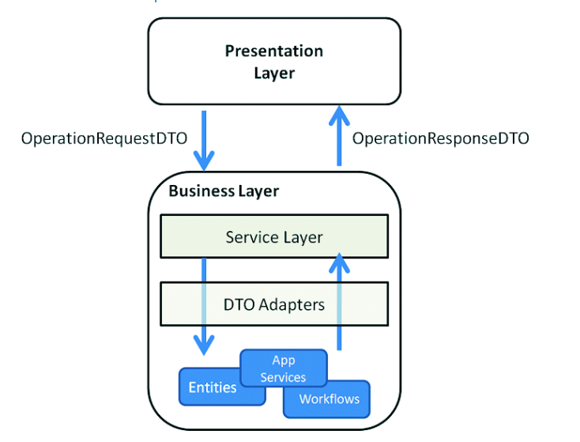
API
Basic Architecture
Client
API Server
Controller
Services
DataBasee

Slide 5
Models
"model" typically refers to a class or a set of classes that define the data structure of the objects that will be used within your application

Slide 6
Id:
Type: string
Purpose: Represents the unique identifier for the document. It's often an automatically generated identifier.
UId:
Type: string
Attributes: Represents a unique identifier, possibly used for data Reading and it is Unique For Entity .
DocumentType: dType
Type: string
Purpose: Represents the type or category of the document. It could be used to distinguish between different types of documents in the collection.
CreatedBy:
Type: string
Purpose: Represents the user or entity that created the document.

Slide 7
CreatedByName:
Type: string
Purpose: Represents the name associated with the user or entity that created the document.
CreatedOn:
Type: DateTime
Purpose: Represents the timestamp when the document was created.
UpdatedBy:
Type: string
Purpose: Represents the user or entity that last updated the document.
UpdatedByName:
Type: string
Purpose: Represents the name associated with the user or entity that last updated the document.
UpdatedOn:
Type: DateTime
Purpose: Represents the timestamp when the document was last updated.

Slide 8
Version:
Type: int
Purpose: Represents a version number associated with the document. It might be used to track changes or concurrency control.
Active:
Type: bool
Purpose: Indicates whether the document is currently active or not.
Archieved:
Type: bool
Purpose: Indicates whether the document has been archived. This might be used for soft deletion or archival purposes.

Slide 9
DAtaBase Operations ( CRUD )
C - Create - [ POST]
R - Read ( Single) - [ GET]
R - Read ( All ) - [ GET]
U - Update - [ PUT ]
D - Delete - [ DELETE ]

Slide 10
Thank You

