Slide 1
.Net TraiNING Week 3

Slide 2
AGENDA
Functions
declaration and defination
Object Oriented Programing
Encapsulation
Abstractions
Inheritance
Polymorphism

Slide 3
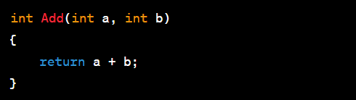
Functions and Debugging
A method is a code block that contains a series of statements and performs a specific task
Method Declaration
void function
Return Type
Parameters
Method Overloading
return statement

Slide 4
Object Oriented Programming
class
object
Access modifier
Encapsulation
Abstraction
Inheritance
Polymorphism

Slide 5
Access Modifiers
Public (public ):
Members declared as public are accessible from any other code in the same assembly or another assembly that references it.
Private (private):
Members declared as private are only accessible within the same class or struct.
Protected (protected):
Members declared as protected are accessible within the same class or struct and by derived classes.
Internal (internal):
Members declared as internal are accessible within the same assembly but not from another assembly.

Slide 6
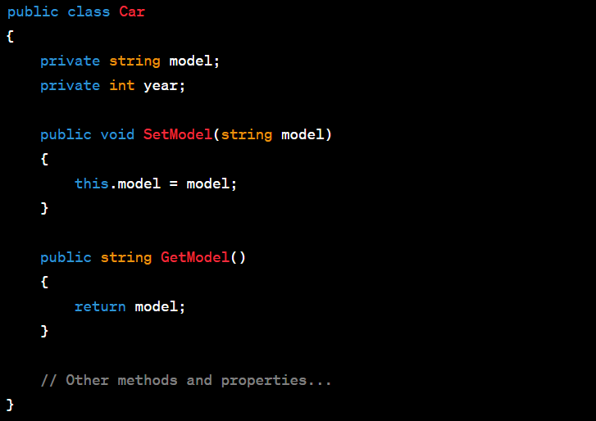
Encapsulation
Encapsulation is the concept of bundling data (attributes) and methods (functions) that operate on the data into a single unit known as a class.

Slide 7
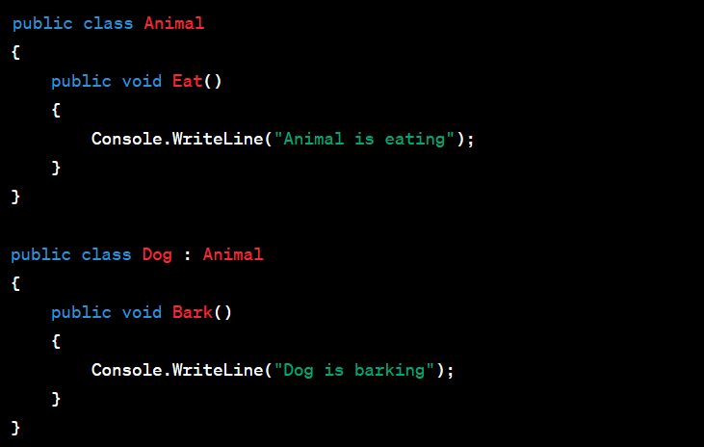
Inheritance
Inheritance is the mechanism that allows a class to inherit properties and behaviors from another class. The class that is inherited from is called the base or parent class, and the class that inherits is called the derived or child class.

Slide 8
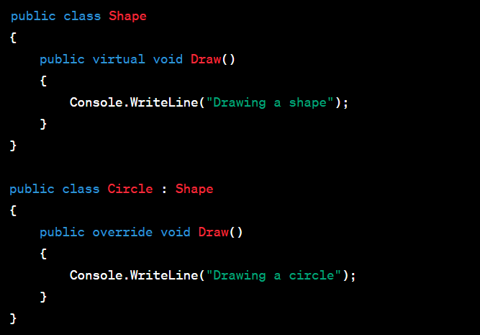
Polymorphism
Polymorphism means "many forms" and allows objects of different types to be treated as objects of a common type. There are two types of polymorphism: compile-time (method overloading) and runtime (method overriding).
Compile-time polymorphism is achieved through method overloading, where multiple methods have the same name but different parameters.

Slide 9
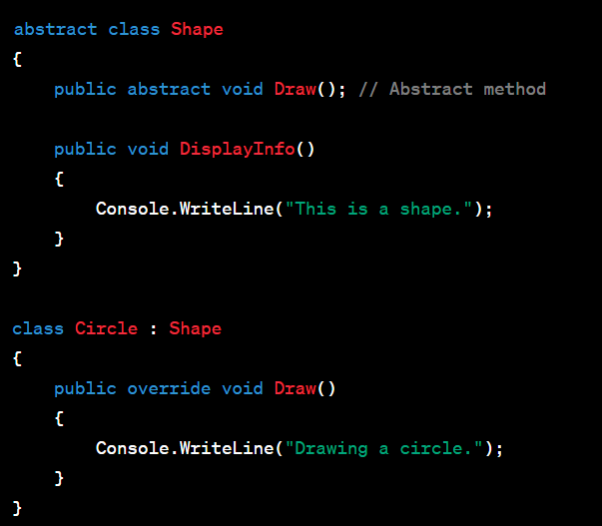
Abstraction
Abstraction is the process of simplifying complex systems by modeling classes based on essential properties and behaviors. It involves hiding the unnecessary details of an object and exposing only what is relevant.
Abstract Classes:
An abstract class is a class that cannot be instantiated on its own and is meant to be subclassed by other classes. It can have both abstract (incomplete) and concrete (complete) methods. Abstract methods do not have a body and must be implemented by the derived classes.

Slide 10
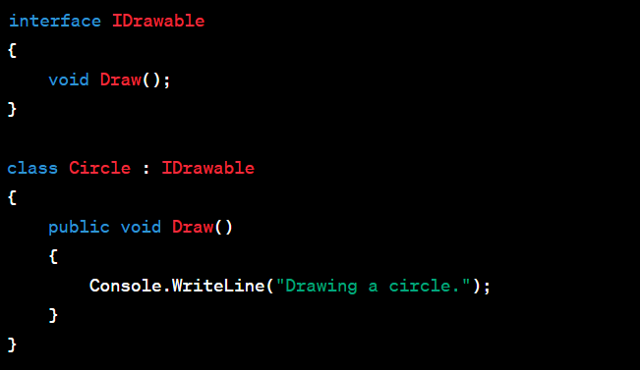
Interfaces:
An interface is a contract that defines a set of methods and properties. A class that implements an interface must provide concrete implementations for all the members of that interface.

Slide 11
Week 3 Assigment
Project: Inventory Management System
Objective:
Develop a console-based Inventory Management System using OOP, functions, arrays, lists, and CRUD operations in C#
Requirements:
Item Class:
Create an Item class with the following attributes: ID, Name, Price, Quantity.
Include appropriate constructors, properties, and methods.
Inventory Class:
Implement an Inventory class that manages a collection of items.
Use a list to store instances of the Item class.
Include methods for:
Adding a new item.
Displaying all items.
Finding an item by ID.
Updating an item's information.
Deleting an item.

Slide 12
User- Interface
Develop a console-based user interface for interacting with the Inventory Management System.
Use loops to repeatedly display a menu and process user input.
The menu should include options for:
Adding a new item.
Displaying all items.
Finding an item by ID.
Updating an item's information.
Deleting an item.
Exiting the program.
Validation:
Implement input validation to ensure that the user provides valid input (e.g., numeric values where expected, non-empty strings, etc.).
Ensure that each item has a unique identifier (ID).
Implement a method in the Inventory class to generate the next available item ID ( can randomly generated ).

Slide 13
Evaluation Criteria:
Proper use of OOP principles (classes, objects, encapsulation, inheritance if applicable).
Correct implementation of the Inventory Management System functionalities.
Effective use of functions, arrays, and lists.
Well-organized and readable code with meaningful variable/method names.
Handling of edge cases and input validation.
Note:
Feel free to explore additional features or improvements beyond the specified requirements. The goal is to demonstrate a good understanding of OOP concepts and proficiency in using functions, arrays, lists, and loops in C#. Good luck!

Slide 14
Thank You

