Slide 1

Codefury 2020
Together We Thrive.

Slide 2

Team Members
Kunal Porwal (Team Lead )
Jayesh Chaudhary
Sanul Raskar
Rohitkaran
Suyog
Aniket Wattamwar
Rasi Wani
Mrunal Kakirwar
Pranav Shirude

Slide 3
Application Features

Slide 4
UI Snapshots

Slide 5

Learning
Concepts
Tools
Collabaration

Slide 6
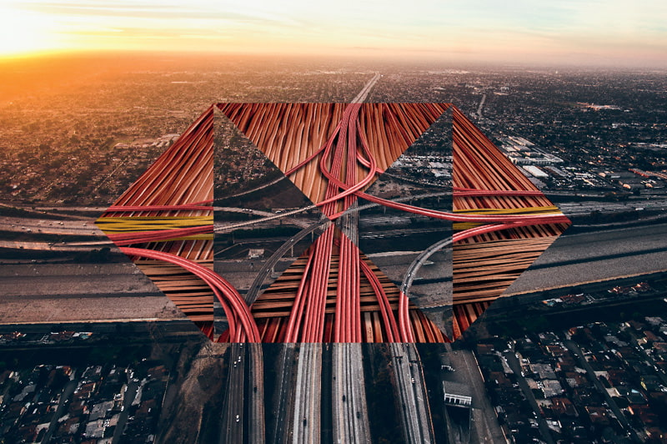
Thank You !
Team BitByBit

