Slide 1
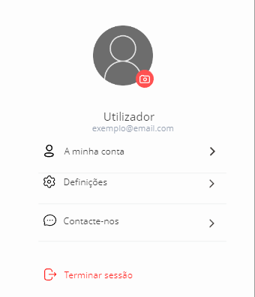
User profile
Microfrontend | Views | FE services
User_Profile | User Account | Add photo Change photo Delete photo Cancel Confirmation of photo Manage Settings See contacts Log-out Confirm Log-out
 | Settings | Change username Cancel Confirm new username Define app language Change email Cancel Confirm new email Change password Confirm new password Cancel password change
 | Contacts | See email Send email See phone number Call Chat

Slide 2
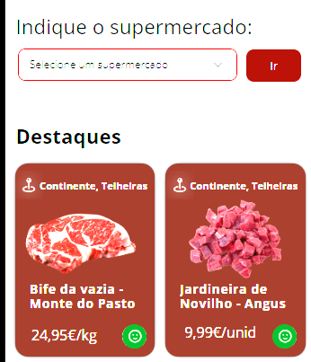
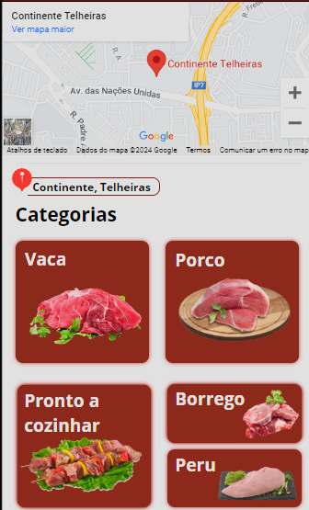
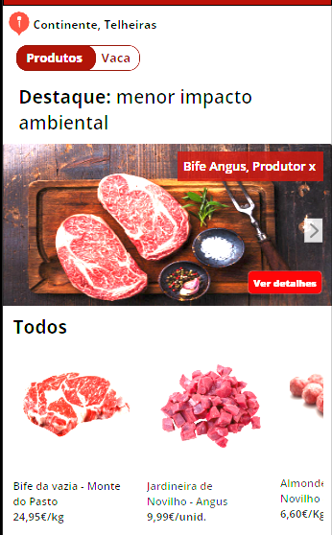
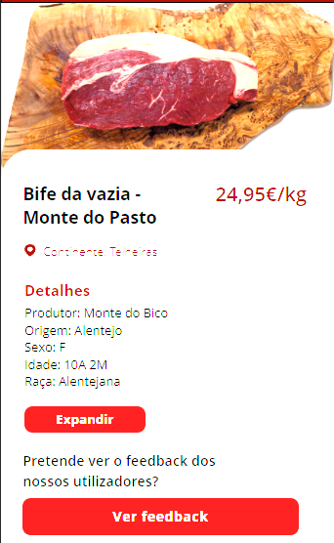
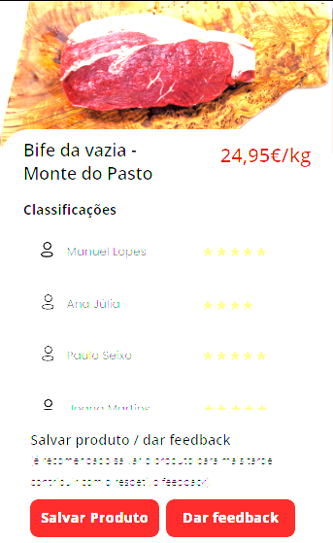
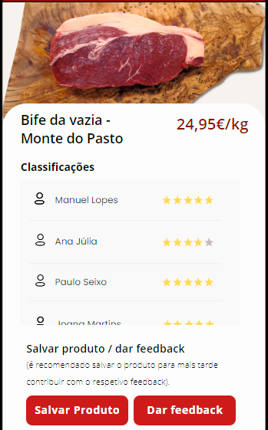
products
Microfrontend | Views | FE services
Products | ProductHomePage | Select supermarket Alter supermarket Go/Confirm Select highlighted product
 | ProductListLocation | See map full screen Zoom in Zoom out Visualize satellite Select category
 | ProductListCategory | Side scroll See highlight evaluation See highlight Arrow to change highlight
 | ProductDetails | Expand See more Go back See feedback
 | ProductFeedback | See list with users feedback Scrollbar Save product Confirmation saved product (Ok) Give feedback Select stars (1 a 5) Cancel feedback Confirm feedback

