Slide 1
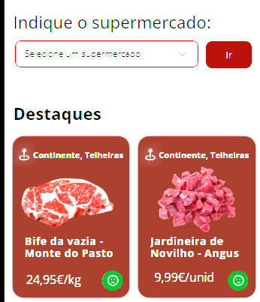
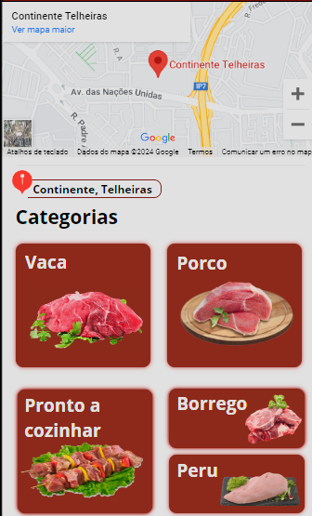
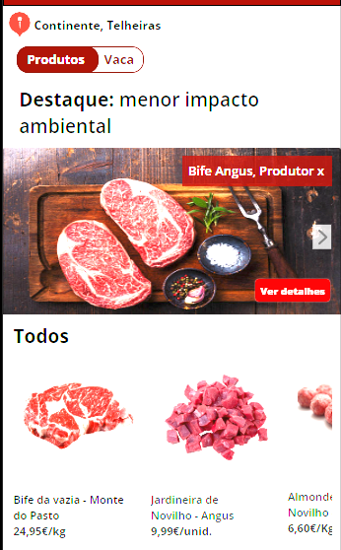
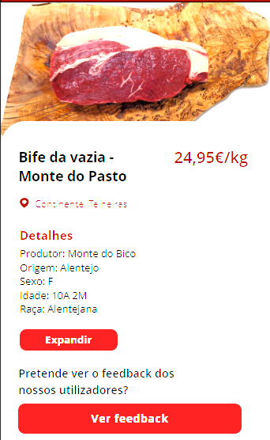
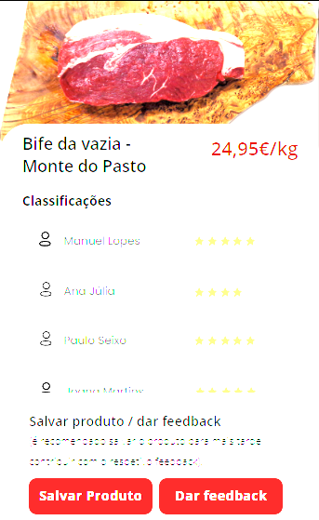
Views | Components | ViewModels
ProductHomePage | Supermarket Selection | Search bar
 | Highlights | Products
ProductListLocation | Map | Satellite View Zoom in/Zoom out
 | Categories | Title Category elements
ProductListCategory | Highlights | Product Name Product Image See details button
 | All products | Horizontal scroll bar
ProductDetails | Details | Product title Product information See more button
 | Feedback | Give feedback button
ProductFeedback | Classifications | Other users classification list
 | Save/Feedback Product | Save Product button Give feedback button

Slide 2
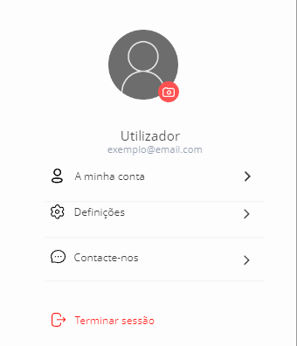
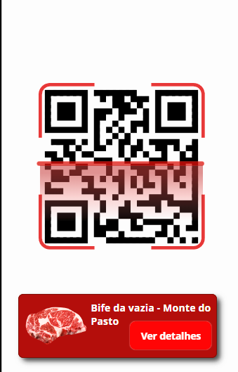
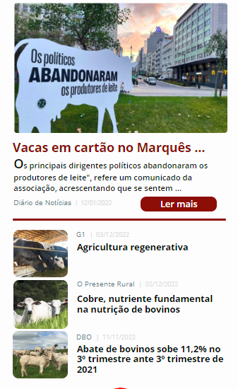

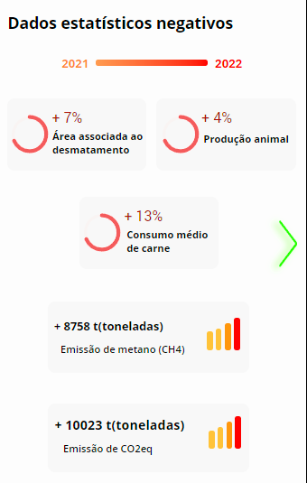
Views | Components | ViewModels
ProfilePage | User details | Photo User name Email
 | Settings | My account button Log out button
QRScanner | QR Scanner | Scanner
 | Product Info | Product name
 |  | Product Image
NewsPage | Highlighted New | News image
 |  | Part of the news
 | List of News | Images
 |  | Title of the news
NewsInfo | News | Image
 |  | Title
 |  | Text
StatisticalData | Data | Year
 |  | Charts

