Slide 1
Student Lifestyle
& Academic
Performance
🎓
Analysis Dashboard
Exploring the relationship between student lifestyle habits and academic performance across 2,000 students.
Princess Ohiri-Okere

Slide 2
Project at a Glance
PROJECT OBJECTIVE
DATASET SCOPE
Investigate which student lifestyle habits most strongly influence academic performance (GPA), and by how much — using Excel, Power Query, and interactive dashboard design.
2,000 synthetic university students
8 original columns · 0 missing values
5 lifestyle activity columns · GPA · Stress Level
4 engineered columns via Power Query
Full analysis and working file available at: View Full Work Here

Slide 3
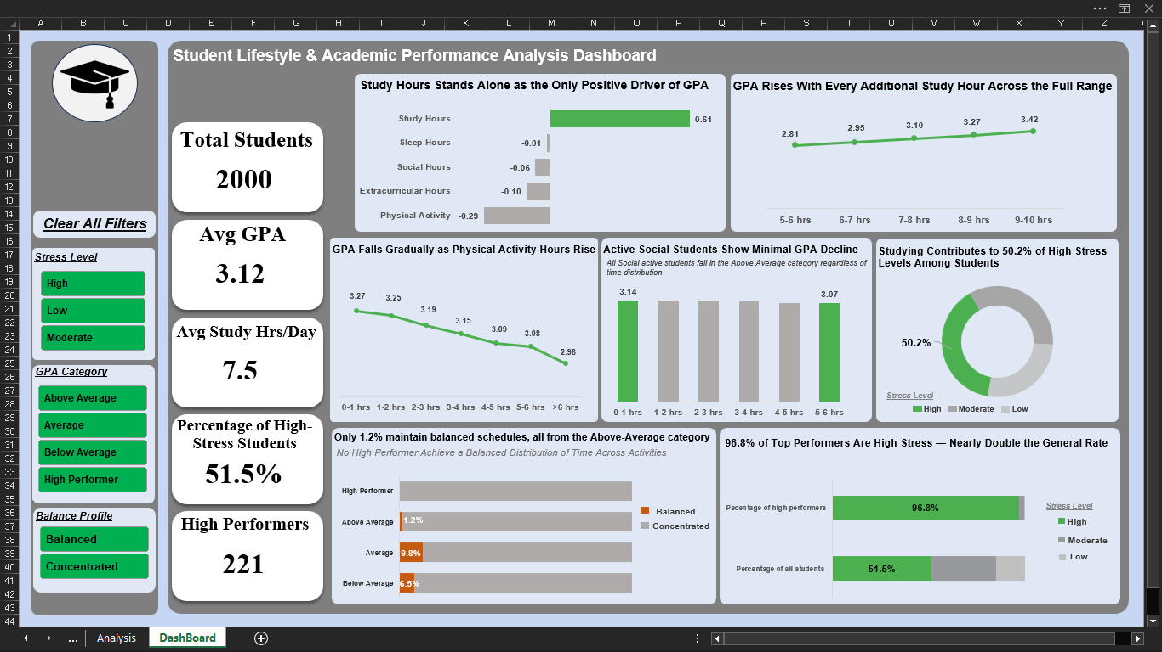
Dashboard Overview
Fully interactive · Three slicers · Five KPI cards · Eight chart panels
Interactive Dashboard · Excel 2019 · Power Query · Slicers

Slide 4
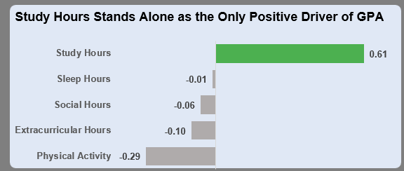
GPA distribution across activities
KEY FINDINGS
Study Hours is the ONLY activity with a positive GPA impact (+0.61 pts).
Every other activity — Physical Activity, Social, Extracurricular, Sleep — shows a neutral or negative net effect.
Academic performance is not driven by balance or variety of activities.
It is driven by deliberate concentration of time on study.

Slide 5
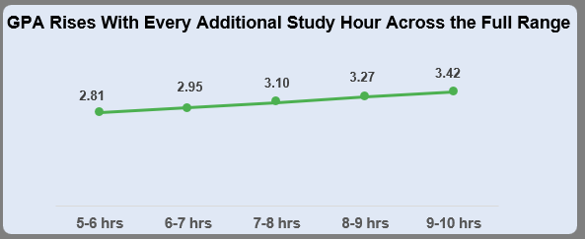
GPA Vs Study Hour
KEY FINDINGS
GPA rises with every additional study hour — no exceptions across the 5–10 hr range.
Average GPA climbs from 2.81 (5–6 hrs) to 3.42 (9–10 hours).
The relationship is linear and consistent — no plateau, no threshold, no diminishing returns within the observed range.

Slide 6
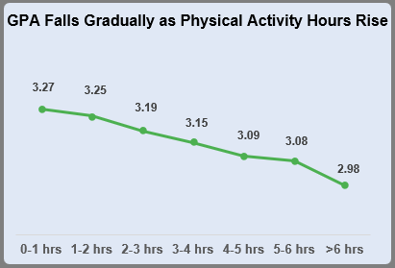
Physical Activity & GPA
KEY FINDINGS
GPA falls gradually as physical activity hours increase — from 3.27 (0–1 hr) to 2.98 (>6 hrs).
The decline is slow and progressive, not sudden.
Physical activity is not academically harmful. It competes with finite time. Every hour exercising is an hour not studying — and study hours drive GPA.

Slide 7
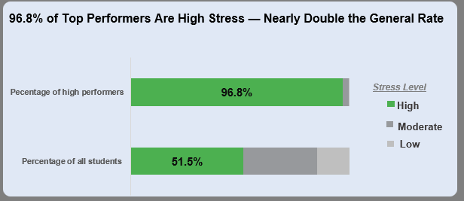
Stress Profile of High Performers
KEY FINDINGS
96.8% of High Performers (GPA ≥ 3.5) experience High Stress.
Across all students, only 51.5% are High Stress — nearly half the rate.
High stress is a feature of top academic performance in this dataset. Academic excellence appears to come with a consistent pressure cost.

Slide 8
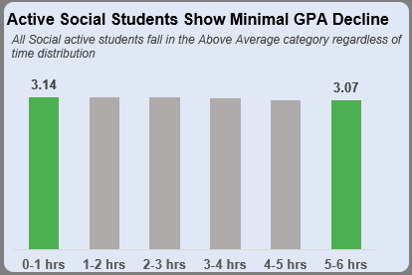
Social Activity & GPA
KEY FINDINGS
Socially active students remain Above Average in GPA regardless of social hours.
Total GPA decline across the full social hours range is just 0.07 points.
The cultural assumption that socializing damages grades is not supported by this data. Students can maintain strong performance while remaining socially active.

Slide 9
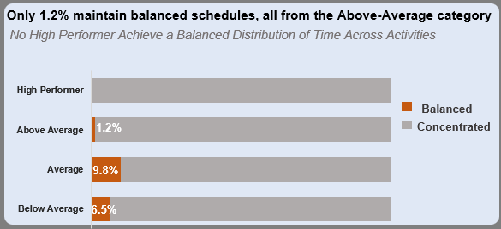
Does the Balanced Student Exist?
KEY FINDINGS
0% of High Performers achieve a genuinely balanced lifestyle.
Only 1.2% of Above Average students meet the balance criteria.
Below Average students show the highest balance rate (6.5%).
True lifestyle balance and peak academic performance are mutually exclusive in this dataset. Top performance requires deliberate concentration, not even distribution.
METHODOLOGY
Balance defined as Activity StdDev ≤ 1.5 across Study, Social, Physical Activity & Extracurricular hours per student.

Slide 10
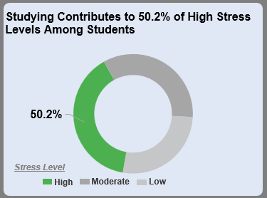
What Drives Student Stress?
KEY FINDINGS
High Stress students dedicate 50.2% of productive hours to study vs 34.6% for Low Stress.
High Stress student study ~3 more hours/day than Low Stress peers.
Stress is driven by study concentration, not by juggling many activities. The allocation of time — not the total — is what separates stress levels.

Slide 11
Analytical Skills Demonstrated
Techniques and reasoning applied throughout this project
Data Transformation
Chart Selection
Power Query: loading, type-setting, multi-step transformation pipeline
Diverging bar, line, 100% stacked bar, clustered bar — matched to analytical question
Feature Engineering
Dashboard Design
5 meaningful columns derived from raw data with documented rationale
Single-screen interactive dashboard with 3 slicers, 5 KPI cards, static + dynamic charts
Statistical Reasoning
Critical Validation
Standard deviation applied as a behavioural profiling metric; threshold validated against raw rows
Independently identified misleading axis scaling, flawed threshold, and chart type mismatch
VBA Automation
Macro recorded to automate filter clearing and improve dashboard usability

Slide 12
Tools Used
Technical stack powering this end-to-end analysis
📊
Microsoft Excel
⚙️
Power Query
🔧
VBA Macro

Slide 13
View the full project on GitHub: https://github.com/Princess-Okere/Student-Lifestyle-and-Academic-Performance-Analysis
Includes: Working Excel file | Full analysis | Interactive dashboard | README documentation
Princess Ohiri-Okere

