Slide 1
SaaS Sales Data Analytics
Princess Gabriella
Capstone Module 2
JCDSOL Purwadhika

Slide 2
Daftar Isi
Data Explanation
Business Question
Analysis
Summary
Recommendation

Slide 3
Data
Datasets contains transaction data from a fictitious SaaS company selling sales and marketing software to other companies (B2B). (Data source: https://www.kaggle.com/datasets/nnthanh101/aws-saas-sales)
There are 9,994 line of data that with 19 columns. However, in this analysis, Row ID and Date Key are dropped because those columns won’t be needed.
There are no null and duplicate data in the dataset.

Slide 4
Columns
Order ID: A unique identifier for each order.
Order Date: The date when the order was placed.
Contact Name: The name of the person who placed the order.
Country: The country where the order was placed.
City: The city where the order was placed.
Region: The region where the order was placed.
Subregion: The subregion where the order was placed.
Customer: The name of the company that placed the order.
Customer ID: A unique identifier for each customer.
Industry: The industry the customer belongs to.
Segment: The customer segment (SMB, Strategic, Enterprise, etc.).
Product: The product was ordered.
License: The license key for the product.
Sales: The total sales amount for the transaction.
Quantity: The total number of items in the transaction.
Discount: The discount applied to the transaction.
Profit: The profit from the transaction.

Slide 5
Business Questions
Sales trend over time
Profit trend over time
Revenue Analysis: Assess revenue streams from products
Optimization Company Operation: Assess the product that will be provided by the company

Slide 6
Outliers
Sales columns : 1,167 data
Profit columns: 1,881 data
Quantity columns: 170 data
Discount columns: 856 data
Outliers are not dropped since it takes a big portion of the data and will be used for the analysis.

Slide 7
Normality Test
Tested using kstest. Ho for normal distribution (parametric) and Ha for Non-normal distribution (non-parametric)
Columns tested:
Sales: pvalue is =0.0, ➔ Non-normal distribution
Discount: pvalue is =0.0, ➔ Non-normal distribution
Profit: pvalue is =0.0, ➔ Non-normal distribution

Slide 8
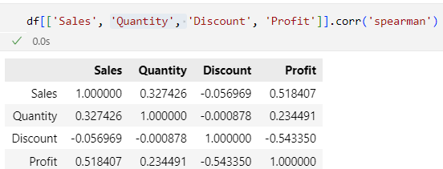
Correlation Test
Spearman test
Result:
Moderate positive correlation between Sales and Profit
Weak negative correlation between Sales and Discount
Moderate negative correlation between Discount and Profit

Slide 9
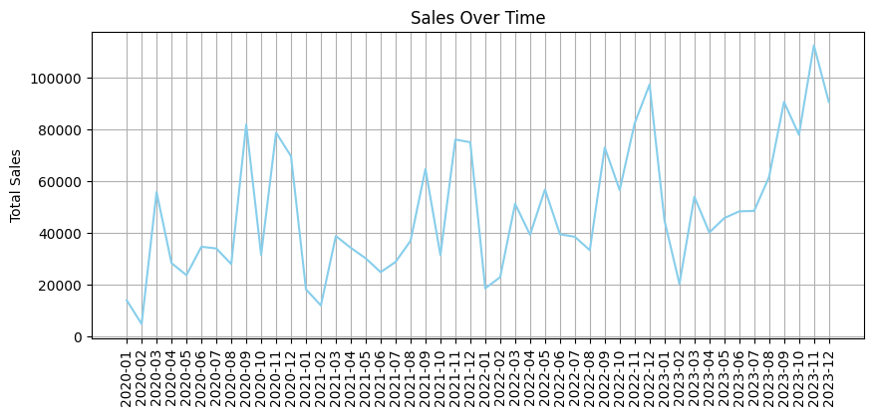
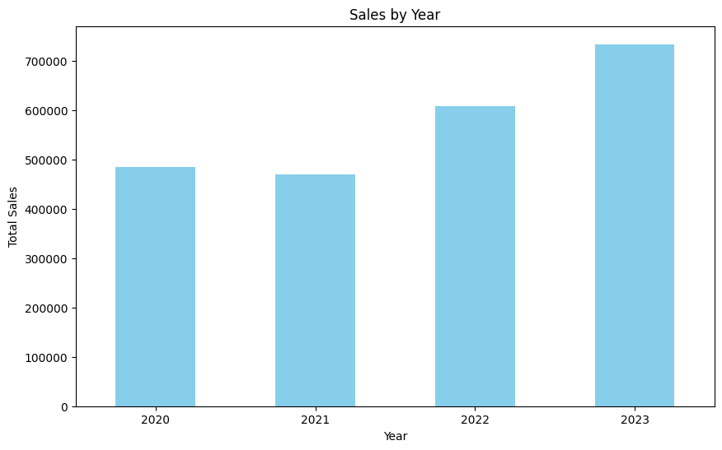
Sales
Lowest monthly sales happened in February 2020 and the highest sales happened in November 2023. From the historical data, we can see that sales tend to decrease at the beginning of the year and become the highest at the end of the year.
The lowest annual sales happened in 2021 and the highest sales happened in 2023. However, looking at the trend, the sales tend to increase every year.

Slide 10
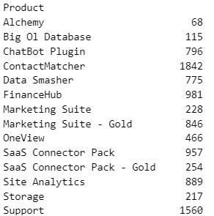
Products
There are 14 product sold by the company with the transaction frequency as follows:

Slide 11
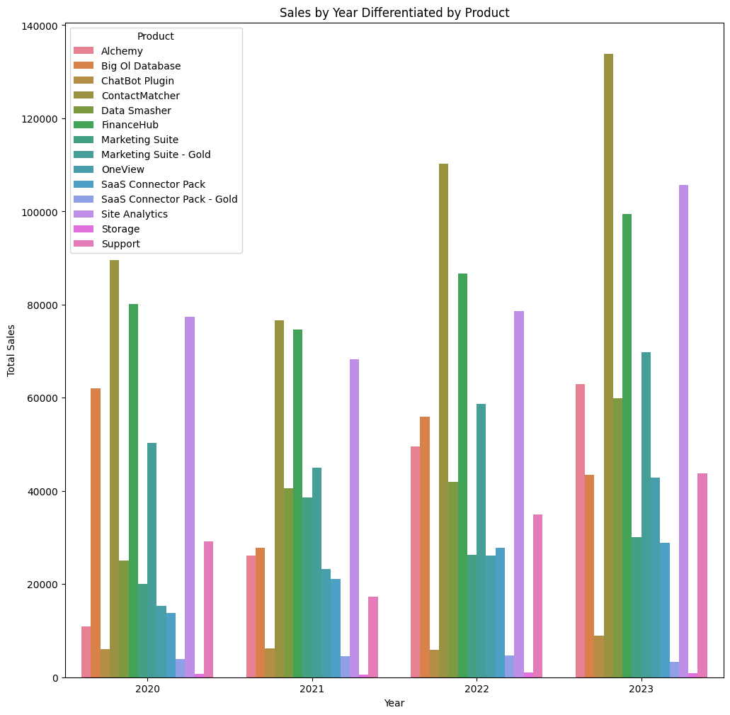
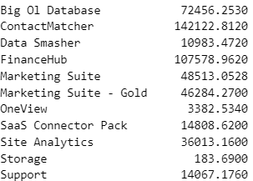
Sales by Product
Total sales by product 2020-2024

Slide 12
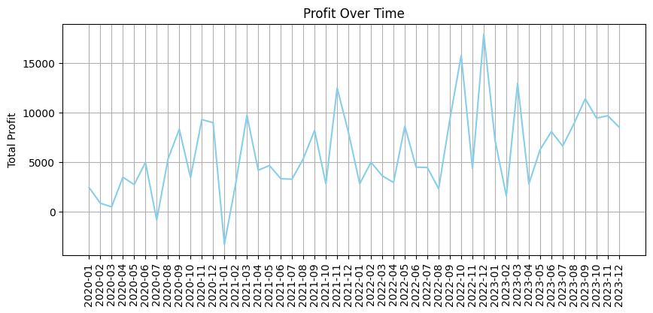
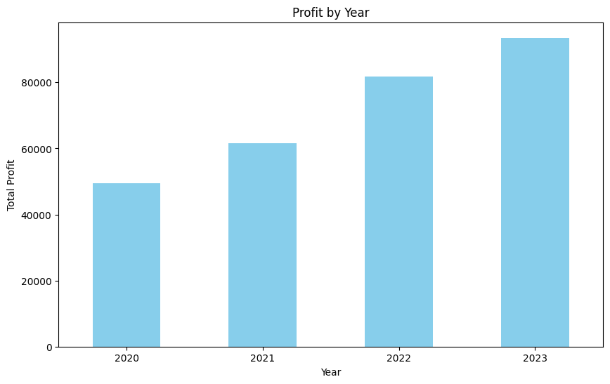
Profit
Lowest monthly profit happened in January 2021 and the highest profit happened in December 2022. From the historical data, we can see that profit tend to decrease at the beginning of the year and become the highest at the end of the year.
The lowest annual profit happened in 2020 and the highest profit happened in 2023. However, looking at the trend, the sales tend to increase every year.

Slide 13
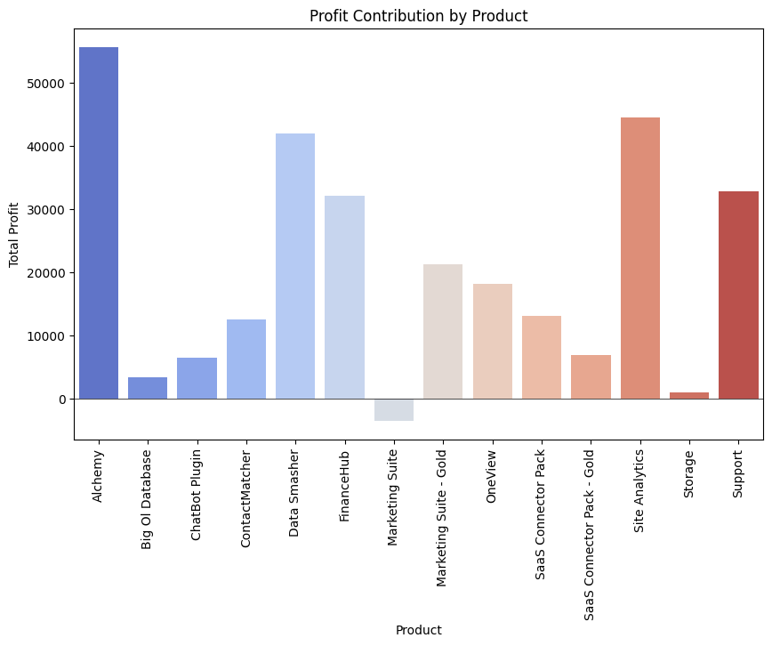
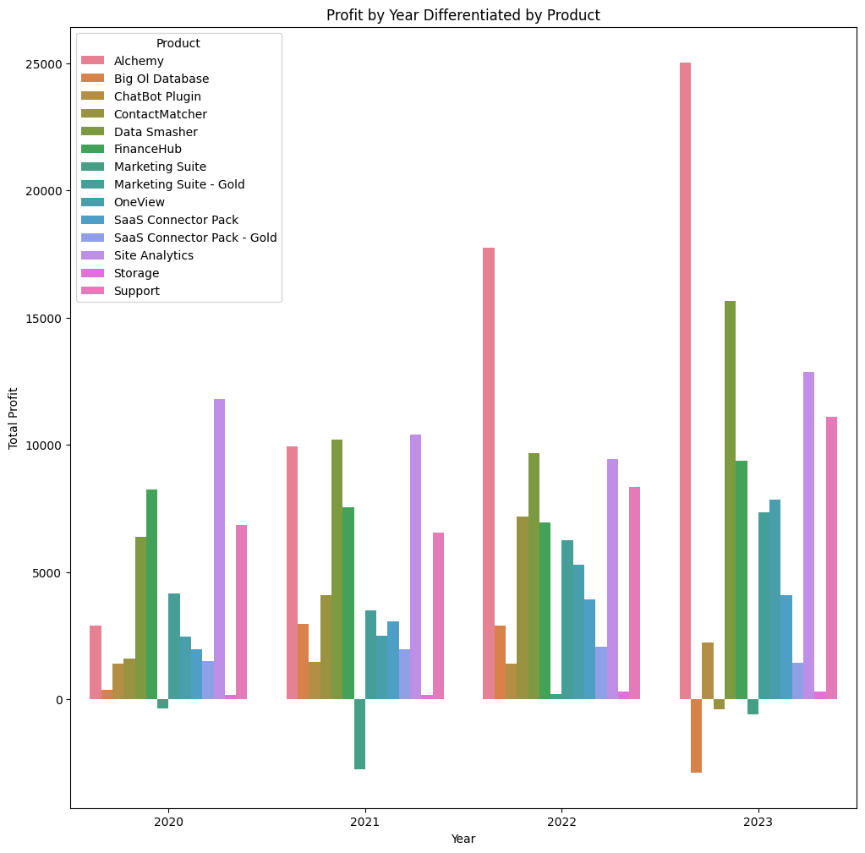
Profit by Product
Overall profit per product showed loss for Marketing Suite and a very small profit contributed by Storage.
Breaking down to profit per product every year, Marketing Suite showed loss almost every year and the biggest loss happened in 2021. Then the loss is also quite big for Big Ol Database in 2023. However, the overall profit in 2023 was still high due to the big profit contributed by Alchemy.

Slide 14
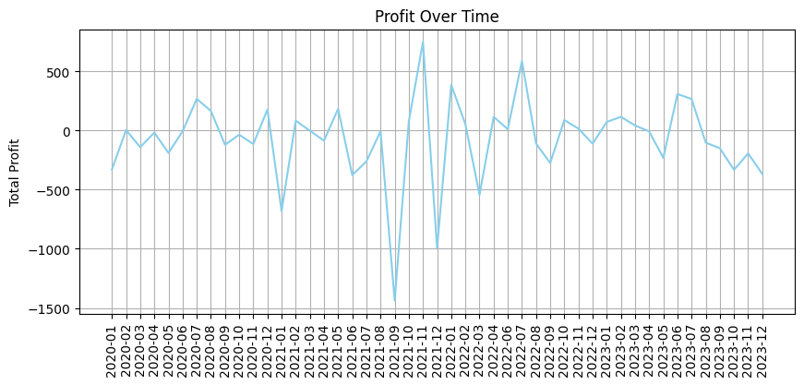
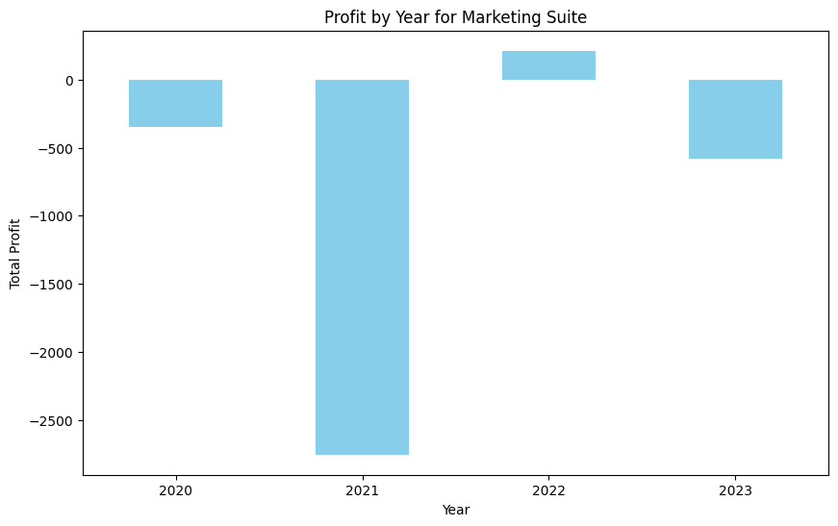
Marketing Suite
Monthly profit for Marketing Suite is not that impressive. From the whole period assessed, only around half of the period shows insignificant profit and other period is loss. The lowest was September 2021.
Even though there is profit in November 2021, it still cannot helped the annual profit for Marketing Suite. Marketing Suite contribute quite a loss in 2021 and only shows a little profit in 2022 which is not significant

Slide 15
Summary
Lowest monthly sales happened in February 2020 and the highest sales happened in November 2023. From the historical data, we can see that sales tend to decrease at the beginning of the year and become the highest at the end of the year.
The lowest annual sales happened in 2021 and the highest sales happened in 2023. However, looking at the trend, the sales tend to increase every year.
There are total 14 products sold by the company.
Lowest monthly profit happened in January 2021 and the highest profit happened in December 2022. From the historical data, we can see that sales tend to decrease at the beginning of the year and become the highest at the end of the year.
The lowest annual profit happened in 2020 and the highest sales happened in 2023. However, looking at the trend, the sales tend to increase every year.
Overall profit per product showed loss for Marketing Suite and a very small profit contributed by Storage.
Profit per product every year ➔ Marketing Suite showed loss almost every year and the biggest loss happened in 2021. Then the loss is also quite big for Big Ol Database in 2023. However, the overall profit in 2023 was still high due to the big profit contributed by Alchemy.
Monthly profit for Marketing Suite is not that impressive. From the whole period assessed, only around half of the period shows insignificant profit and other period is loss. The lowest was September 2021.
Even though there is profit in November 2021, it still cannot help the annual profit for Marketing Suite. Marketing Suite contribute quite a loss in 2021 and only shows a little profit in 2022 which is not significant

Slide 16
Suggestions
Considering the company tend to have a lower profit and sales in the beginning of the year, marketing can start approaching in the end of the previous year for sales in the beginning of the next year.
Seeing that Marketing Suite tend to contribute loss, company could consider stopping the marketing for the product and focus on the higher selling product.

